Slide 1




Frond-end
HTTP Request/Post
Back-end
Database
Email
password
Sign up
Check if the user’s name exists in the Database already
出现alarm:
The email has been registered !!
Yes: 反馈给前端
数据库存入Email, password
No: 把Email, password传给数据库
跳转至log in界面
Sign up 成功
Email
password
Check if the password and the mail matches
从数据库取出相应的数据库存入Email, password
Log in
进入SOM Database的主界面
Yes: 反馈给前端
Alarm: You may input incorrect username or password!!
No: 反馈给前端

Slide 2
Frond-end
HTTP Request/Post
Back-end
Database
Upload a dataset File
Dataset file .dat/.csv
Pass the dataset to the MongoDB
Dataset file .dat/.csv
形成对应的表单，
并且能够读取详细数据
Show dataset file table
Id, file_name, size
获取从数据传来的所有数据，传给前端
附加功能，file_name名字不能重复，相同名字自动在后面加_copy.
所以file name也可以当ID来唯一识别
取出Id, file_name, size
附加功能，dataset的表单里多创建一个metadata的属性。
或者能确保metadata和对应dataset连接
Id
Id
Delete a dataset File
对数据库进行删除操作
删除相应数据，
并返回全部dataset数据
Click submit metadata
Id
获取对应dataset file的metadata
找到并返回返回详细的metadata
Show metadata
把metadata信息传给前端
Modify and submit metadata
Id, metadata (key words…)
获取对应dataset file的metadata
metadata
取出获取对应dataset file的metadata

Slide 3
Frond-end
HTTP Request/Post
Back-end
Database
Upload a model File
Model file .dat/.csv
Pass the model to the MongoDB
Model file .dat
形成对应的表单，
并且能够读取详细数据
Show model file table
Id, file_name, size
获取从数据传来的所有数据，传给前端
取出Id, file_name, size
附加功能，model_name名字不能重复，相同名字自动在后面加_copy.
所以model name也可以当ID来唯一识别
附加功能，dataset的表单里多创建一个metadata的属性。
或者能确保metadata和对应dataset连接
Id
Id
Delete a model File
对数据库进行删除操作
删除相应数据，
并返回全部dataset数据

Slide 4
Frond-end
HTTP Request/Post
Back-end
Database
Check detailed data in a dataset file
Dataset file .dat/.csv
Pass the model to the MongoDB
Model file .dat
形成对应的表单，
并且能够读取详细数据
获取从数据传来的所有数据，传给前端
Detailed data
Detailed data

Slide 5
Frond-end
HTTP Request/Post
Back-end
Database
Query similar databases
Key words, file_name
全部用小写
Query datasets – matching key words and file_name
Input Key words or file_name
Key words, file_name
匹配数据，并返回查找出的dataset file
Show similar datasets
Datasets: file_name, size
Datasets: file_name, size
Query models
Dataset file .dat/.csv
Pass the model to the MongoDB
Model file .dat
Input file_name
形成对应的表单，
并且能够读取详细数据
Show a model
获取从数据传来的所有数据，传给前端
Detailed data
Detailed data

Slide 6
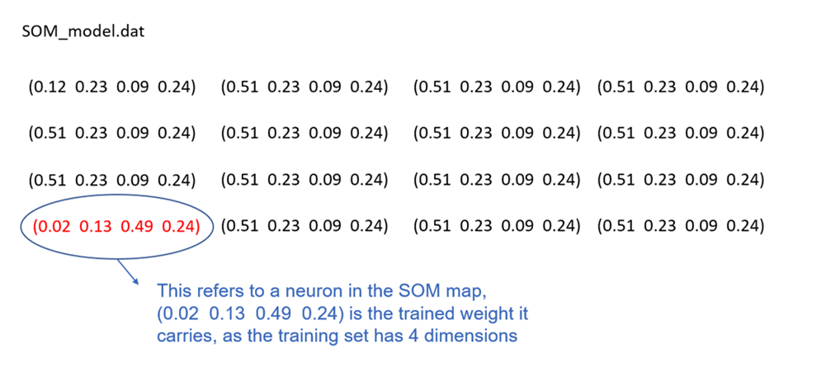

























Slide 7
Individual Task [Week 4]

Slide 8
Anzi Liu | Github Basic python (https://www.runoob.com/python/python-operators.html) Python + flask (https://www.youtube.com/watch?v=mqhxxeeTbu0&list=PLzMcBGfZo4-n4vJJybUVV3Un_NFS5EOgX&index=1) 尝试自己搭建一个简单的Python flask框架 MongoDB atlas (如何读数据，删除数据) https://docs.mongodb.com/manual/introduction/
Mingyi Li | Basic python (https://www.runoob.com/python/python-operators.html) Python + flask (https://www.youtube.com/watch?v=mqhxxeeTbu0&list=PLzMcBGfZo4-n4vJJybUVV3Un_NFS5EOgX&index=1) 尝试自己搭建一个简单的Python flask框架 MongoDB atlas (增查改) https://docs.mongodb.com/manual/introduction/
Cheng Liang
Jiayu Huang | 学习一下Javascript的数据结构
Yuqi Mao

Slide 9
SOM
Username:
Password:
Log in
Signup

Slide 10




SOM
Flower; 限制一个字
Search
ID
File name
Type
My database
Click this, add a new record for the uploaded dataset
My models
Visualisation

Slide 11


SOM
Flower
Search
Click this to check
The details of the
Dataset.
File name
Type
Iris
dat
My database
Students
dat
My models
Click this, add metadata for the dataset
Visualisation
Notes:
文件名字不允许重复，如果重复，自动在名字后面加其它数字，比如SOM1_1, SOM1_2
TODO: 显示用户上传的时间

Slide 12
SOM
Data Description – 01 Iris
Save
Dataset description:
Keywords:
Iris
flower
My database
Source:
My models
Number of Instances:
Number of Attributes:
Visualisation
Whether the dataset contains labels:
Yes
Attributes Information:
Attributes 1:
attributes name
description
Add one more attribute
Notes:
后端要保存好metadata的信息， 当用户第一次输入metadata，保存以后，在进入这个界面，系统应该获取各个已保存的信息供用户进行修改。

Slide 13
SOM
Data Description – 01 Iris
Save
Dataset description:
A user needs to add some keywords here for future data querying
Keywords:
My database
Iris
flower
Source:
My models
Number of Instances:
Number of Attributes:
Visualisation
Attributes Information:
Attributes 1:
attributes name
description
Attributes 2:
attributes name
description

Slide 14

Data Description - Iris
SOM
Title: Iris Plants Database
Updated Sept 21 by C.Blake - Added discrepency information2.
Sources:
(a) Creator: R.A. Fisher
(b) Donor: Michael Marshall (MARSHALL%PLU@io.arc.nasa.gov)
Attribute 1 | Attribute 2 | Attribute 3 | Attribute 4 | label
5.1 | 3.5 | 1.4 | 0.2 | Setosa
4.9 | 3 | 1.4 | 0.2 | Setosa
4.7 | 3.2 | 1.3 | 0.2 | Setosa
4.6 | 3.1 | 1.5 | 0.2 | Setosa
5 | 3.6 | 1.4 | 0.2 | Setosa
5.4 | 3.9 | 1.7 | 0.4 | Setosa
4.6 | 3.4 | 1.4 | 0.3 | Setosa
5 | 3.4 | 1.5 | 0.2 | Setosa
4.4 | 2.9 | 1.4 | 0.2 | Setosa
4.9 | 3.1 | 1.5 | 0.1 | Setosa
5.4 | 3.7 | 1.5 | 0.2 | Setosa
4.8 | 3.4 | 1.6 | 0.2 | Setosa
4.8 | 3 | 1.4 | 0.1 | Setosa
4.3 | 3 | 1.1 | 0.1 | Setosa
5.8 | 4 | 1.2 | 0.2 | Setosa
5.7 | 4.4 | 1.5 | 0.4 | Setosa
5.4 | 3.9 | 1.3 | 0.4 | Setosa
5.1 | 3.5 | 1.4 | 0.3 | Setosa
My database
My models
Visualisation

Slide 15



SOM
SOM1
Search
My database
Model name
Size(KB)
My models
SOM1
23
Visualisation
SOM 2
15

Slide 16

SOM
Model:
Please input your model's name
U-Matrix
Dataset:
Please input your dataset's name
My database
1.206
Weight:
0.456
My models
Visualisation
1.114
0.735

Slide 17
SOM_model.dat
(0.12 0.23 0.09 0.24)
(0.51 0.23 0.09 0.24)
(0.51 0.23 0.09 0.24)
(0.51 0.23 0.09 0.24)
(0.51 0.23 0.09 0.24)
(0.51 0.23 0.09 0.24)
(0.51 0.23 0.09 0.24)
(0.51 0.23 0.09 0.24)
(0.51 0.23 0.09 0.24)
(0.51 0.23 0.09 0.24)
(0.51 0.23 0.09 0.24)
(0.51 0.23 0.09 0.24)
(0.02 0.13 0.49 0.24)
(0.51 0.23 0.09 0.24)
(0.51 0.23 0.09 0.24)
(0.51 0.23 0.09 0.24)

