Slide 1




SOM
C:/User/MyDatabase
browse
ID
File name
Type
01
Iris
csv
My database
02
Students
CSV
Data training
Visualisation

Slide 2


SOM
Input the id of your dataset
Search
My database
Data training
Visualisation

Slide 3


SOM
Search
Input the id of your dataset
ID
Name
Type
Training
My database
01
Iris
csv
Data training
Visualisation

Slide 4



SOM
Search
Input the id of your dataset
Training
My database
Data training
ID
Name
Type
Status
Visualisation
01
Iris
csv
02
Students
csv

Slide 5
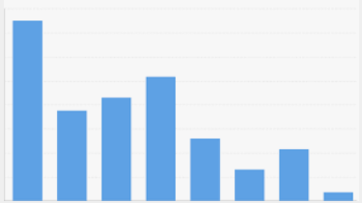
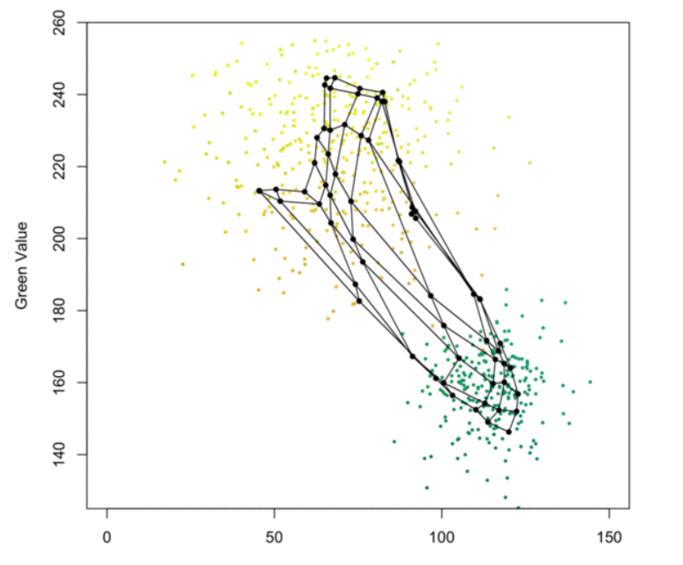
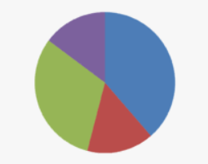
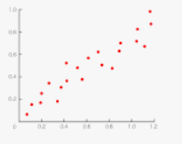

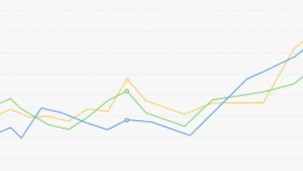
SOM
My database
Data training
Visualization

