Slide 1
Data analysis of Hollywood Age Gaps
Date：
Presenter：

Slide 2
Content
01
Summary of the dataset
Data visualization and analysis
02
03
Key challenges and shortcomings

Slide 3
01
Summary of the dataset

Slide 4

Summary of the dataset
olympics.csv
The data set included biological data on actors in Hollywood films that featured two or more actors playing true love interests and the youngest non-animated character over 17 years old.
The dataset comes from:
https://hollywoodagegap.com/ via https://www.data-is-plural.com/archive/2018-02-07-edition/
https://www.vcg.com/creative/1327147689.html
Notes:
Describes the source of the dataset and its contents

Slide 5
02
Data visualization and analysis

Slide 6
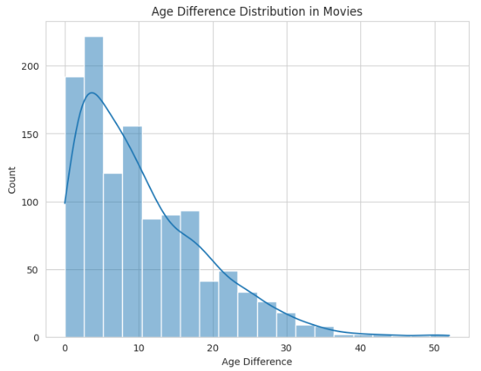
Data visualization and analysis
Shows the distribution of age differences in movies.
The data mainly focuses on 0-10 years old, which can prove that the couples in most movies are close in age
Notes:
The age difference of the characters in most movies is concentrated between 0 and 10 years, which can indicate that the couples in the movies are similar in age, but there are still large age differences in actors playing couples

Slide 7
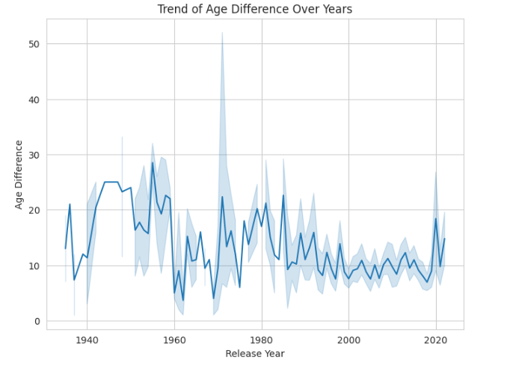
Data visualization and analysis
Before 1940, when it might have been easier to accept a larger age difference.
From 1950 to 1970, the age difference showed a downward trend and reached its maximum in 1960.
After 1980, the overall age gap leveled off, with most films maintaining a character age gap between 5 and 15 years.
Notes:
Early films (1940-1960) accepted actors with a large age difference as lovers.The age difference between actors in modern movies (after 2000) tends to be stable, and it may be more acceptable for actors with a smaller age difference to play lovers.

Slide 8
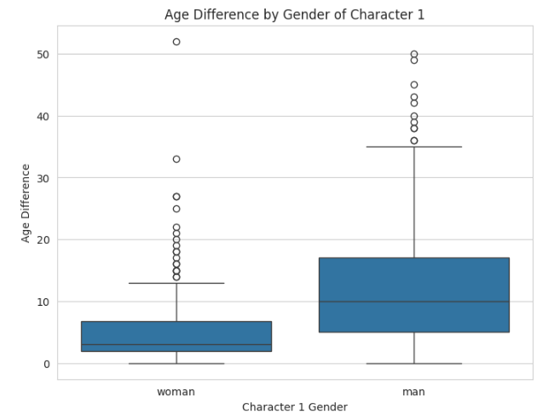
Data visualization and analysis
Analysis of Age Difference by Gender of Character 1
The difference in the age of men as older characters is much larger than that of women.
There are fewer films with women as older characters and the age difference is smaller.
Notes:
The film industry is more accepting of couple films in which men play as older characters, and less accepting of films in which women play as older characters.

Slide 9
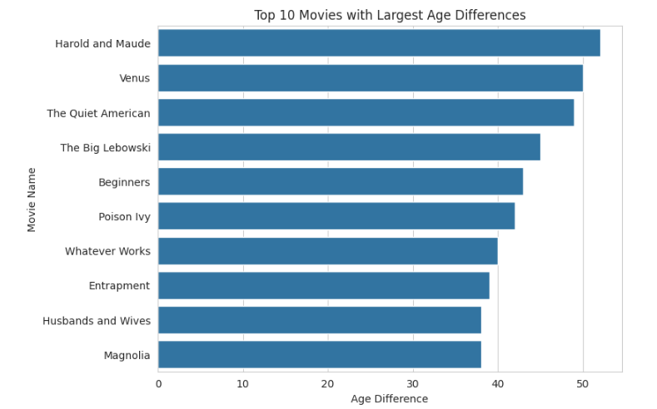
Data visualization and analysis
Analysis of Top 10 Movies with Largest Age Differences.
The films with the largest age gap all have an age gap of more than 50 years, but the trend of the 10 films with the largest age gap shows that the age gap of more than 40 years is very rare.
Notes:
Films with an age difference of more than 40 years are in the minority.

Slide 10
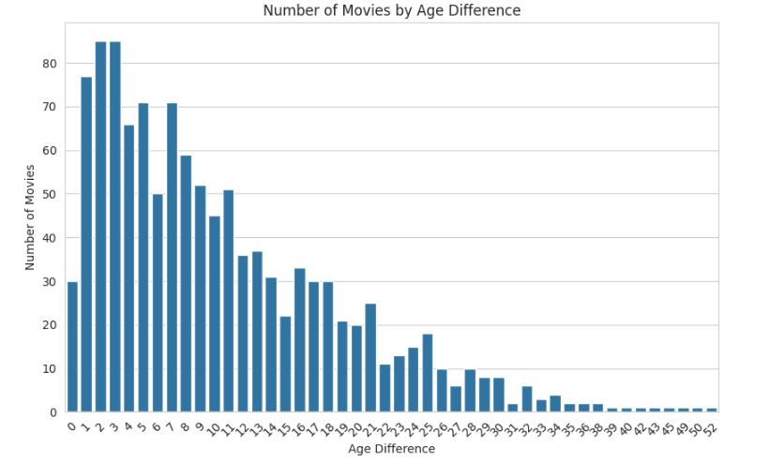
Data visualization and analysis
Through the analysis of the Number of Movies by Age Difference.
The number of films with an age difference of 0-10 years is the largest, the number of films with an age difference of 10-20 years is significantly reduced, and the number of films with an age difference of more than 20 years is very few.
Notes:
The film industry is more accepting of actors from 0 to 10 years old playing couples, and actors with an age difference of more than 20 years old playing couples are more likely to appear in works of specific themes.

Slide 11
03
Key challenges and Shortcomings

Slide 12
Key challenges and Shortcomings
Challenges
Shortcomings
Use of git:
Using git effectively.
Ensure code efficiency.
Data set analysis
Show statistics in more ways.
Categorize datasets more accurately.
Notes:
More ways can be used to display only statistics to help analyze the overall data.Use git more effectively through video learning.

Slide 13
Thank you for listening!
Date：
Presenter：

