Slide 1
Data analysis of Olympic athletes and medals
Date：
Presenter：

Slide 2
Content
01
Summary of the dataset
Data visualization and analysis
02
03
Key challenges and shortcomings

Slide 3
01
Summary of the dataset

Slide 4

Summary of the dataset
olympics.csv
Basic athlete biographies and medal performances from the Athens 1896 Olympics to the Rio 2016 Olympics.
The dataset comes from ：
https://github.com/rfordatascience/tidytuesday/tree/2500765853ea5235409d936cf9bbbf7d5f8b6881/data/2024/2024-08-06
This file contains a total of 271116 rows and 15 columns.
https://www.pexels.com/zh-cn/photo/236937/
Notes:
Describes the source of the dataset and its contents

Slide 5
02
Data visualization and analysis

Slide 6
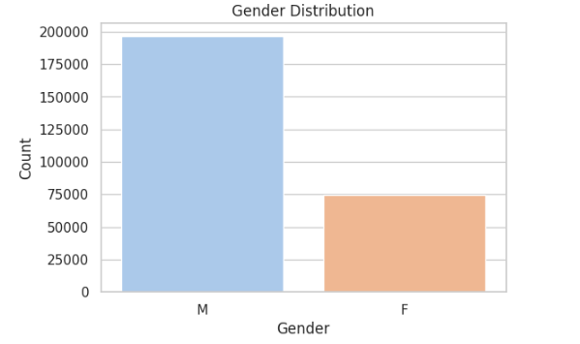
Data visualization and analysis
Analyzing the ratio of men to women participating in the Olympic Games
Men far outnumber women at the Olympics.
Gender balance at the Olympics has historically varied.
Notes:
By analyzing the number of men and women participating in the Olympic Games, it is clear that there have been differences in the balance of men and women participating in the Olympic Games throughout history.

Slide 7
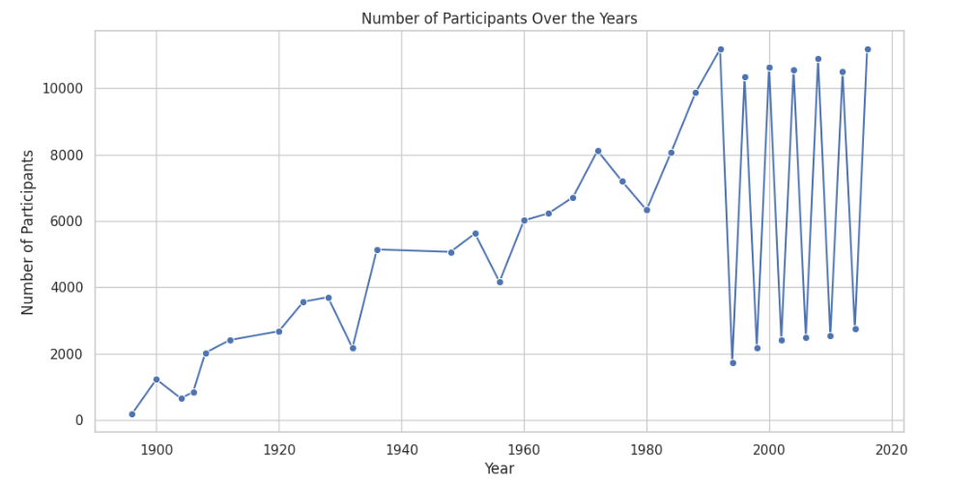
Data visualization and analysis
Analysis of the number of participants in different years.
The number of participants has generally increased, with fluctuations after 1992 due to the separation of the Winter Olympics from the Summer Olympics.
The expansion of the scale and importance of hosting the Olympic Games in various countries
Notes:
By analyzing the number of participants in different years, we can see an overall upward trend. We can also see the impact of major world events on the number of participants. We can also see that the large fluctuations in the figure are due to the separation of the Winter Olympics from the Summer Olympics in 1992, which reflects the increasing importance that various countries attach to the Olympics.

Slide 8
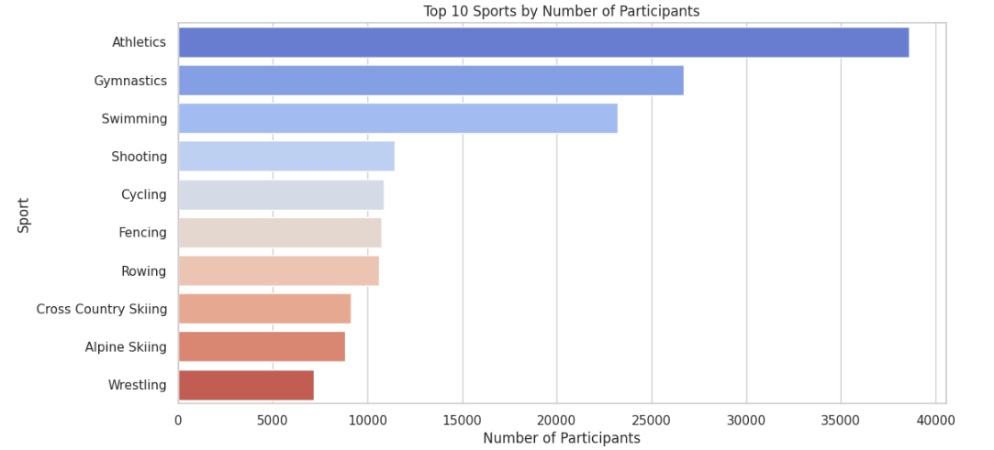
Data visualization and analysis
Number of participants in different sports.
Track and field and swimming are the sports with the most participants.
These sports are more popular and more entertaining.
Notes:
Track and field, swimming and other traditional events have the largest number of participants. It can be concluded that these events are highly popular and enjoyable to watch, and are also the core of the Olympic Games.

Slide 9
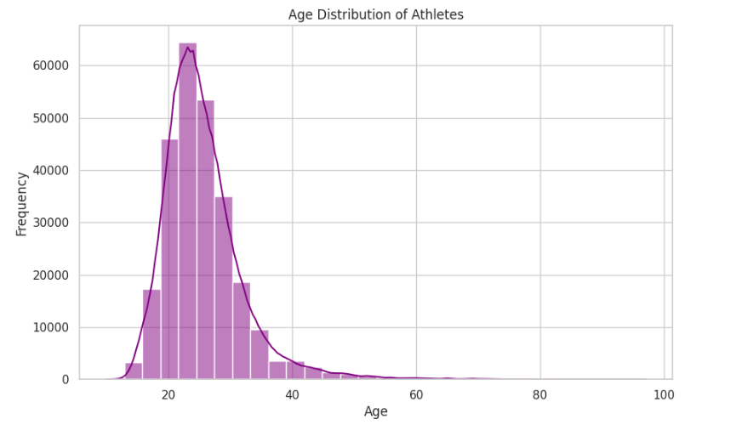
Data visualization and analysis
Analysis of the Age of Athletes Participating in the Olympic Games
The age of athletes is concentrated between 20 and 30 years old.
This reflects the physical advantages of this age group and highlights that this is the golden age group for athletes.
Notes:
The age analysis of the participating athletes revealed the golden age group of the athletes.

Slide 10
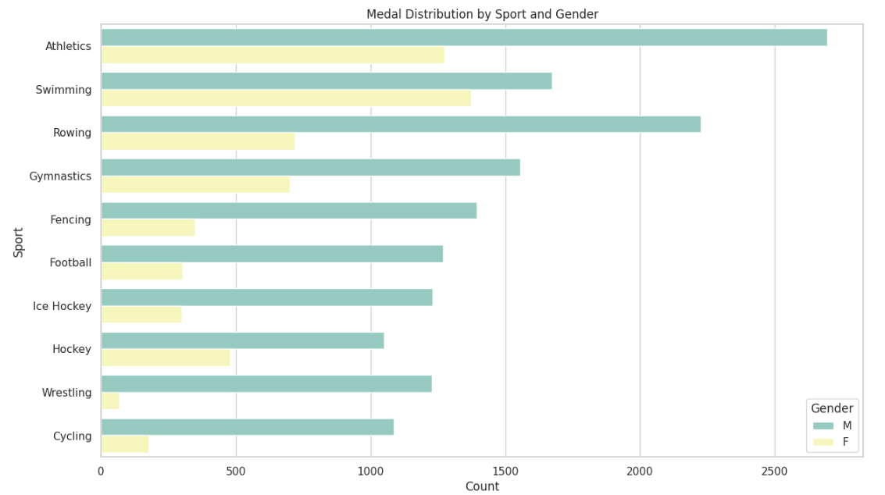
Data visualization and analysis
Medal distribution by Sport and Gender
Gender medal distribution varies across events.
Notes:
By analyzing the medal distribution by gender and event grouping, it can be concluded that there are differences in medal distribution between men and women, which may be caused by the difference in physical fitness between different events.

Slide 11
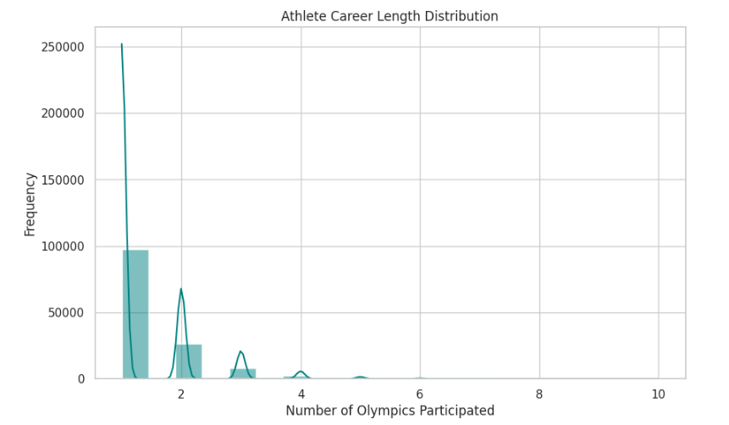
Data visualization and analysis
The number of times an athlete participates in competitions reflects the athlete's career lifespan.
Most athletes compete in only one Olympics, perhaps because of a highly competitive or short career. A very small number compete in multiple Olympics.
Notes:
An athlete’s career is short, either because of intense competition or a short career, and countries should focus on providing for the well-being of these athletes after they retire.

Slide 12
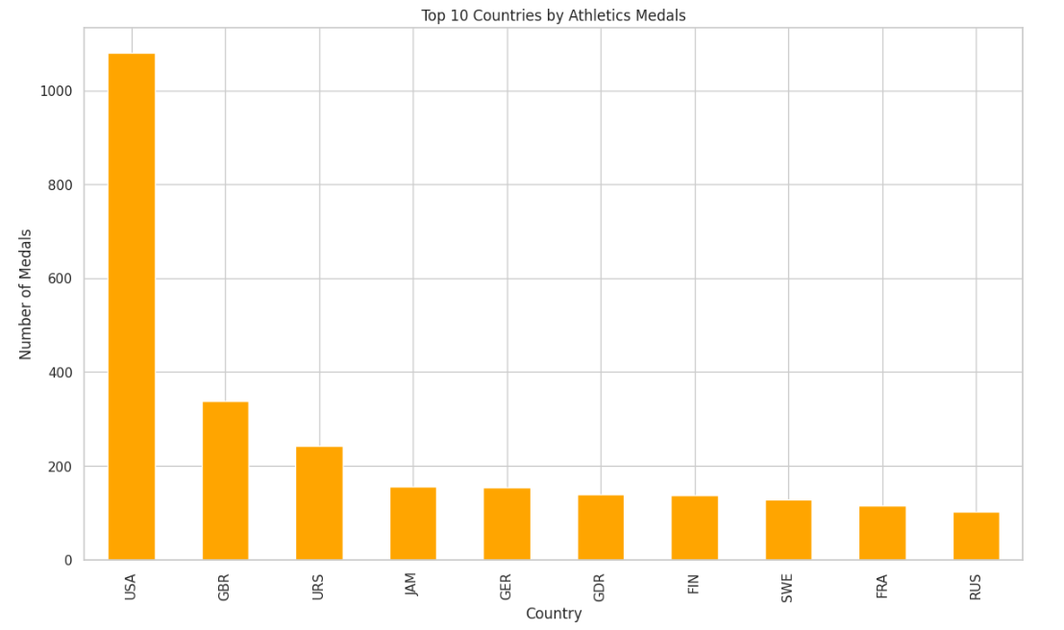
Data visualization and analysis
Analyze the awards for individual events, taking track and field events as an example.
The United States has significant dominance in track and field. It reflects the United States' tilt towards a strong athlete base and resources. Some countries may have advantages in specific athletics events.
Notes:
The distribution of medals in individual events can be analyzed to reflect the country's resource inclination or athlete base towards specific events.

Slide 13
03
Key challenges and Shortcomings

Slide 14
Key challenges and Shortcomings
Challenges
Shortcomings
Analysis of the dataset:
Rich data set
Use of git:
Using git effectively
Ensure code efficiency
Show statistics in more ways
Become more proficient with git.
Categorize datasets more accurately.
Notes:
I was very hesitant in choosing the data to analyze due to the huge amount of data in the dataset. And learn how to use git through videos.

Slide 15
Thank you for listening!
Date：
Presenter：

