Slide 1

Analysis of E-Commerce Shipping Data
——MISY225 - Fall 2022
Team 4: Zhiyuan Liu , Qiukai Cheng
2022.11

Slide 2
01
Dataset
03
Data app demo
CONTENTS
02
Analysis

Slide 3
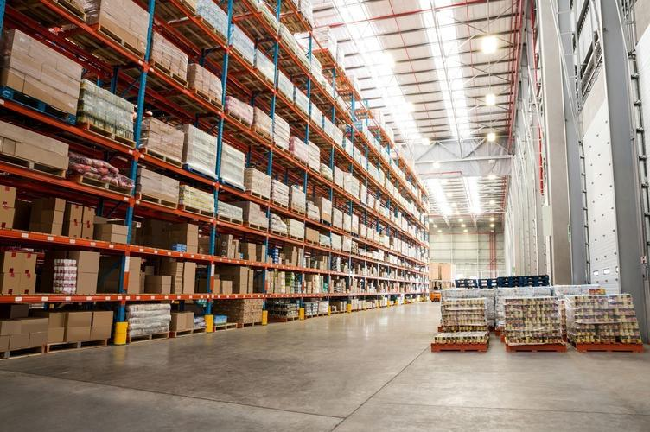
Context
An international e-commerce company wants to discover key insights from their customer database. They want to use some of the most advanced machine learning techniques to study their customers. The company sells electronic products.

Slide 4
Context and Content
Warehouse block: The Company have big Warehouse which is divided in to block such as A,B,C,D,F.
Mode of shipment: The Company Ships the products in multiple way such as Ship, Flight and Road.
Customer rating: The company has rated from every customer. 1 is the lowest (Worst), 5 is the highest (Best).
Cost of the product: Cost of the Product in US Dollars.
Gender: Male and Female.
Discount offered: Discount offered on that specific product.
Weight in gms: It is the weight in grams.
Reached on time: It is the target variable, where 1 Indicates that the product has NOT reached on time and 0 indicates it has reached on time.

Slide 5
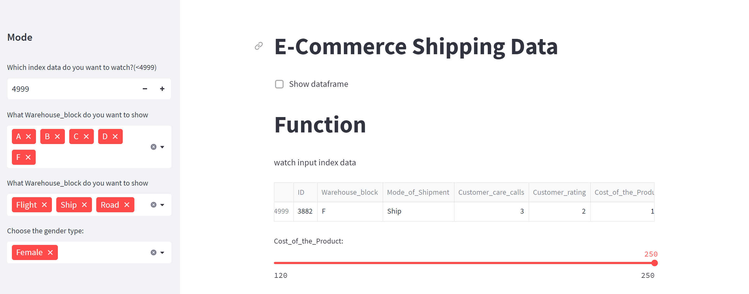
Design

Slide 6
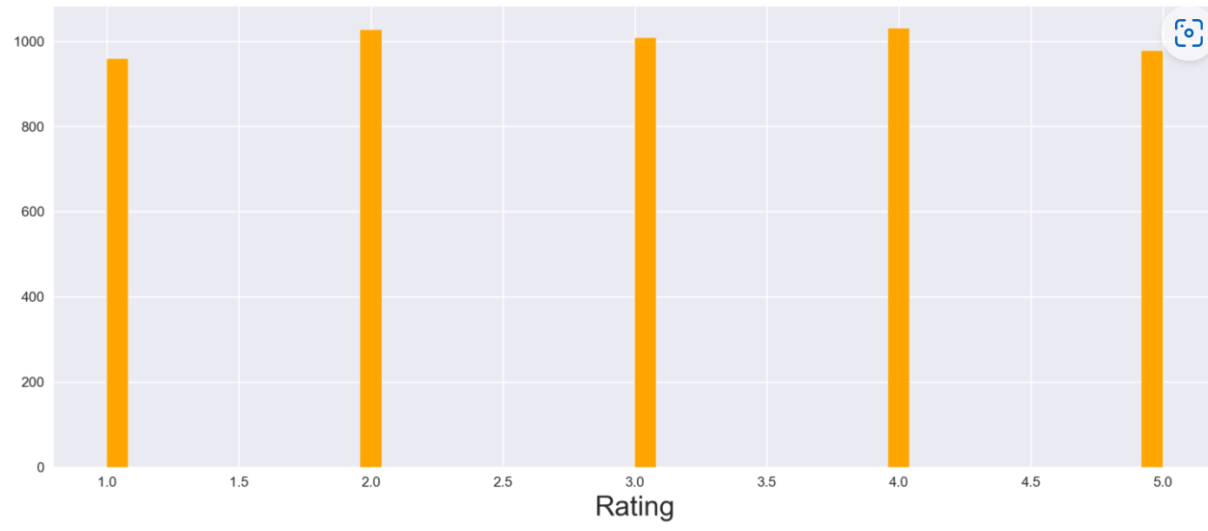
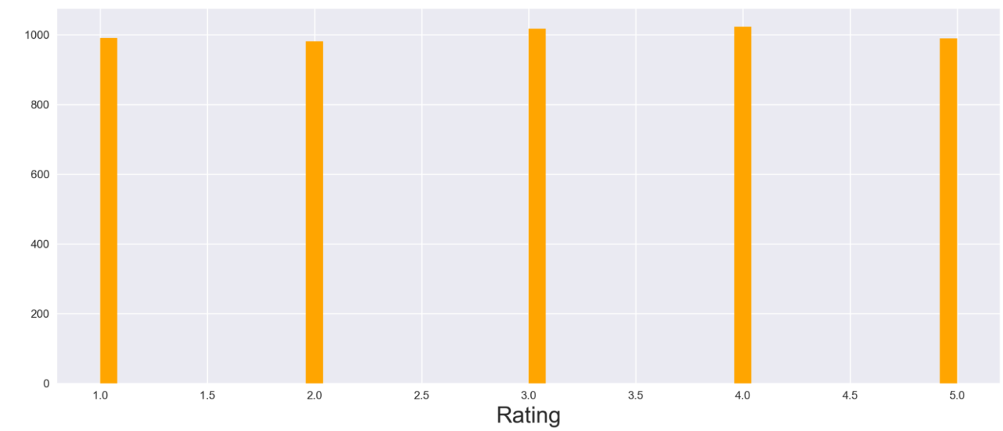
The relationship between customer rating and gender
Male
Male customers give less negative comments.
Female

Slide 7
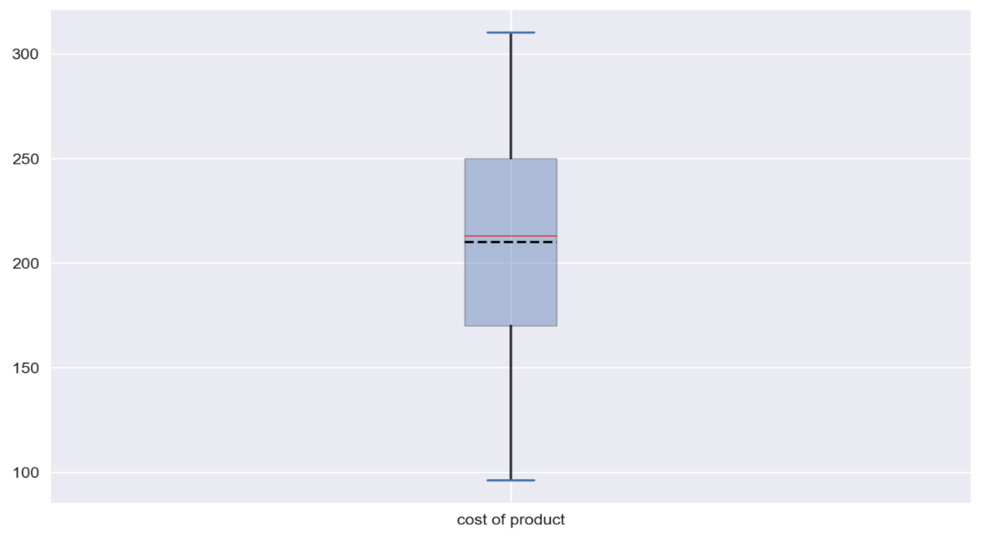

Whether the male or female purchase more on the products
Female
Male
Female spend more money on products
Male shows great difference when purchasing the electronic products
And company should pay more attention to female customer

Slide 8
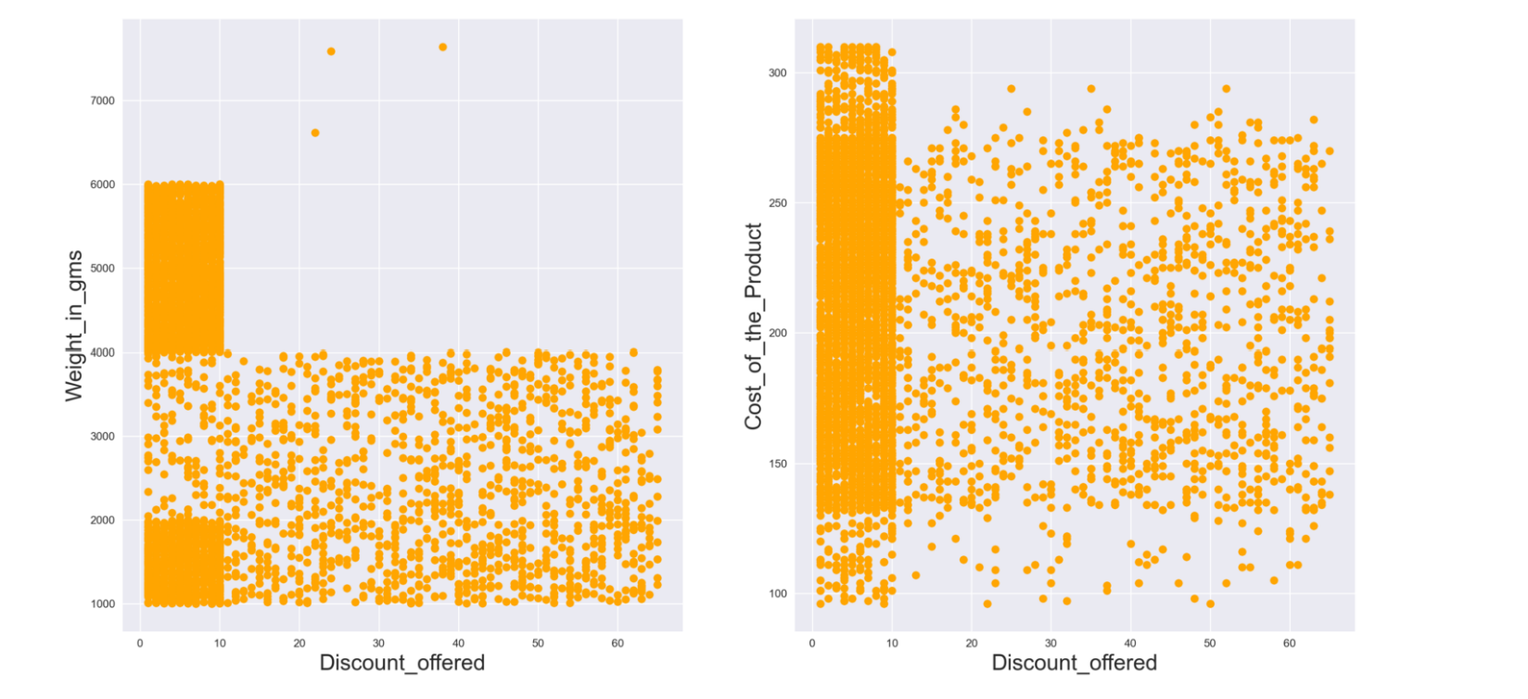
Discount offered with weight and product cost

Slide 9
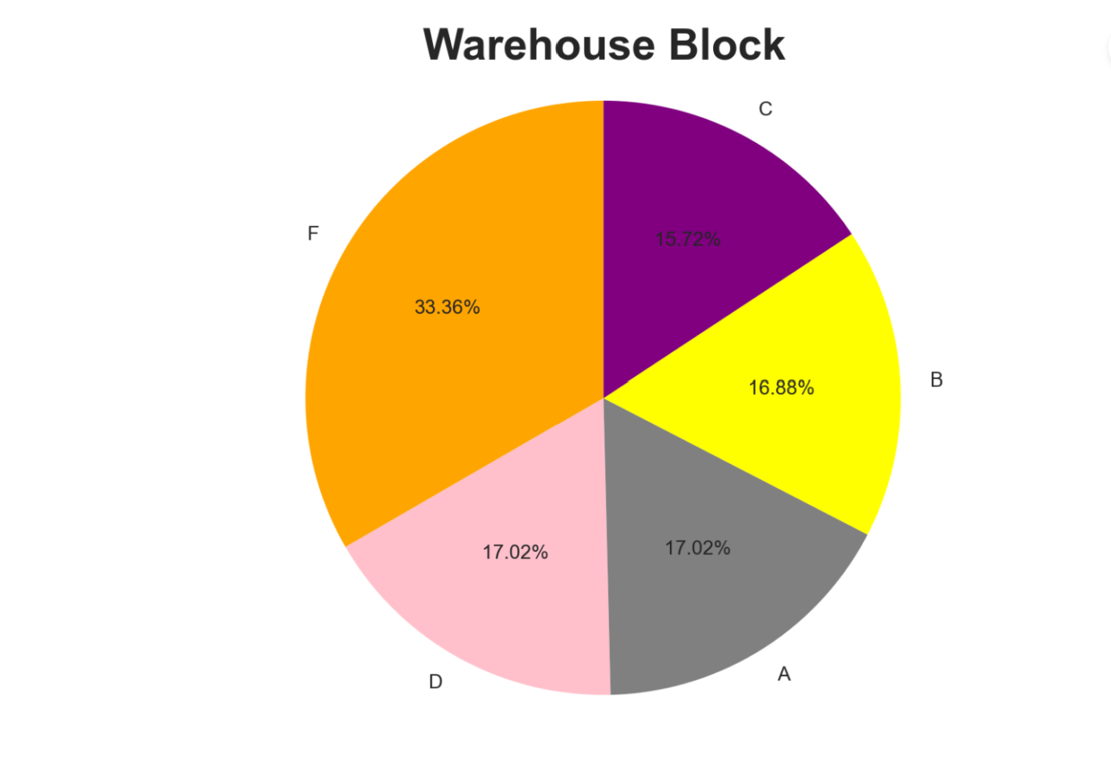

Warehouse block distribution
04

Slide 10
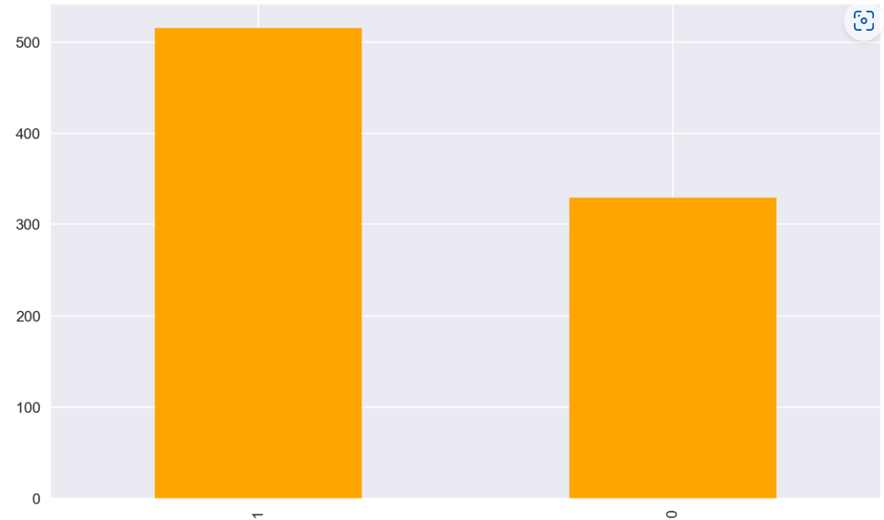
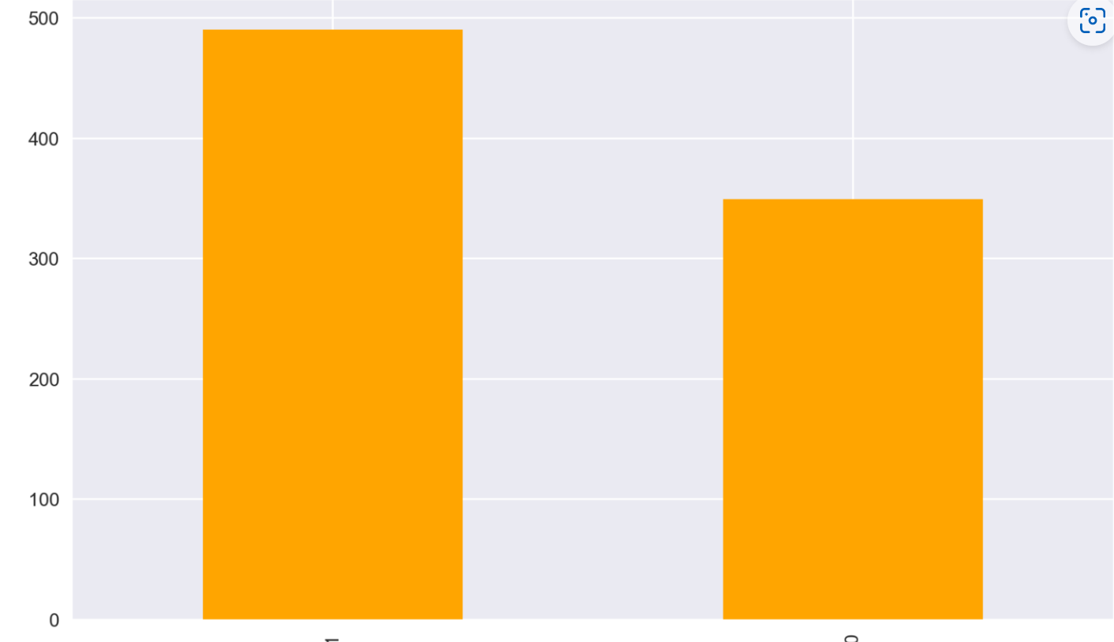
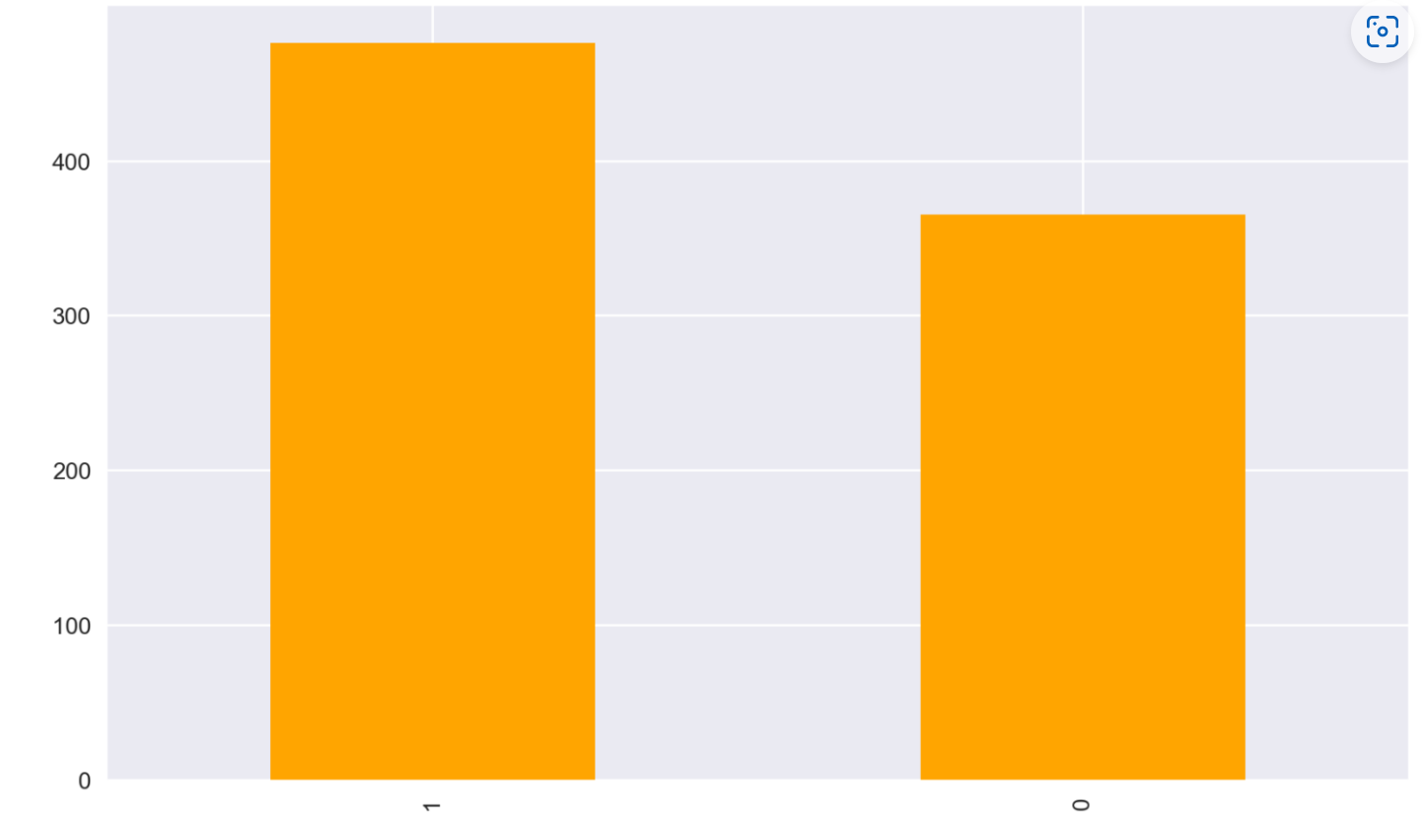
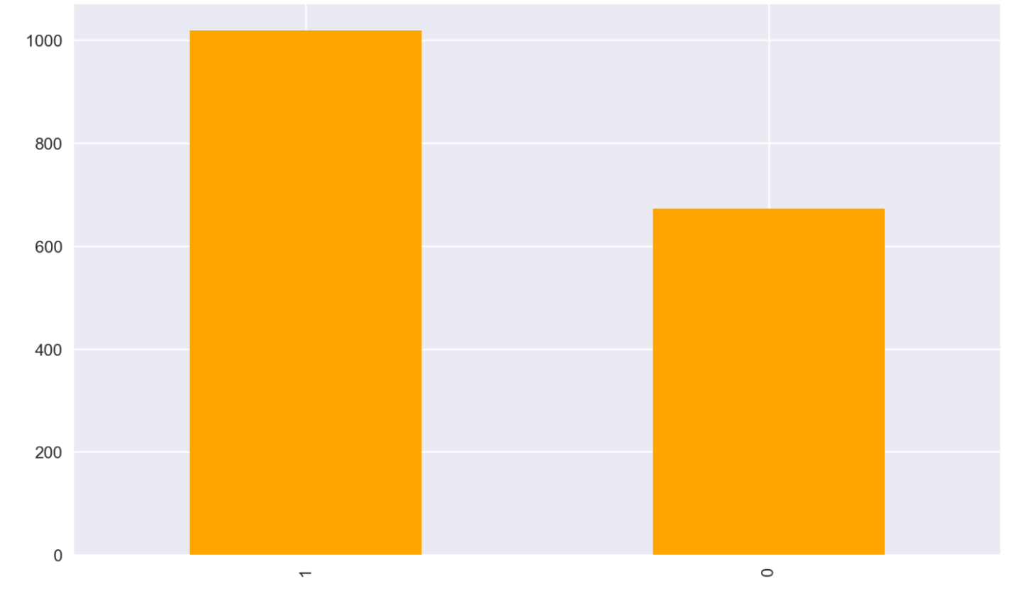
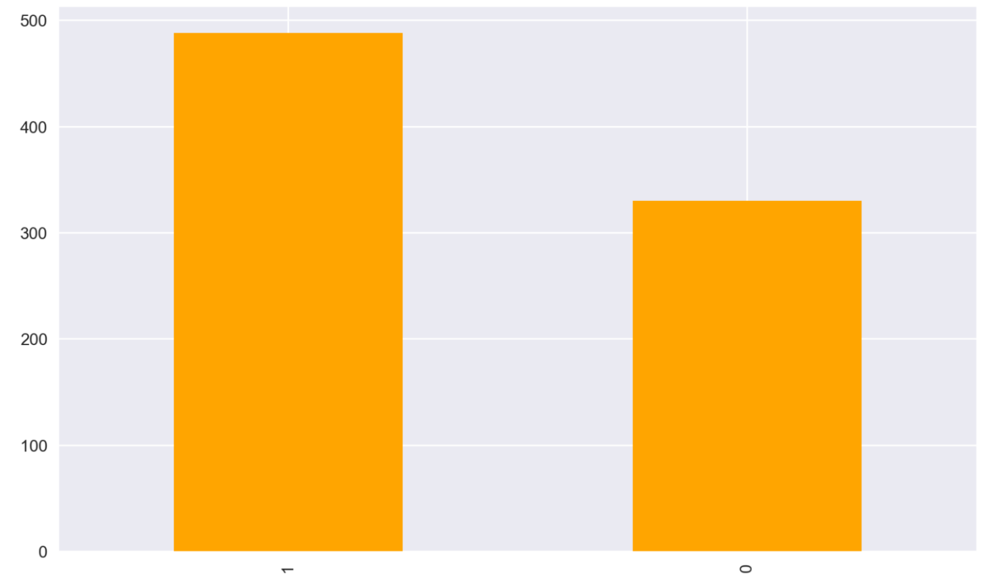
The impact of warehouse block on the product reach time
A
B
C
F
D
1 Indicates that the product has NOT reached on time and 0 indicates it has reached on time.

Slide 11
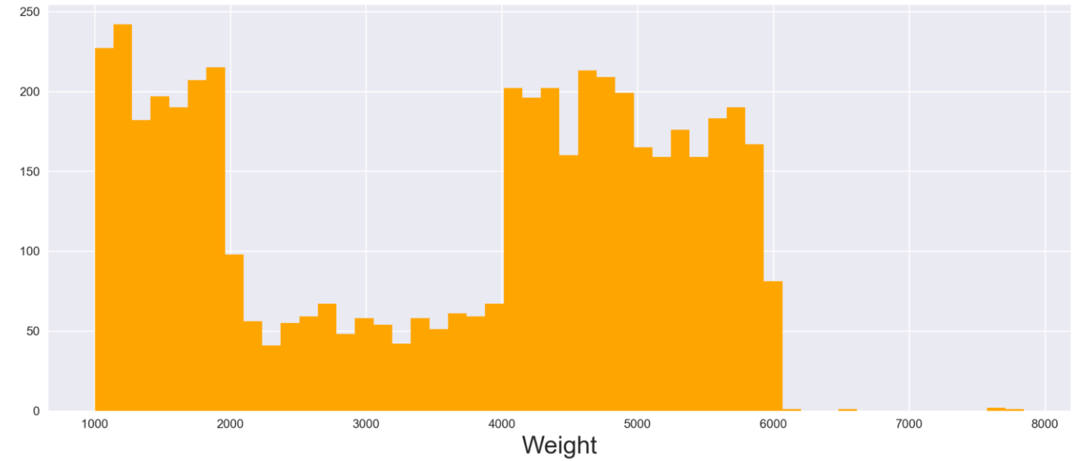
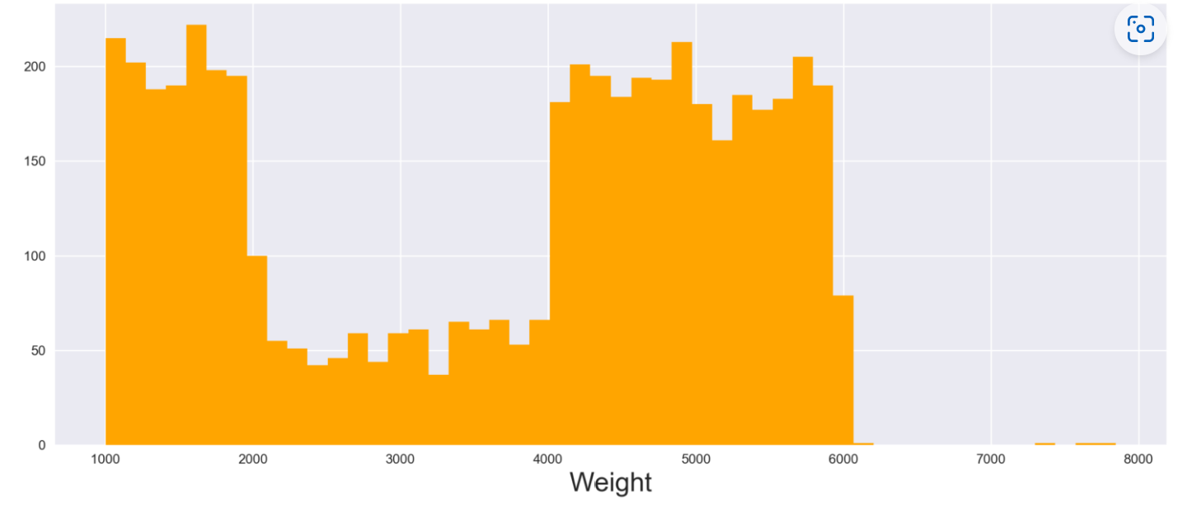
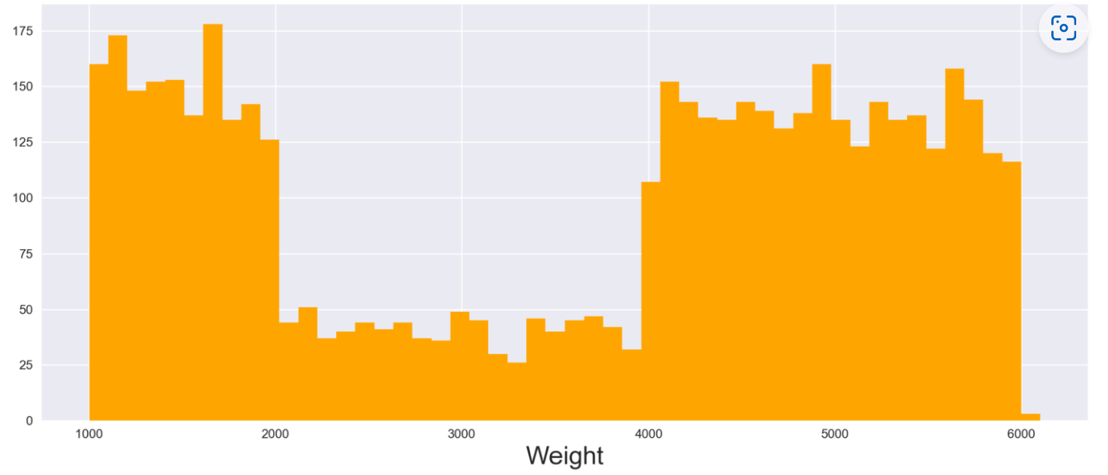
The relationship between shipment and the product weight
Road
Flight
Female
Ship

Slide 12
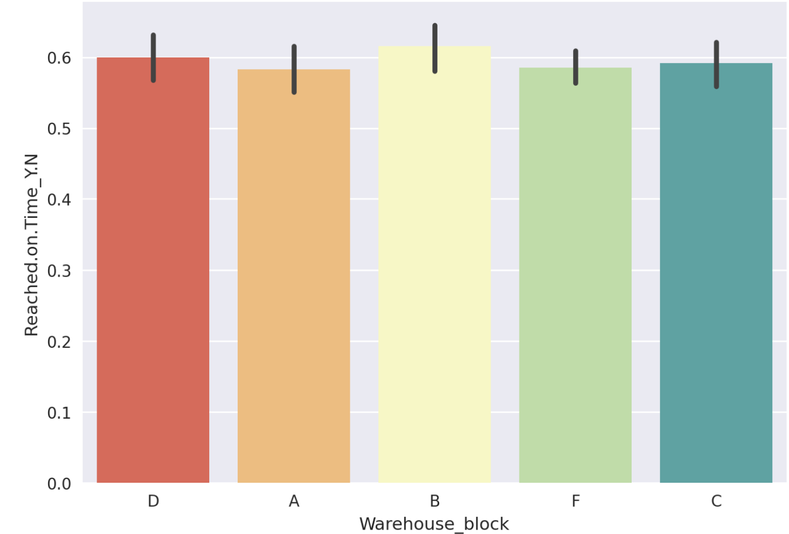
Whether the warehouse area is related to whether the goods arrive or not
The warehouse area has little influence on the delivery.

Slide 13
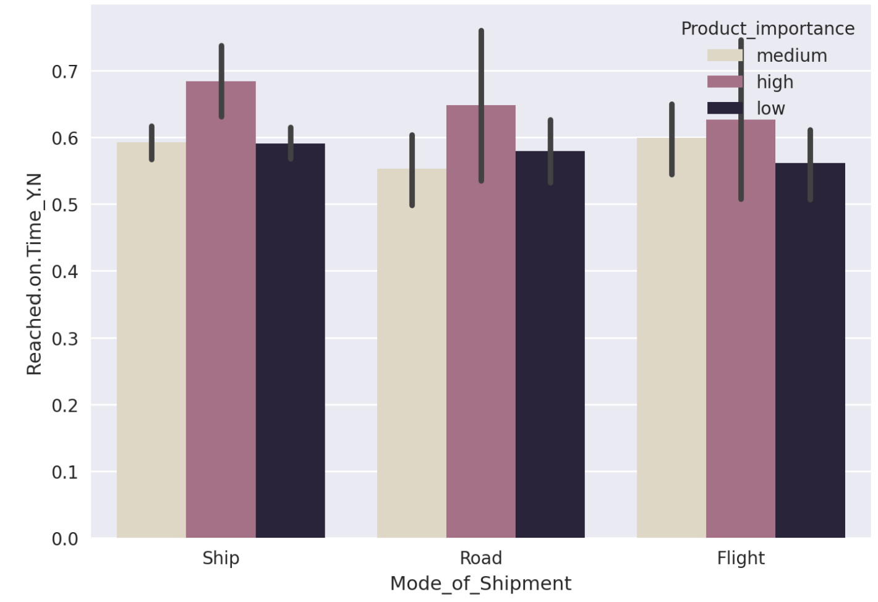
Relationship between different shipping methods, importance and arrival rate
The arrival rate of different shipping methods is basically the same, but the arrival rate of products with higher importance is relatively higher

Slide 14
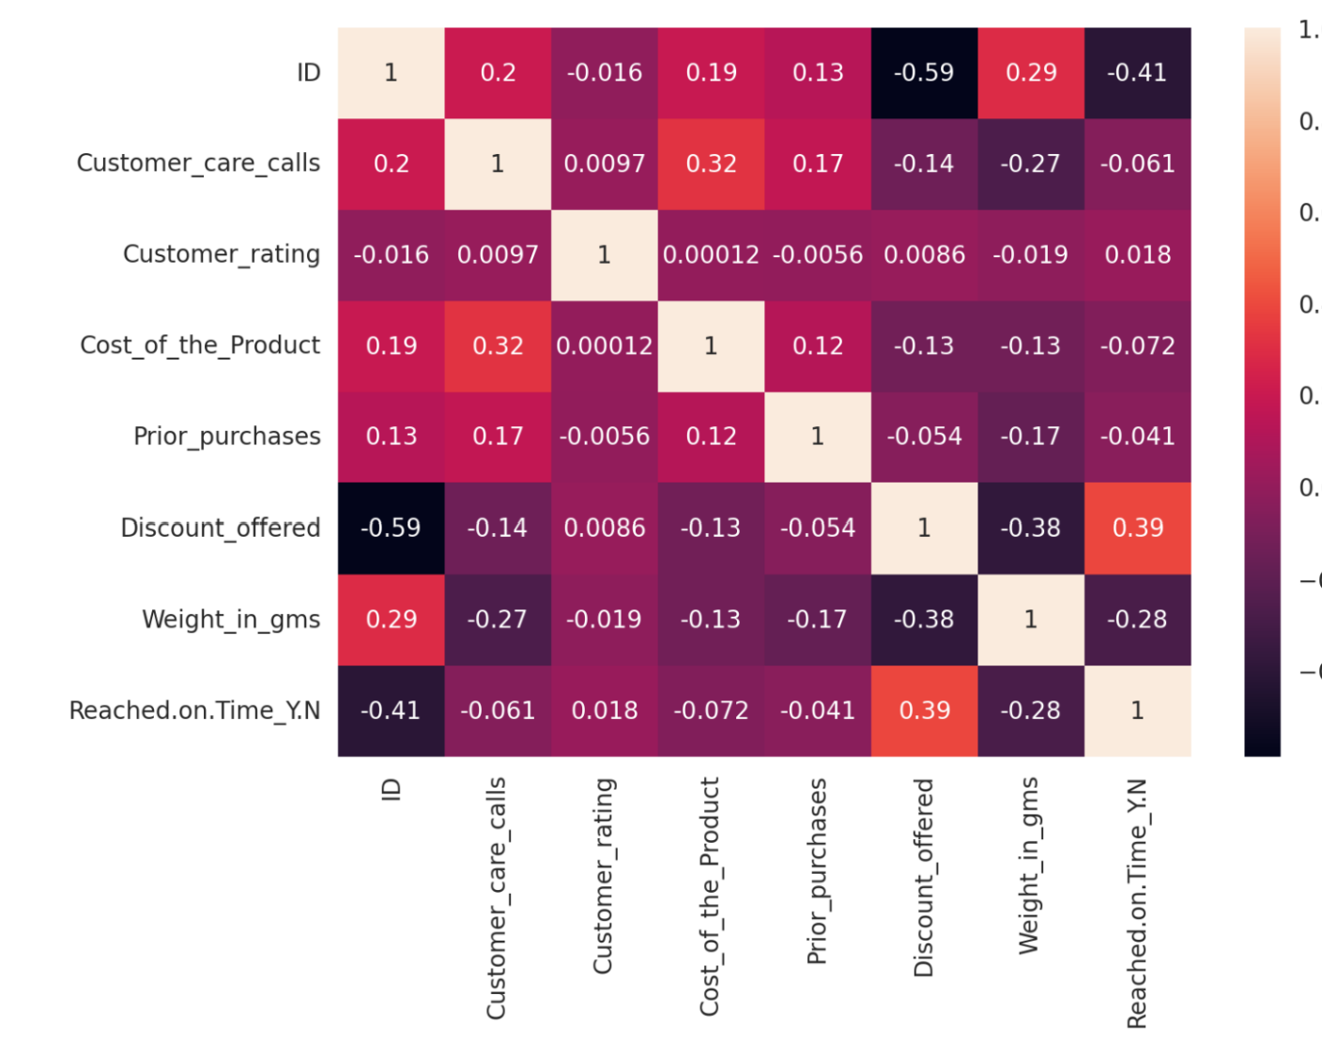
Use a heatmap to see if there are correlations between features
The correlation corresponding to the color is displayed in the bar on the right. The positive and negative values represent positive and negative correlations respectively. The closer the value is to 1 and -1, the greater the correlation. It can be seen that there is no absolute relationship between commodity price and weight.

Slide 15
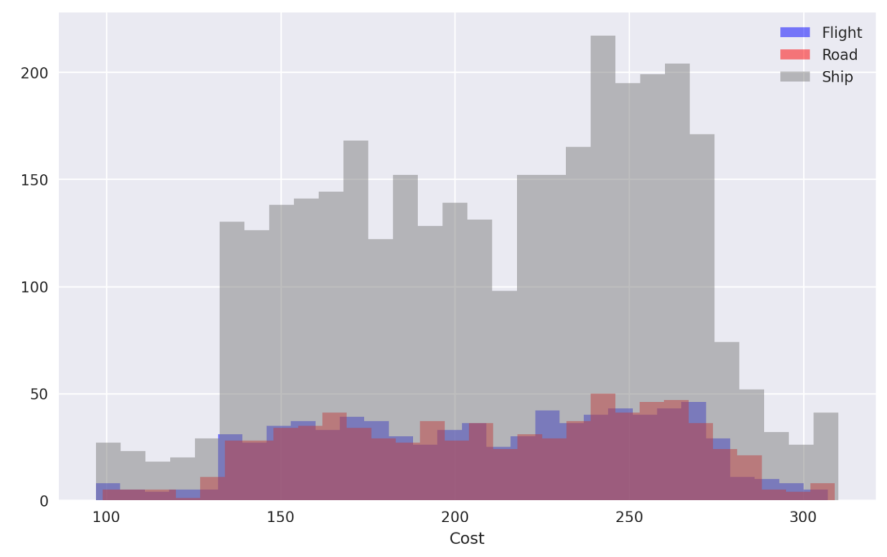
Transportation mode, product cost and quantity
Each color represents a different mode of transportation, the horizontal axis represents the cost of the product, and the vertical axis represents the quantity. It can be seen that regardless of the cost of the product, most of them choose to ship by ship, and the proportions of the other two modes of transportation are similar.

Slide 16
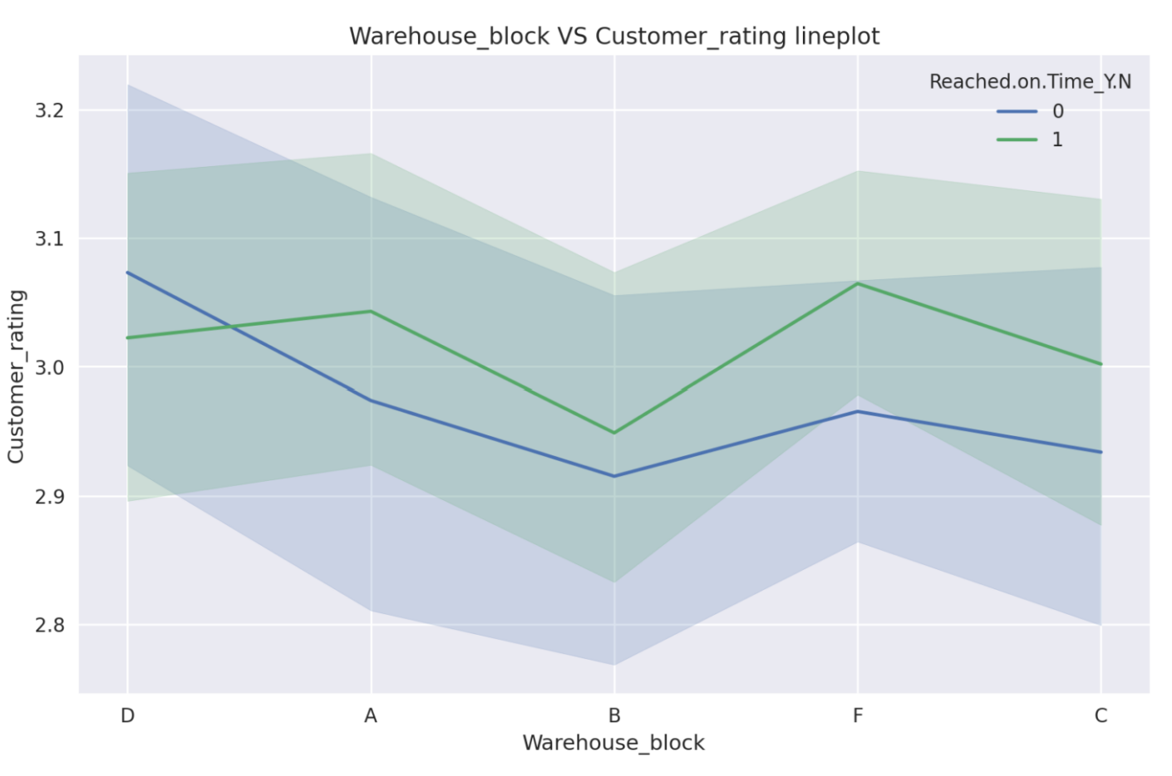
Warehouse block, Customer rating, reach on time line graph
Use a line chart to show the Warehouse block, and the relationship between the customer's evaluation level and whether the goods arrive

Slide 17
Thank you !

