Slide 1

Analysis of E-Commerce Shipping Data
——MISY225 - Fall 2022
Team 4: Zhiyuan Liu , Qiukai Cheng
2022.11

Slide 2
01
Dataset
03
Data app demo
CONTENTS
02
Analysis

Slide 3

Context
An international e-commerce company based wants to discover key insights from their customer database. They want to use some of the most advanced machine learning techniques to study their customers. The company sells electronic products.

Slide 4
Context and Content
The dataset used for model building contained 10999 observations of 12 variables. The data contains the following information:
ID: ID Number of Customers.
Warehouse block: The Company have big Warehouse which is divided in to block such as A,B,C,D,E.
Mode of shipment: The Company Ships the products in multiple way such as Ship, Flight and Road.
Customer care calls: The number of calls made from enquiry for enquiry of the shipment.
Customer rating: The company has rated from every customer. 1 is the lowest (Worst), 5 is the highest (Best).
Cost of the product: Cost of the Product in US Dollars.
Prior purchases: The Number of Prior Purchase.
Product importance: The company has categorized the product in the various parameter such as low, medium, high.
Gender: Male and Female.
Discount offered: Discount offered on that specific product.
Weight in gms: It is the weight in grams.
Reached on time: It is the target variable, where 1 Indicates that the product has NOT reached on time and 0 indicates it has reached on time.

Slide 5
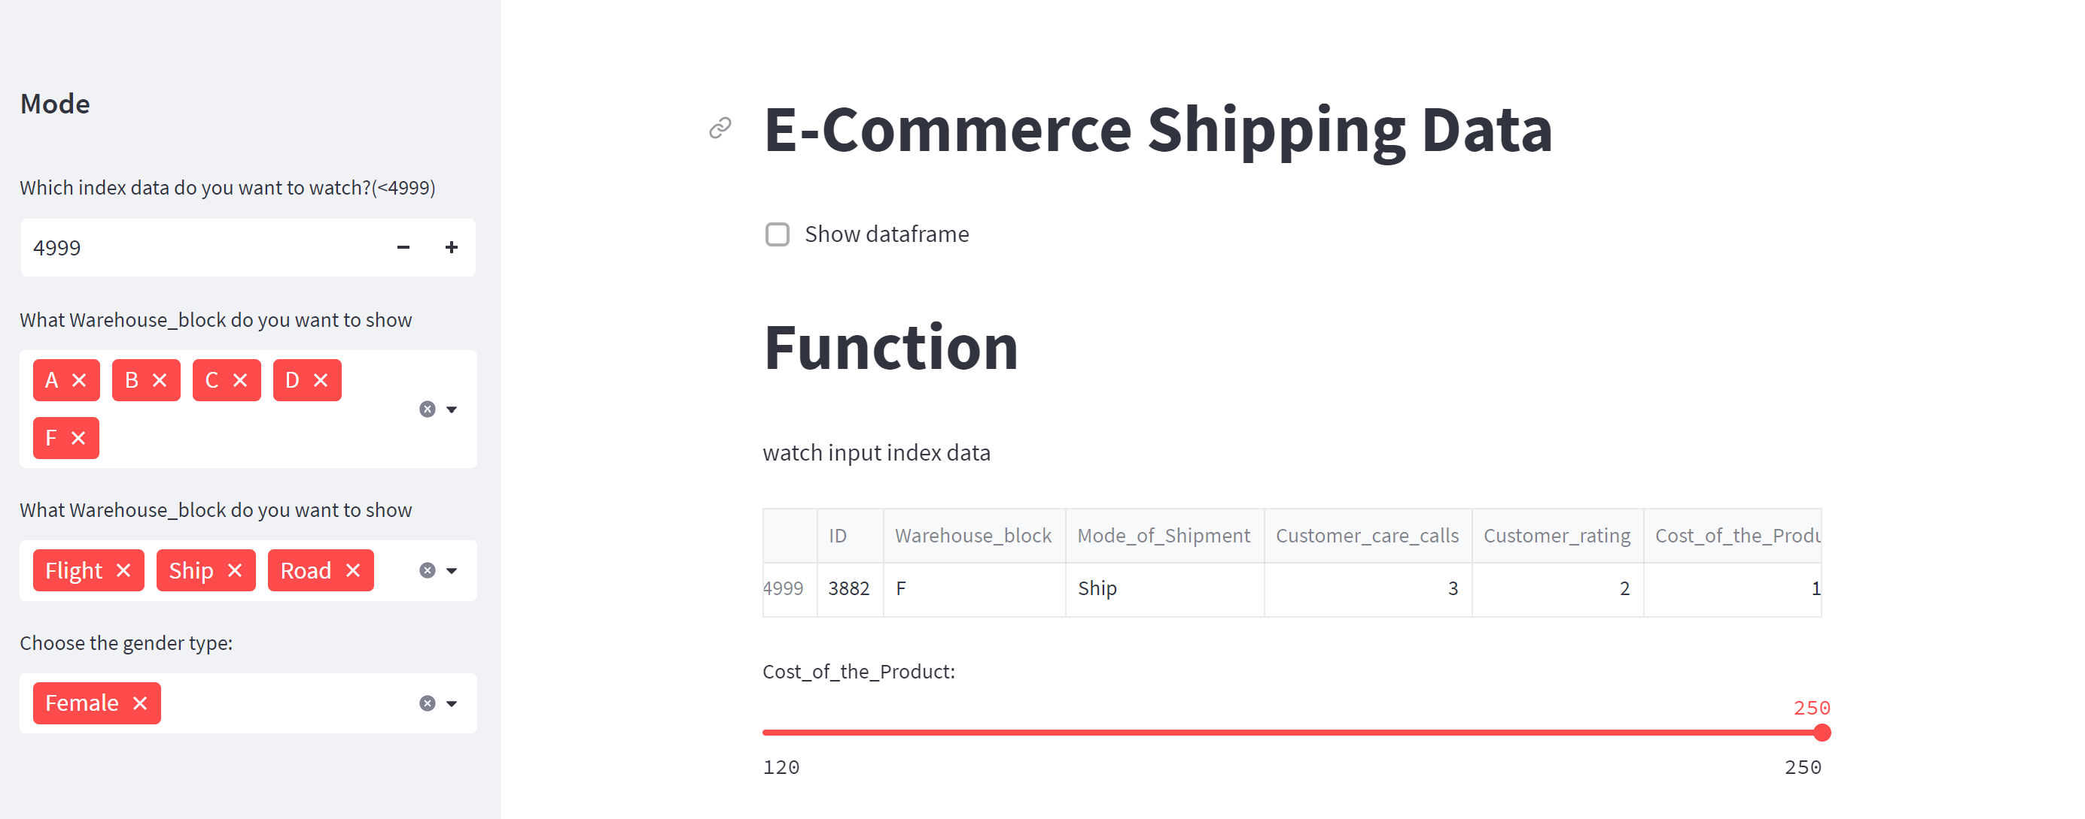
Design

Slide 6
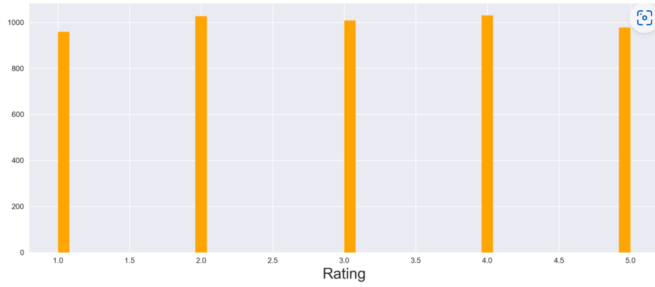
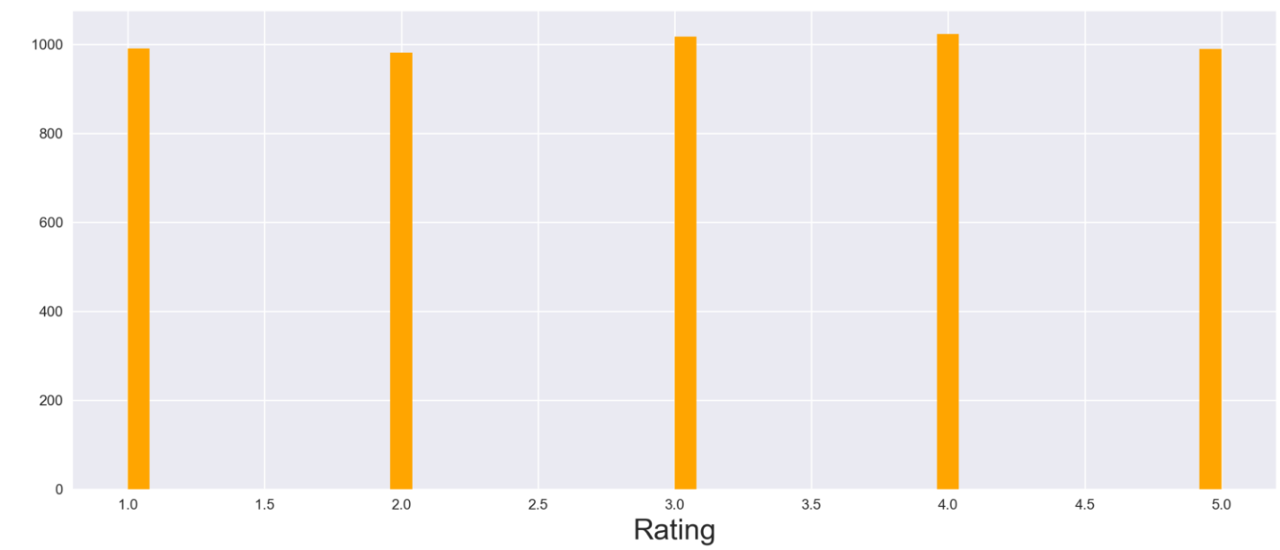
The relationship between customer rating and gender
Male
Male customers give less negative comments while Female customers give more positive comments
Female

Slide 7
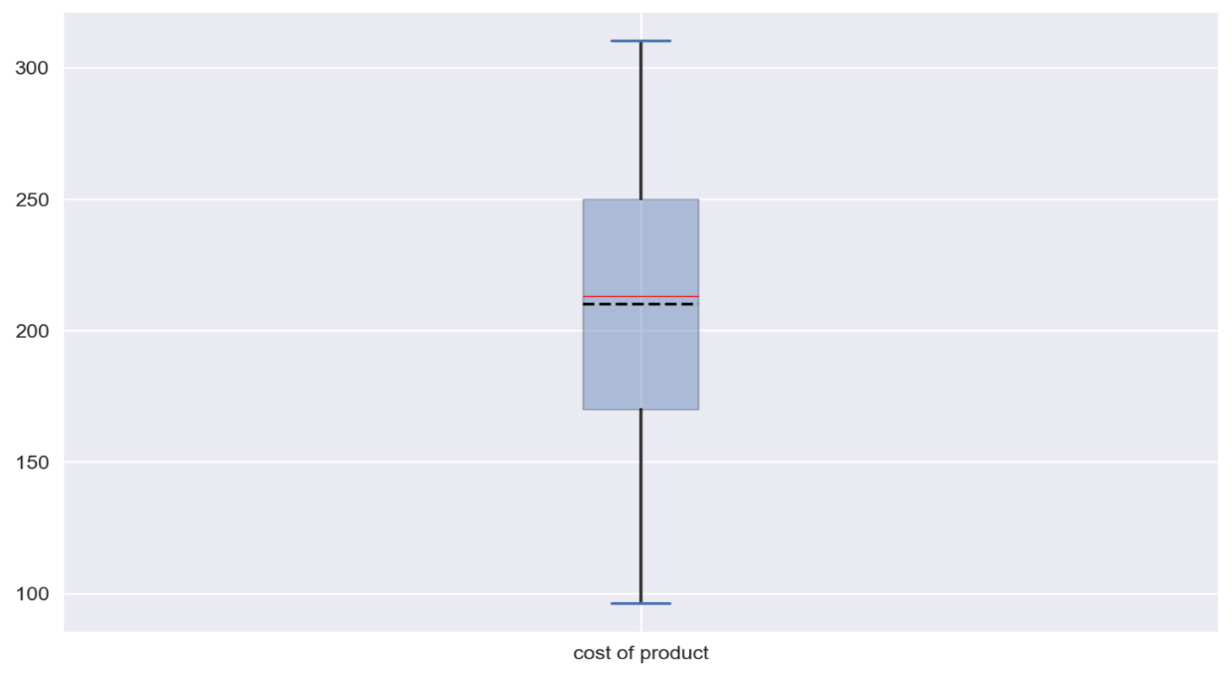

Whether the male or female purchase more on the products
Female
Male
Female spend more money on products
Male shows great difference when purchasing the electronic products
And company should pay more attention to female customer

Slide 8
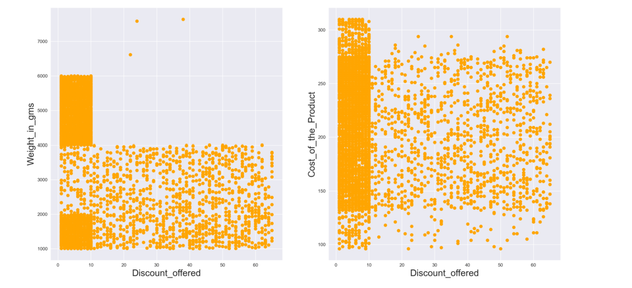
Discount offered with weight and product cost

Slide 9
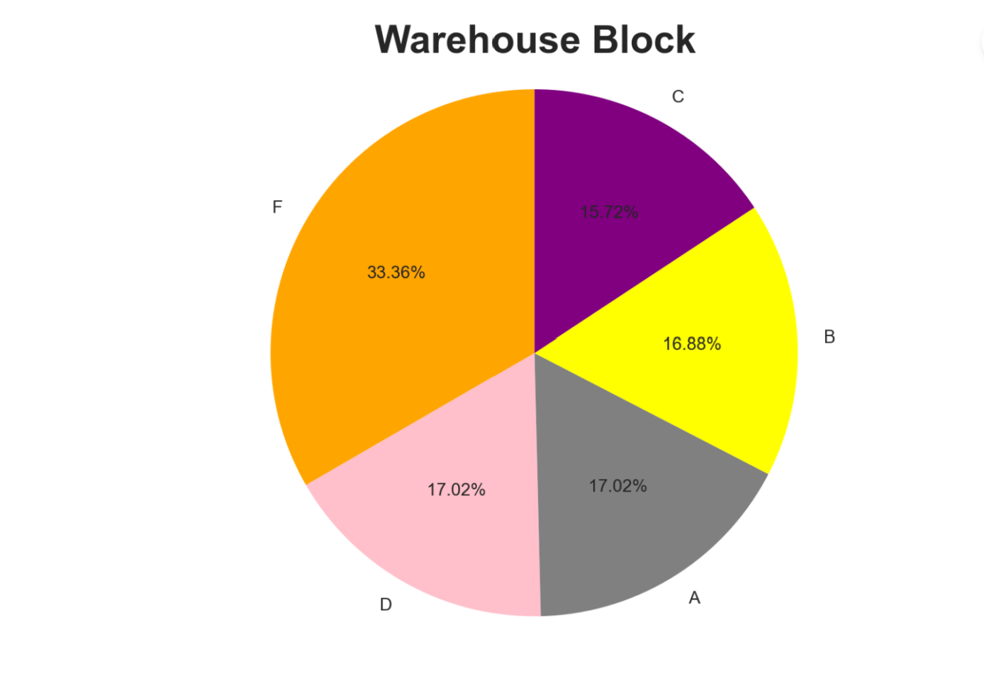

Warehouse block distribution
04

Slide 10
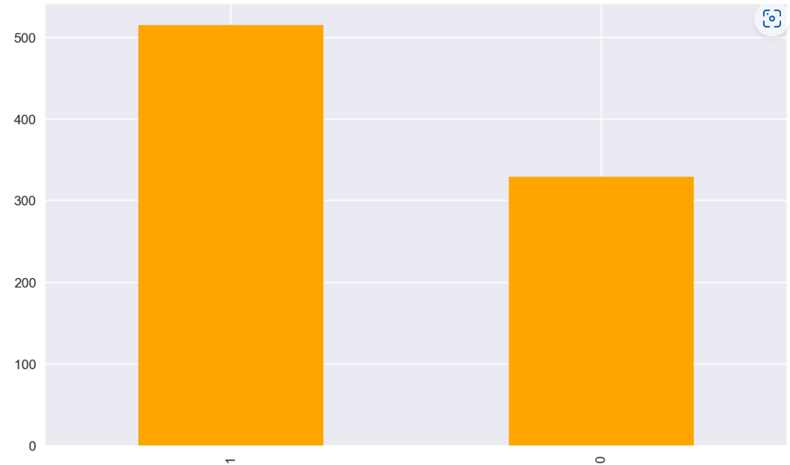
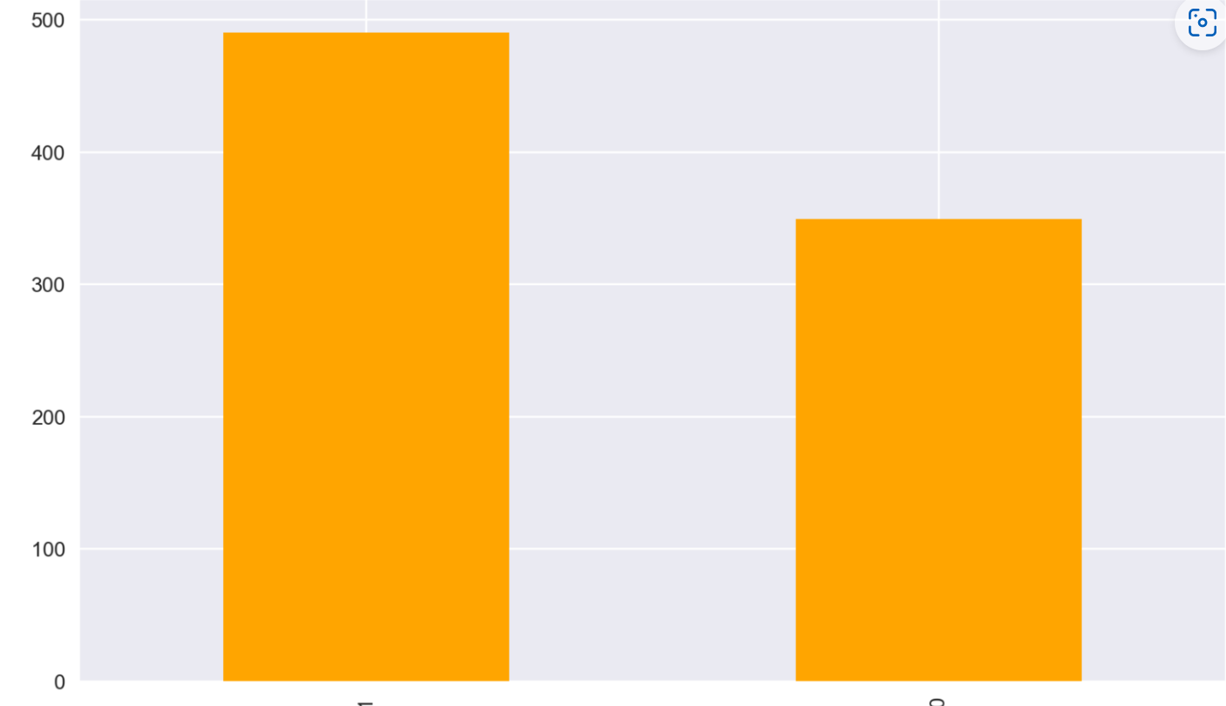
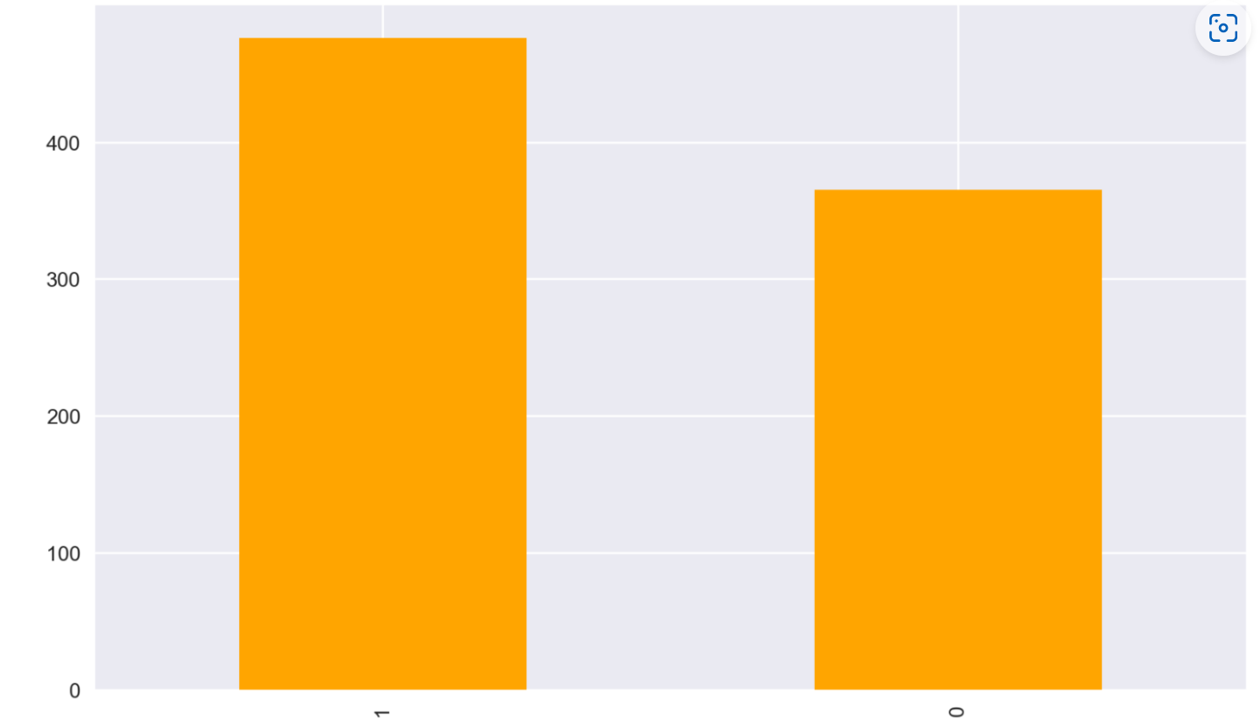
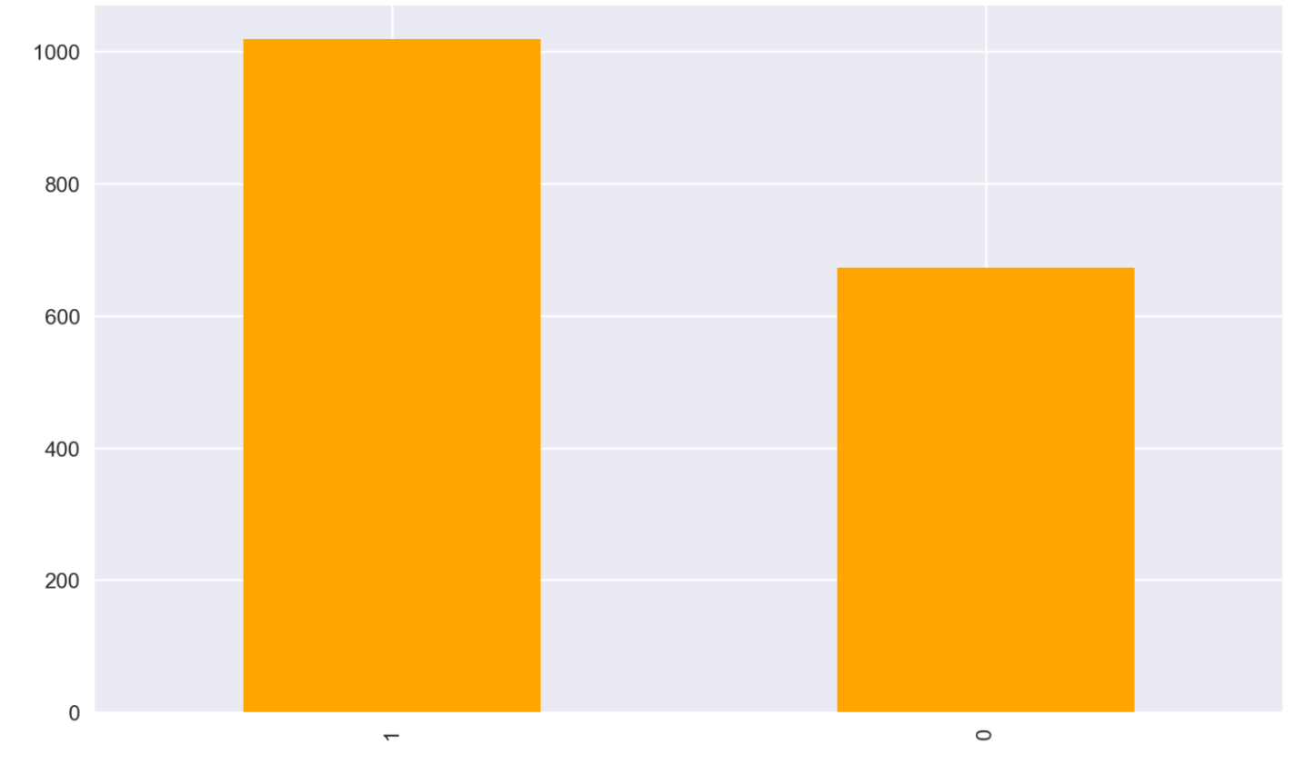
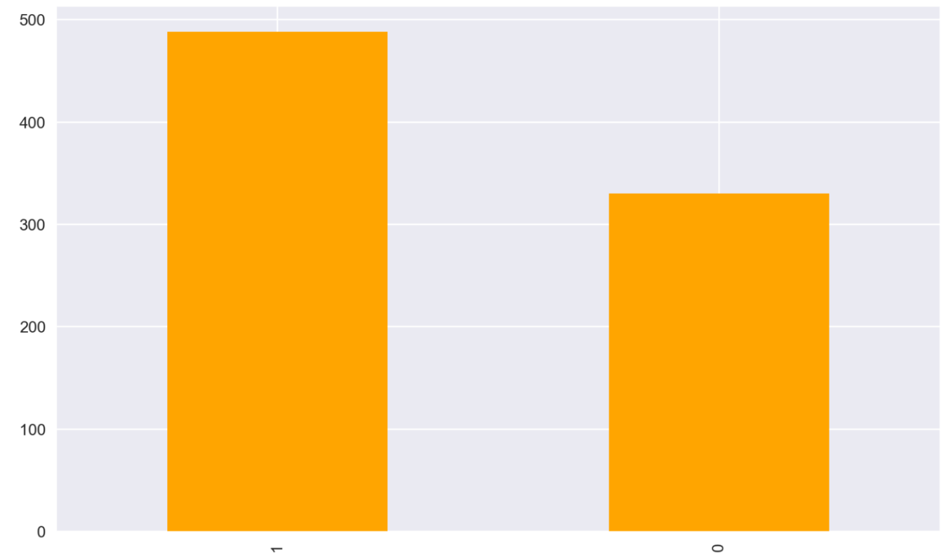
03
The impact of warehouse block on the product reach time
A
B
C
F
D
1 Indicates that the product has NOT reached on time and 0 indicates it has reached on time.

Slide 11
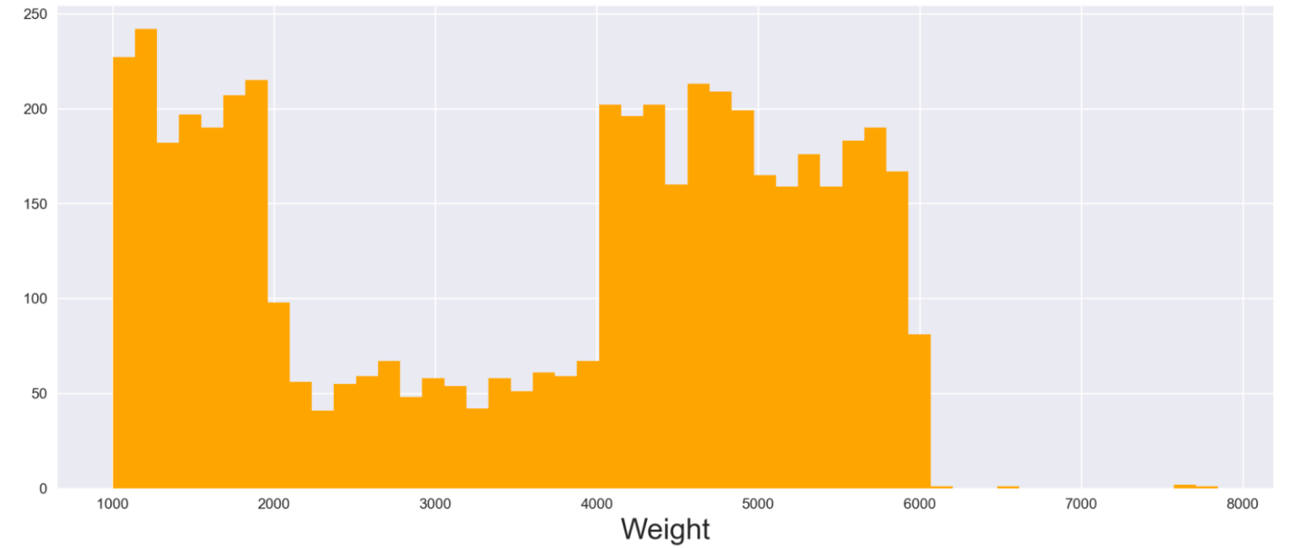
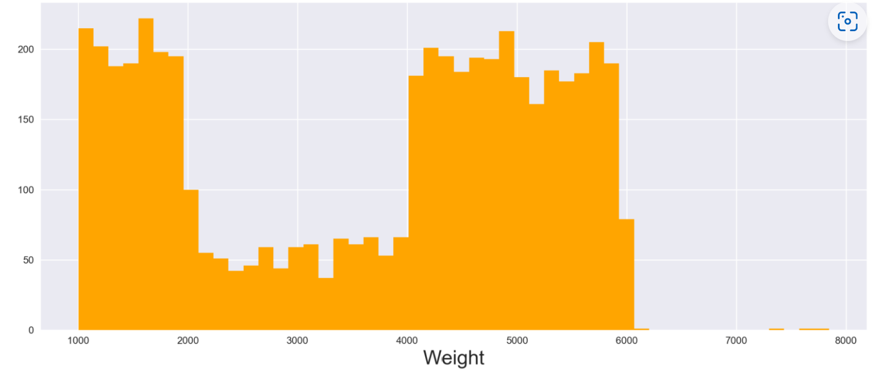
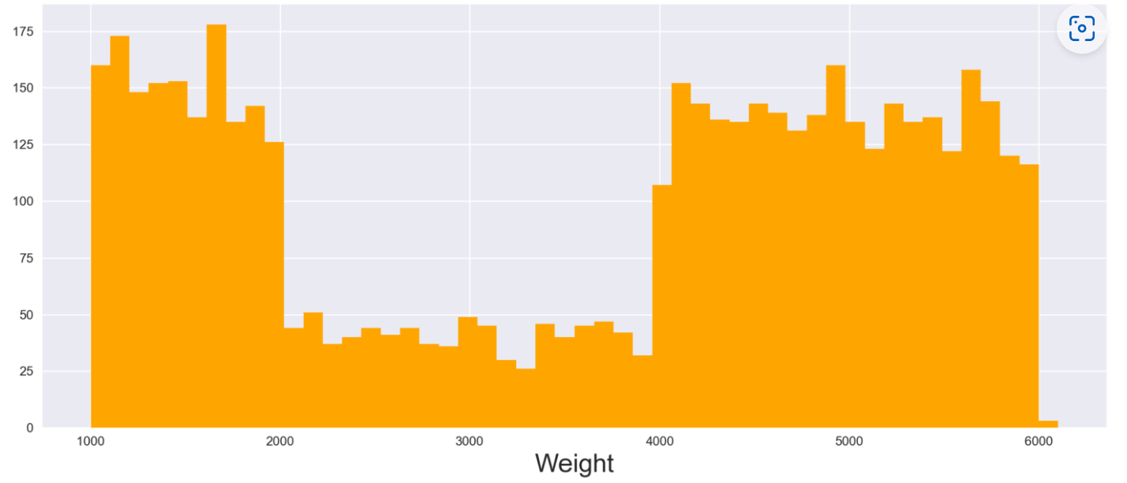
The relationship between shipment and the product weight
Road
Flight
Female
Ship

Slide 12
Thank you !

