Slide 1
Capstone Project
Choose a place to open a restaurant
in Hong Kong

Slide 2
Content Page
1 - Introduction: Business Problem
2 - Data
3 - Methodology
4 - Analysis
5 - Results and Discussion
6 - Conclusion

Slide 3
Business problem
The location is very important when you want to open a restaurant in Hong Kong. Traditionally people would look for traffic pattern information, demographic and lifestyle data online or by handing out survey. There are real-time data sources for traffic and demographic information.

Slide 4
2. Data
In the first part of the project, I draw data frames containing neighborhood names and their locations.
In the second part of the project, I use the Four Square API to explore more information. Foursquare is a technology company that built a massive dataset of location.

Slide 5
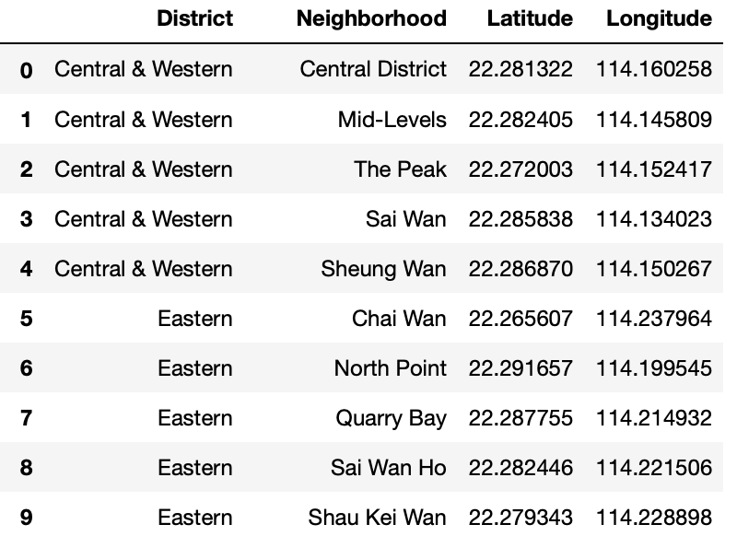
2. Data 2.2 Download and Explore Dataset

Slide 6
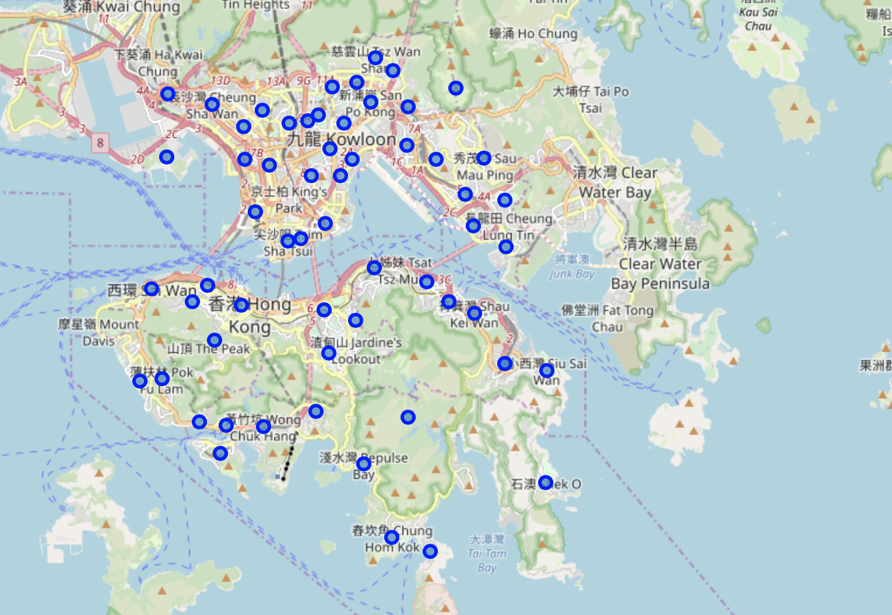

Slide 7
3. Methodology
The first step should be defined the business problem, we already have done that in Introduction
The second step should be downloaded the data and explore it, as we have done in Data
The Third step is to explore neighborhoods in Hong Kong with Foursquare API
The final step, cluster the all the neighborhoods with K-means & visualize geographic details of each cluster

Slide 8
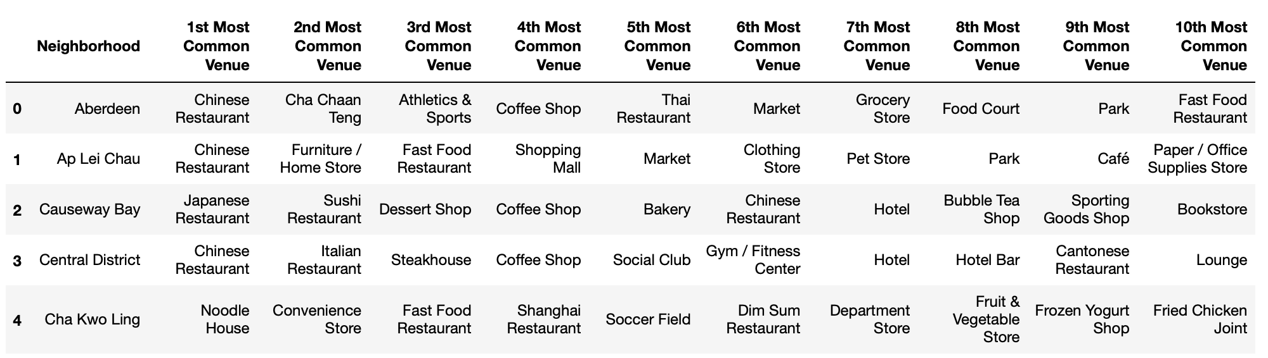
4. Analysis 4.1 Analyze Each Project
top 10 VENUES FOR EACH NEIGHBORHOOD

Slide 9
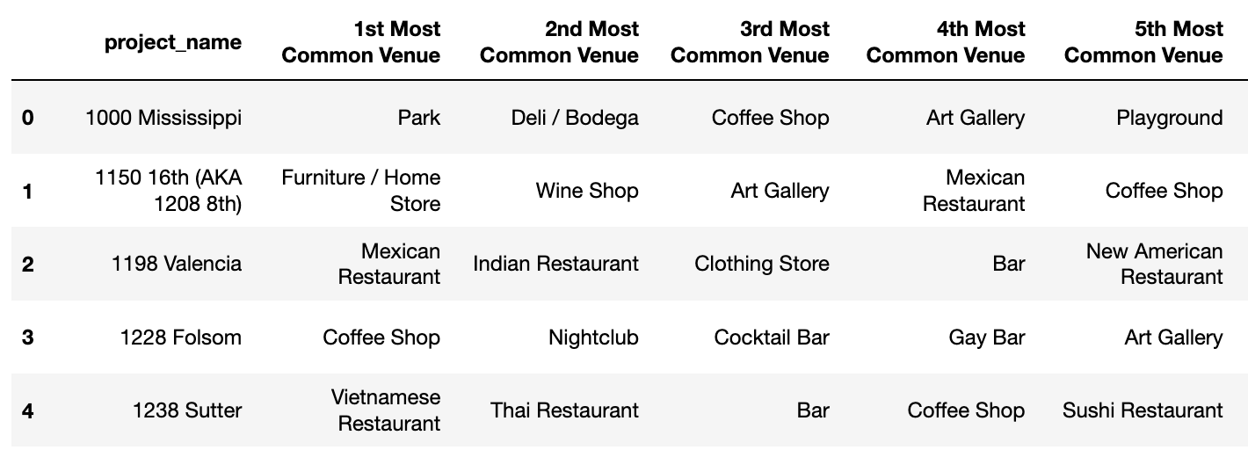
4. Analysis
Most common venues around each project

Slide 10
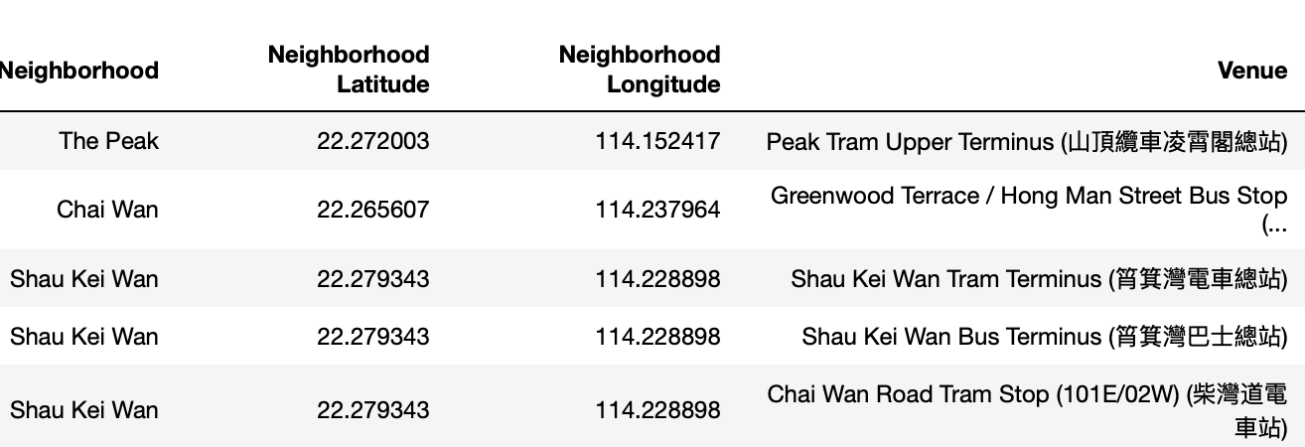
4. Analysis
APPEND TRAFFICE INFORMATION

Slide 11
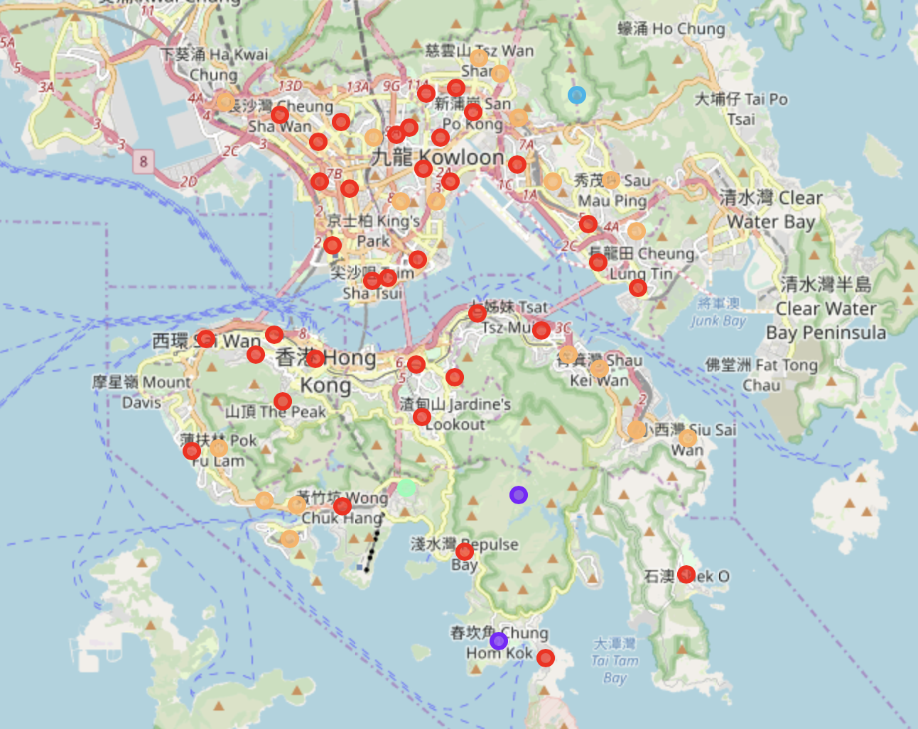
4. Analysis Cluster Projects

Slide 12
Conclusion
Look back to our vitualization map, we can exclude Cluster 3,4,5 from ur candidates since there are mountains and parks. After examining cluster 1 and cluster 2, I'd like to say cluster 1 represents residential area and cluster 2 represents commercial area. So if you want to open a restaurant, you should firstly choose the type of your restaurant and choose the corresponding location.

