Slide 1
SQL I
R & G - Chapter 5

Slide 2
What is a database?

Slide 3
What is a database?
“A structured set of data held in a computer, especially one that is accessible in various ways.”
- Google
“A usually large collection of data organized especially for rapid search and retrieval.”
- M&W
“A database is a searchable collection of information.”
- U. Victoria, Libraries
“A database is an organized collection of data. A DBMS is a computer-software application that interacts with end-users, other applications, and the database itself to capture and analyze data. ”
- Wikipedia

Slide 4
What is a relational database?
Codd, E. F. (1970). "A relational model of data for large shared data banks" CACM.

Slide 5

What is a relational database?
A database of named Relations (or tables)
ssn integer | first text | last text
123456789 | wei | jones
987654321 | apurva | lee
543219876 | sara | manning

Slide 6
Why relations (or tables)?

Slide 7
Why relations (or tables)?
Simple & Familiar
accounting, finance, insurance, scientific, …
Universal
many types of structured data can be represented as tables
logs, graphs, trees, objects, matrices, tensors, …
doesn’t matter HOW you store it
doesn’t matter WHAT you want to store
Notes:
Give you logical and physical independence.

Slide 8
SQL is the language for querying a database of relations (or tables). store, search, retrieve, and analyze

Slide 9
SQL: “Intergalactic Dataspeak”
Developed @IBM Research in the 1970s
System R project
Vs. Berkeley’s Quel language (Ingres project)
Commercialized/Popularized in the 1980s
IBM beaten to market by a startup called Oracle
Questioned repeatedly
90’s: Object-Oriented DBMS (OQL, etc.)
2000’s: XML (Xquery, Xpath, XSLT)
2010’s: NoSQL & MapReduce
SQL keeps re-emerging as the standard
Even Hadoop, Spark etc. mostly used via SQL
May not be perfect, but it is useful

Slide 10
SQL Pros and Cons
Declarative!
Say what you want, not how to get it
Implemented widely
With varying levels of efficiency, completeness
Constrained
Not targeted at Turing-complete tasks
General-purpose and feature-rich
many years of added features
extensible: callouts to other languages, data sources

Slide 11
Relational Terminology
Database: Set of named Relations
ssn integer | first text | last text
123456789 | wei | jones
987654321 | apurva | lee
543219876 | sara | manning

Slide 12
Relational Terminology
Database: Set of named Relations
Relation (Table):
Schema: description (“metadata”)
Instance: set of data satisfying the schema
Folks
ssn integer | first text | last text
123456789 | wei | jones
987654321 | apurva | lee
543219876 | sara | manning

Slide 13
Relational Terminology
Database: Set of named Relations
Relation (Table):
Schema: description (“metadata”)
Instance: set of data satisfying the schema
Attribute (Column, Field)
first text
wei
apurva
sara

Slide 14
Relational Terminology
Database: Set of named Relations
Relation (Table):
Schema: description (“metadata”)
Instance: set of data satisfying the schema
Attribute (Column, Field)
Tuple (Record, Row)
543219876 | sara | manning

Slide 15
Relational Tables
Schema is fixed¹:
unique attribute names, atomic types
folks (ssn integer, first text, last text)
Instance can change often
a multiset of “rows” (“tuples”)
{(123456789, ’wei’, ’jones’), (987654321, ’apurva’, ’lee’), (543219876, ‘sara’, ‘manning’), (987654321, ’apurva’, ’lee’)}
¹more or less

Slide 16
Quick Check 1
Why is this not a relation? saddress(num integer, street text, zip integer) {(84, ‘Maple Ave’, 54704), (22, ‘High’, ‘Street’, 76425), (75, 'Hearst Ave’, 94720)}
A | B | C | D | E
Schema Error | First Tuple Invalid | Second Tuple Invalid | Third Tuple Invalid | Other

Slide 17
Quick Check 1
Why is this not a relation?
saddress
num integer | street text | zip integer
84 | Maple Ave | 54704
22 | High | Street
75 | Hearst Ave | 94720
76425

Slide 18
Quick Check 2
Why is this not a relation?
baddress
num integer | street text | num text
84 | Maple Ave | 54704
22 | High Street | 76425
75 | Hearst Ave | 94720
A | B | C | D | E
Schema Error | First Tuple Invalid | Second Tuple Invalid | Third Tuple Invalid | Other

Slide 19
Quick Check 3
Why is this not a relation? maddress(first text, last text, addr address) {(‘wei’, ‘jones’, (84, ‘Maple’, 54704)), (‘apurva’, ‘lee’, (22, ‘High’, 76425)), (‘sara, ‘manning’, (75, ‘Hearst’, 94720))}
A | B | C | D | E
Schema Error | First Tuple Invalid | Second Tuple Invalid | Third Tuple Invalid | Other

Slide 20
SQL Language
Two sublanguages:
DDL – Data Definition Language
Define and modify schema
DML – Data Manipulation Language
Queries can be written intuitively.
RDBMS responsible for efficient evaluation.
Choose and run algorithms for declarative queries
Choice of algorithm must not affect query answer.

Slide 21
Example Database
Users
Channels
uid | uname | followers | age
1 | Anurag | 2224 | 22
2 | Ryan | 12 | 39
3 | Rolando | 2 | 27
cid | cname | bkcolor
101 | homeworks | red
102 | midterms | magenta
103 | lectures | red
Posts
uid | cid | time
1 | 101 | 2018-01-16 09:00:00
2 | 101 | 2018-01-17 09:02:00

Slide 22
The SQL DDL
CREATE TABLE Users (
uid INTEGER,
uname CHAR(20),
followers INTEGER,
age FLOAT
uid | uname | followers | age
1 | Anurag | 2224 | 22
2 | Ryan | 12 | 39
3 | Rolando | 2 | 27

Slide 23
The SQL DDL
CREATE TABLE Users (
uid INTEGER,
uname CHAR(20),
followers INTEGER,
age FLOAT,
PRIMARY KEY (uid));
uid | uname | followers | age
1 | Anurag | 2224 | 22
2 | Ryan | 12 | 39
3 | Rolando | 2 | 27

Slide 24
The SQL DDL
uid | uname | followers | age
1 | Anurag | 2224 | 22
2 | Ryan | 12 | 39
3 | Rolando | 2 | 27
CREATE TABLE Users (
uid INTEGER,
uname CHAR(20),
followers INTEGER,
age FLOAT,
PRIMARY KEY (uid));
Primary Key column(s)
Provides a unique “lookup key” for the relation
Cannot have any duplicate values
Can be made up of >1 column
E.g. (firstname, lastname)

Slide 25
The SQL DDL
CREATE TABLE Users (
uid INTEGER,
uname CHAR(20),
followers INTEGER,
age FLOAT,
PRIMARY KEY (uid));
CREATE TABLE Channels (
cid INTEGER,
cname CHAR (20),
bkcolor CHAR(10),
PRIMARY KEY (cid));
uid | uname | followers | age
1 | Anurag | 2224 | 22
2 | Ryan | 12 | 39
3 | Rolando | 2 | 27
cid | cname | bkcolor
101 | homeworks | red
102 | midterms | magenta
103 | lectures | red

Slide 26
The SQL DDL
CREATE TABLE Users (
uid INTEGER,
uname CHAR(20),
followers INTEGER,
age FLOAT,
PRIMARY KEY (uid));
CREATE TABLE Channels (
cid INTEGER,
cname CHAR (20),
bkcolor CHAR(10),
PRIMARY KEY (cid));
CREATE TABLE Posts (
uid INTEGER,
cid INTEGER,
time TIMESTAMP,
PRIMARY KEY (uid, cid, time)
uid | uname | followers | age
1 | Anurag | 2224 | 22
2 | Ryan | 12 | 39
3 | Rolando | 2 | 27
cid | cname | bkcolor
101 | homeworks | red
102 | midterms | magenta
103 | lectures | red
uid | cid | time
1 | 102 | 2018-01-16 09:00:00
2 | 102 | 2018-01-17 09:02:00

Slide 27
The SQL DDL
CREATE TABLE Users (
uid INTEGER,
uname CHAR(20),
followers INTEGER,
age FLOAT,
PRIMARY KEY (uid));
CREATE TABLE Channels (
cid INTEGER,
cname CHAR (20),
bkcolor CHAR(10),
PRIMARY KEY (cid));
CREATE TABLE Posts (
uid INTEGER,
cid INTEGER,
time TIMESTAMP,
PRIMARY KEY (uid, cid, time),
FOREIGN KEY (uid) REFERENCES Users
uid | uname | followers | age
1 | Anurag | 2224 | 22
2 | Ryan | 12 | 39
3 | Rolando | 2 | 27
cid | cname | bkcolor
101 | homeworks | red
102 | midterms | magenta
103 | lectures | red
uid | cid | time
1 | 102 | 2018-01-16 09:00:00
2 | 102 | 2018-01-17 09:02:00

Slide 28
The SQL DDL
CREATE TABLE Users (
uid INTEGER,
uname CHAR(20),
followers INTEGER,
age FLOAT,
PRIMARY KEY (uid));
CREATE TABLE Channels (
cid INTEGER,
cname CHAR (20),
bkcolor CHAR(10),
PRIMARY KEY (cid));
CREATE TABLE Posts (
uid INTEGER,
cid INTEGER,
time TIMESTAMP,
PRIMARY KEY (uid, cid, time),
FOREIGN KEY (uid) REFERENCES Users
FOREIGN KEY (cid) REFERENCES Channels);
uid | uname | followers | age
1 | Anurag | 2224 | 22
2 | Ryan | 12 | 39
3 | Rolando | 2 | 27
cid | cname | bkcolor
101 | homeworks | red
102 | midterms | magenta
103 | lectures | red
uid | cid | time
1 | 102 | 2018-01-16 09:00:00
2 | 102 | 2018-01-17 09:02:00

Slide 29
The SQL DDL
CREATE TABLE Users (
uid INTEGER,
uname CHAR(20),
followers INTEGER,
age FLOAT,
PRIMARY KEY (uid));
CREATE TABLE Boats (
bid INTEGER,
bname CHAR (20),
color CHAR(10),
PRIMARY KEY (bid));
CREATE TABLE Posts (
uid INTEGER,
cid INTEGER,
time TIMESTAMP,
PRIMARY KEY (uid, cid, time),
FOREIGN KEY (uid) REFERENCES Users
FOREIGN KEY (cid) REFERENCES Channels);
uid | uname | followers | age
1 | Anurag | 2224 | 22
2 | Ryan | 12 | 39
3 | Rolando | 2 | 27
Foreign key references a table
Via the primary key of that table
Need not share the name of the referenced primary key
cid | cname | bkcolor
101 | homeworks | red
102 | midterms | magenta
103 | lectures | red
uid | cid | time
1 | 102 | 2018-01-16 09:00:00
2 | 102 | 2018-01-17 09:02:00

Slide 30
Administrivia
Website: http://cs186berkeley.net
Email: cs186.spring.18@gmail.com
HW0 (setup) is simple (available soon)
Will be due Wednesday at 2
Section will be held next week
Help getting set up for homework

Slide 31
Enrollment
Still evolving, but expect ~450.
Some students will drop
Drop soon if you can!
CS186 staff are not involved in enrollment
Please don’t ask us if we can help

Slide 32
The SQL DML
Users
uid | uname | followers | age
1 | Anurag | 2224 | 22
2 | Ryan | 12 | 39
3 | Rolando | 2 | 27
Find all 27-year-old users:
SELECT *
FROM Users AS U
WHERE U.age=27;
To find just names and followers, replace the first line:
SELECT U.uname, U.followers

Slide 33
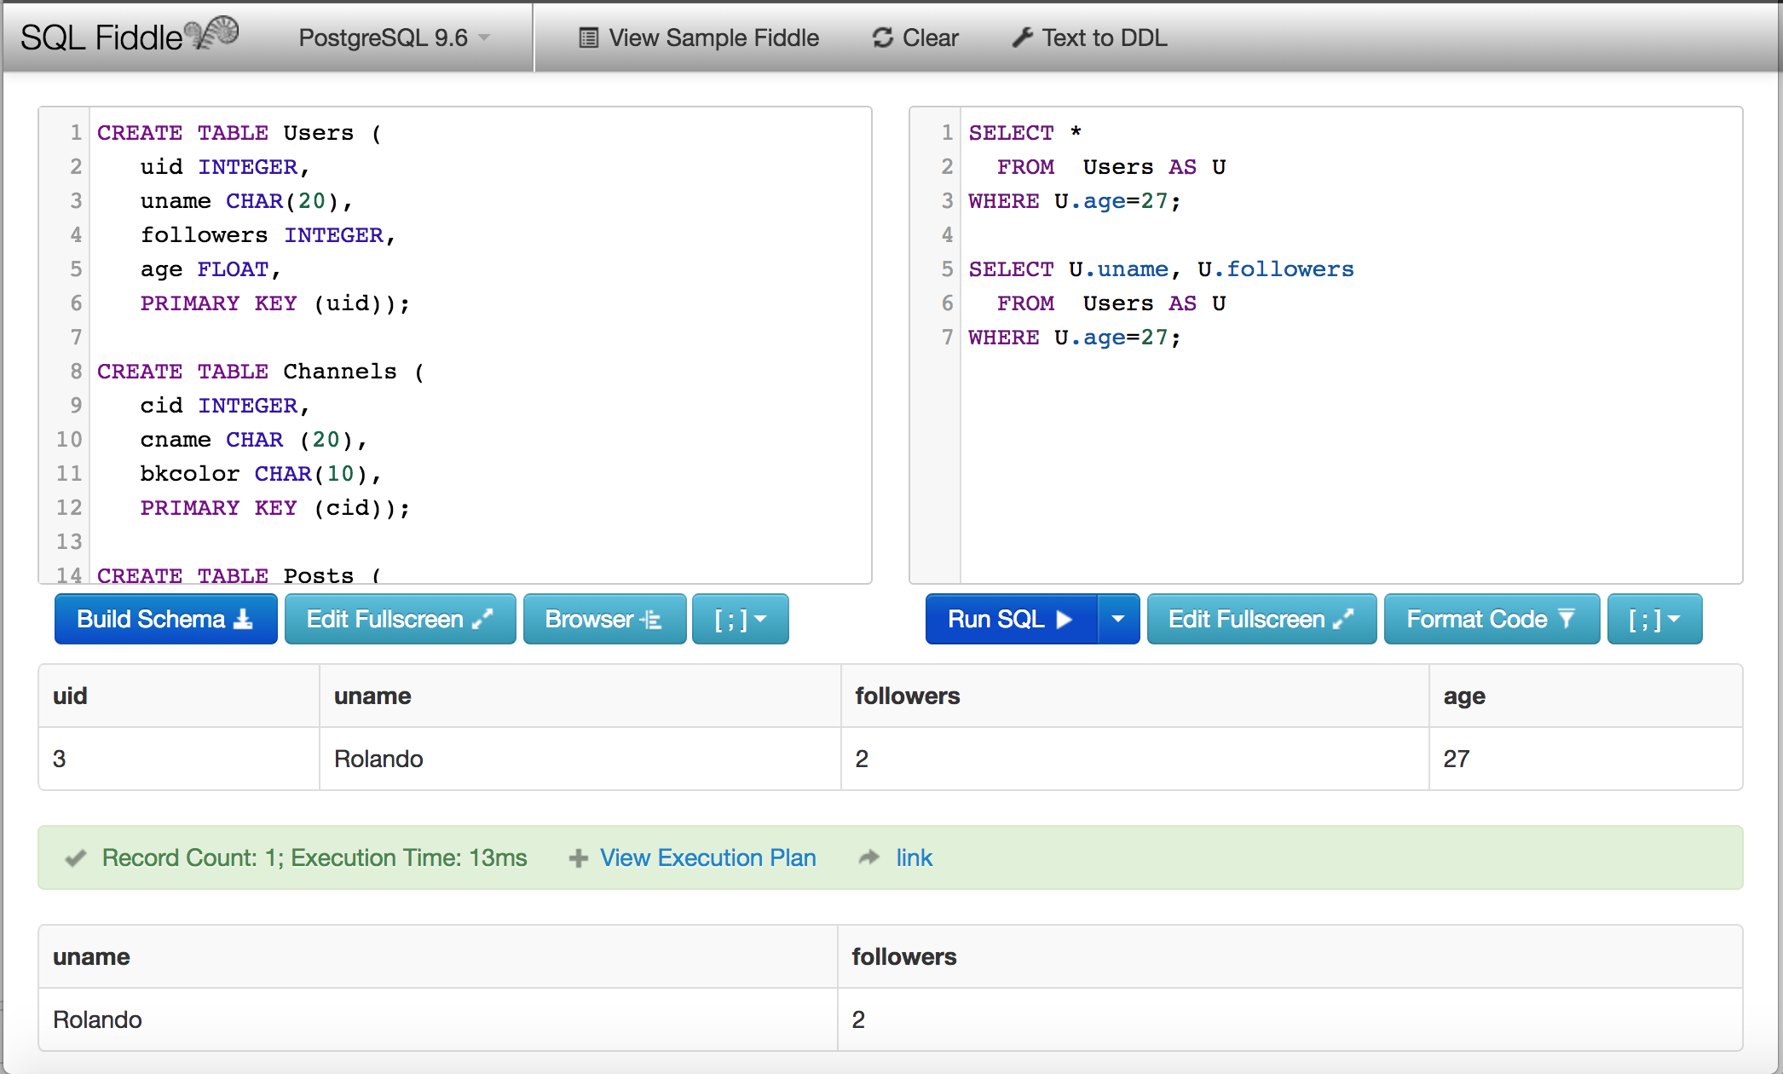
Check it out!
http://sqlfiddle.com/#!17/d1478/3
Click “Build Schema” on left
Click “Run SQL” on right
Notes:
CREATE TABLE Sailors (
sid INTEGER,
sname CHAR(20),
rating INTEGER,
age REAL,
PRIMARY KEY (sid));
CREATE TABLE Boats (
bid INTEGER,
bname CHAR (20),
color CHAR(10),
PRIMARY KEY (bid));
CREATE TABLE Reserves (
sid INTEGER,
bid INTEGER,
day DATE,
PRIMARY KEY (sid, bid, day),
FOREIGN KEY (sid) REFERENCES Sailors,
FOREIGN KEY (bid) REFERENCES Boats);
INSERT INTO Sailors VALUES
(1, 'Fred', 7, 22),
(2, 'Jim', 2, 39),
(3, 'Nancy', 8, 27);
INSERT INTO Boats VALUES
(101, 'Nina', 'red'),
(102, 'Pinta', 'blue'),
(103, 'Santa Maria', 'red');
INSERT INTO Reserves VALUES
(1, 102, '9/12/2017'),
(2, 102, '9/13/2017');

Slide 34
SQL DML 1: Basic Single-Table Queries
SELECT [DISTINCT] <column expression list> FROM <single table> [WHERE <predicate>] [GROUP BY <column list> [HAVING <predicate>] ] [ORDER BY <column list>] [LIMIT <integer>];

Slide 35
Basic Single-Table Queries
SELECT [DISTINCT] <column expression list> FROM <single table> [WHERE <predicate>] [GROUP BY <column list> [HAVING <predicate>] ] [ORDER BY <column list>] [LIMIT <integer>] ;
Simplest version is straightforward
Produce all tuples in the table that satisfy the predicate
Output the expressions in the SELECT list
Expression can be a column reference, or an arithmetic expression over column refs

Slide 36
Some DDL to set us up
insert into students values
('Sergey Brin', 4.0, 40, 'CS', 'M'),
('Danah Boyd', 4.0, 35, 'CS', 'F'),
('Bill Gates', 1.0, 60, 'CS', 'M'),
('Hillary Mason', 4.0, 35, 'DATASCI', 'F'),
('Mike Olson', 4.0, 50, 'CS', 'M'),
('Mark Zuckerberg', 4.0, 30, 'CS', 'M'),
('Cheryl Sandberg', 4.0, 47, 'BUSINESS', 'F'),
('Susan Wojcicki', 4.0, 46, 'BUSINESS', 'F'),
('Marissa Meyer', 4.0, 45, 'BUSINESS', 'F');

Slide 37
Basic Single-Table Queries
SELECT S.sname, S.gpa FROM students S WHERE S.dept = 'CS' [GROUP BY <column list> [HAVING <predicate>] ] [ORDER BY <column list>] [LIMIT <integer>] ;
Simplest version is straightforward
Produce all tuples in the table that satisfy the predicate
Output the expressions in the SELECT list
Expression can be a column reference, or an arithmetic expression over column refs
Notes:
insert into students values
('Sergey Brin', 4.0, 40, 'CS', 'M'),
('Danah Boyd', 4.0, 35, 'CS', 'F'),
('Bill Gates', 1.0, 60, 'CS', 'M'),
('Hillary Mason', 4.0, 35, 'DATASCI', 'F'),
('Mike Olson', 4.0, 50, 'CS', 'M'),
('Mark Zuckerberg', 4.0, 30, 'CS', 'M'),
('Cheryl Sandberg', 4.0, 47, 'BUSINESS', 'F'),
('Susan Wojcicki', 4.0, 46, 'BUSINESS', 'F'),
('Marissa Meyer', 4.0, 45, 'BUSINESS', 'F');

Slide 38
Basic Single-Table Queries
SELECT S.sname, S.gpa FROM students S WHERE S.dept = 'CS' [GROUP BY <column list> [HAVING <predicate>] ] [ORDER BY <column list>] [LIMIT <integer>] ;
http://sqlfiddle.com/#!17/67109/1
Try changing the WHERE clause, e.g. ‘WHERE S.gpa < 4.0’
Try changing the SELECT clause, e.g. ‘SELECT S.sname, S.gender‘
Try changing the capitalization of various things
Notes:
insert into students values
('Sergey Brin', 4.0, 40, 'CS', 'M'),
('Danah Boyd', 4.0, 35, 'CS', 'F'),
('Bill Gates', 1.0, 60, 'CS', 'M'),
('Hillary Mason', 4.0, 35, 'DATASCI', 'F'),
('Mike Olson', 4.0, 50, 'CS', 'M'),
('Mark Zuckerberg', 4.0, 30, 'CS', 'M'),
('Cheryl Sandberg', 4.0, 47, 'BUSINESS', 'F'),
('Susan Wojcicki', 4.0, 46, 'BUSINESS', 'F'),
('Marissa Meyer', 4.0, 45, 'BUSINESS', 'F');

Slide 39
SELECT DISTINCT
SELECT DISTINCT S.name, S.gpa FROM students S WHERE S.dept = 'CS' [GROUP BY <column list> [HAVING <predicate>] ] [ORDER BY <column list>] [LIMIT <integer>] ;
DISTINCT specifies removal of duplicate rows before output
http://sqlfiddle.com/#!17/40517/1
http://sqlfiddle.com/#!17/40517/2

Slide 40
ORDER BY
SELECT S.name, S.gpa, S.age*2 AS a2 FROM Students S WHERE S.dept = 'CS' [GROUP BY <column list> [HAVING <predicate>] ] ORDER BY S.gpa, S.name, a2 [LIMIT <integer>] ;
ORDER BY clause specifies output to be sorted
Lexicographic ordering
Obviously must refer to columns in the output
Note the AS clause for naming output columns!
http://sqlfiddle.com/#!17/2c5c9/1

Slide 41
ORDER BY
SELECT S.name, S.gpa, S.age*2 AS a2 FROM Students S WHERE S.dept = 'CS' [GROUP BY <column list> [HAVING <predicate>] ] ORDER BY S.gpa DESC, S.name ASC, a2 [LIMIT <integer>] ;
Ascending order by default, but can be overriden
DESC flag for descending, ASC for ascending
Can mix and match, lexicographically
http://sqlfiddle.com/#!17/347b7/1

Slide 42
LIMIT
SELECT S.name, S.gpa, S.age*2 AS a2 FROM Students S WHERE S.dept = 'CS' [GROUP BY <column list> [HAVING <predicate>] ] ORDER BY S.gpa DESC, S.name ASC, a2 LIMIT 3 ;
Only produces the first <integer> output rows
Typically used with ORDER BY
Otherwise the output is non-deterministic
Not a “pure” declarative construct in that case – output set depends on algorithm for query processing
http://sqlfiddle.com/#!17/347b7/1

Slide 43
Aggregates
SELECT [DISTINCT] AVG(S.gpa) FROM Students S WHERE S.dept = 'CS' [GROUP BY <column list> [HAVING <predicate>] ] [ORDER BY <column list>] ;
Before producing output, compute a summary (a.k.a. an aggregate) of some arithmetic expression
Produces 1 row of output
with one column in this case
Other aggregates: SUM, COUNT, MAX, MIN
http://sqlfiddle.com/#!17/67109/5

Slide 44
DISTINCT Aggregates
SELECT COUNT(DISTINCT S.name) FROM Students S WHERE S.dept = 'CS';
SELECT DISTINCT COUNT(S.name) FROM Students S WHERE S.dept = 'CS';
http://sqlfiddle.com/#!17/347b7/3
A | B | C | D | E
SAME | DIFFERENT | -- | -- | --

Slide 45
GROUP BY
SELECT [DISTINCT] AVG(S.gpa), S.dept FROM Students S [WHERE <predicate>] GROUP BY S.dept [HAVING <predicate>] [ORDER BY <column list>] ;
Partition table into groups with same GROUP BY column values
Can group by a list of columns
Produce an aggregate result per group
Cardinality of output = # of distinct group values
Note: can put grouping columns in SELECT list
http://sqlfiddle.com/#!17/67109/7
Notes:
http://sqlfiddle.com/#!17/67109/8

Slide 46
What Is This Asking For?
SELECT S.name, AVG(S.gpa) FROM Students S GROUP BY S.dept;
http://sqlfiddle.com/#!17/67109/8
A | B | C | D | E
Name of student with average GPA per dept | All names per department with the AVG gpa | Illegal Query | -- | --
Notes:
http://sqlfiddle.com/#!17/67109/8

Slide 47
HAVING
SELECT [DISTINCT] AVG(S.gpa), S.dept FROM Students S [WHERE <predicate>] GROUP BY S.dept HAVING COUNT(*) > 2 [ORDER BY <column list>] ;
The HAVING predicate filters groups
HAVING is applied after grouping and aggregation
Hence can contain anything that could go in the SELECT list
I.e. aggs or GROUP BY columns
HAVING can only be used in aggregate queries
It’s an optional clause
http://sqlfiddle.com/#!17/67109/10

Slide 48
Putting it all together
SELECT S.dept, AVG(S.gpa), COUNT(*) FROM Students S WHERE S.gender = 'F' GROUP BY S.dept HAVING COUNT(*) >= 2 ORDER BY S.dept;
http://sqlfiddle.com/#!17/67109/12

Slide 49
Summary
Relational model has well-defined query semantics
Modern SQL extends “pure” relational model
(some extra goodies for duplicate row, non-atomic types… more in next lecture)
Typically, many ways to write a query
DBMS figures out a fast way to execute a query, regardless of how it is written.

Slide 50
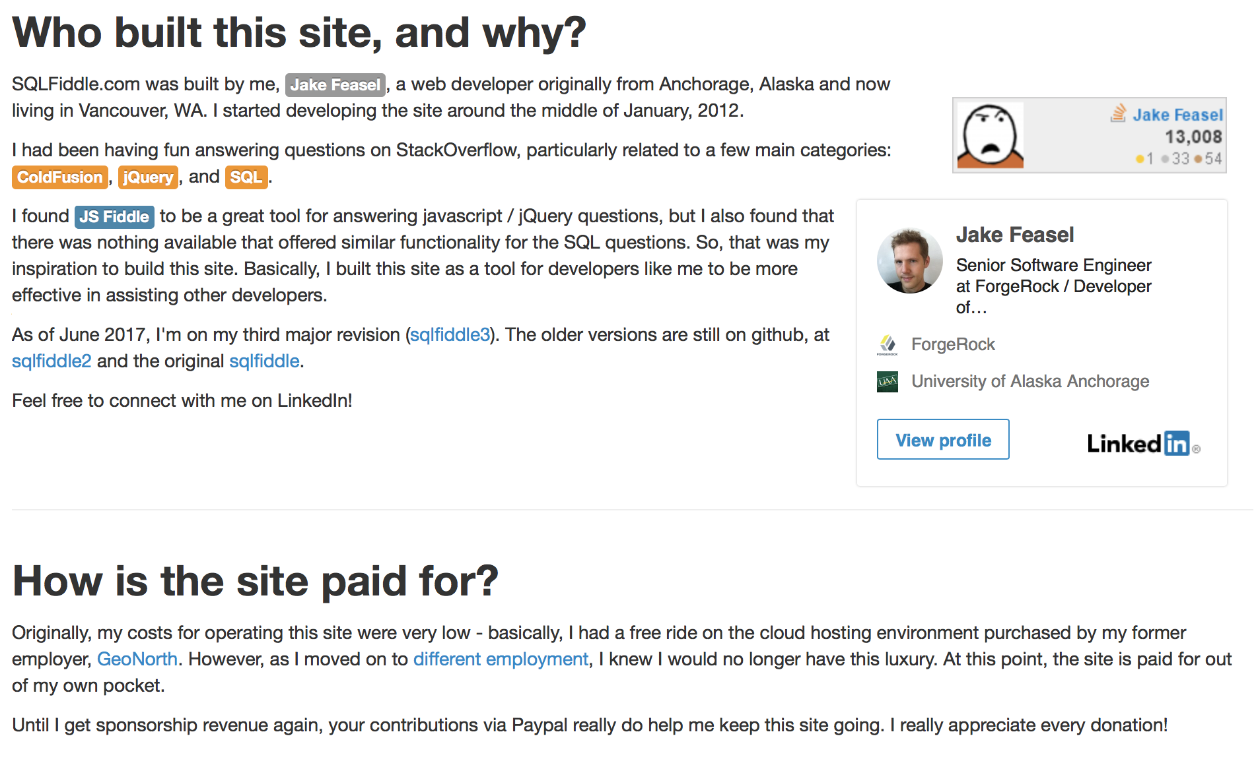
Support SQLFiddle

