Slide 1

Angular Triplet-Center Loss for Multi-view 3D Shape Retrieval
Zhaoqun Li, Cheng Xu, Biao Leng
Beihang University

Slide 2
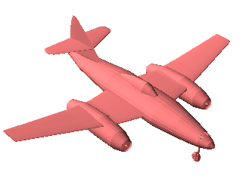
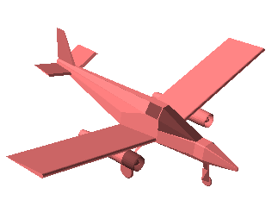
Metric learning for 3D shape retrieval
Methodology:
Enlarge inter-class distance
Reduce intra-class distance
pull
push

Slide 3
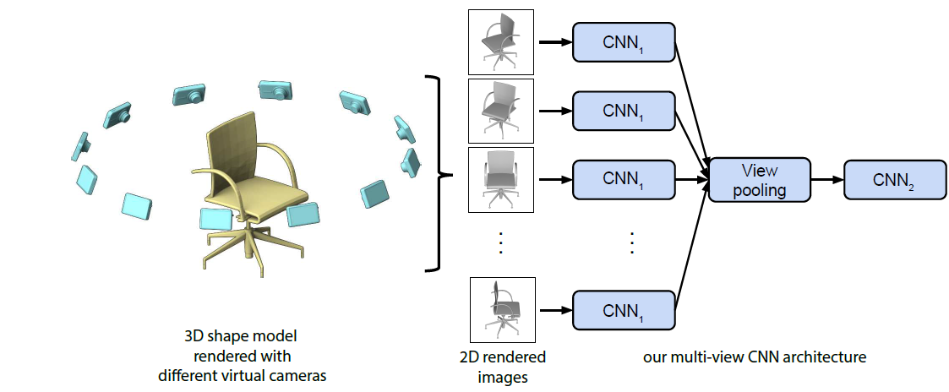
State-of-art method
Adopt softmax loss as supervision signal
e.g. MVCNN
Metric loss use Euclidean distance and margin
e.g. Triplet-Center Loss (TCL)
MVCNN (Su et al. 2015)

Slide 4
State-of-art method
Adopt softmax loss as supervision signal
e.g. MVCNN
Metric loss use Euclidean distance and margin
e.g. Triplet-Center Loss (TCL)
anchor
TCL (He et al. 2018)

Slide 5
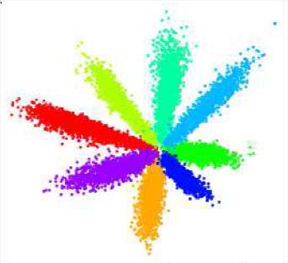
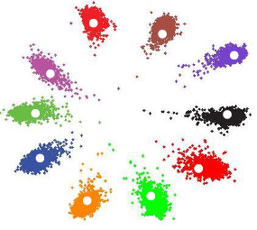
Metric learning for 3D shape retrieval
Challenges:
The discriminative power of model feature is not enough under softmax loss
Most metric loss function use Euclidean distance in the loss design, which is not desirable for retrieval task
softmax loss
center loss (Wen et al. 2016)

Slide 6

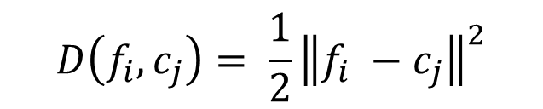
Motivation
Cosine distance is adopted in the evaluation
Angular margin has a more clear interpretation than Euclidean margin
$$D\left(f_{i},c_{j}\right)= \frac{1}{2}{\left\|f_{i} −c_{j}\right\|}^{2}$$
$$D\left(f_{i},c_{j}\right)= <f_{i},c_{j}>$$
Directly optimize angular distance

Slide 7


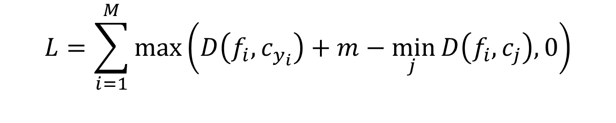




Angular Triplet-Center Loss (ATCL)
intra-class distance
inter-class distance
$$L=\sum_{i=1}^{M}{max\left(D\left(f_{i},c_{y_{i}}\right)+m−\min_{j }{D\left(f_{i},c_{j}\right), 0}\right)}$$
$$=\sum_{i=1}^{M}{max\left(α_{i}+m−β_{i}, 0\right)}$$
$$α_{i}: positive angle$$
$y_{i}$: label of sample $i$
$$M: batch size$$
$$β_{i}: negative angle$$
$$m: angular margin$$

Slide 8
Angular Triplet-Center Loss
Based on MVCNN
positive feature
positive center
negative feature
negative center
anchor
Max Pooling
α
β
Fully-connected
CNN
Angular Triplet-Center loss
MVCNN Framework

Slide 9
Angular Triplet-Center Loss
The effect of different loss functions on the feature distribution
Euclidean margin
positive feature
positive center
Angular margin
negative feature
negative center
anchor
(a) softmax loss
(b) center loss + softmax loss
(c) triplet-center loss
(d) angular triplet-center loss

Slide 10
Result: ModelNet40
Methods | ModelNet40 |  | ModelNet10
 | AUC | MAP | AUC | MAP
DeepPano | 77.63% | 76.81% | 85.45% | 84.18%
MVCNN | - | 78.90% | - | -
GIFT | 83.10% | 81.94% | 92.35% | 91.12%
GVCNN | - | 85.70% | - | -
ATCL | 86.52% | 85.35% | 91.19% | 90.60%
ATCL + softmax loss | 87.23% | 86.11% | 92.49% | 92.07%

Slide 11
Result: ShapeNetCore 55
SHREC2016 large-scale 3D shape retrieval track
Perturbed dataset
Methods | Micro |  |  | Macro |  |  | Micro+Macro
 | F-measure | MAP | NCDG | F-measure | MAP | NCDG | F-measure | MAP | NCDG
Tatsuma | 0.413 | 0.638 | 0.838 | 0.166 | 0.493 | 0.743 | 0.290 | 0.566 | 0.791
Wang | 0.246 | 0.600 | 0.776 | 0.163 | 0.478 | 0.695 | 0.205 | 0.539 | 0.736
Li et al. | 0.534 | 0.749 | 0.865 | 0.182 | 0.579 | 0.767 | 0.358 | 0.664 | 0.816
MVCNN | 0.612 | 0.734 | 0.843 | 0.416 | 0.662 | 0.793 | 0.514 | 0.698 | 0.818
GIFT | 0.661 | 0.811 | 0.889 | 0.423 | 0.730 | 0.843 | 0.542 | 0.770 | 0.866
our | 0.665 | 0.843 | 0.885 | 0.404 | 0.777 | 0.851 | 0.535 | 0.810 | 0.868

Slide 12
Result: ModelNet40
Comparison with other loss functions
Methods | AUC | MAP
Softmax loss | 79.67% | 78.28%
Softmax loss + Center loss | 82.24% | 80.95%
Triplet loss | 80.12% | 78.90%
TCL (VGG_M) | 85.59% | 84.35%
ATCL | 86.52% | 85.35%
ATCL + Softmax loss | 87.23% | 86.11%

Slide 13
Result: ModelNet40
Comparison with other loss functions
center loss
softmax loss
ATCL
TCL
cos(β)
cos(α)

Slide 14

Discussion
Influence of angular margin on retrieval performance
AUC
MAP
$$m$$

Slide 15
Conclusion
Angular margin provides more explicit discriminative constraints on the shape embedding than Euclidean margin
Under the supervision of ATCL, the features in different classes have large cosine/angular distance while that in the same class have small cosine/angular distance

Slide 16
Thank you

