Slide 1
Internet connection Test

Slide 2
Table of contents
Required Changes
Additional Changes

Slide 3
Testing the internet connection
Change from requests (GET) to PING
  requests handles HTTP/HTTPS
  PING uses Internet Control Message Protocol (ICMP)
Considerations for PING
  Protocol agnostic
  Measures round-trip time
Notes:
Requests is more suitable to check for availability of a specific application or service

Slide 4
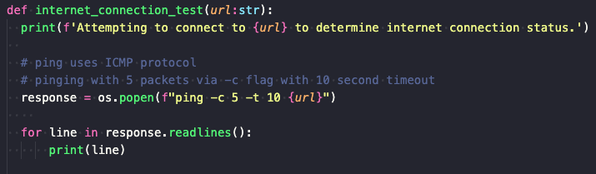
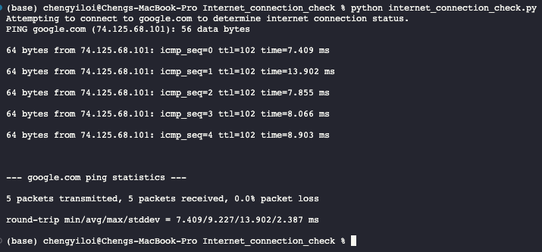
Testing the internet connection (Cont’D)
Notes:
Requests is more suitable to check for availability of a specific application or service

Slide 5
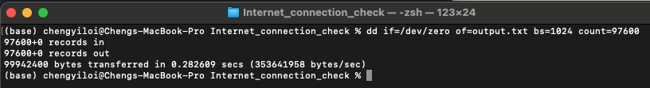
Check the internet download speed
Using built in packages (requests and time)
Notes:
GitHub has a file size limit of 100 MB
Google Drive has a virus scanning limit of 100 MB
Speedtest-cli package ~ https://pypi.org/project/speedtest-cli/
Python API GitHub Wiki ~ https://github.com/sivel/speedtest-cli/wiki

Slide 6
Additional changes
Code smells

