Slide 1
Deep Learning Lab Segmentation of ISPRS Vaihingen dataset including DSM data
Yu-Chuan Cheng, 20.Sep.2022
yu-chuan.cheng@tu-braunschweig.de

Slide 2
Outline
Outline
Introduction
Dataset
Experiment Setup
Evaluation and Result
Summary

Slide 3
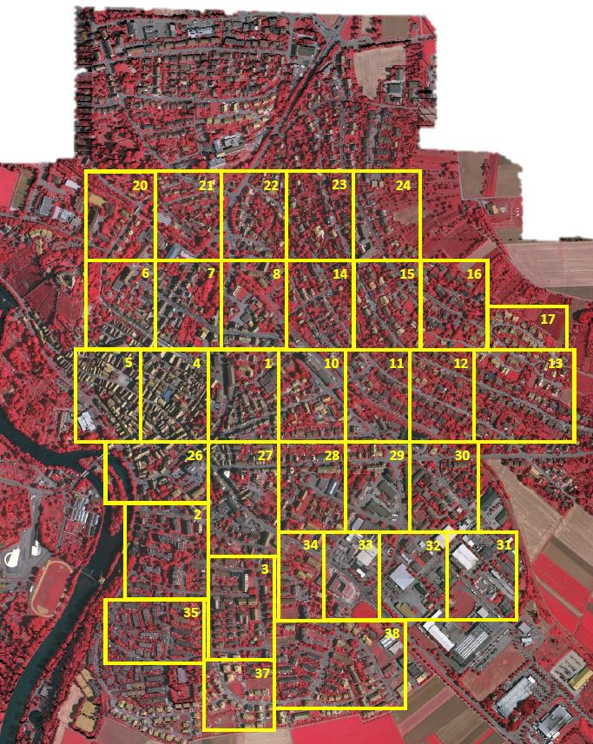
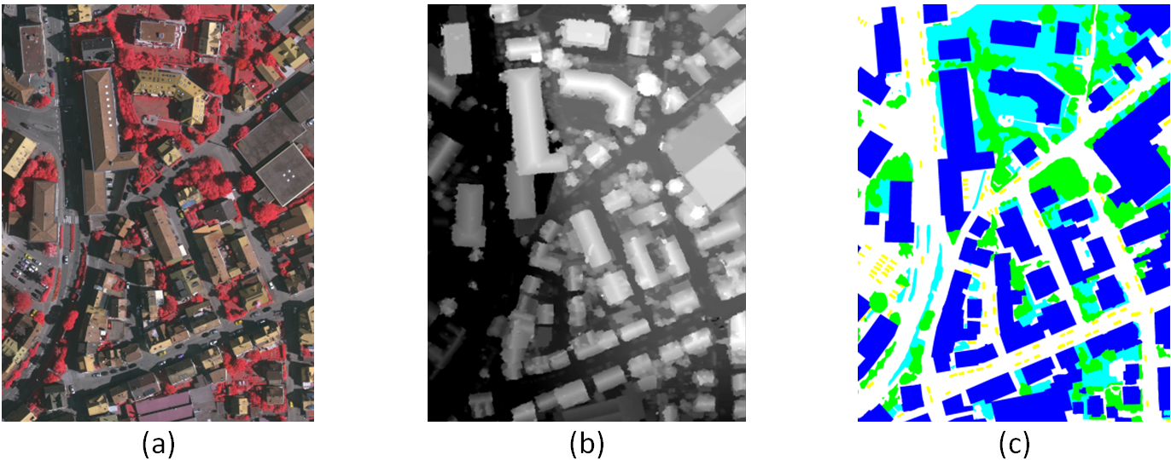
Dataset
128 Training datasets, 38 Validation datasets, 190 Testing datasets
Image size: (2767, 2428, 3)
Patch size: 256
(a) True orthophoto (b) DSM (c) ground truth
Source: 2D Semantic Label. - Vaihingen (isprs.org)

Slide 4
Experiment Setup Model
U-net
Downsampling
Upsampling
Concatenation
DeepLab3+
Atrous Convolution
Atrous Spatial Pyramid Pooling (ASPP)
Decoder

Slide 5
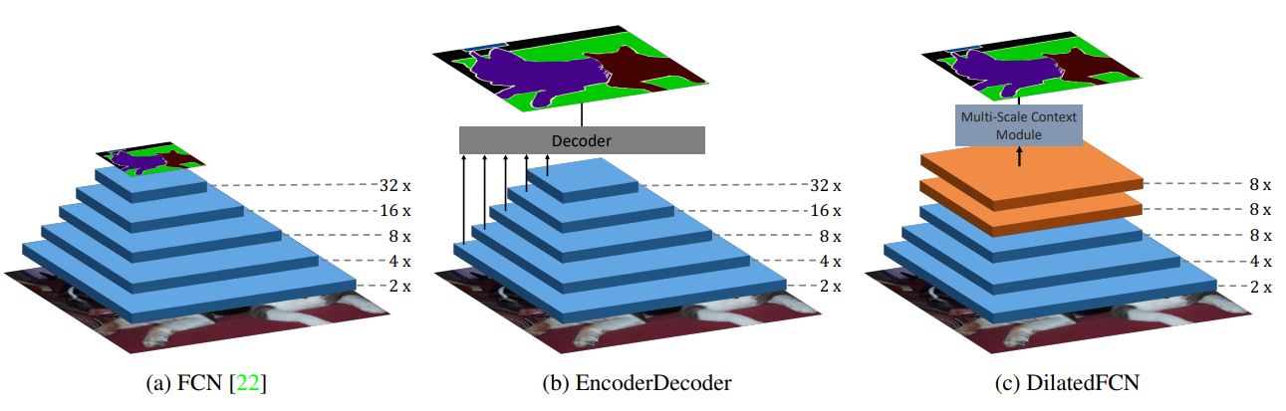
Experiment Setup Model
Original Fully Convolutional networks: lose position information
Encoder-Decoder(U-net): lose position information, but better than FCN
DilatedFCN(DeepLab3+): trade off computing power with strong samentic segmentation
Different types of networks for semantic segmentation.
Huikai Wu, Junge Zhang, Kaiqi Huang (2019). FastFCN: Rethinking Dilated Convolution in the Backbone for Semantic Segmentation

Slide 6
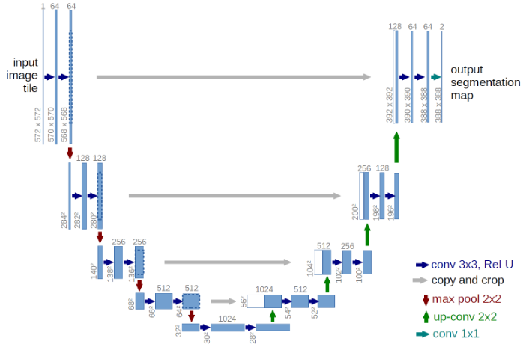
Experiment Setup Model-Unet
Concatenation
Downsampling
Upsampling
U-net structure
Ronneberger, O., Fischer, P., & Brox, T. (2015, October). U-net: Convolutional networks for biomedical image segmentation. In International Conference on Medical image computing and computer-assisted intervention (pp. 234-241). Springer, Cham.

Slide 7
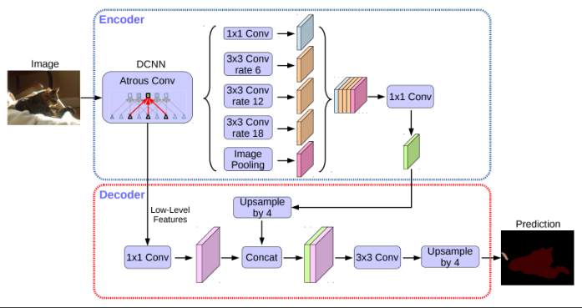
Experiment Setup Model-Deeplab3+
Be mroe Robust
improve resolution
improve results along object boundaries
Chen, L. C., Zhu, Y., Papandreou, G., Schroff, F., & Adam, H. (2018). Encoder-decoder with atrous separable convolution for semantic image segmentation. In Proceedings of the European conference on computer vision (ECCV) (pp. 801-818)..

Slide 8
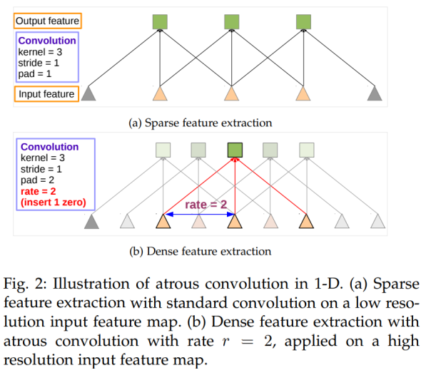
Experiment Setup Model-Deeplab3+-DCNN
Improve feature resolution
Chen, L. C., Papandreou, G., Kokkinos, I., Murphy, K., & Yuille, A. L. (2017). Deeplab: Semantic image segmentation with deep convolutional nets, atrous convolution, and fully connected crfs. IEEE transactions on pattern analysis and machine intelligence, 40(4), 834-848.

Slide 9
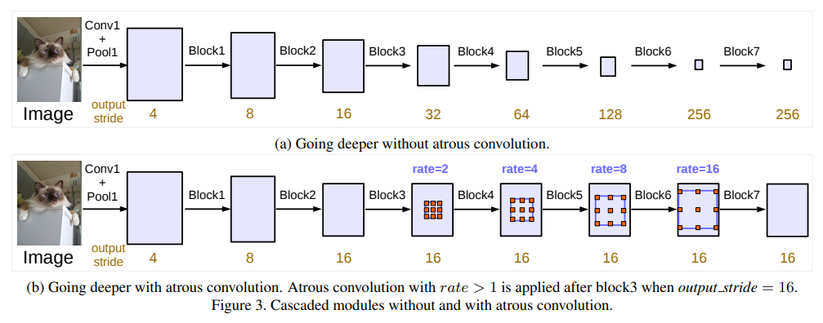
Experiment Setup Model- Deeplab3+-Atrous Convolution
Improve feature resolution
Chen, L. C., Papandreou, G., Schroff, F., & Adam, H. (2017). Rethinking atrous convolution for semantic image segmentation.

Slide 10
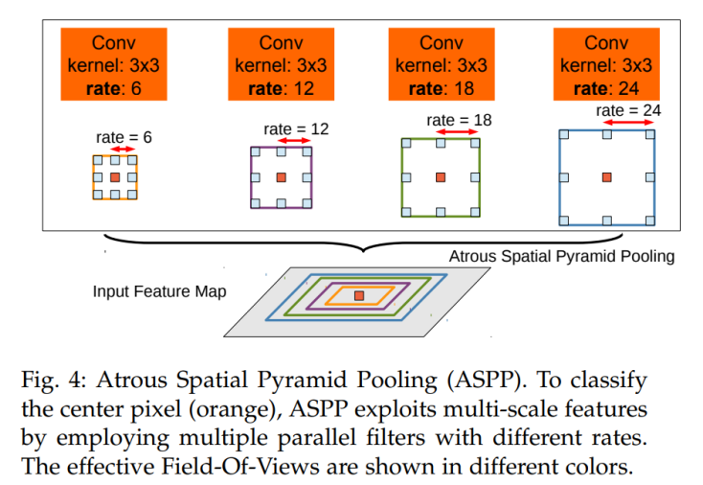
Experiment Setup Model- Deeplab3+-Atrous Spatial Pyramid Pooling (ASPP)
Robust against objects at multiple scales
Chen, L. C., Papandreou, G., Kokkinos, I., Murphy, K., & Yuille, A. L. (2017). Deeplab: Semantic image segmentation with deep convolutional nets, atrous convolution, and fully connected crfs. IEEE transactions on pattern analysis and machine intelligence, 40(4), 834-848.

Slide 11
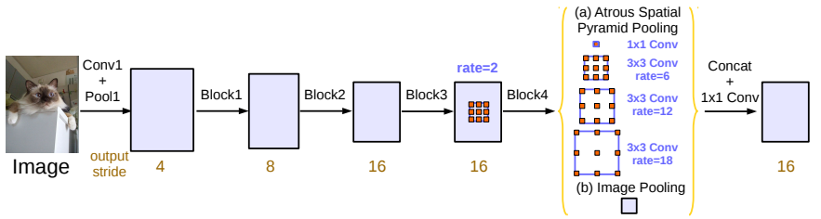
Experiment Setup Model-Deeplab3+-Atrous Spatial Pyramid Pooling (ASPP)
Chen, L. C., Papandreou, G., Kokkinos, I., Murphy, K., & Yuille, A. L. (2017). Deeplab: Semantic image segmentation with deep convolutional nets, atrous convolution, and fully connected crfs. IEEE transactions on pattern analysis and machine intelligence, 40(4), 834-848.

Slide 12
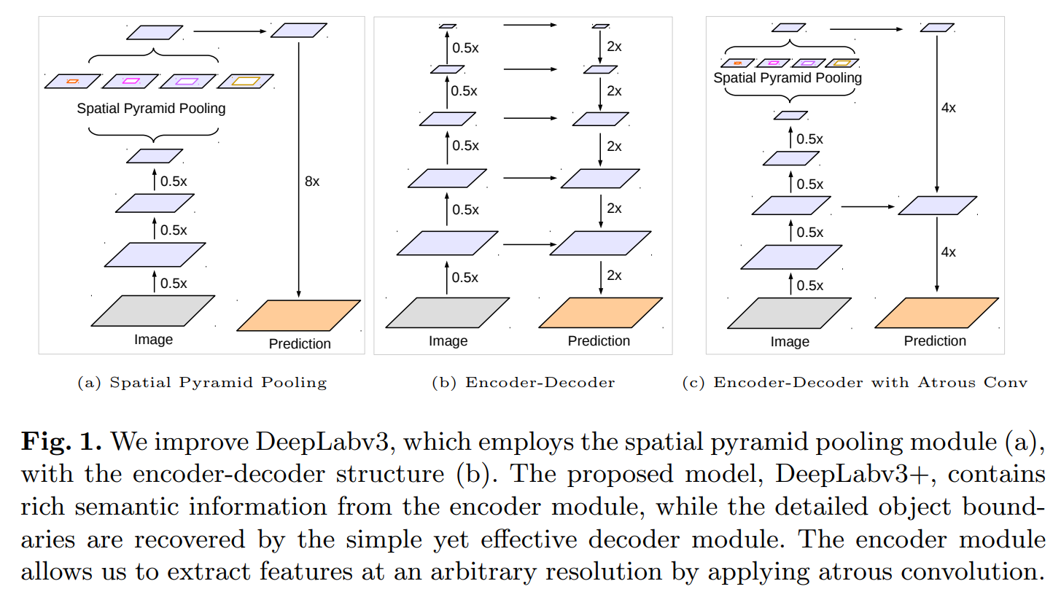
Experiment Setup Model- Deeplab3+- Encoder & Decoder
Encoder-Decoder to improve results along object boundaries
Chen, L. C., Zhu, Y., Papandreou, G., Schroff, F., & Adam, H. (2018). Encoder-decoder with atrous separable convolution for semantic image segmentation. In Proceedings of the European conference on computer vision (ECCV) (pp. 801-818)..

Slide 13
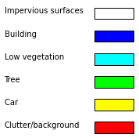
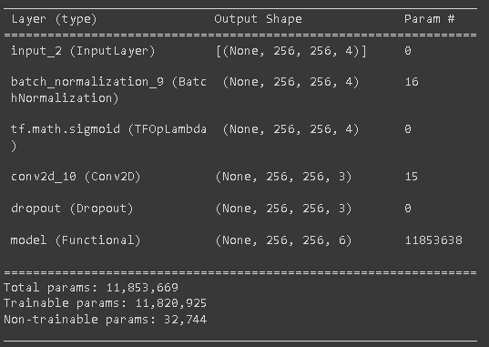
Experiment Setup Model- Deeplab3+ integrate DSM data
4 input channels
input (256,256,4)
BatchNormalization
Sigmoid
Conv2D
Dropout
6 output classes
DeepLab3+
Numbers of DeepLab3+’s parameters
Input image size and preprocess

Slide 14

Experiment Setup Model U-net integrate DSM data
input (256,256,4)
U-Net
Input image size of U-net
Numbers of U-net’s Parameters

Slide 15
Experiment Setup Training protocol
Adam Optimizer with epsilon value: 1e-8
Standard normalization (0 mean, 1 std)
Early stopping patience : 40
Learning rate = 0.001 (by default)
200 Epoch
Data augmentation:
Horizontal Flip
Vertical Flip
Random Rotate 90
Shift Scale Rotate

Slide 16
Evaluation and Result
U-Net
with CE loss: 51.17% mIOU without DSM
with Focal loss: 53.20% mIOU without DSM
DeepLab3+
with CE loss: 64.31% mIOU without DSM
with Focal loss: 63.56% mIOU without DSM

Slide 17
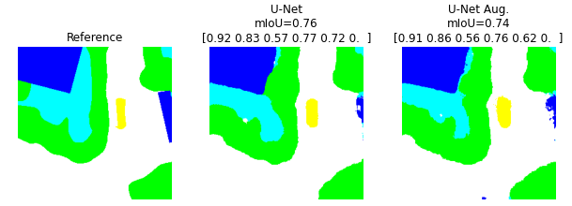
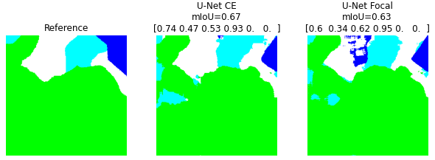
Evaluation and Result
U-Net
With CE loss: 55.03%mIOU 51.17% mIOU without DSM
With Focal loss: 51.2%mIOU 53.20% mIOU without DSM
The semantic segmentation result of U-Net
Notes:
30.16%

Slide 18
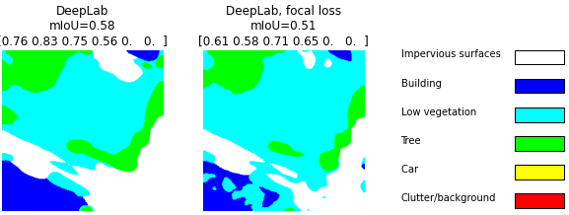
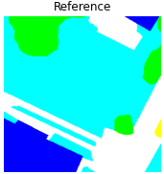
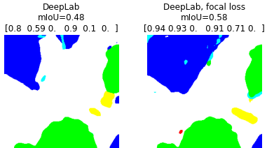
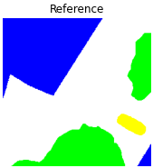
Evaluation and Result
DeepLab3+
with CE loss: 52.78% mIOU 64.31% without DSM
with Focal loss: 58.65% mIOU 63.56% without DSM
The semantic segmentation result of DeepLab3+
Notes:
36.75%, 53.26%

Slide 19
Summary
The main parts of my presentation
Integration the 4th channel
Comparison between Cross Entropy loss (CE) and focal loss
Comparison between U-net and Deeplab3+
Discussion
The best performance is Deeplab3+ with focal loss 58.65% mIOU, but still lower than the one using CE with only RGB channel (64.31%).
Focal loss tends to make false semantic segmentations on impervious surfaces.
Future work
tuning the gamma value of focal loss
try SGD or RMSProp optimizer

Slide 20
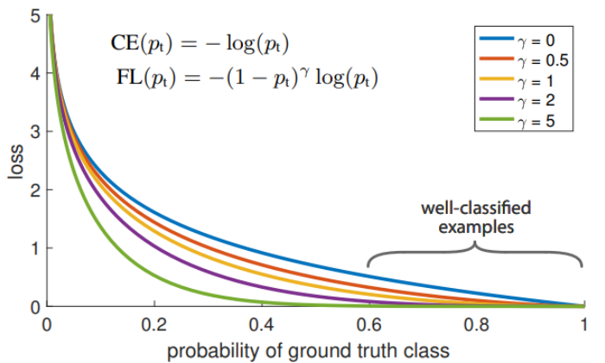
Focal loss
Tsung-Yi Lin, Priyal Goyal, Ross Girshick, et al. „Focal Loss for Dense Object Detection“. In: IEEE Transactions on Pattern Analysis and Machine Intelligence 42 (2020), pages 318–327.

