Slide 1

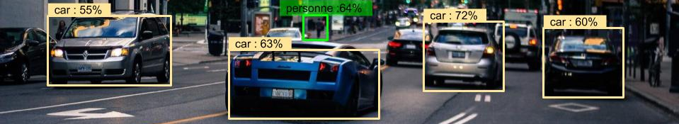
MobileNet – an efficient CNN for Mobile Vision Applications
source: https://penseeartificielle.fr
Yu-Chuan Cheng
Fabian Linkerhägner

Slide 2
Today’s agenda
Introduction to MobileNets
Characteristics of the MobileNet architecture
Depthwise separable convolutions
Global Hyperparameters
Network structure and it‘s special features
Benchmark: MobileNet compared to other popular NNs
Benchmark: MobileNet performance on various datasets
Own implementation: MobileNet performance on EuroSAT dataset
Answering your questions

Slide 3
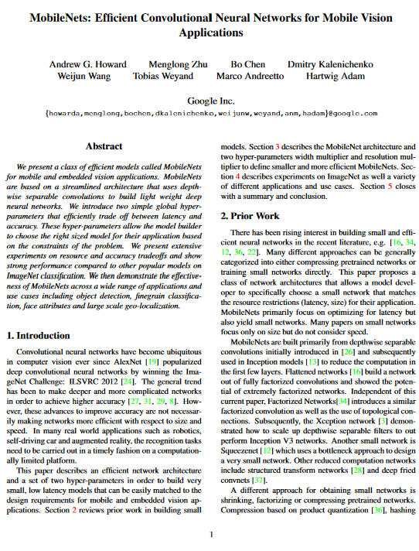
Introduction to MobileNets
MobileNet
a leight-weighted and flexible CNN
efficient trade off (latency vs. accuracy)
mobile and embedded vision applications
Motivation:
time matters in real world applications
computationally restricted platforms
networks need to be efficient
Applications (…)
Fine Grained Recognition / Object Detection
Face Recognition / Facial Attribute Classification
Large Scale Image Geolocalization
Paper from 2017:
source: https://arxiv.org/pdf/1704.04861.pdf
Notes:
Developed by researchers at Google in 2017
Used to incorprate Computer Vision efficiently into small, portable devices like moile phones and robots without significantly reducinc accuracy
Total number of parameters in a standard MobileNet is 4.2 Million (in comparison: …)
Gives model developers the flexiility to control the size of their model depending on their requirements

Slide 4
Introduction to MobileNets
MobileNet
a leight-weighted and flexible CNN
efficient trade off (latency vs. accuracy)
mobile and embedded vision applications
Motivation:
time matters in real world applications
computationally restricted platforms
networks need to be efficient
Applications (…)
Fine Grained Recognition / Object Detection
Face Recognition / Facial Attribute Classification
Large Scale Image Geolocalization
Paper from 2017:
source: https://arxiv.org/pdf/1704.04861.pdf
Notes:
Developed by researchers at Google in 2017
Used to incorprate Computer Vision efficiently into small, portable devices like moile phones and robots without significantly reducinc accuracy
Total number of parameters in a standard MobileNet is 4.2 Million (in comparison: …)
Gives model developers the flexiility to control the size of their model depending on their requirements

Slide 5
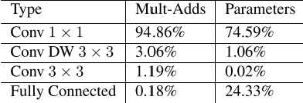
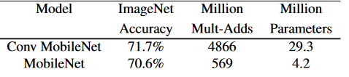
Characteristics of the MobileNet architecture
Depthwise separable convolutions (2 steps)
Depthwise Convolution
Pointwise Convolution
Global Hyperparameters:
Width Multiplier
Resolution Multiplier
Standard MobileNet model
only 28 layers, 4.2x10⁶ parameters
less computation (8-9x less)
only slightly reduced accuracy
low risk of overfitting
less regularization required
Distribution of parameters in standard MobileNet
source: https://arxiv.org/pdf/1704.04861.pdf
Comparison of accuracy and size
for depthwise separable convolution and standard convolution
source: https://arxiv.org/pdf/1704.04861.pdf
Notes:
1x1 conv: GEMM functions (highly optimized)

Slide 6
Characteristics of the MobileNet architecture
Depthwise separable convolutions (2 steps)
Depthwise Convolution
Pointwise Convolution
Global Hyperparameters:
Width Multiplier
Resolution Multiplier
Standard MobileNet model
only 28 layers, 4.2x10⁶ parameters
less computation (8-9x less)
only slightly reduced accuracy
low risk of overfitting
less regularization required
Distribution of parameters in standard MobileNet
source: https://arxiv.org/pdf/1704.04861.pdf
Comparison of accuracy and size
for depthwise separable convolution and standard convolution
source: https://arxiv.org/pdf/1704.04861.pdf
Notes:
1x1 conv: GEMM functions (highly optimized)

Slide 7
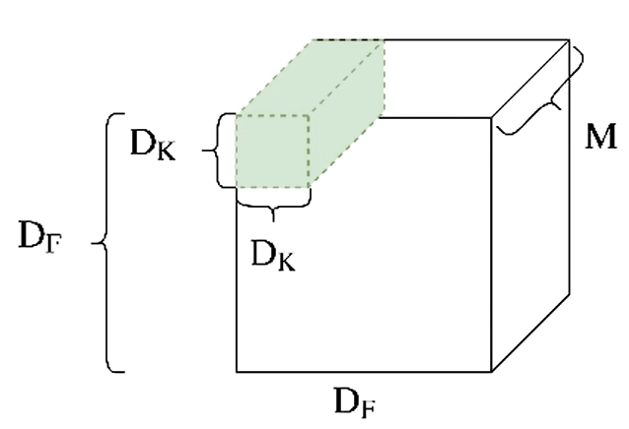
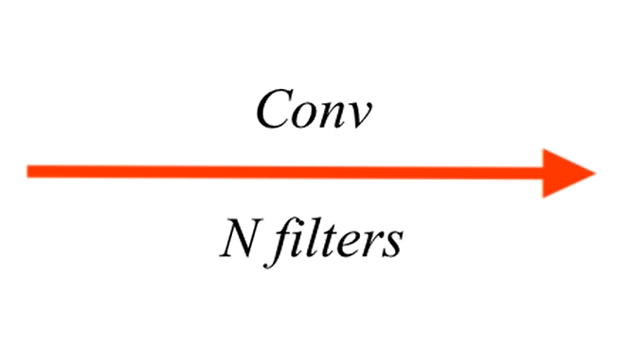
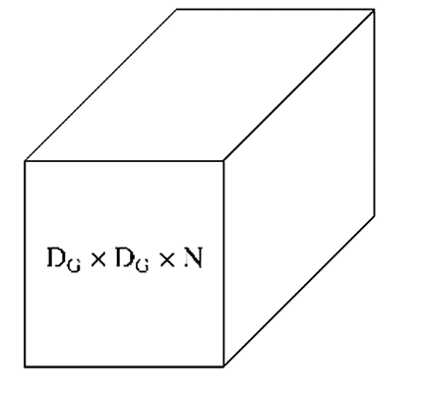
Depthwise separable convolution (1 / 3)
Recap: Standard Convolution
sources: engineering.flipboard.com
Notes:
1 filter -> DgxDgx1 feature map --> n filters -> DgxDgxn feature map/stack

Slide 8
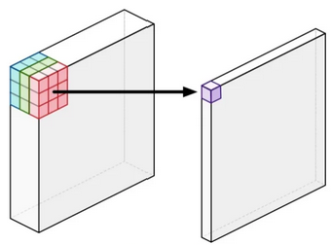
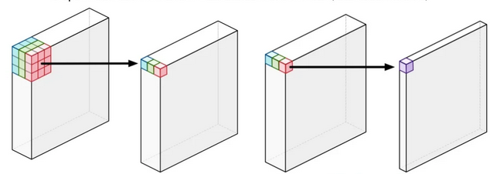
Depthwise separable convolution (2 / 3)
Standard Convolution
applies 1 kernel/filter to all channels at a time
slides kernel across image
each step: weighted sum of covered area
combines values of channels
Depthwise Convolution
no combination of the input channels
seperate convolution on each channel
Pointwise Convolution
same as regular convolution (1x1)
weighted sum of all the channels
combines values of depthwise conv. output channels
Standard convolution
graphics source:
https://machinethink.net/blog/googles-mobile-net-architecture-on-iphone/
Depthwise convolution
Pointwise convolution
Notes:
Talk about different approach btwn. Standard / depthwise
Depthwise sep. --> two step process
Reduces computational costs -> more on that in a minute

Slide 9
Depthwise separable convolution (2 / 3)
Standard Convolution
applies 1 kernel/filter to all channels at a time
slides kernel across image
each step: weighted sum of covered area
combines values of channels
Depthwise Convolution
no combination of the input channels
seperate convolution on each channel
Pointwise Convolution
same as regular convolution (1x1)
weighted sum of all the channels
combines values of depthwise conv. output channels
Standard convolution
graphics source:
https://machinethink.net/blog/googles-mobile-net-architecture-on-iphone/
Depthwise convolution
Pointwise convolution
Notes:
Talk about different approach btwn. Standard / depthwise
Depthwise sep. --> two step process
Reduces computational costs -> more on that in a minute

Slide 10
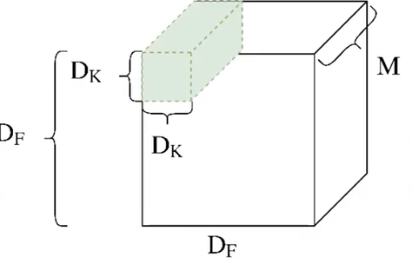
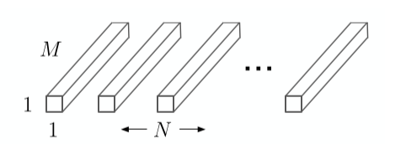
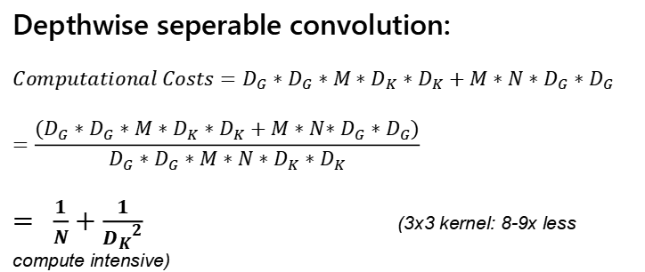

Depthwise separable convolution (3 / 3)
Here is the „Why do this“:
D_{F}: spatial width and height of input
D_{K}: spatial dimension of the kernel
D_{G}: spatial dimension of output feature map
M: number of input channels
N: number of output channels
Standard convolution:
$Computational Costs=D_{G}∗D_{G}∗M∗N∗D_{K}∗D_{K}$
Depthwise convolution:
$Computational Costs=D_{G}∗D_{G}∗M∗D_{K}∗D_{K}$
Pointwise convolution
$Computational Costs=M∗N∗D_{G}∗D_{G}$
source: Rahul Deora@YouTube
source: https://arxiv.org/pdf/1704.04861.pdf
Depthwise seperable convolution:
$$Computational Costs=D_{G}∗D_{G}∗M∗D_{K}∗D_{K}+M∗N∗D_{G}∗D_{G}$$
$$=\frac{{(D}_{G}∗D_{G}∗M∗D_{K}∗D_{K}+M∗N{∗D}_{G}∗D_{G})}{D_{G}∗D_{G}∗M∗N∗D_{K}∗D_{K}}$$
$= \frac{1}{N}+\frac{1}{{D_{K}}^{2}}$ (3x3 kernel: 8-9x less compute intensive)

Slide 11
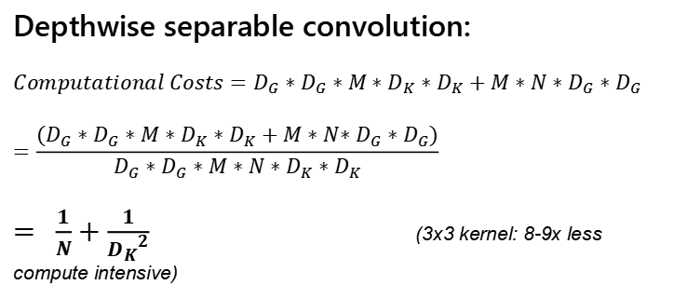
Depthwise separable convolution (3 / 3)
Here is the „Why do this“:
D_{F}: spatial width and height of input
D_{K}: spatial dimension of the kernel
D_{G}: spatial dimension of output feature map
M: number of input channels
N: number of output channels
Standard convolution:
$Computational Costs=D_{G}∗D_{G}∗M∗N∗D_{K}∗D_{K}$
Depthwise convolution:
$Computational Costs=D_{G}∗D_{G}∗M∗D_{K}∗D_{K}$
Pointwise convolution
$Computational Costs=M∗N∗D_{G}∗D_{G}$
source: Rahul Deora@YouTube
source: https://arxiv.org/pdf/1704.04861.pdf
Depthwise separable convolution:
$$Computational Costs=D_{G}∗D_{G}∗M∗D_{K}∗D_{K}+M∗N∗D_{G}∗D_{G}$$
$$=\frac{{(D}_{G}∗D_{G}∗M∗D_{K}∗D_{K}+M∗N{∗D}_{G}∗D_{G})}{D_{G}∗D_{G}∗M∗N∗D_{K}∗D_{K}}$$
$= \frac{1}{N}+\frac{1}{{D_{K}}^{2}}$ (3x3 kernel: 8-9x less compute intensive)
Notes:
Depthwise conv: apply kernel to one channel at a time
Pointwise: 1x1 over output feature map -> linear combination of channels
In total: same output as standard but less comp costs

Slide 12
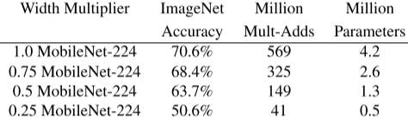
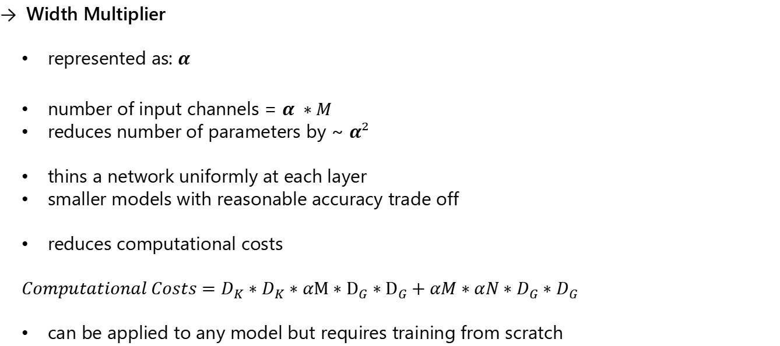
Global Hyperparameters (1 / 2)
Width Multiplier
represented as: $α$
number of input channels = $α ∗M$
reduces number of parameters by ~ $α²$
thins a network uniformly at each layer
smaller models with reasonable accuracy trade off
reduces computational costs
$Computational Costs=D_{K}∗D_{K}∗αM∗D_{G}∗D_{G}+αM∗αN∗D_{G}∗D_{G}$
can be applied to any model but requires training from scratch
Effect of different Width Multiplier
source: https://arxiv.org/pdf/1704.04861.pdf
Notes:
Why: small models, but sometimes even lower latency required
Width multiplier: reduces #input channels / #output channels

Slide 13
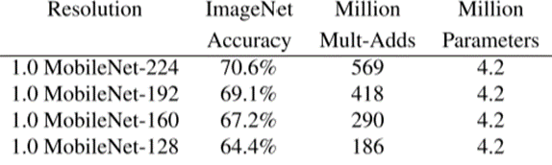
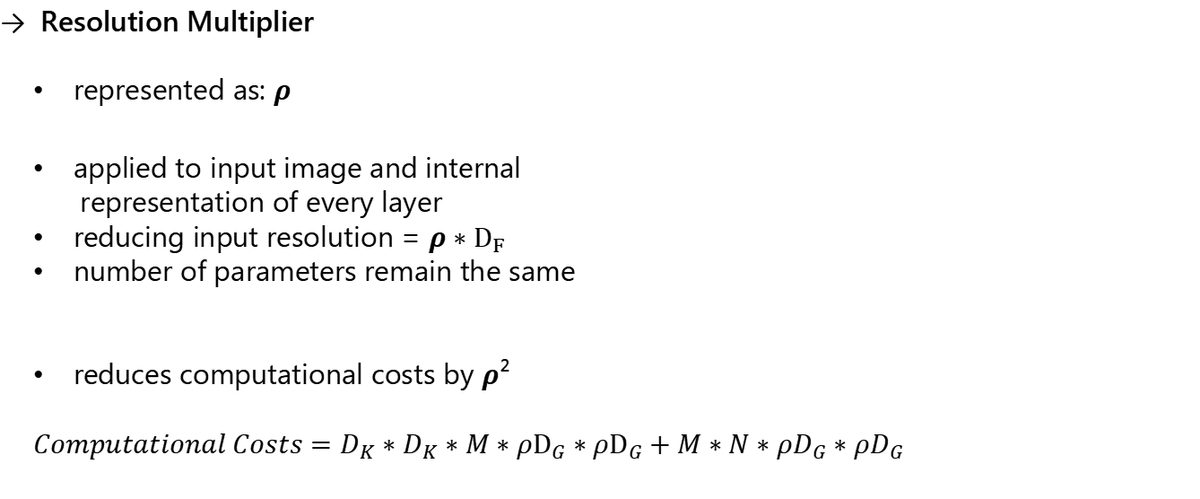
Global Hyperparameters (2 / 2)
Resolution Multiplier
represented as: $ρ$
applied to input image and internal
representation of every layer
reducing input resolution = $ρ∗D_{F}$
number of parameters remain the same
reduces computational costs by $ρ$²
$Computational Costs=D_{K}∗D_{K}∗M∗{ρD}_{G}∗{ρD}_{G}+M∗N∗{ρD}_{G}∗{ρD}_{G}$
Effect of different Resolution Multiplier
source: https://arxiv.org/pdf/1704.04861.pdf
Notes:
Reduces input resolution

Slide 14
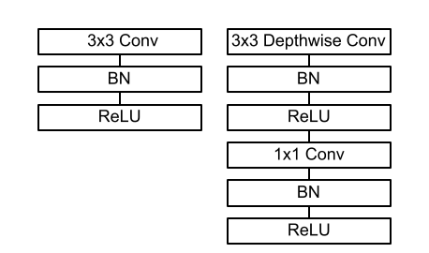
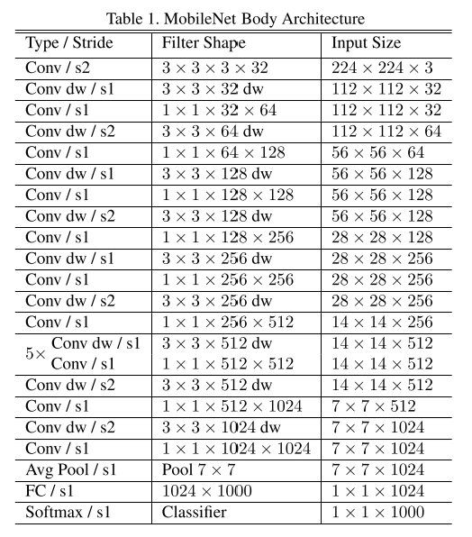
Network structure and it’s special features
Effect of different Resolution Multiplier
Effect of different Resolution Multiplier
source: https://arxiv.org/pdf/1704.04861.pdf
source: https://arxiv.org/pdf/1704.04861.pdf

Slide 15
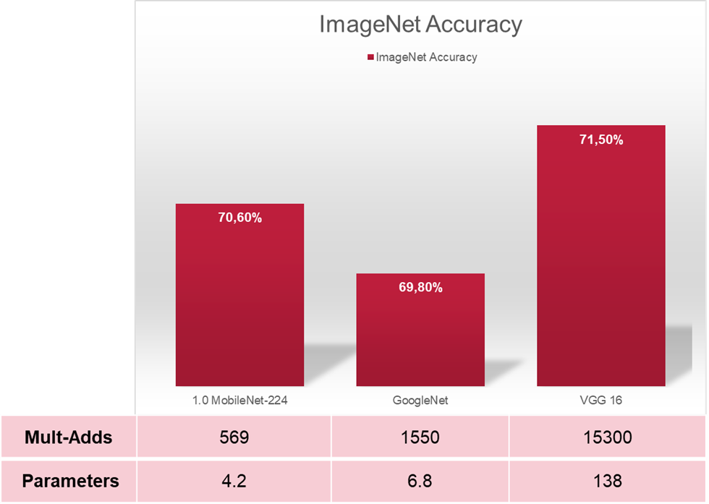
Benchmark: MobileNet compared to other popular NNs (1 / 2)
unit: Million
source: https://arxiv.org/pdf/1704.04861.pdf

Slide 16
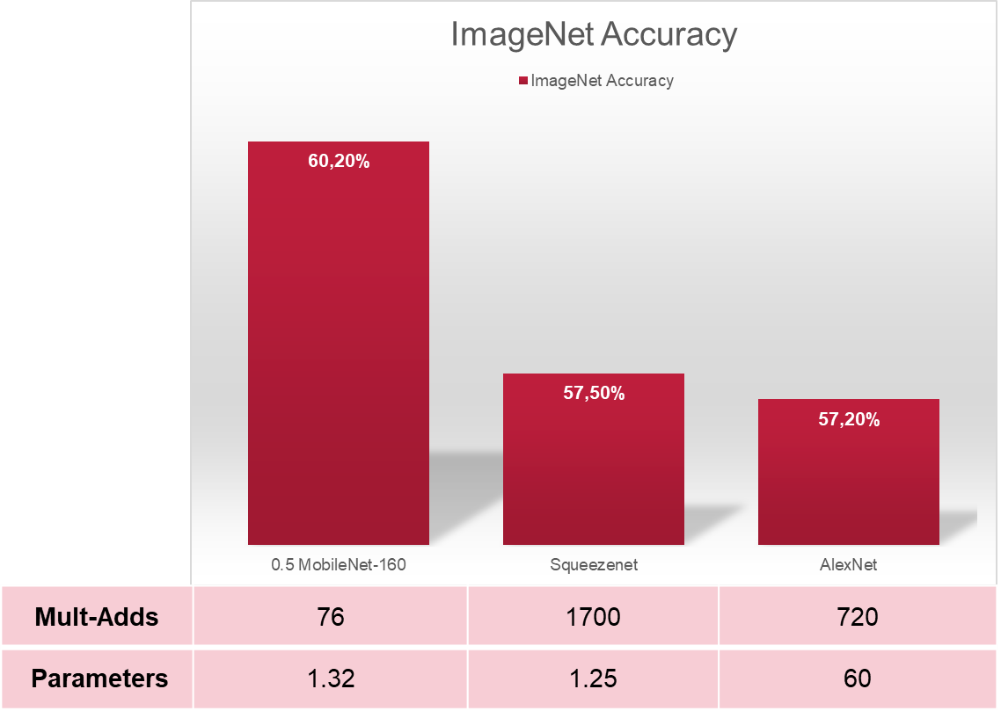
Benchmark: MobileNet compared to other popular NNs (2 / 2)
unit: Million
source: https://arxiv.org/pdf/1704.04861.pdf

Slide 17
Benchmark: MobileNet performance on various datasets
Baseline
FaceNet
PalNet
Deeplab-VGG
source: https://arxiv.org/pdf/1704.04861.pdf

Slide 18
Next up:
Own implementation
of a MobileNet network
and it‘s performance
on the EuroSAT dataset

Slide 19

Today’s summary
MobileNet and it‘s key features
leight-weighted NN mostly used on portable devices
uses depthwise seperable convolution
two hyperparameters allow highly adapted models
Why use it?
can be used on computational restricted platforms
can be used in real-time / real world applications
performs well on major datasets for it‘s applications
performs well compared to other NN architectures
source: itpro.co.uk

Slide 20
Thank you for your attention!
Any questions?

