Slide 1
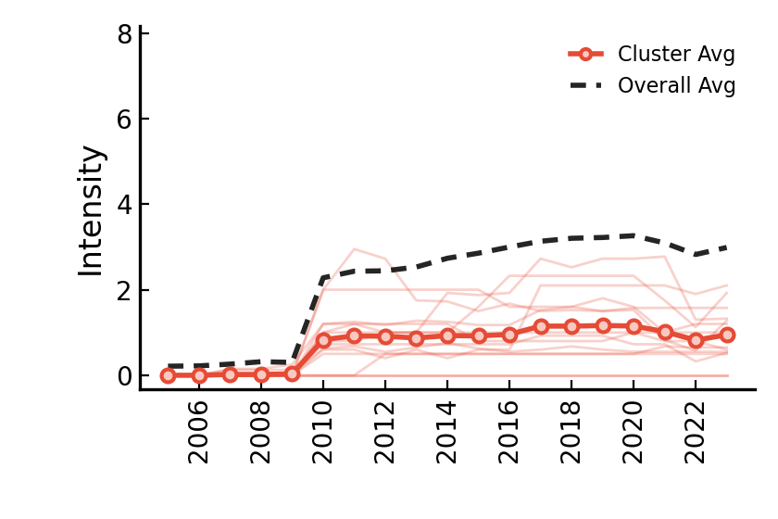
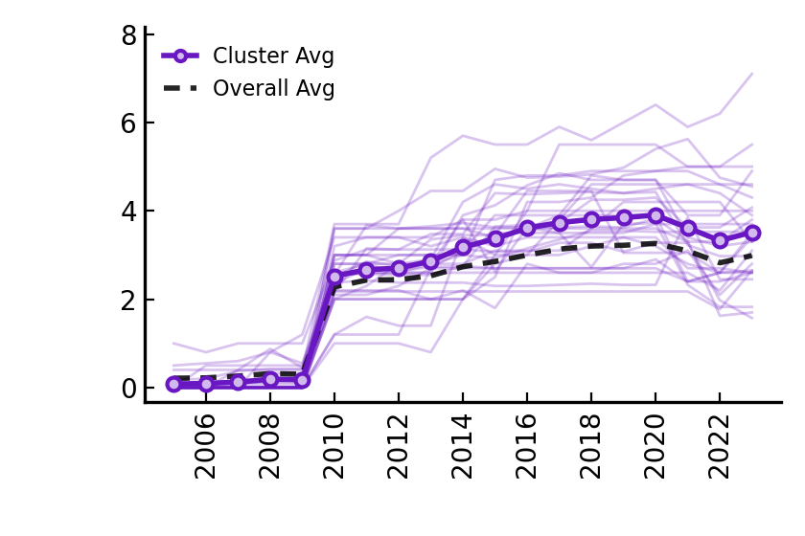
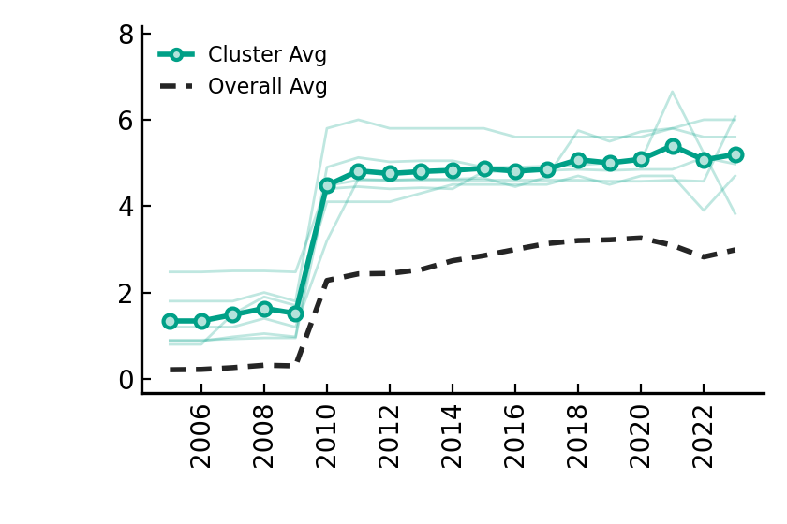
Buildings – market-based instruments
Low+Rise+Low (14 countries)
Low+Rise+Medium (29 countries)
High+Rise+High (6 countries)

Slide 2
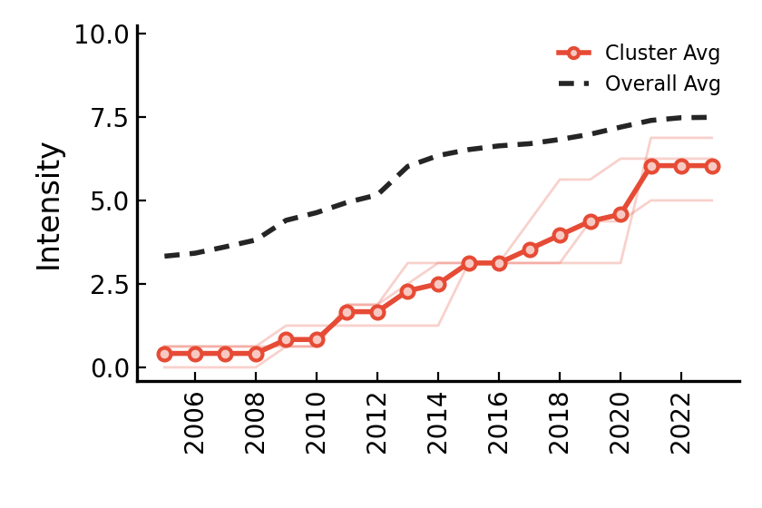
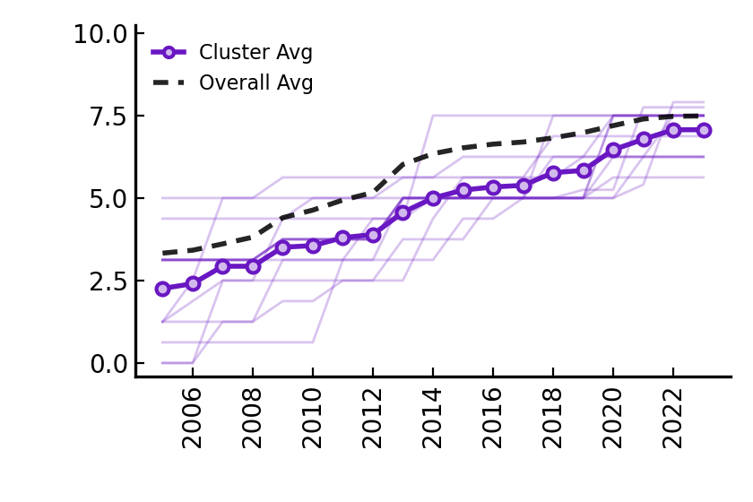
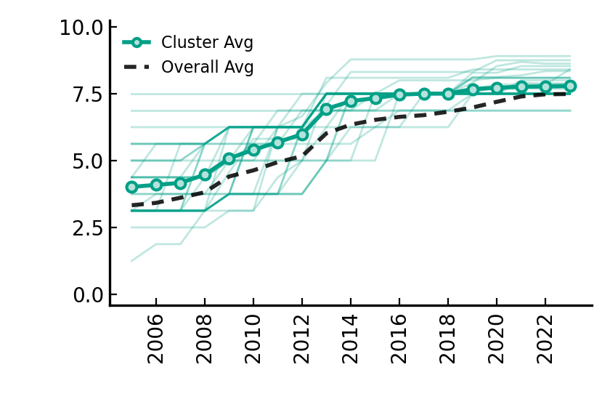
Buildings – non market-based instruments
Low+Rise+Low (3 countries)
Low+Rise+Medium (13 countries)
High+Rise+Medium (33 countries)

Slide 3
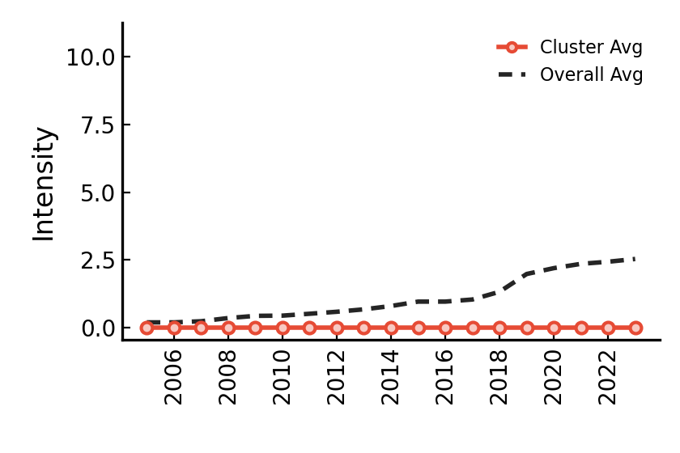
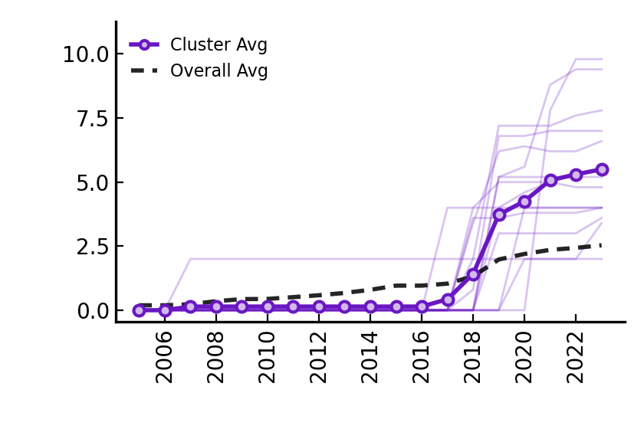
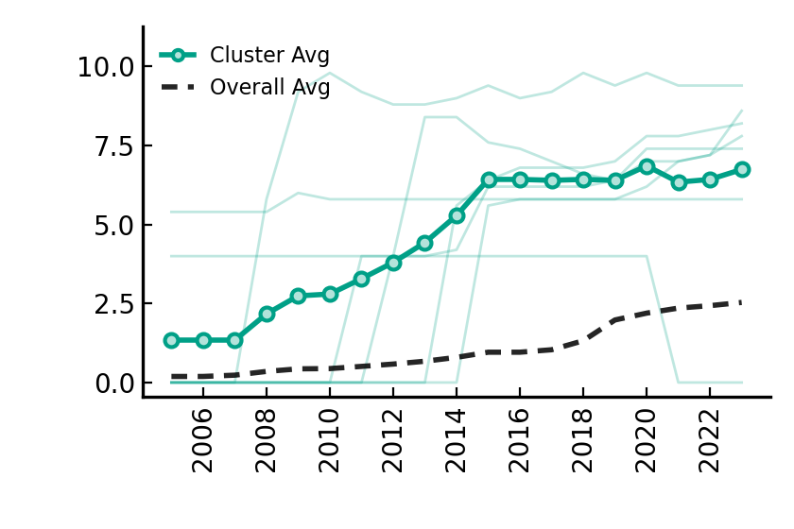
Climate governance
Low+Stable+Low (28 countries)
Low+Rise+High (14 countries)
High+Rise+High (7 countries)

Slide 4
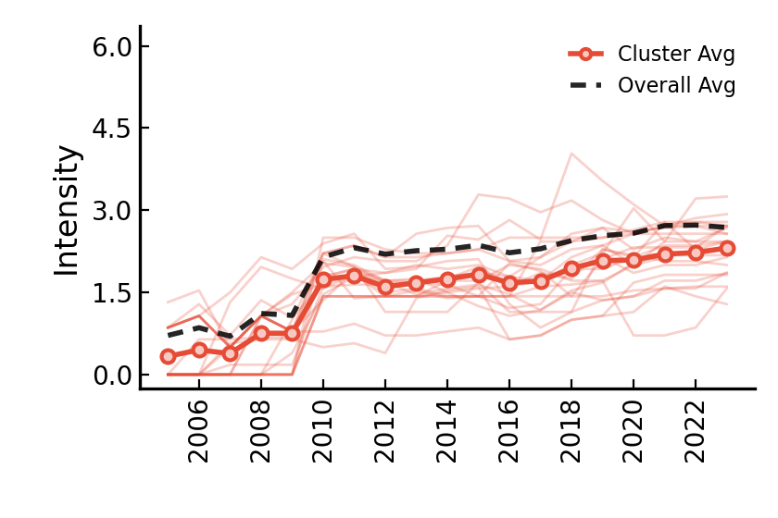
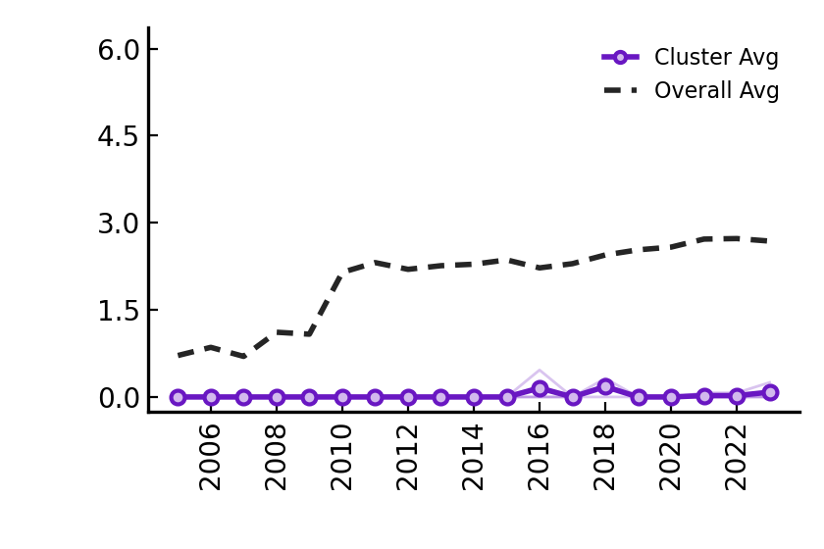
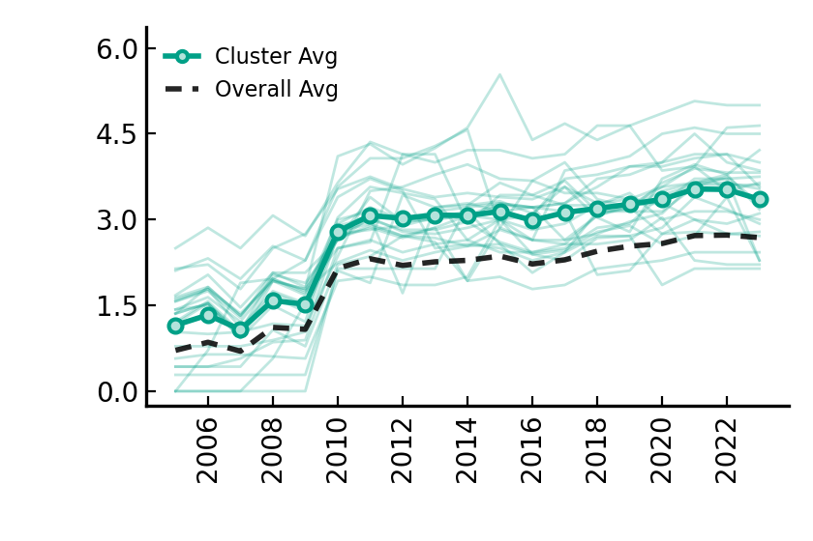
Electricity – market-based instruments
Low+Rise+Low (22 countries)
Low+Stable+Low (3 countries)
High+Rise+High (24 countries)

Slide 5
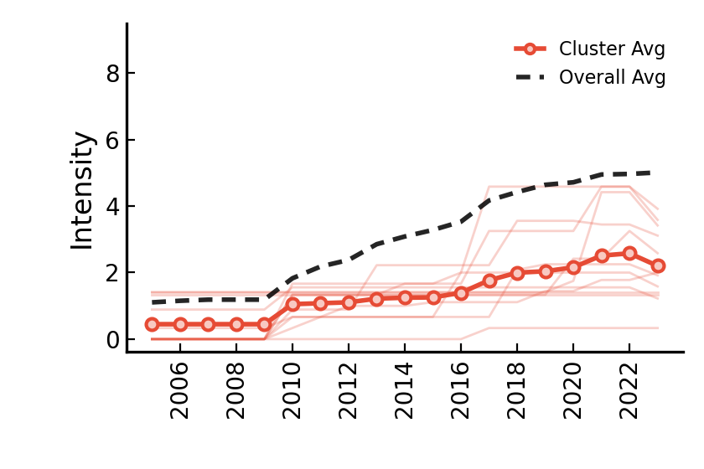
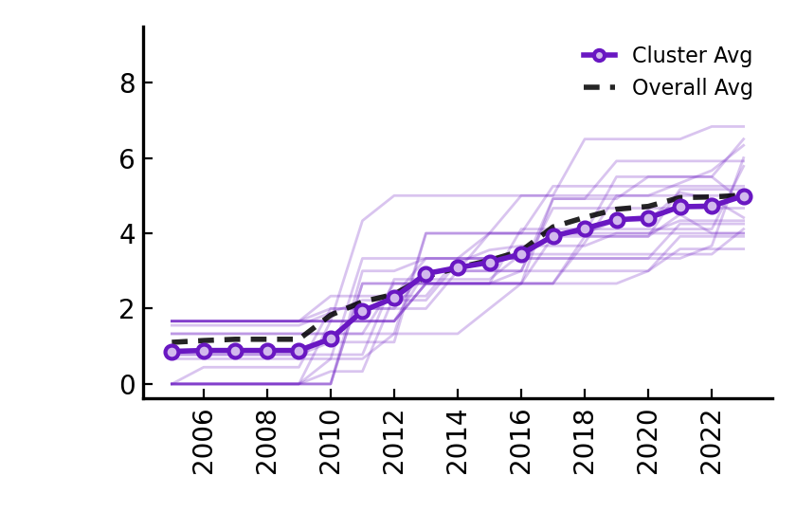
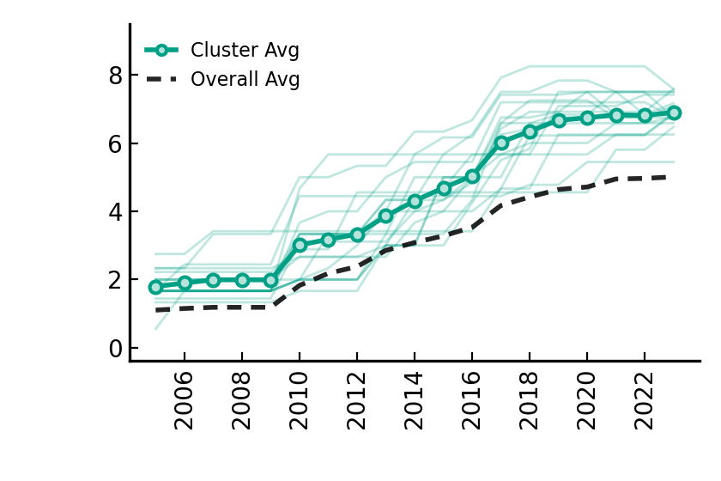
Electricity – non market-based instruments
Low+Rise+Low (12 countries)
Medium+Rise+Medium (19 countries)
High+Rise+High (18 countries)

Slide 6
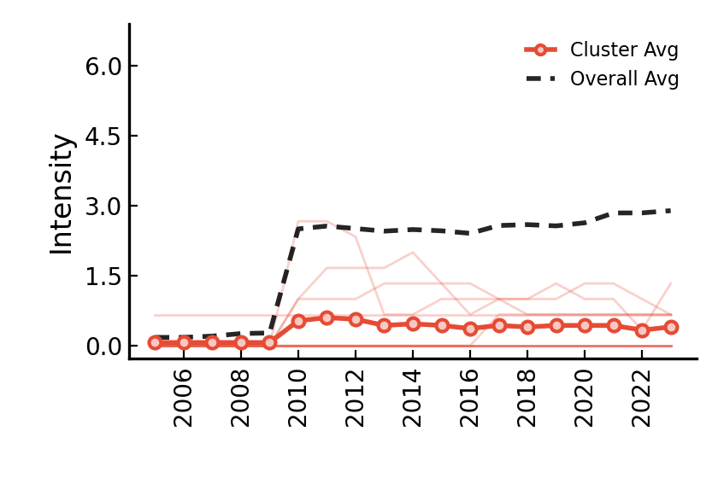
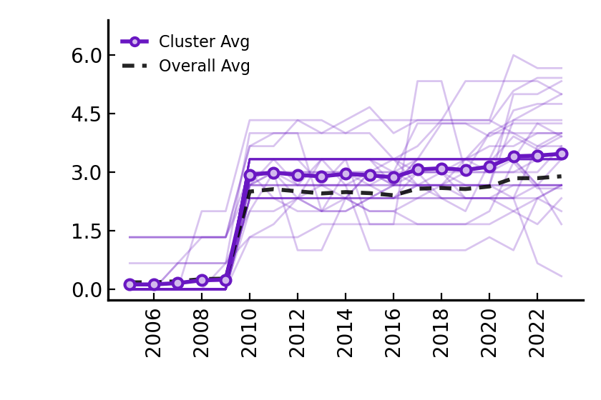
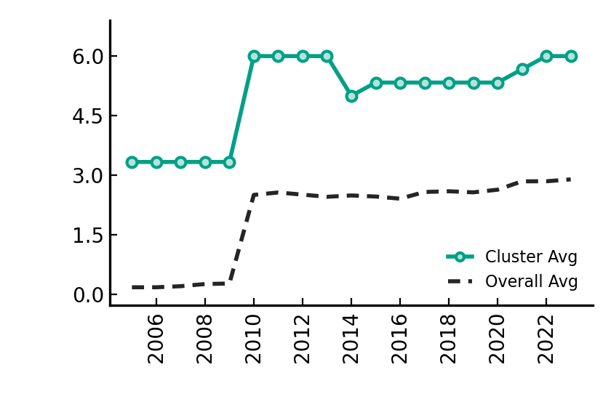
Fossil fuel production policies
Low+Stable+Low (10 countries)
Low+Rise+Medium (38 countries)
High+Fluctuate+High (1 countries)

Slide 7
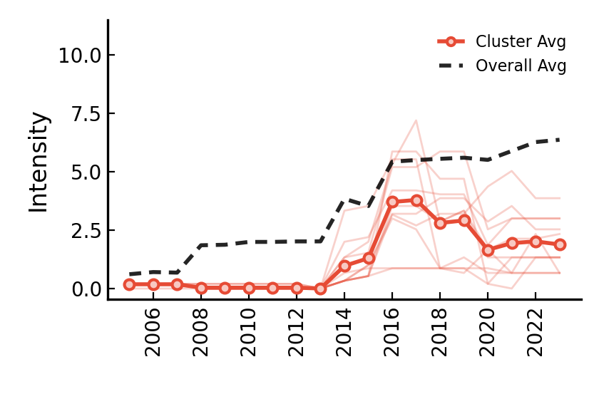
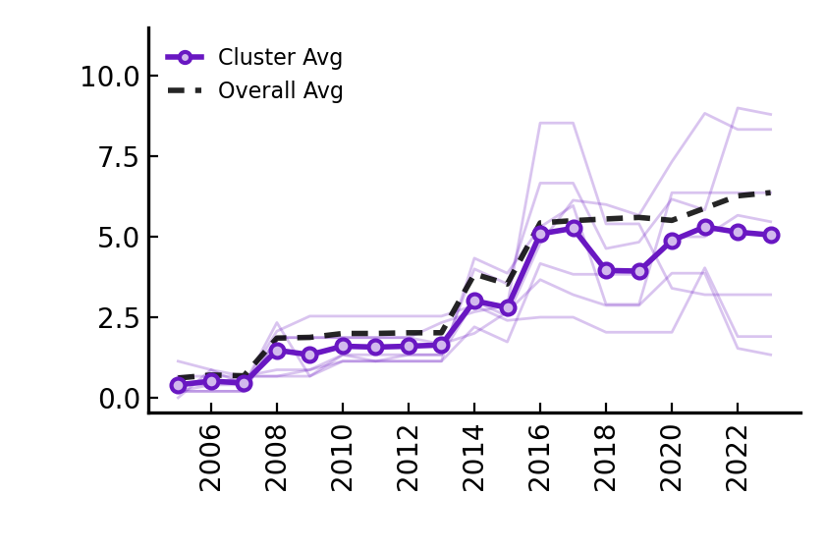
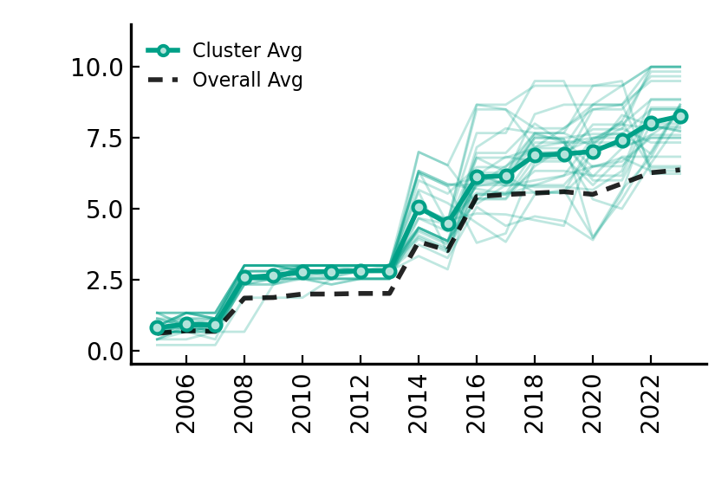
GHG emissions data and reporting
Low+Fluctuate+Low(11 countries)
Low+Fluctuate+Medium(7 countries)
Medium+Rise+High (31 countries)

Slide 8
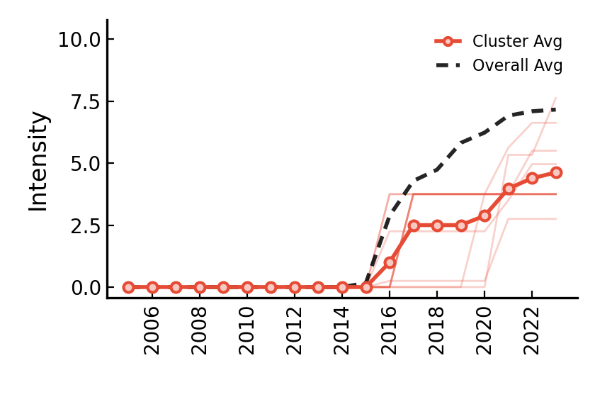
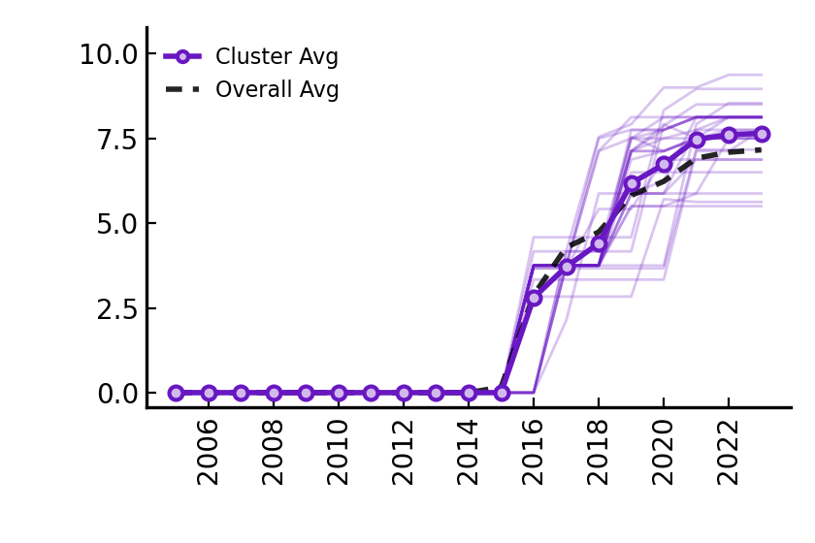
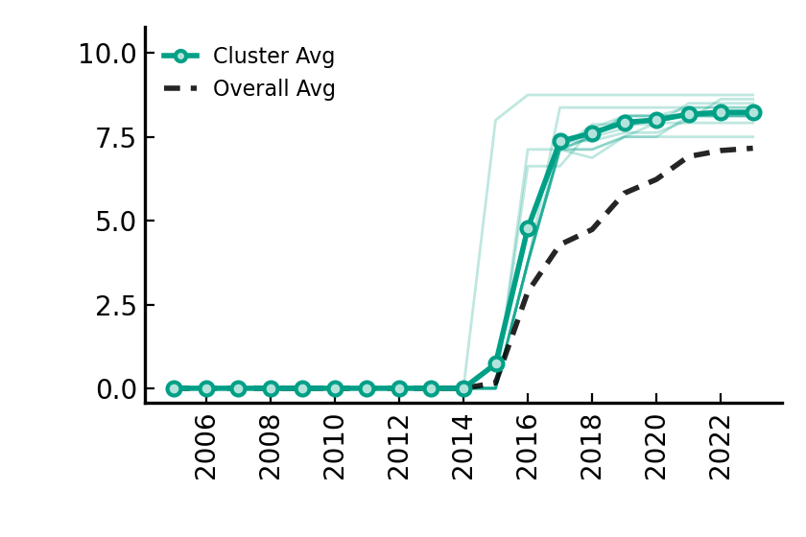
GHG emissions targets
Low+Rise+Low (10 countries)
Low+Rise+Medium (28 countries)
Low+Rise+High (11 countries)

Slide 9
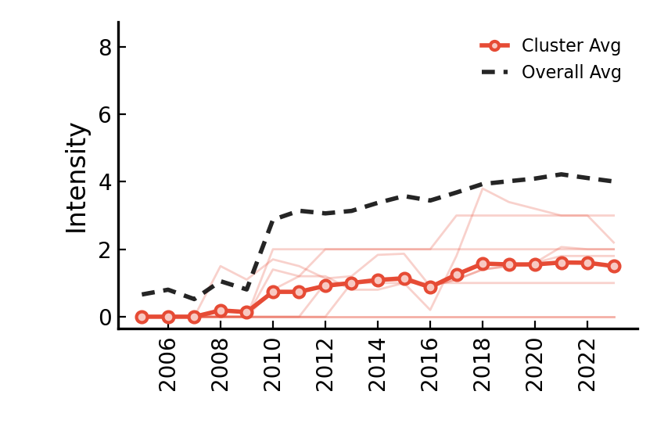
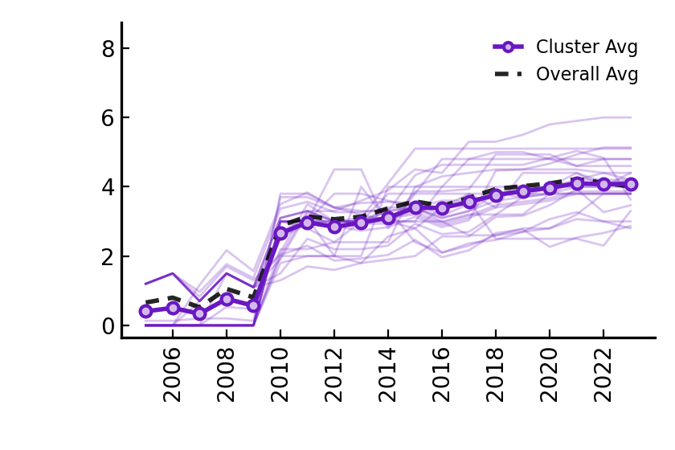
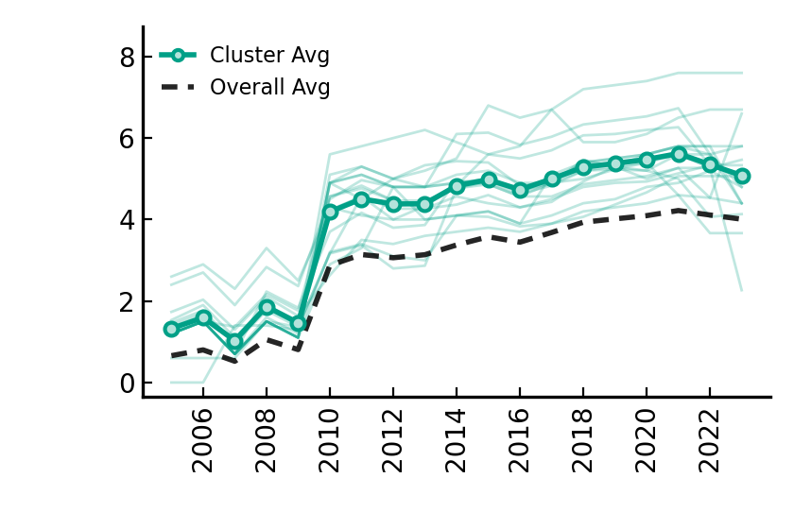
Industry – market-based instruments
Low+Rise+Low (8 countries)
Low+Rise+Medium (24 countries)
High+Rise+High (17 countries)

Slide 10
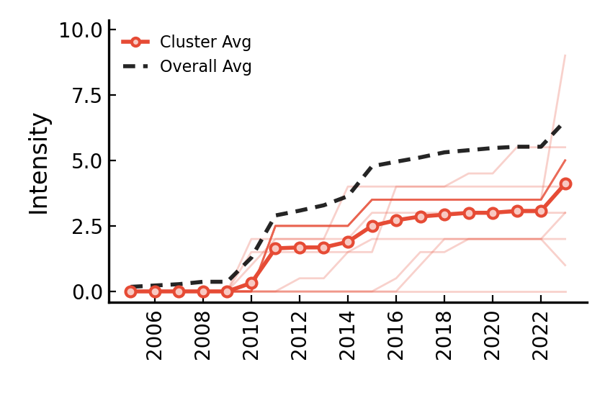
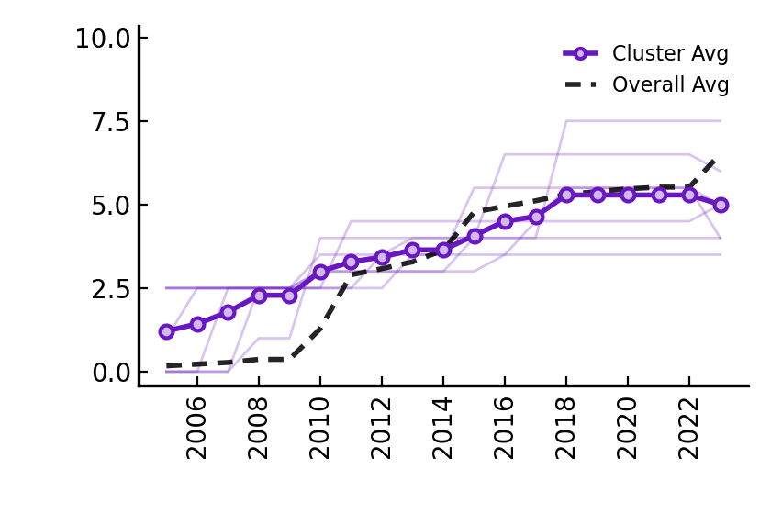
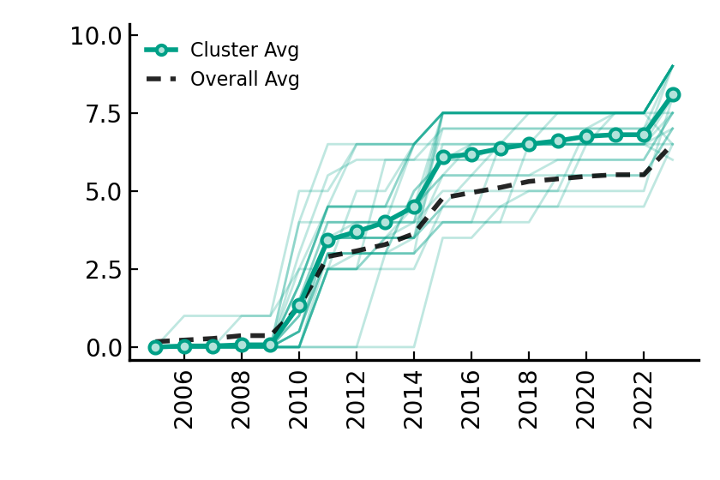
Industry – non market-based instruments
Low+Rise+Medium (14 countries)
High+Rise+Medium (7 countries)
Low+Rise+High (28 countries)

Slide 11
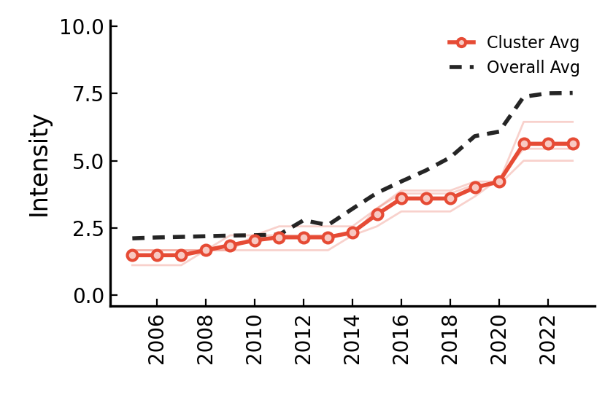
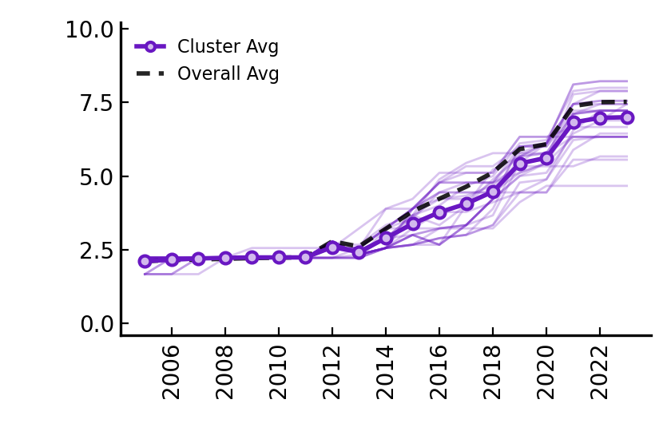
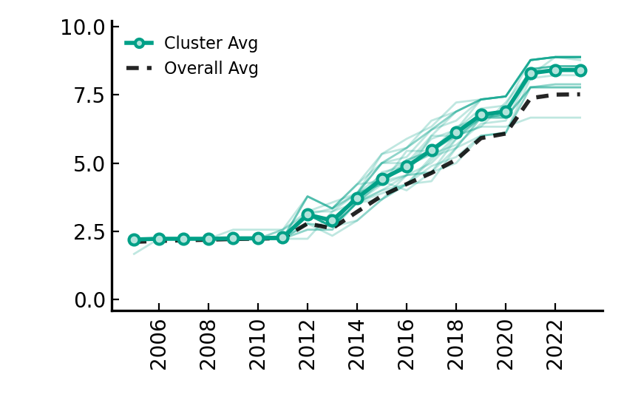
International climate co-operation
Low+Rise+Low (3 countries)
Medium+Rise+Medium (25 countries)
Medium+Rise+High (21 countries)

Slide 12
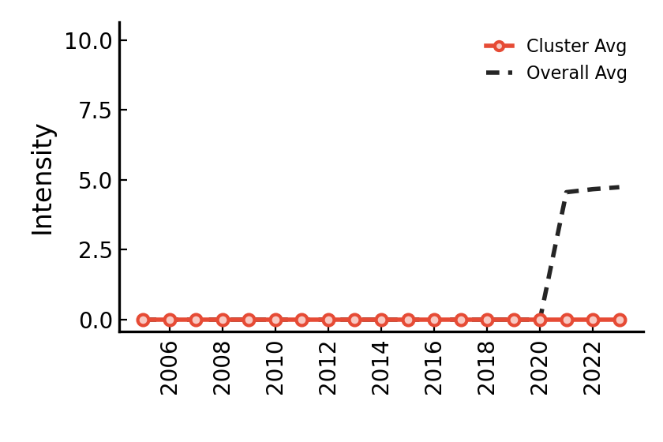
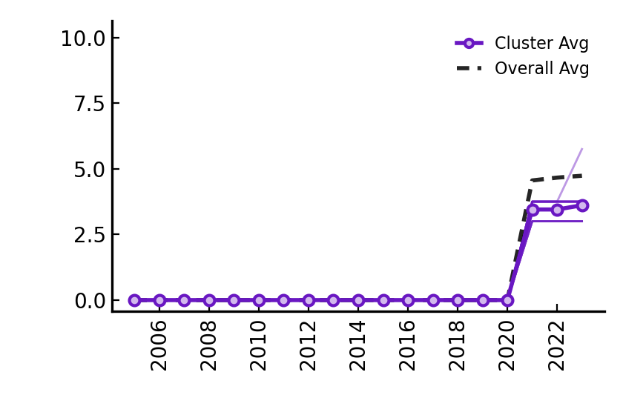
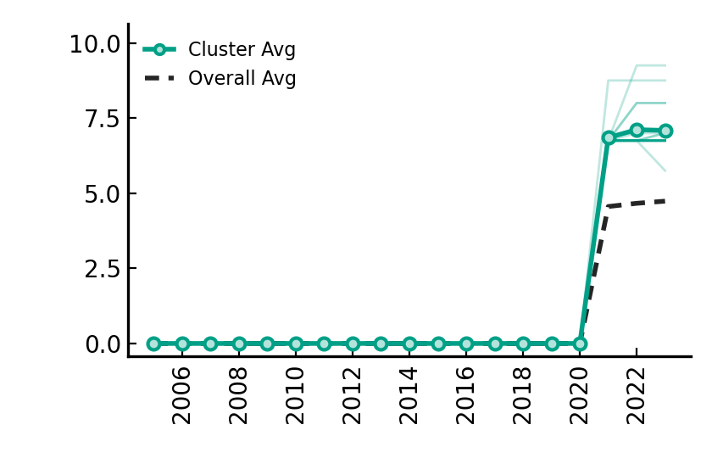
International public finance
Low+Stable+Low (4 countries)
Low+Rise+Low (25 countries)
Low+Rise+High (20 countries)

Slide 13
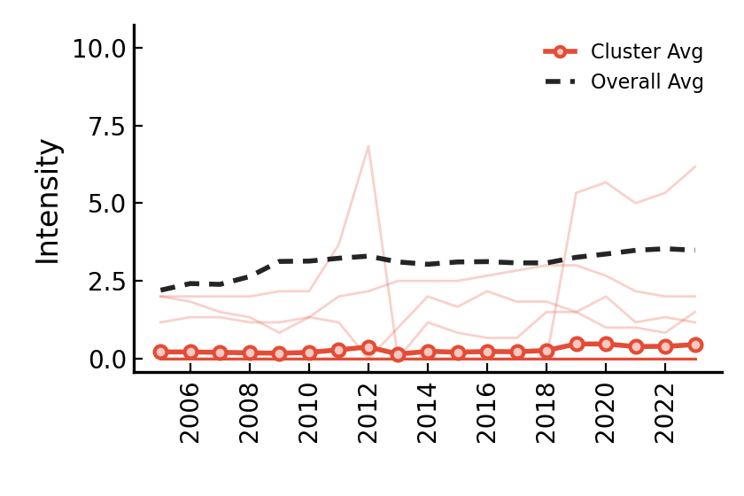
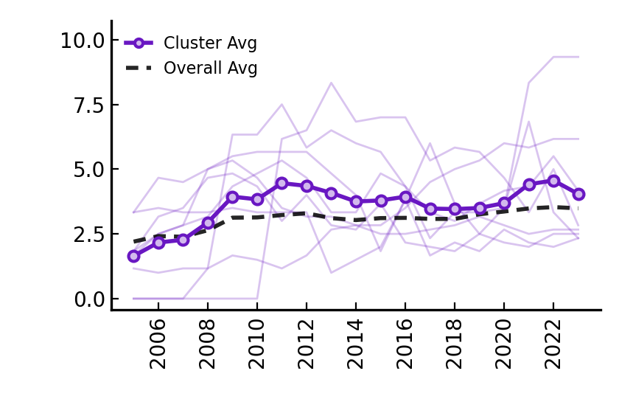
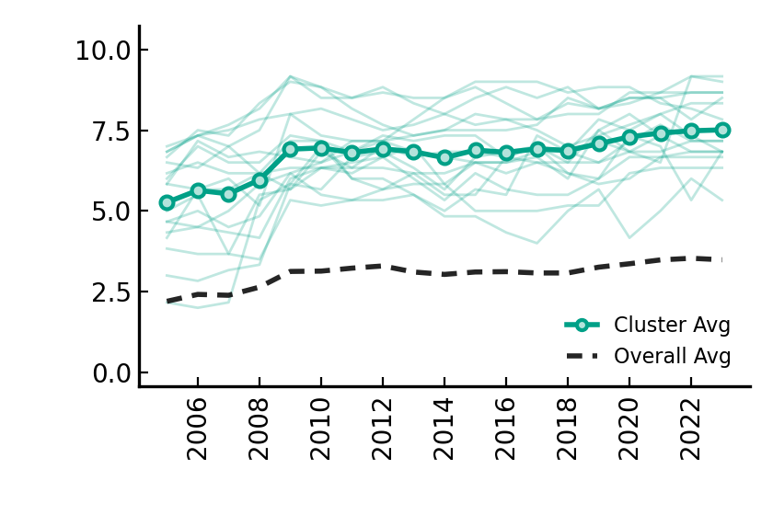
Public Research, Development and Demonstration
Low+Stable+Low (24 countries)
Medium+Fluctuate+Medium (8 countries)
High+Rise+High (17 countries)

Slide 14
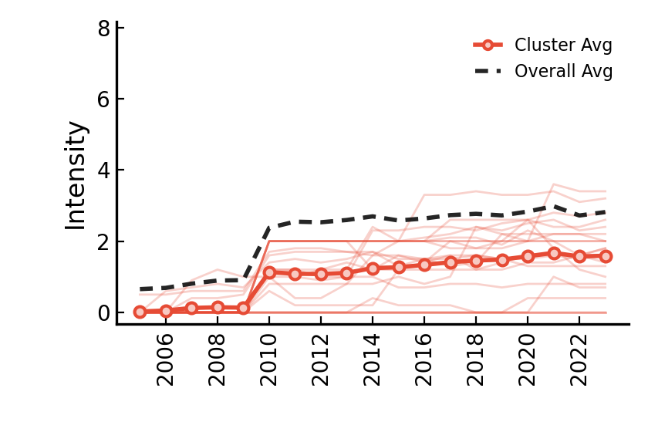
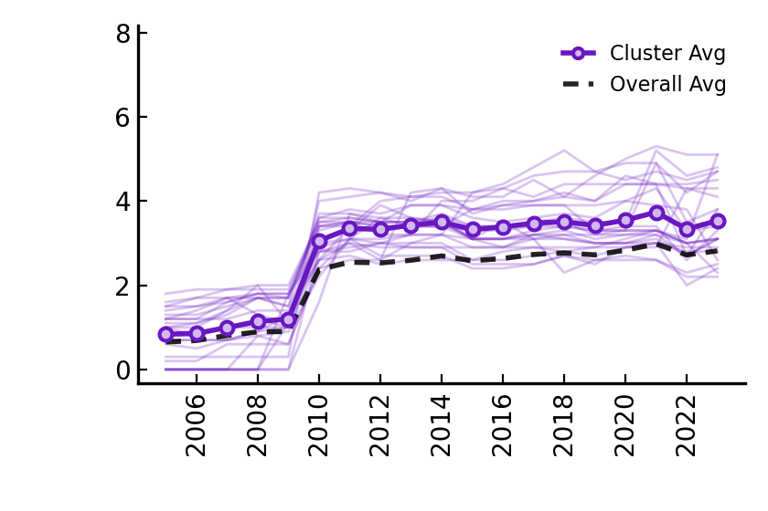
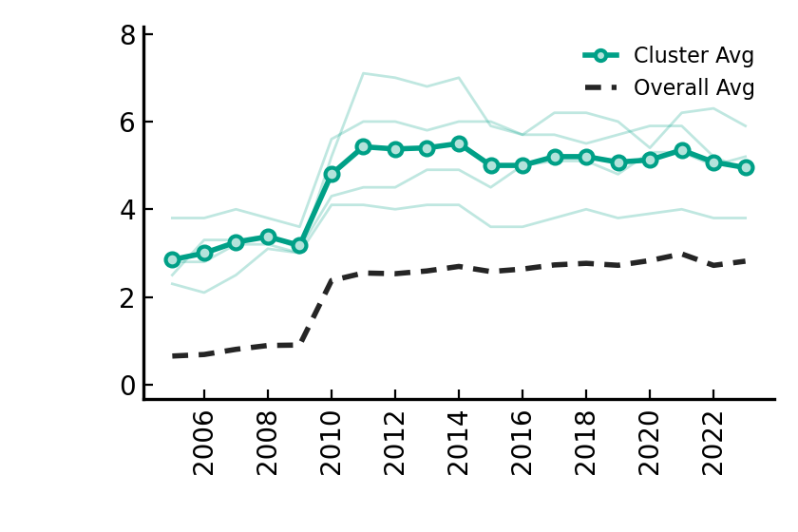
Transport – market-based instruments
Low+Rise+Low (21 countries)
Medium+Rise+High (24 countries)
High+Rise+High (4 countries)

Slide 15
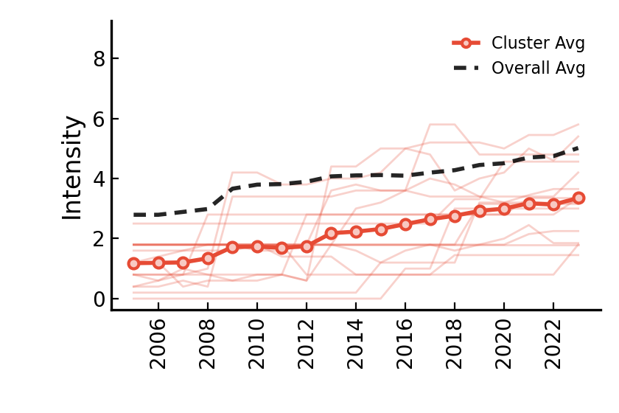
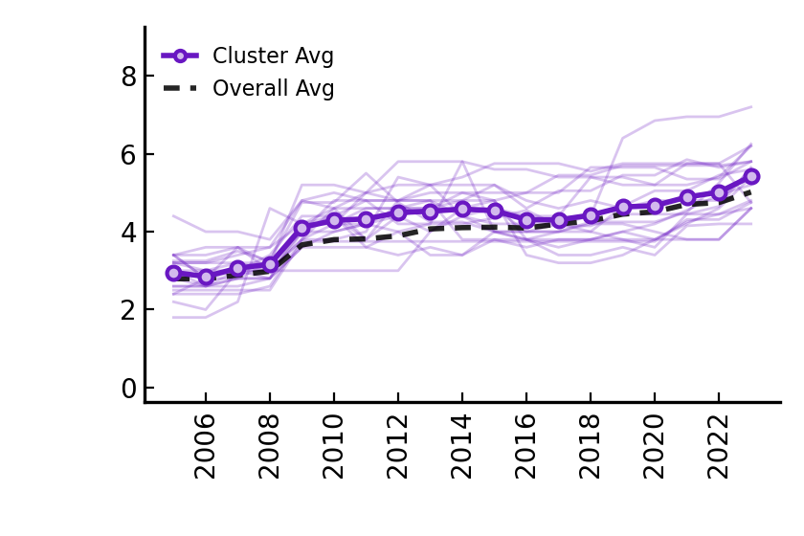
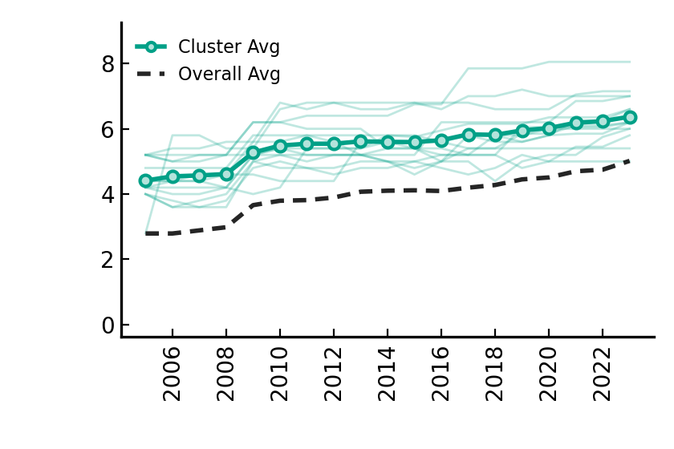
Transport – non market-based instruments
Low+Rise+Low (16 countries)
Medium+Rise+Medium (19 countries)
High+Rise+High (14 countries)

