Slide 1
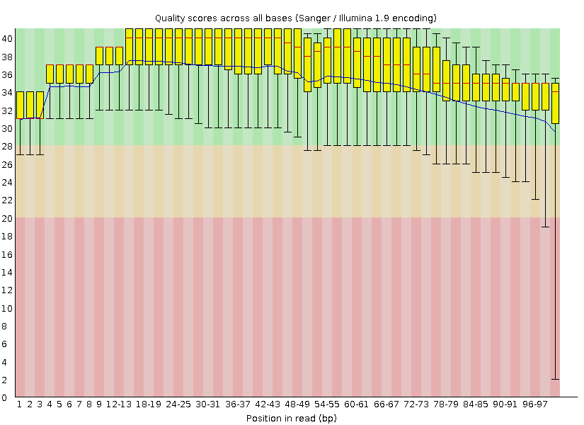
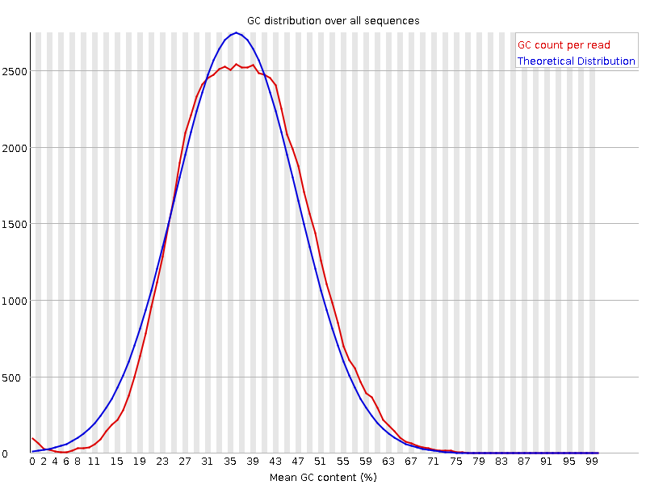
A
B
C
D
Notes:
图1. FastQC

Slide 2
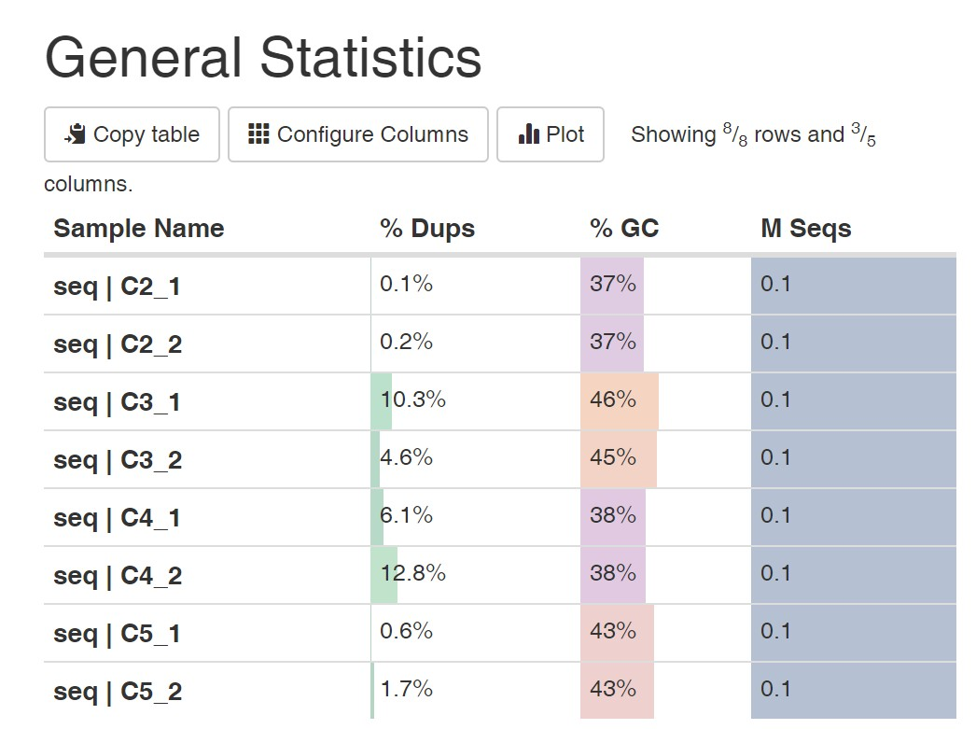
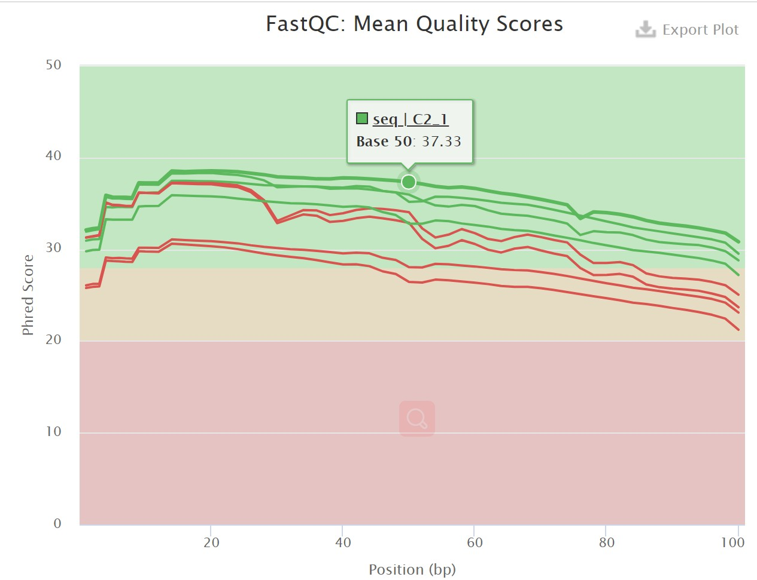
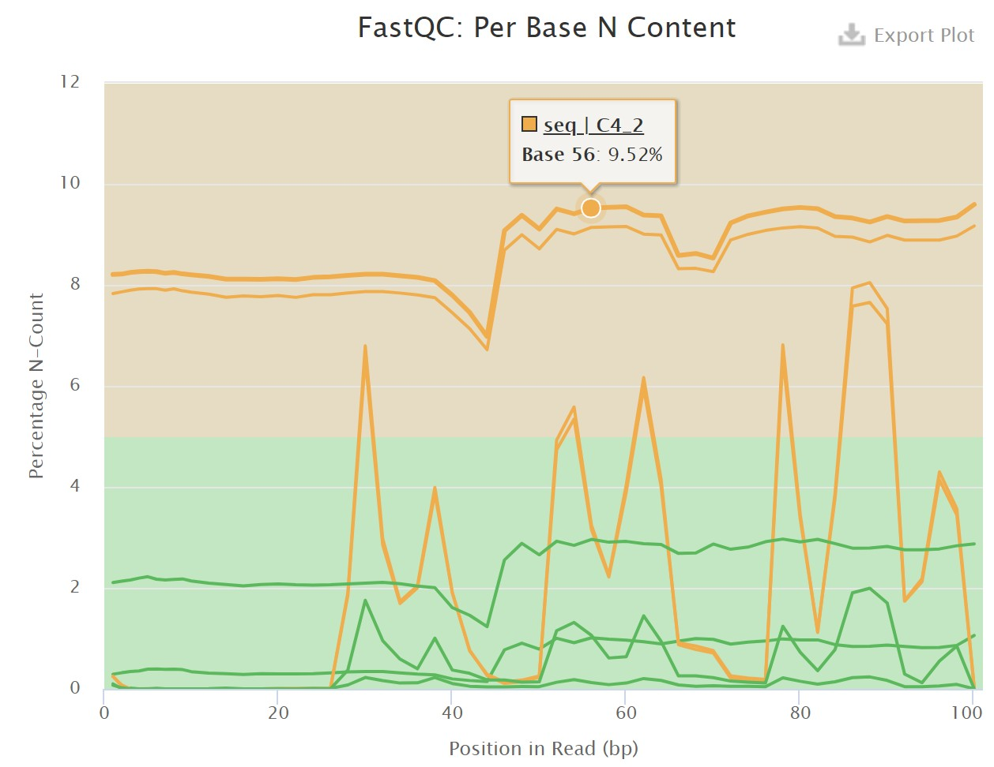
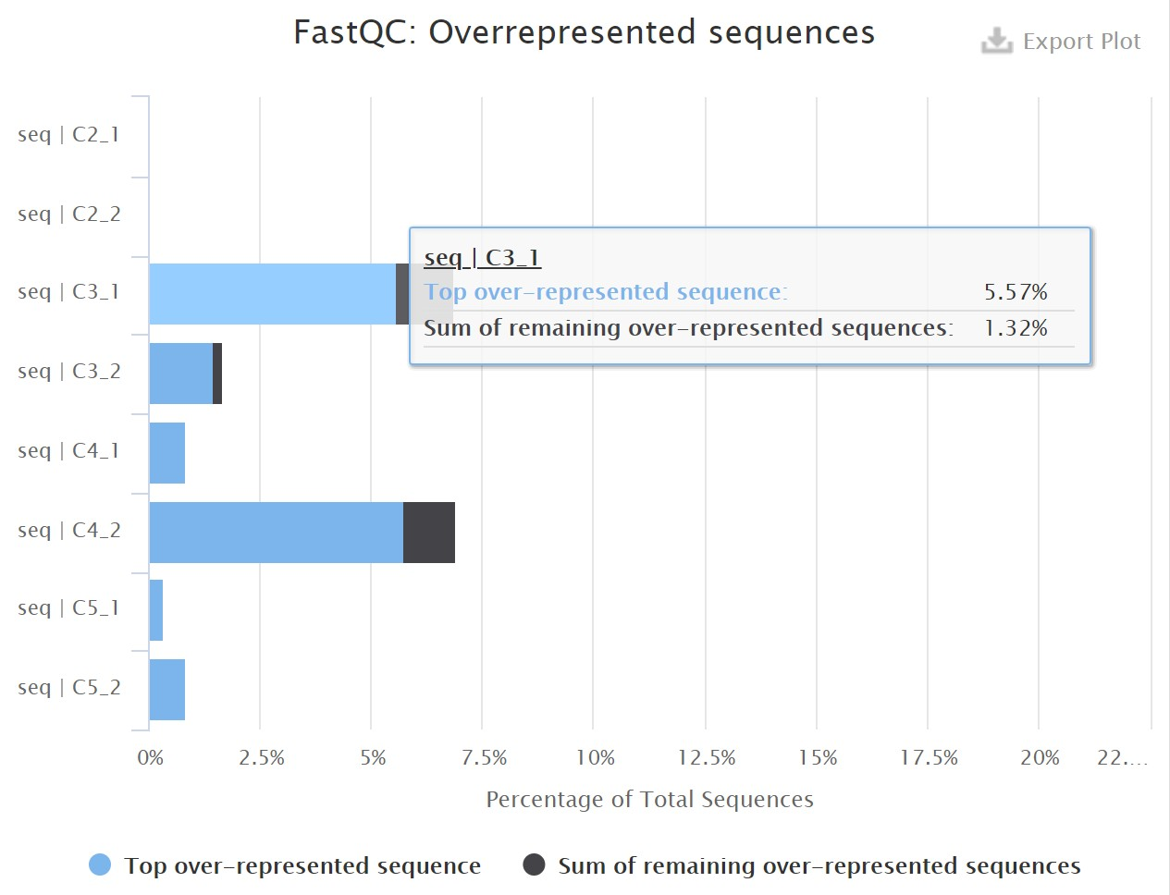
A
B
C
D

Slide 3
A. NCBI SRA sequence IDs are duplicated
B. Modified NCBI SRA sequence IDs are unique
(qc2) [yongxin@meta:~/KneadData]$zcat seq/C2_1.fq.gz|head
@SRR3586062.883556
CTTGGGGCTGCTGAGCTTCATGCTCCCCTCCTGCCTCAAGGACAATAAGGAGATCTTCG
+
CCCFFFFFHHHHHIJJJJJJJIJIJJJJGIJDGIJEIIJIJJJJJJJJIJJJJIJJIJJ
@SRR3586062.3376311
GACGGTGTCCTCAGGACCCTTCAGTGCCTTCATGATCTGCTCAGAGGTGATGGAGTCAC
+
@@@DDDDAFF?DF;EH+ACHIIICHDEHGIGBFE@GCGDGG?D?G@BGHG@FHCGC;CC
@SRR3586062.3139527
CCTCTATTTCCAACTTGGTCATTTCTCTCTACATATGAAAATGAATTTACACATAAAAT
(qc2) [yongxin@meta:~/KneadData]$zcat seq/C2_2.fq.gz|head
@SRR3586062.883556
AAGCCAGGACCCGAGTAGTCTCGGCCAGCATAGTACTCCATACGCCAGCCCTTGGGCGC
+
CCCFFFFFHHHHHJJHIJEHIJJHIIIIIIJJJHIJGIJIGIJJJJGGCHFEGCHGHGF
@SRR3586062.3376311
TGGCGTGCAGTTCAATACCCTCCTCGACACCGTCGTCGTCGTGCGTGTCATCGAGGGTG
+
=8+=?=)0<+CDDEAEEA<C>FD>F<EEDADDBD)@DA7BADDD8CDA(7.;@A@@>=;
@SRR3586062.3139527
ATTAATTTATTTTTATATTTACTTAGAATCTTTGGAAGAAAAAAATAATTACTTAGGAG
(qc2) [yongxin@meta:~/KneadData]$head seq/C2_1.fq
@SRR3586062.883556\1
CTTGGGGCTGCTGAGCTTCATGCTCCCCTCCTGCCTCAAGGACAATAAGGAGATCTTCG
+
CCCFFFFFHHHHHIJJJJJJJIJIJJJJGIJDGIJEIIJIJJJJJJJJIJJJJIJJIJJ
@SRR3586062.3376311\1
GACGGTGTCCTCAGGACCCTTCAGTGCCTTCATGATCTGCTCAGAGGTGATGGAGTCAC
+
@@@DDDDAFF?DF;EH+ACHIIICHDEHGIGBFE@GCGDGG?D?G@BGHG@FHCGC;CC
@SRR3586062.3139527\1
CCTCTATTTCCAACTTGGTCATTTCTCTCTACATATGAAAATGAATTTACACATAAAAT
(qc2) [yongxin@meta:~/KneadData]$head seq/C2_2.fq
@SRR3586062.883556\2
AAGCCAGGACCCGAGTAGTCTCGGCCAGCATAGTACTCCATACGCCAGCCCTTGGGCGC
+
CCCFFFFFHHHHHJJHIJEHIJJHIIIIIIJJJHIJGIJIGIJJJJGGCHFEGCHGHGF
@SRR3586062.3376311\2
TGGCGTGCAGTTCAATACCCTCCTCGACACCGTCGTCGTCGTGCGTGTCATCGAGGGTG
+
=8+=?=)0<+CDDEAEEA<C>FD>F<EEDADDBD)@DA7BADDD8CDA(7.;@A@@>=;
@SRR3586062.3139527\2
ATTAATTTATTTTTATATTTACTTAGAATCTTTGGAAGAAAAAAATAATTACTTAGGAG

Slide 4
KneadData质控关键步骤统计
Sample | raw 1 | raw 2 | trimmed 1 | trimmed 2 | final 1 | final 2
C2 | 75000 | 75000 | 65316 | 65316 | 64876 | 64876
C3 | 75000 | 75000 | 48082 | 48082 | 30897 | 30897
C4 | 75000 | 75000 | 50387 | 50387 | 29343 | 29343
C5 | 75000 | 75000 | 60959 | 60959 | 57379 | 57379

Slide 5
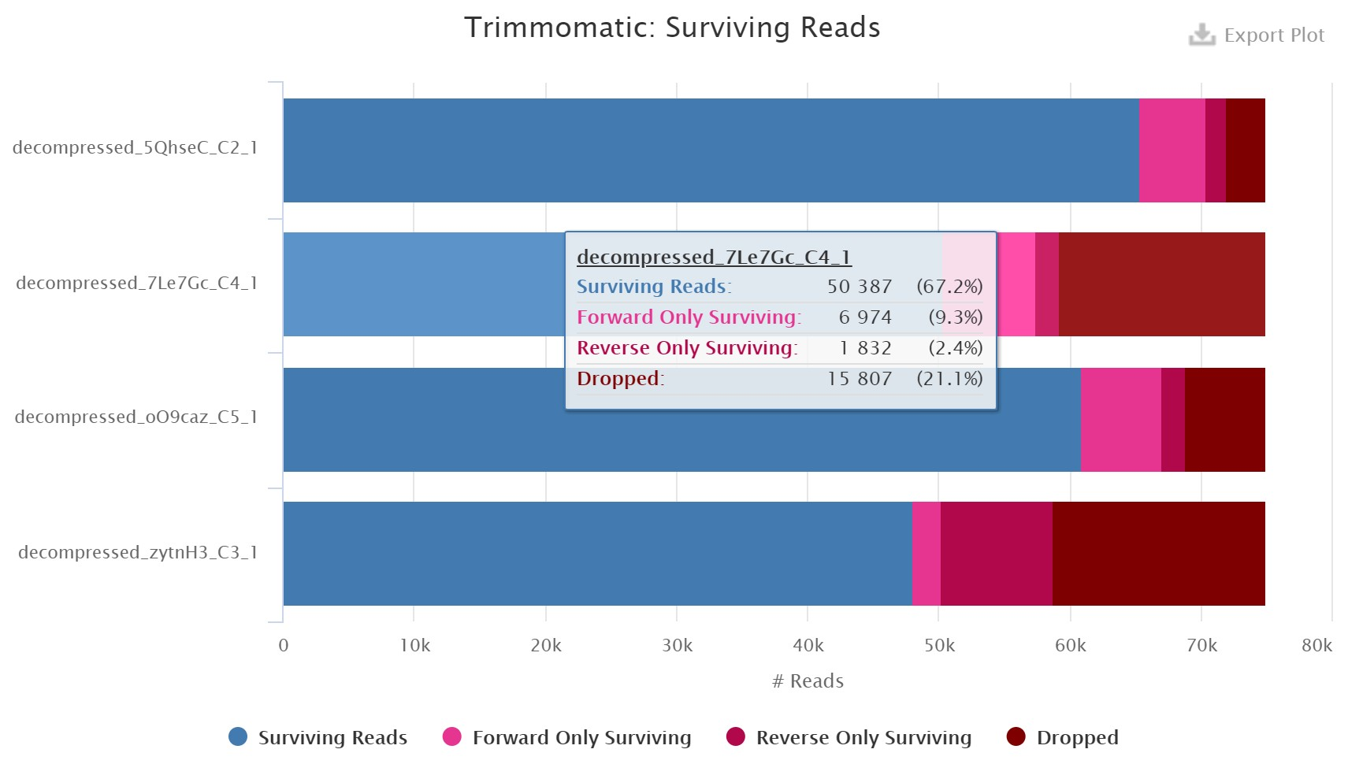
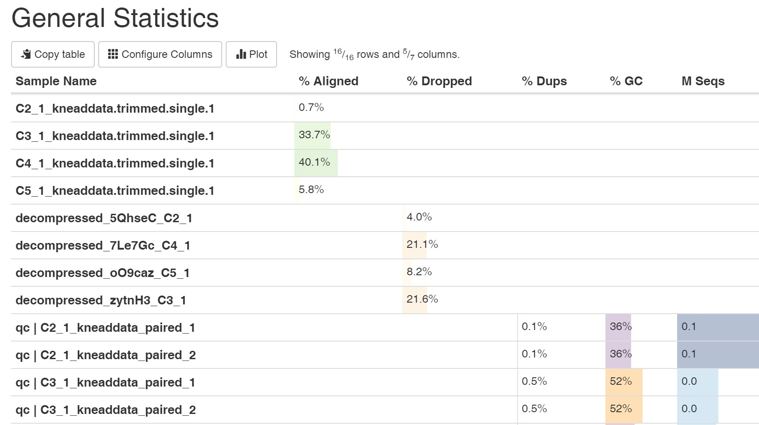
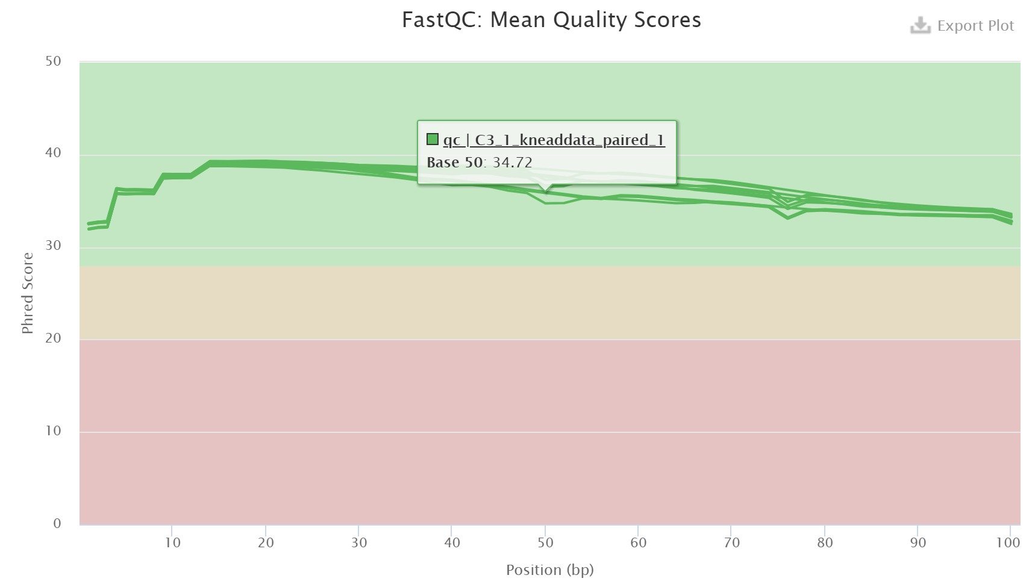
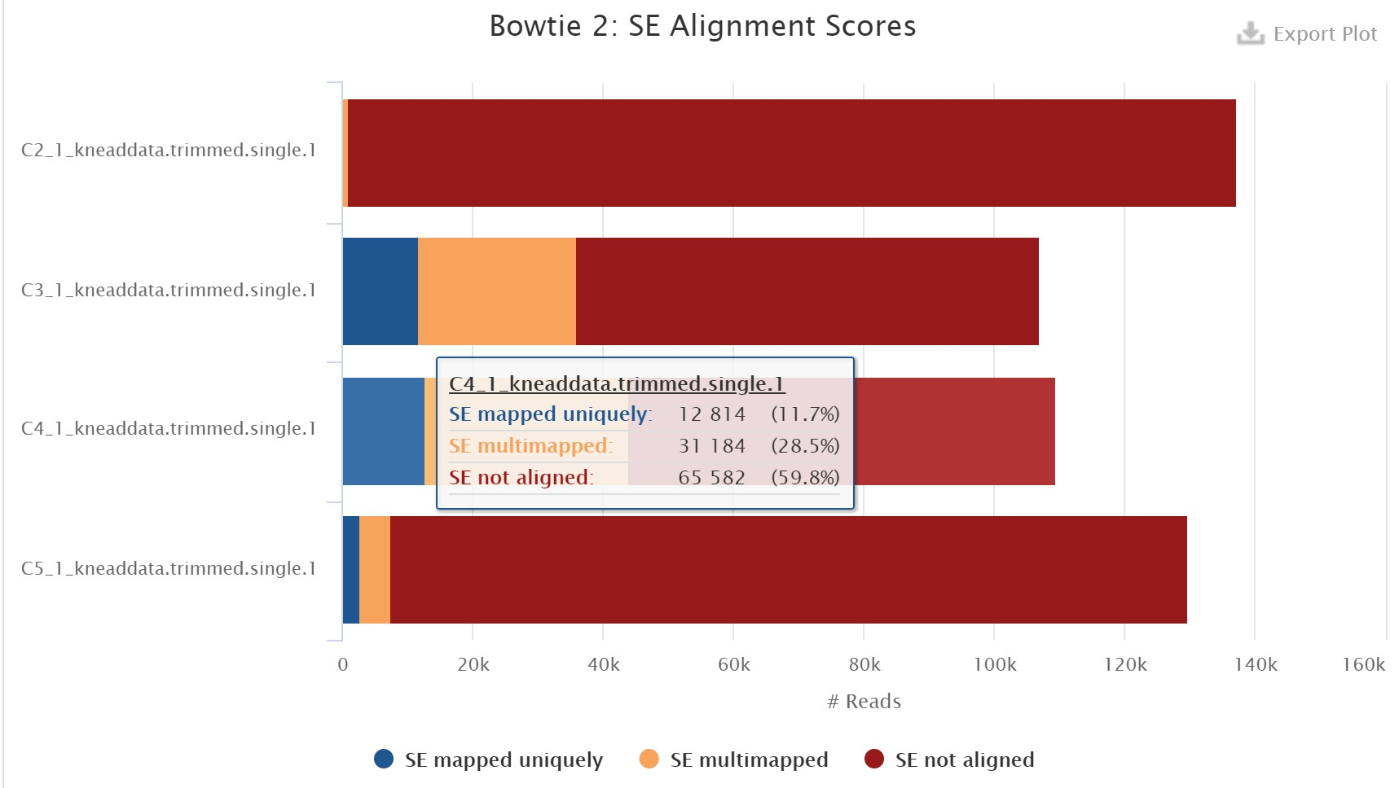
A
B
C
D

