Slide 1
Specifications Area – Protocol Independent Forwarding
Workday session / February, 2015

Slide 2
ONF Antitrust & Intellectual Policies and Specific Guidance
This is a reminder that all Open Networking Foundation activities are subject to strict compliance with the Open Networking Foundation's Antitrust Guidelines. Each individual participant and attendee at this meeting is responsible for knowing the contents of the Antitrust Guidelines, and for complying with the Antitrust Guidelines. Copies of the Antitrust Guidelines are available at: https://www.opennetworking.org/about/onf-overview Participants also are expected to adhere to these Guidelines in any informal meetings or social gatherings in which they might participate in connection with the activities of the Corporation.
You are required to treat the contents, notes, artifacts, and all materials associated with this meeting (including recordings) as protected by the ONF Intellectual Property Rights (IPR) policy. Do not forward any of these contents to any non ONF members. For more information on the ONF IP policy, please consult https://www.opennetworking.org/images/stories/downloads/about/onf-operating-documents/organizational-documents/onf-ipr-policy.pdf
All participants are reminded that the FCC's anti-collusion rules are in effect for the AWS-3 auction. To ensure full compliance with these rules, participants must avoid any statements or discussions relating to the auction or to any auction applicant's bids or bidding strategies in the auction, or which could affect any company's bids or bidding strategy. For additional guidance, please consult your own counsel.

Slide 3

PIF work session agenda
Overview of the PIF group activity
(Ben Mack-Crane, 30 mins) Johann Tonsing
Motivation and terminology
Projects and responsibilities
Tour of the AIR-IRI Intermediate Representation code base
(Johann Tonsing, 30 mins):
Sample datapath program
Overview of interpreter and infrastructure
Work items and infrastructure
(Gordon Brebner, 40 mins):
Summary of work so far
Future work areas
Next steps and how to participate
(Gordon Brebner, 20 mins)

Slide 4
Overview of the PIF group activity
Ben Mack-Crane Johann Tonsing

Slide 5
Tour of the AIR-IRI Intermediate Representation code base
Johann Tonsing

Slide 6
Work items and infrastructure
Gordon Brebner

Slide 7

Summary of progress
Meeting since October 2014; over 100 people on mailing list
Backdrop: OF-PI white paper
AIR/IRI open source code by Dan Talayco
Much meeting/email discussion about IR characteristics
Particular focus on the nature of parsing
Also considered hardware target aspects
Some statefulness matters
Instruction sets
[Overlap with FAWG] Configuration time vs. run time
Show-and-tells:
Netronome
Xpliant
Presentation of Flowgrammable open source OpenFlow projects
Discussion on templates, for software collateral and for samples

Slide 8
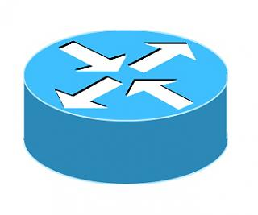
Xpliant/Cavium PIFL Architecture
High Level Language
Front End Compiler
PIFL IR
Back End Compiler
Hardware data

Slide 9
Generic Switch Forwarding Model
…
Update/Queue Packet
Format Key
Lookup Table
Process Result
Format Key
Lookup Table
Process Result
…
Parser
Format Key
Lookup Table
Process Result
Format Key
Lookup Table
Process Result
.
.
.
.
.
.
.
.
.
.
.
.
…
Format Key
Lookup Table
Process Result
Format Key
Lookup Table
Process Result
Incoming packet gets parsed and classified.
Keys into tables are formed depending on packet meta data, possibly in parallel.
Tables are looked up, possibly in parallel.
The results are processed, possibly merging results from different lookups.
During this stage:
States and Table entries can get updated.
Packet can be acted upon. (Dropped, Forwarded etc).
Packets can get replicated.
Multiple stages of lookups/processing can be defined.
Packets can be modified/appended/truncated.
Packets can be queued to go out based on available data.

Slide 10
PIFL Highlights
High Level Language.
Human writable/readable.
Familiar, C like interface.
Provides ‘natural’ programming constructs:
Structures and Variables – Defines Packet Headers and Metadata.
Statements – Allows copy of fields.
ALU operations – Performs operations like TTL decrement.
Conditional execution – Matches on field values.
Directives for sequential and parallel control flow.
Provides constructs to define switch primitives exposed by the PIFL IR.
PARSER, TABLE, KEY_FORMATTER, LOOKUP, POST_LOOKUP, PACKET_HEADER, LAYER_DATA, PACKET_UPDATE, ENQUEUE
Independent of hardware.
Independent of networking protocols.

Slide 11

Proposal from Haoyu Song: A Really Simple Abstract Forwarding Model
Tables
Actions
In
Ports
Out Ports
Ports can be physical or virtual ports
Including queue/buffer, switch fabric, controller, clone re-entry, recirculation, autonomous function
Action block is the major programming point
Can derive parser using one of the two approaches
Can infer table dependency
This model is always for just a single packet
Cloned packets need to be submitted to some “port”

Slide 12
Proposal from Haoyu Song: Objects in Abstract Model & IR
Operable objects (writable)
Table & Table entry
Packet data (no need to distinguish header and payload in OF-PI)
Packet Metadata
Per packet registers
Flow Metadata (counter, meter, and other global resources)
Per flow registers
Timers
Non-operable objects (read only)
Port
Queue/buffer (can this be abstracted as virtual port?)
Event
Autonomous function (can this be abstracted as virtual port?)

Slide 13
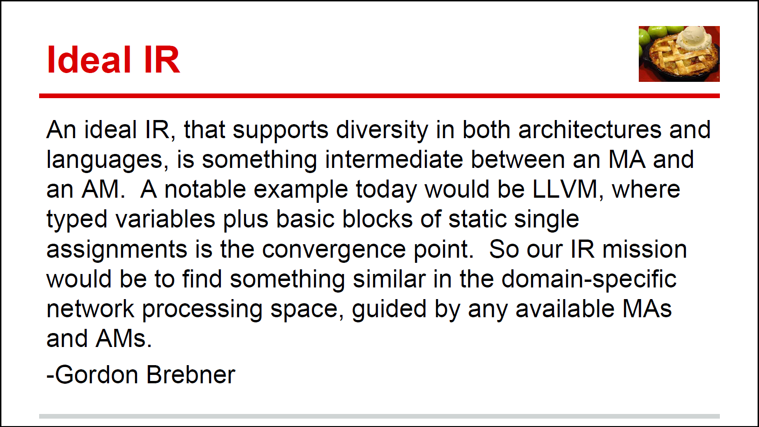
Beyond Motherhood and Apple Pie
Source:
PIF Update
Dan Talyco
October 9, 2014
Glossary:
MA =
Machine Abstraction
(of hardware)
AM =
Abstract Machine
(for software)
p.s. It should not lose or obscure useful higher-level information that is not easy to reconstruct or rediscover at a lower level
This presentation: coming from the MA direction

Slide 14
Underlying Hardware 1: Architectures and Programmability
Control flow centric stereotype:
Random packet access
Run to completion
Generalized execution units and datapaths
High programmability through instructions
Stateful
Data flow centric stereotype:
Linear packet access
Pipelined
Specialized function units and datapaths
Varied programmability through configurations
Stateless
… and hybrids of the above
Question:
Is there an IR that can be mapped efficiently to both models, without an excessive number of optional features?

Slide 15
Underlying Hardware 2: Chips, Boards, Racks, and Software
The “switching chip” is just a virtual concept (= the abstract forwarding model)
Hardware:
Chips for switching, packet processing, lookups, storage
Boards with multiple chips
Racks with line cards and switch fabrics
Software:
Software-only switching or packet processing
Software with hardware acceleration
Firmware for hardware configuration
Question:
Is there an IR that can be mapped efficiently to all targets, without an excessive number of optional features?

Slide 16
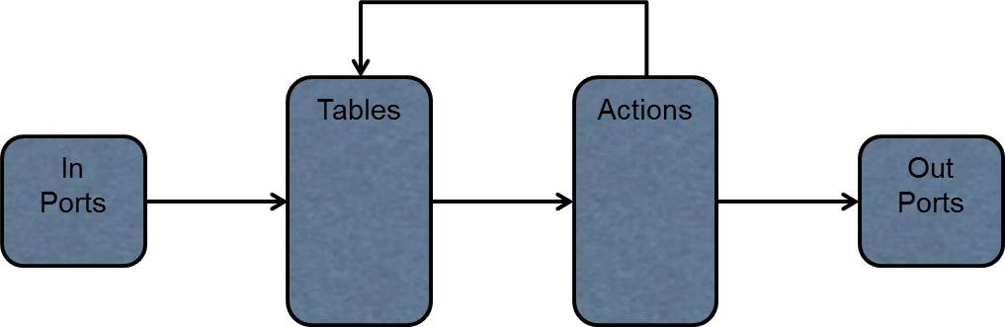
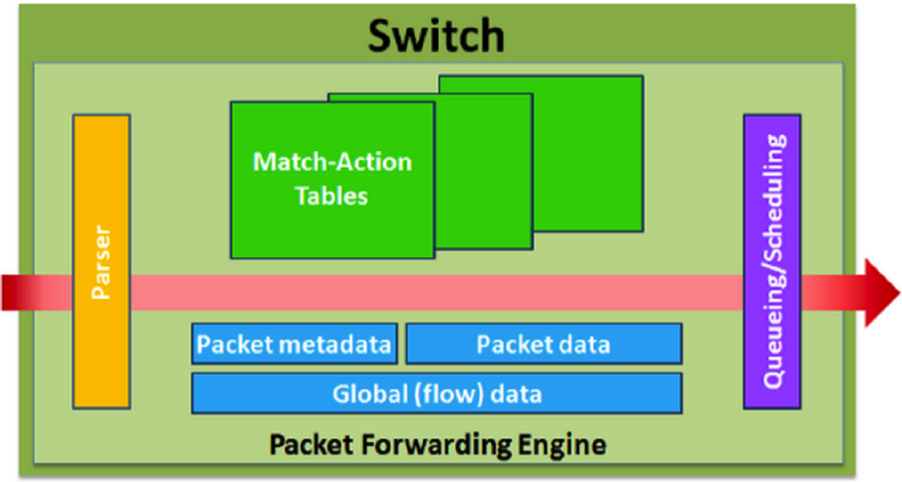
Abstract Forwarding Model: Continuum of Granularity
Haoyu Song proposal, October 2014
Finer-grain end:
Functions programmed using (e.g. POF-FIS) actions
Question:
Is packet processing better represented by simple instructions operating on packets, or by larger components acting on packets?
OF-PI strawman proposal, July 2014
Coarser-grain end:
Built-in functions programmed with custom configuration

Slide 17
Future work areas
Three general areas identified:
IR development – simulator and related tools
Investigate modifications/extensions to AIR
Includes feedback from (maybe closed source) back ends
IR sample programs
Capture important use cases
Proxies for future front ends
IR run-time interface
Important but not for immediate attention
Relates to validation frameworks

Slide 18
IR development topics
AIR-IRI is starting point
Improve/extend simulator
Associated tools
IR experiments
Review and understand current AIR components
Develop proposals for where information and constraints are best captured
Examples: parser, control program, traffic manager
Representation of expressions
Feedback from any back end experiments
These might be closed-source by vendors

Slide 19
IR sample programs
Catalog any existing programs/fragments
Review any known front end (e.g., P4) experience
Suggestions:
L4-L7
Tunnel
OpenFlow clone
… other OF-NG use cases as identified by FAWG
Move in direction of toolkit based on library components
Avoid duplication of effort

Slide 20
IR run-time interface
Relationship to OF-Config and OF-Switch discussion
Relationship to FAWG lifecycle and temporal discussions
Validation framework for PIF

Slide 21
Next steps and how to participate
Gordon Brebner

Slide 22
Trajectory of PIF group
Currently
Within ONF
Members only
Standard ONF IPR policy
Focused project
Plan (some time later in 2015)
Open source, sponsored by ONF
Open to all contributors
Apache 2.0 license
Enlarged project

Slide 23
Ways to participate
Best:
Write code contributions
Volunteers wanted today
Increase diversity of opinions
And:
Active participation in weekly PIF call
Join in PIF email discussions
But understand:
PIF output is code, and documentation derived from code
Not a “PDF” group

Slide 24
How to join in
See the shared Google Drive at: https://drive.google.com/folderview?id=0B_2T-rZM3pK9RmtlV25KeDF3MWM This contains an FAQ, documents, presentations, meeting minutes, pointers to code, etc.
Join the weekly call:
Fridays 9AM-10AM Pacific
VoIP / screen sharing: http://onfevents.webex.com - password 4Meeting
Audio call (when not using VoIP): +1-650-479-3207, code 666 936 914
Join the mailing list (pif@login.opennetworking.org) using the ONF ARO interface

