Slide 1
Open Source SDN – Protocol Independent Forwarding
Gordon Brebner / October 13, 2015

Slide 2
Open Source SDN Meeting Parameters
This is a reminder that all Open Source SDN meetings (sponsored by Open Networking Foundation) and activities are subject to strict compliance with the Open Networking Foundation's Antitrust Guidelines. Each individual participant and attendee at this meeting is responsible for knowing the contents of the Antitrust Guidelines, and for complying with the Antitrust Guidelines. Copies of the Antitrust Guidelines are available at: https://www.opennetworking.org/about/onf-operating-documents.
There are no specific IP agreements that guide these meetings. All communications should be construed as completely open and not subject to any pre-existing licensing or intellectual property regime from any organization, including those of Open Networking Foundation. All software that will be developed in these engagements will be licensed by a license that is in all respects an Apache 2.0 software license.

Slide 3

Today’s PIF agenda
Administrivia
Actions from last meeting
Welcome to new Open Source SDN project participants
BIR update
Deliverable timescales
Any other business

Slide 4
Actions from last meeting
[Rolling forward] Johann Tonsing to provide slides overviewing Netronome demo, and from David George presentation
[Rolling forward] Gordon to check with contributors to past meetings on whether their material/comments/questions can be transferred to non-ONF openness

Slide 5


BIR (pronounced “beer”) update
Gordon Brebner / Xilinx

Slide 6
BIR: the “B” IR
Intended to capture the different threads of IR-related discussions
Intended to be at the “right” level for this domain-specific IR
Intended to be more language/target neutral than the AIR/IRI IR
Proposal for an IR spec for wider review and discussion
Open source software simulator based on AIR-IRI infrastructure

Slide 7
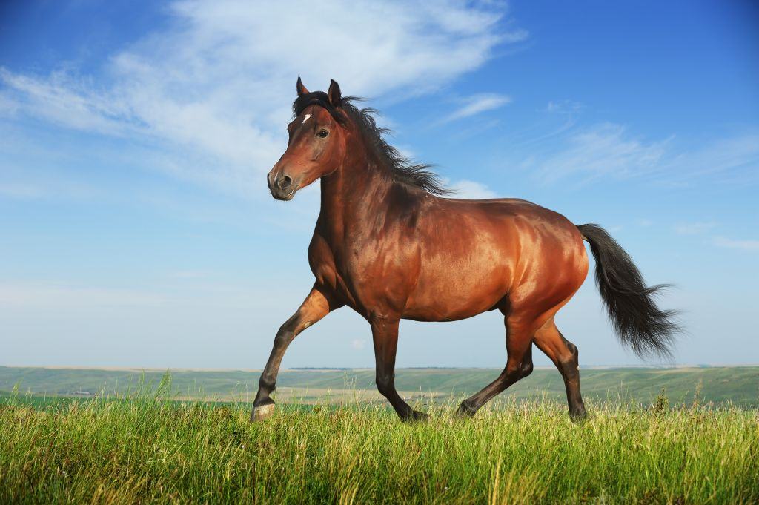
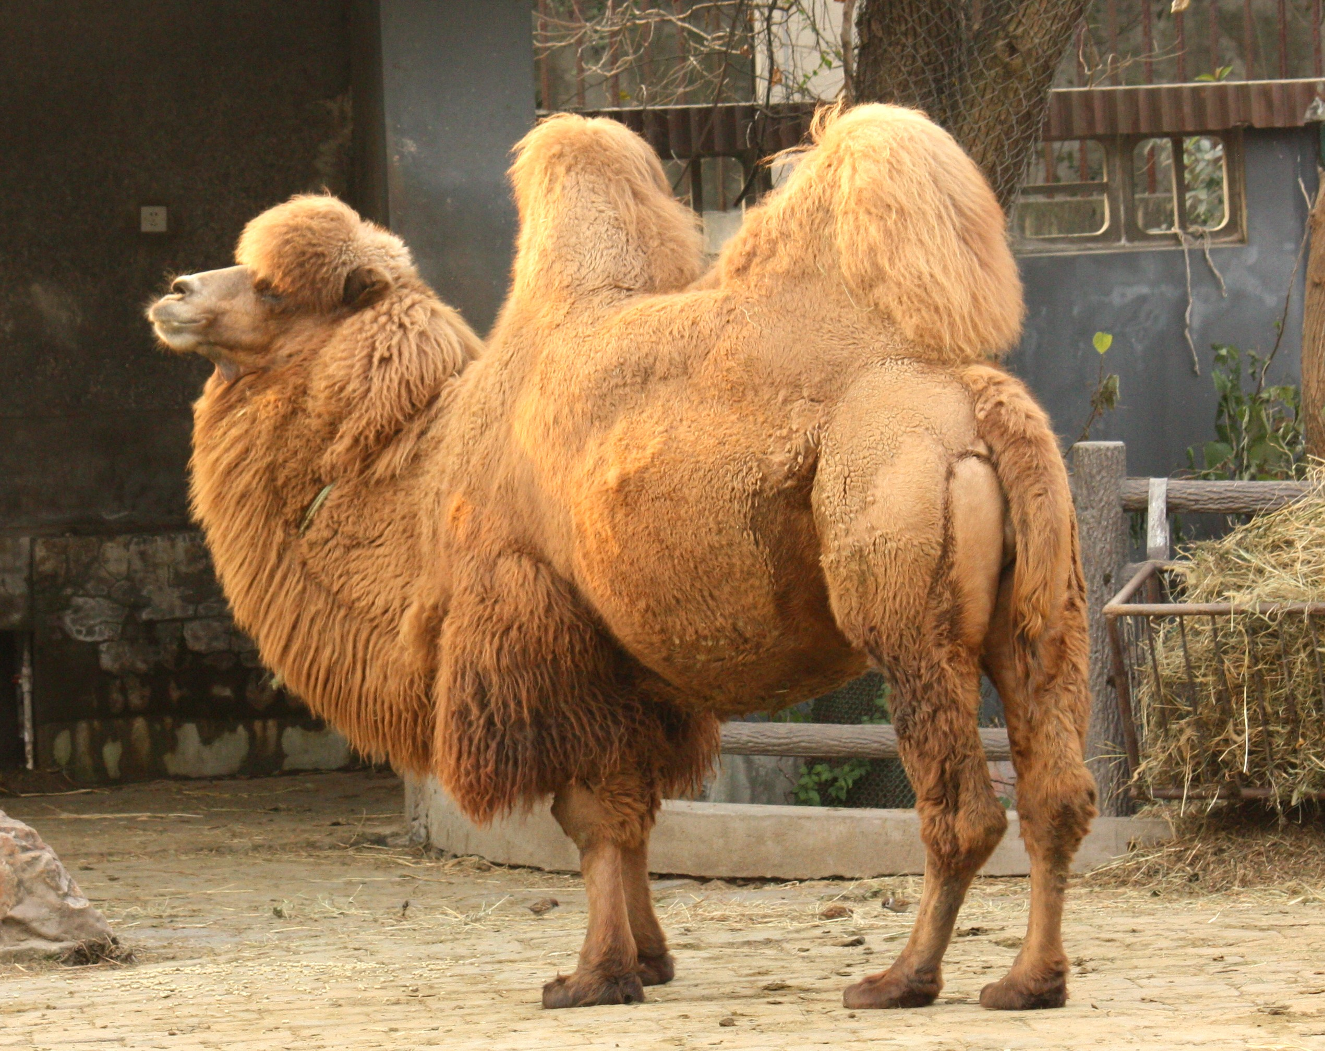
Main influences
PIF group discussions
P4, RMT, AIR-IRI
school
BIR
POF
school
NetASM
school
PX
school
rather than
Design

Slide 8
Key characteristics
Top-level static packet data flow graph (linear pipeline at first)
Each node is a “packet processor”
Either a “control flow”: programmed processor
Or an “other processor”: supplied processor
A control flow involves traversing “basic blocks” to completion
Captures both parsers and table match-action pipelines
A basic block:
Has optional defined local contexts of: header type, table
Is passed a packet and an offset into the packet – where header is mapped
Carries out header/metadata updates and/or calls on supplied methods
Calculates next offset and next basic block
Expressions are atomic
Tables are header-in, header-out (not match-action abstraction)

Slide 9
Using the AIR meta infrastructure New meta.yml specification (current draft)
# These are the recognized top level BIR object types
air_types :
- header
- metadata
- table
- other_module
- basic_block
- control_flow
- other_processor
- processor_layout
# These BIR objects must implement a process method
air_processors :
- control_flow
- other_processor
# These are the attributes each object type supports
# All objects support the type and doc attributes
air_attributes :
header :
- fields
metadata :
- fields
- initial_values
table :
- type
- depth
- request
- response
- operations
other_module :
- operations
basic_block :
- local_header
- local_table
- instructions
- next_offset_block
control_flow :
- start_offset_block
other_processor :
- class
processor_layout :
- format
- implementation

Slide 10
Mapping AIR-IRI types to BIR types
Header
Metadata
Table
Action
Parse_state
Parser
Control_flow
Traffic_manager
Processor_layout
Value_set
Value_map
Header
Metadata
Table
Basic_block
Control_flow
Other_processor
Processor_layout
Other_module

Slide 11
Control flow
Recognizes that packet processing is driven by two dynamic factors:
Packet data (data plane input)
Table data (control plane input)
Context for a basic block:
Particular header in packet: can be read or written
Particular table:
Lookup takes a struct containing expressions
Result is a struct containing values: some can be decoded as actions
Using metadata associated with each packet
Can represent fine- and coarse-grain parsing and match-action
Not defined as a graph, edges come dynamically from bb transitions
Expression to determine next basic block (or terminate) and next packet offset

Slide 12
Basic block instructions
Field assign
Destination in local packet header, or in metadata
Value is expression over local packet header, or metadata, fields
Header assign
Destination is metadata header
Value is result of lookup in local table, key is metadata header
Method call
Call on built-in method: header insert/remove, table entry add/remove
Call on other-module method

Slide 13
Expressions
Expressions may be used widely
Constructing lookup keys
Updating packet fields
Computing next offset and next basic block
Conditionals
Certain languages/targets may restrict generality of expressions
Expressions not broken down further into simple operations
This left to target-specific backends for implementation

Slide 14
Tables
Not represented as match-action tables in the OpenFlow sense
Lookup key is arbitrary struct of expressions
Not just a selection of fields
Result is arbitrary struct of values
Not just a selection of pre-defined actions, generally a source of operands
Some expressions can be interpreted as actions in basic block
Table is closer to real table implementations
Standard exact match, LPM, TCAM, types

Slide 15
Other topics pending
Templating
Used to produce samples (Johann)
Used to produce different collateral (Dan)
Runtime

Slide 16
Deliverable timescales

Slide 17
ONF definition of stable IR Question from Dan Pitt, prompted by Michael Orr (CAB)
Proposed rough steps:
PIF group agrees that its "IR experimentation phase" is now done, and a broad consensus has been reached
Less new experimentation during the past months, but prior work (e.g., POF at Huawei, PX at Xilinx) forms a proxy for extra AIR/IRI experiments, and gets the key input from those people who are most deep in this IR area
A strawman IR 0.9 specification and open-source simulator is issued for feedback before the end of the year
… including from CAB representing targets and also P4 representing high-level languages
… particularly sought on inter-operability aspects, given the IR should be a solid target- and language-neutral thing (without being bland to the point of uselessness)
BIR exercise is designed to capture a consensus (and not just a prelude to CIR, DIR, etc.) leading towards a strawman that captures the best, most relevant, and most general, aspects of the experimentation
Refinement by PIF group based on feedback
Specification 1.0 by end of first quarter of 2016

