Slide 1
Protocol Independent Forwarding (PIF) group BIR: From Powerpoint to Python and PDF
Workday session / March, 2016

Slide 2
Open Source SDN Meeting Parameters
This is a reminder that all Open Source SDN meetings (sponsored by Open Networking Foundation) and activities are subject to strict compliance with the Open Networking Foundation's Antitrust Guidelines. Each individual participant and attendee at this meeting is responsible for knowing the contents of the Antitrust Guidelines, and for complying with the Antitrust Guidelines. Copies of the Antitrust Guidelines are available at: https://www.opennetworking.org/about/onf-operating-documents.
There are no specific IP agreements that guide these meetings. All communications should be construed as completely open and not subject to any pre-existing licensing or intellectual property regime from any organization, including those of Open Networking Foundation. All software that will be developed in these engagements will be licensed by a license that is in all respects an Apache 2.0 software license.

Slide 3
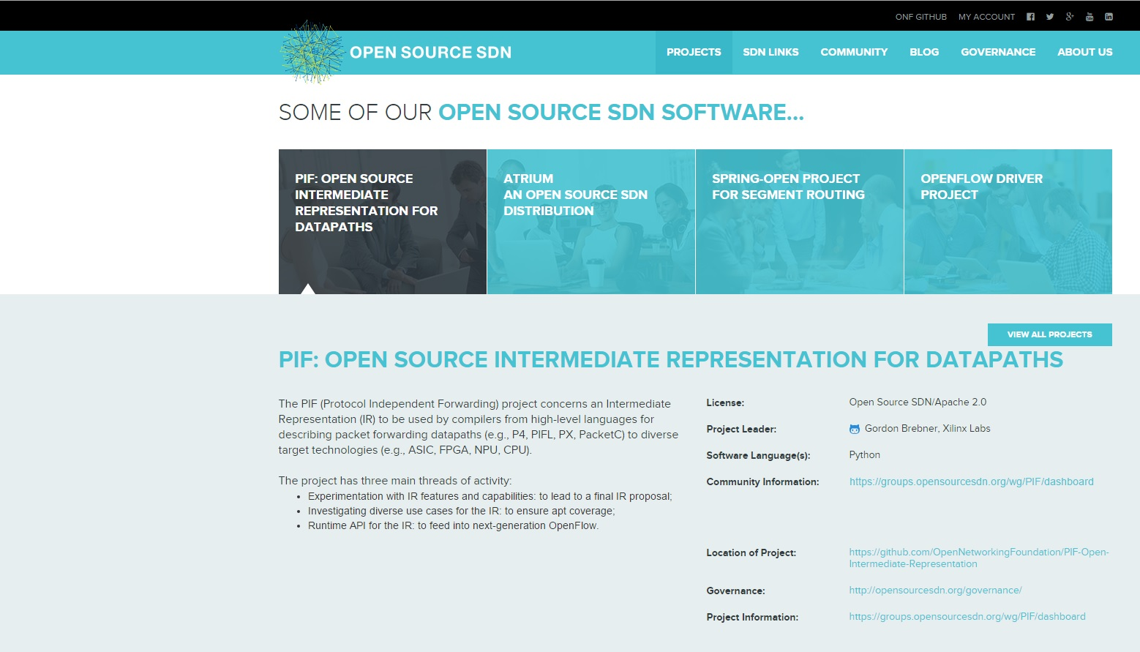
Open Source SDN presence opensourcesdn.org

Slide 4
PIF Open Source SDN software project … and also ONF Specifications Area group
P4
PIFL
PX
Focus areas of PIF project:
Intermediate representation
IR elements
Use cases
Runtime APIs
Feeds into ONF “OpenFlow Next Gen” specification activity

Slide 5
BIR (pronounced “beer”): the “B” IR
Intended to capture the different threads of IR-related discussions
Intended to be at the “right” level for this domain-specific IR
Intended to be more language/target neutral than the AIR strawman
Proposal for an IR spec for wider review and discussion
Open source software simulator based on Meta-IR infrastructure

Slide 6
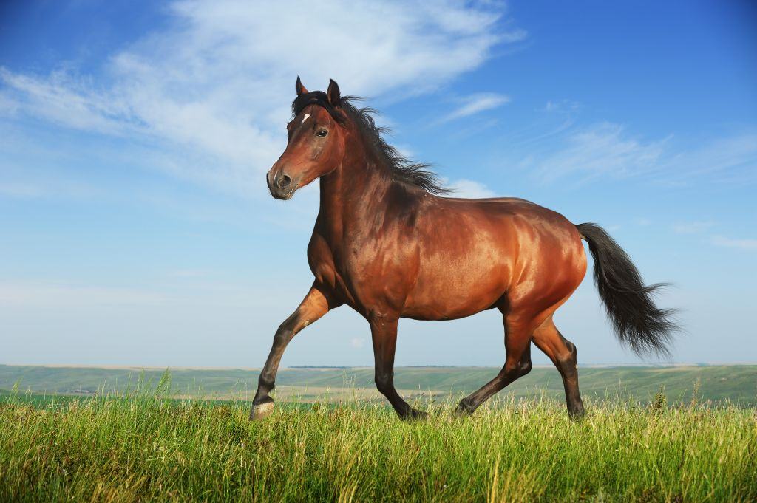
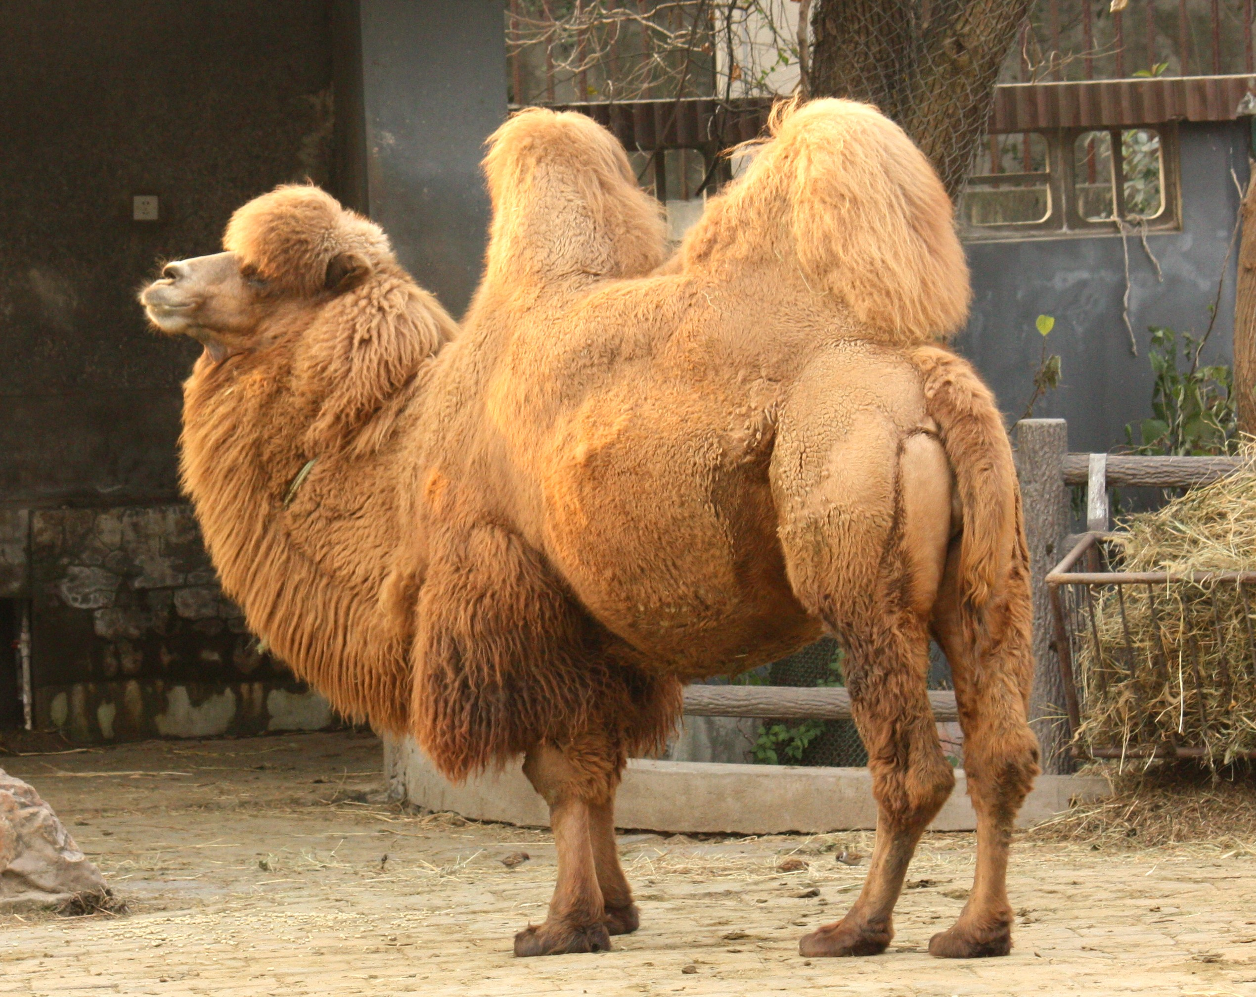
Main influences
PIF group discussions
P4, RMT, AIR
school
BIR
POF
school
NetASM
school
PX
school
rather than
Design

Slide 7
The BIR packet processing model
Top-level static packet data flow graph (linear pipeline at first)
User-defined metadata collection(s) associated with each packet in transit
Each node is a “packet processor”
Either a “control flow”: programmed processor
Or an “other processor”: supplied processor
Could be described as “µVNF chaining”
A control flow involves traversing “basic blocks” to completion
A basic block:
Has optional defined local contexts of: header type, table
Is passed a packet and an offset into that packet
Carries out an unconditional sequence of header/metadata updates and/or calls on library methods
Calculates next offset and next basic block at end

Slide 8
Control flow rationalization
Recognizes that packet processing is driven by two dynamic factors:
Packet data (data plane input)
Table data (control plane input)
Therefore, context for a basic block:
Particular header in packet: can be read or written
Particular table:
Lookup takes a struct containing expressions for values
Result is a struct containing values: some can be decoded as actions
Metadata collections can be associated with each packet
Can represent fine- and coarse-grain parsing and match-action pipelines

Slide 9
Example: Three-stage processor pipeline
Control Flow
Other Processor
Control Flow
Start Control State
Compute Packet_offset
Select Basic_block
Start Control State
Terminate
Terminate
Basic Block
Instruction 1
Instruction 2
. . .
Instruction N
BB
BB
BB
Header format
BB
BB
BB
BB
BB
BB
Next Control State
Compute Packet_offset
Select Basic_block
BB

Slide 10
From Powerpoint to Python and PDF …
September 2015 workday:
Initial BIR slideware
March 2016 workday:
BIR software model and switch simulation
BIR technical report v1.0
In between:
PIF group discussion and development of BIR proposal

Slide 11
BIR open source software
GitHub:
OpenNetworkingFoundation/PIF-Open-Intermediate-Representation
Refactoring of original PIF AIR-IRI software framework
Meta-IR for defining experimental IRs
BIR model defined using Meta-IR
Switches defined as BIR instances
YAML used to represent BIR model, and BIR-defined switches
Some very short term, as well as longer term, to-do items …

Slide 12
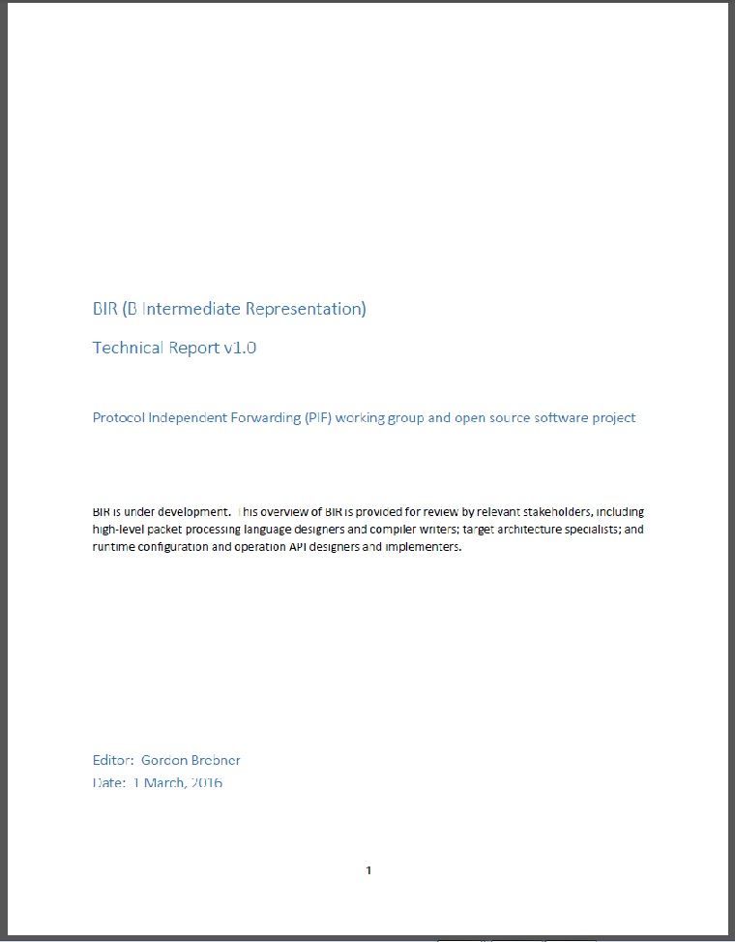
BIR technical report
Version 1.0
In the OSSDN PIF GitHub repository
Also in the ONF ARO repository
Now open for wider (extra-PIF) review
Appendix summarizes some issues under discussion
First step towards a ONF “Open IR” specification

Slide 13
Three important sanity checks for BIR
Can P4 v1.x (x = 0, 1, 2) be mapped to BIR?
Already have sketch of mapping for x = 1.5
Can TTP examples be expressed in BIR?
Via hand-written BIR code samples at first
Can BIR be efficiently mapped to a range of targets?
Through participation by a range of providers

Slide 14
Notable BIR further discussion topics
Adding explicit packet cloning capability
Current data flow is one-packet-in, one-packet-out
Stateful information:
More general read/write access to tables from data plane
Concurrency issues
Annotations
Do not lose useful information from original high-level language
Runtime API

Slide 15
Runtime API setting
P4
PIFL
PX
HLL’s API
Generates
Adapter
Intermediate representation
IR’s API
Generates
Adapter
Target’s API

Slide 16
Summary of PIF work areas
Experimentation with IR features and capabilities:
to lead to a final IR proposal
Investigating diverse use cases for the IR:
to ensure apt coverage
Runtime API for the IR:
to feed into next-generation OpenFlow

Slide 17
Ways to participate in the PIF project
Best:
Write code contributions
Volunteers wanted today
Increase diversity of opinions
And:
Experiments using existing code
Active participation in weekly PIF call
Join in PIF email discussions
But remember:
PIF output is code, and documentation derived from code
A “Python” group, as opposed to a “PDF” group

Slide 18
How to join in the PIF project
PIF Open Source SDN project at:
https://groups.opensourcesdn.org/wg/PIF/dashboard
Contains calendar, mail archive, documents, etc.
Warning: many documents still “in transit” between ONF and OSSDN
PIF GitHub:
https://github.com/OpenNetworkingFoundation/PIF-Open-Intermediate-Representation
Join the weekly call:
Mondays 11am -12 noon Pacific
See calendar entry for full information
Join the mailing list (pif@groups.opensourcesdn.org)

