Slide 1
Open Source SDN – Protocol Independent Forwarding
Gordon Brebner / January 26, 2016

Slide 2
Open Source SDN Meeting Parameters
This is a reminder that all Open Source SDN meetings (sponsored by Open Networking Foundation) and activities are subject to strict compliance with the Open Networking Foundation's Antitrust Guidelines. Each individual participant and attendee at this meeting is responsible for knowing the contents of the Antitrust Guidelines, and for complying with the Antitrust Guidelines. Copies of the Antitrust Guidelines are available at: https://www.opennetworking.org/about/onf-operating-documents.
There are no specific IP agreements that guide these meetings. All communications should be construed as completely open and not subject to any pre-existing licensing or intellectual property regime from any organization, including those of Open Networking Foundation. All software that will be developed in these engagements will be licensed by a license that is in all respects an Apache 2.0 software license.

Slide 3

Today’s PIF agenda
Administrivia
Actions from last meeting
Welcome to new Open Source SDN project participants
Feedback on BIR 0.9 outline specification
Refactored AIR-IRI code base
Any other business

Slide 4
Actions from last meeting
[Rolling forward] Johann Tonsing to provide slides overviewing Netronome demo, and from David George presentation
[Rolling forward] Gordon to check with contributors to past meetings on whether their material/comments/questions can be transferred to non-ONF openness

Slide 5


Feedback on BIR 0.9 outline spec

Slide 6
Feedback from …
Michael Orr
Ben Mack-Crane
Curt Beckmann
Haoyu Song
Joe Tardo

Slide 7
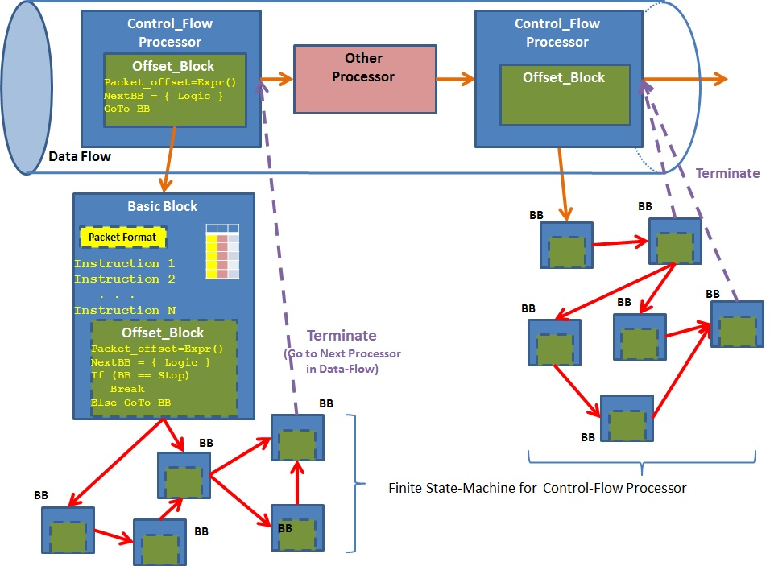
Michael’s visualization

Slide 8
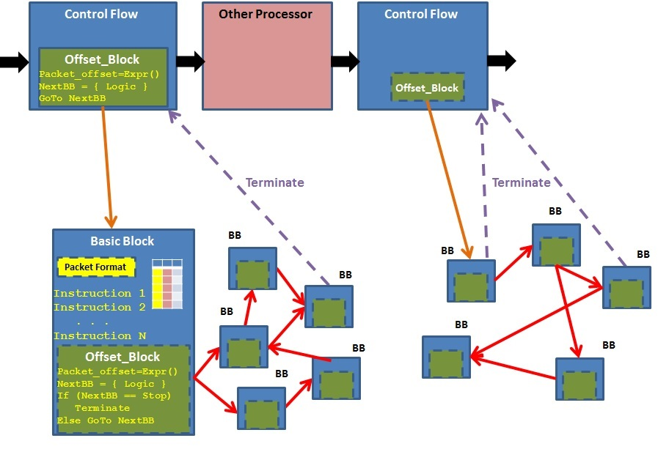
Gordon’s version of Michael’s visualization

Slide 9
Refactored AIR-IRI code base

