Slide 1
Open Source SDN – Protocol Independent Forwarding
Gordon Brebner / February 16, 2016

Slide 2
Open Source SDN Meeting Parameters
This is a reminder that all Open Source SDN meetings (sponsored by Open Networking Foundation) and activities are subject to strict compliance with the Open Networking Foundation's Antitrust Guidelines. Each individual participant and attendee at this meeting is responsible for knowing the contents of the Antitrust Guidelines, and for complying with the Antitrust Guidelines. Copies of the Antitrust Guidelines are available at: https://www.opennetworking.org/about/onf-operating-documents.
There are no specific IP agreements that guide these meetings. All communications should be construed as completely open and not subject to any pre-existing licensing or intellectual property regime from any organization, including those of Open Networking Foundation. All software that will be developed in these engagements will be licensed by a license that is in all respects an Apache 2.0 software license.

Slide 3

Today’s PIF agenda
Administrivia
Actions from last meeting
Welcome to new Open Source SDN project participants
Upcoming ONF workdays, Wed/Thu 2/3 March
Further discussion of BIR 0.9 outline specification
Sketch of P4 1.x to BIR 0.9 mapping
Any other business

Slide 4
Actions from last meeting
Gordon to firm up arrangements for PIF at ONF workdays in March
Gordon to modify/amplify BIR 0.9 specification to reflect feedback
[Rolled over] Gordon to overview P4-to-BIR mapping at next meeting
[Rolled over] Gordon and Johann to interact offline on completing the transfer of past PIF ONF-only material to OSSDN site
[Rolled over] Johann to check on status of packetC language

Slide 5
ONF workdays plan for PIF
Pre-workdays hands-on session:
Tuesday 1 March, 1.30pm to 4.30pm, at Netronome Santa Clara
Workdays open session
Thursday 3 March, 3pm to 4pm, at Marriott Santa Clara
Related OF-NextGen meetings:
Tuesday 1 March, 9am to 12pm, at Netronome Santa Clara
Thursday 3 March, 12.30pm to 2pm, at Marriott Santa Clara

Slide 6


Further discussion of BIR 0.9 outline spec

Slide 7
Sketch of P4 1.x to BIR 0.9 mapping

Slide 8
P4 to BIR: Basics
P4 headers => BIR headers
fixed length
variable length handled by offsets, maybe sub-header sequences
P4 metadata => BIR metadata
includes standard intrinsic metadata
P4 extern calls => BIR method calls (i.e. M instructions)
user specified methods
Exceptions
BIR: modeled with metadata, with annotation for possible target use

Slide 9
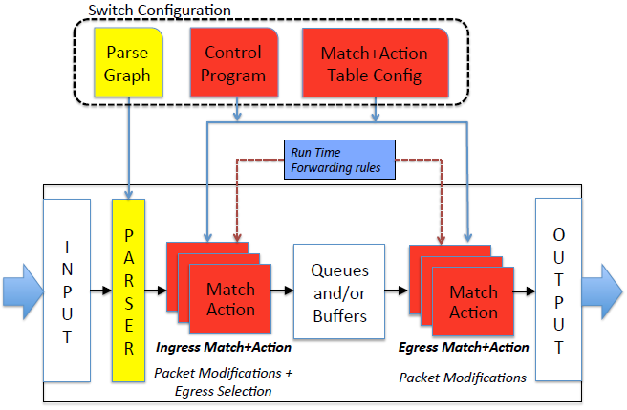
P4 to BIR: Standard Architecture
Parser: Control Flow
M+A: Control Flow
Deparser: Control Flow
BB
BB
BB
BB
BB
BB
BB
BB
BB

Slide 10
P4 to BIR: Parser
extract() & set_metadata()
BIR: A Control Flow of Basic Blocks with F instructions that only write to metadata
select()
BIR: next BB selection in offset_block
key masks
BIR: expressions with masks in next BB selection
value sets
BIR: use table to drive next BB selection
Deparsing
BIR: same as parsing except the F instructions only write to packet headers

Slide 11
P4 to BIR: Tables & Control Flow
Tables
BIR: has table type objects, which are managed in Basic Blocks
Types: Exact, Ternary, LPM, Index, Range, Valid
BIR: may support the same table types (or maybe, say, just TCAM as a generality)
BIR: currently does not allow read fields with different lookup styles per table
Actions
BIR: encoded as enum in table, then BB selection based on enum
Control Flow: apply()
BIR: Basic Block with a table, next BB selection based on table’s action selection
Control Flow: if/else conditions
BIR: next BB selection supports if/else statements

Slide 12
P4 to BIR: Primitive Actions
P4’s modify_field() => BIR F instruction
P4’s copy_header() => multiple BIR F instructions (expand out)
P4’s drop() => BIR F instruction
updates the egress_spec in the standard metadata
Not supported in BIR (expected to be factored out of P4 language)
resubmit
recirculate
clone_{ingress|egress}_to_{ingress|egress}

Slide 13
P4 to BIR: Primitive Actions
REMEMBER: headers are “extracted” to BIR metadata objects
these metadata object hold: header fields; is_valid bit; in_packet bit
add_header/remove_header
BIR: updates the metadata’s is_valid bit
BIR: the “deparser” Control Flow uses is_valid & in_packet bits
push/pop
BIR: copy headers, update is_valid bit
BIR: handled the same as insert/remove in the “deparser” Control Flow

Slide 14
P4 to BIR: Statefulness
Counters, Meters & Registers
P4: a lot of debate in the language design group
can the same stateful object be accessed at multiple locations?
P4: First class citizens in P4 v1.1, but are expected to be extern call in P4 v1.2
BIR: M instructions with background state
Work in progress …

Slide 15
P4 to BIR: Unsupported
Checksums & Hash-Value Generators
The above two are being factored out of the P4 language into libraries
Tables: multiple fields with different access types
Needs further iteration of definition of tables

