Slide 1
ATAC-seq data analysis handbook
Chengchen ZHAO, Zheting ZHANG, Yawen LYU, Wei SHI, Tianci KONG, Tiancheng Yu, Yuxiang YAO
2025.3.20

Slide 2
Outline
Experiment Overview (Yawen)
Pre-process Pipeline (Wei)
Downstream Analysis
  Quality control (Zejie)
  Dynamic pattern analysis (Tianci & Wei)
  Motif analysis (Tianci)
  Accessibility in selected regions (Tiancheng)
  Visualization in IGV (Jingyu)
  Correlation analysis (Zheting)
Tricks
Extension & Limitation

Slide 3
Experiment Overview

Slide 4
Pre-process Pipeline
测序数据量=目标区域大小×测序深度
1
Raw data vs. Clean data？

Slide 5
Quality control
QC of sequencing
QC of library construction
  Fragment length distribution

Slide 6
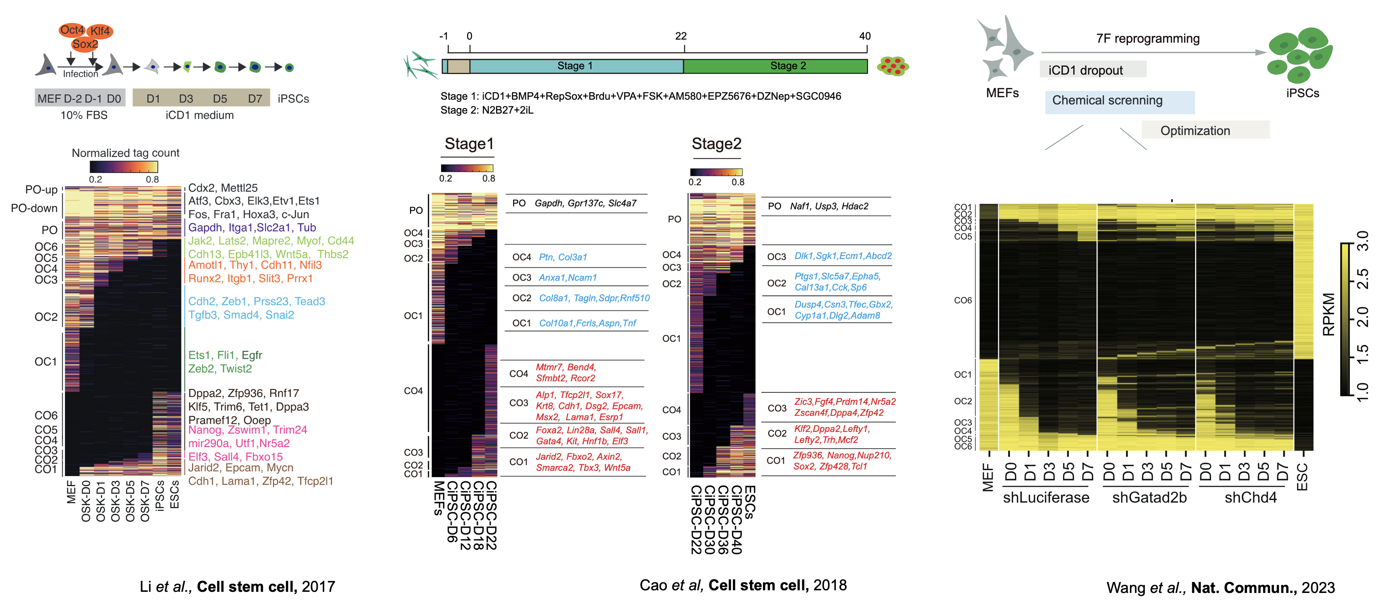
Dynamic pattern analysis

Slide 7
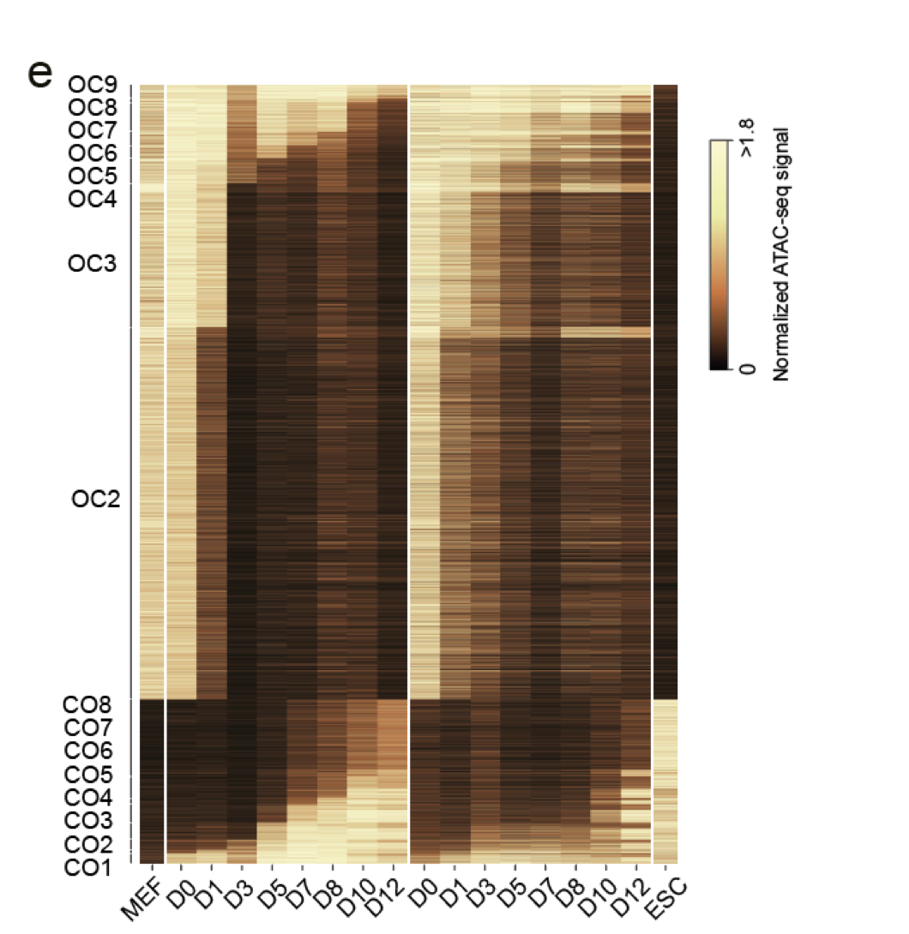

Slide 8
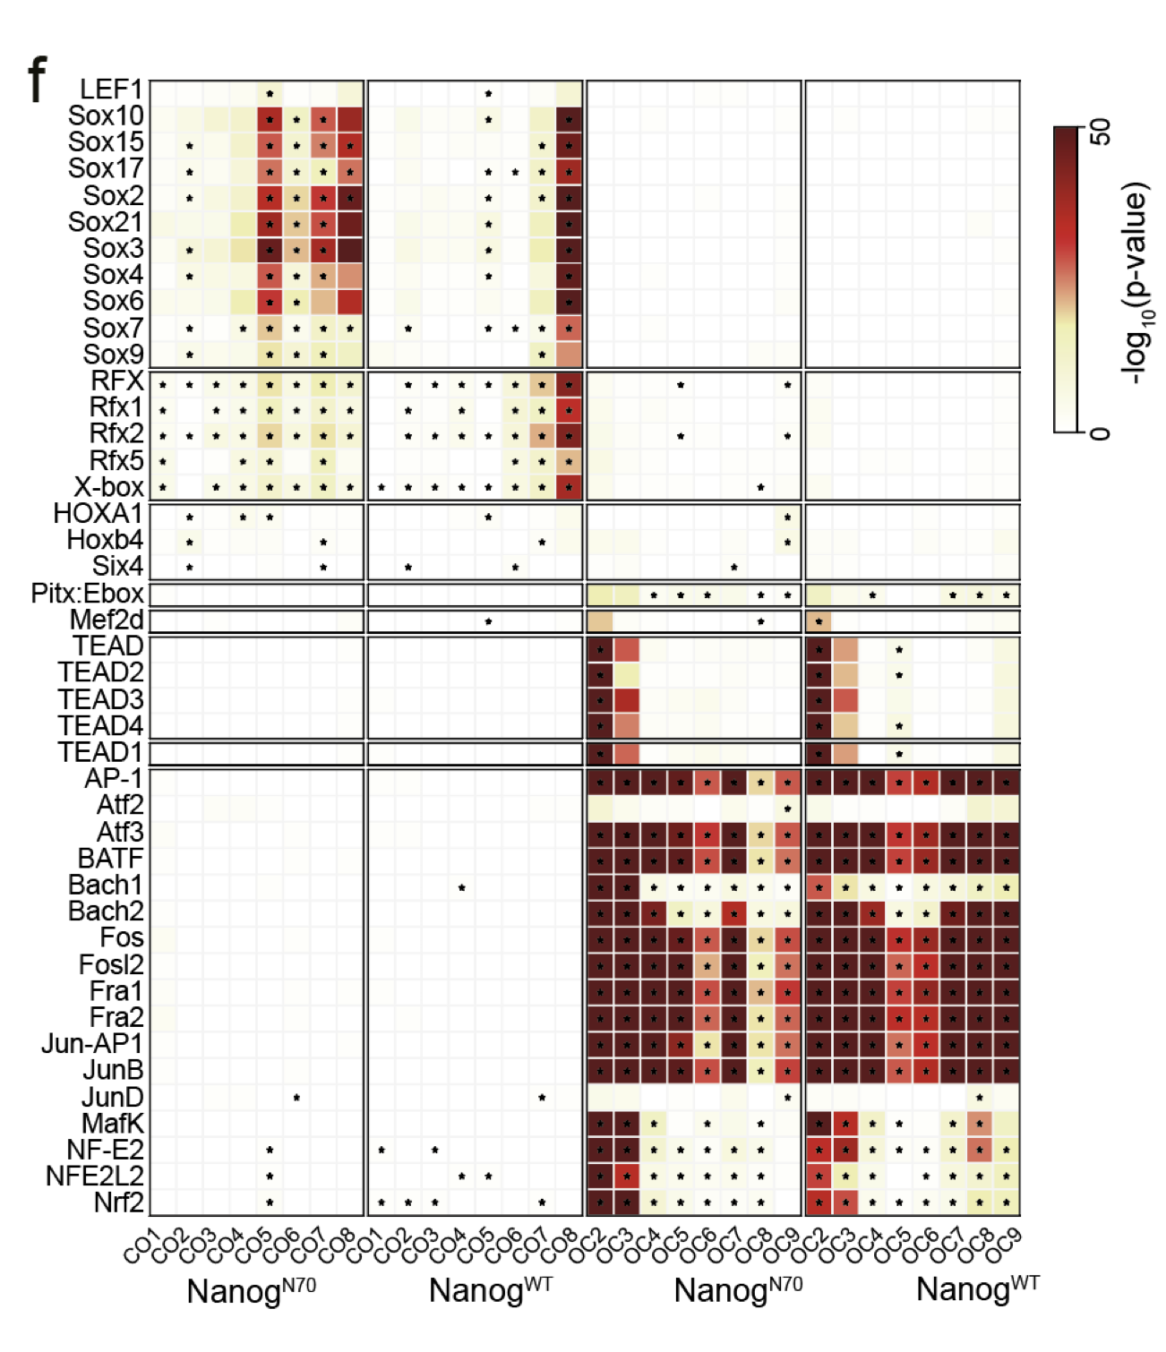
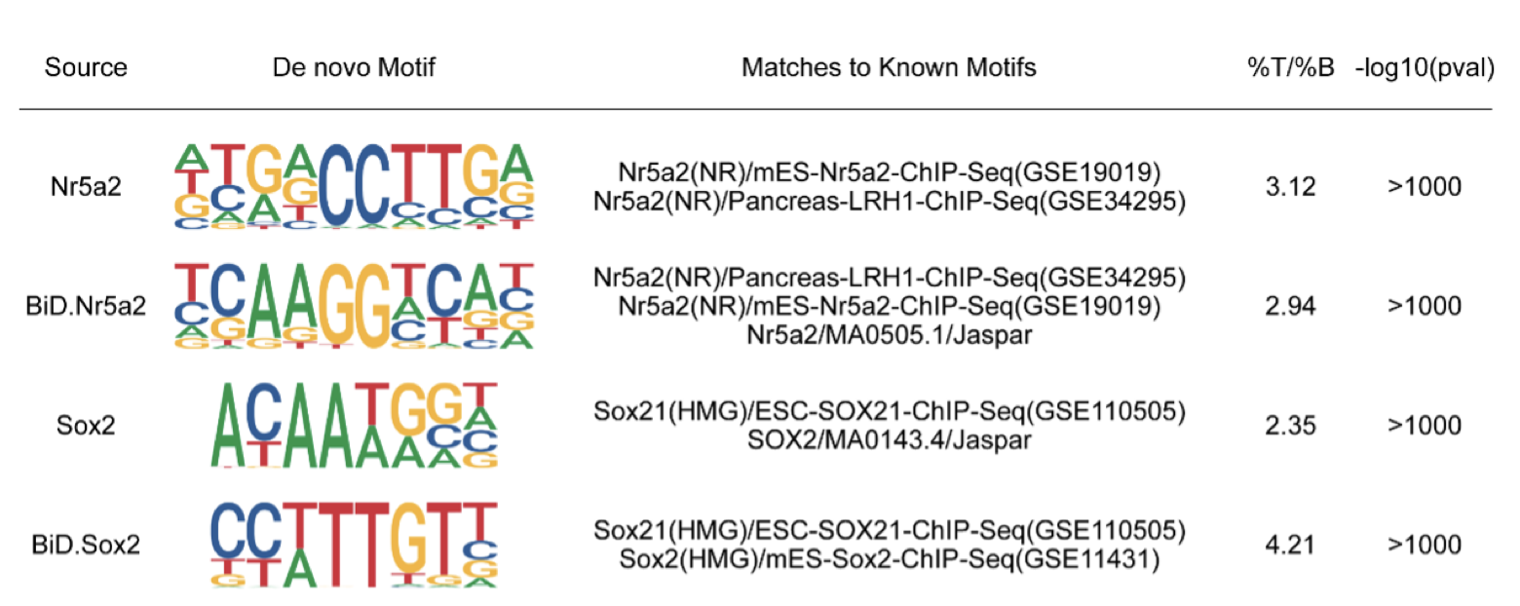
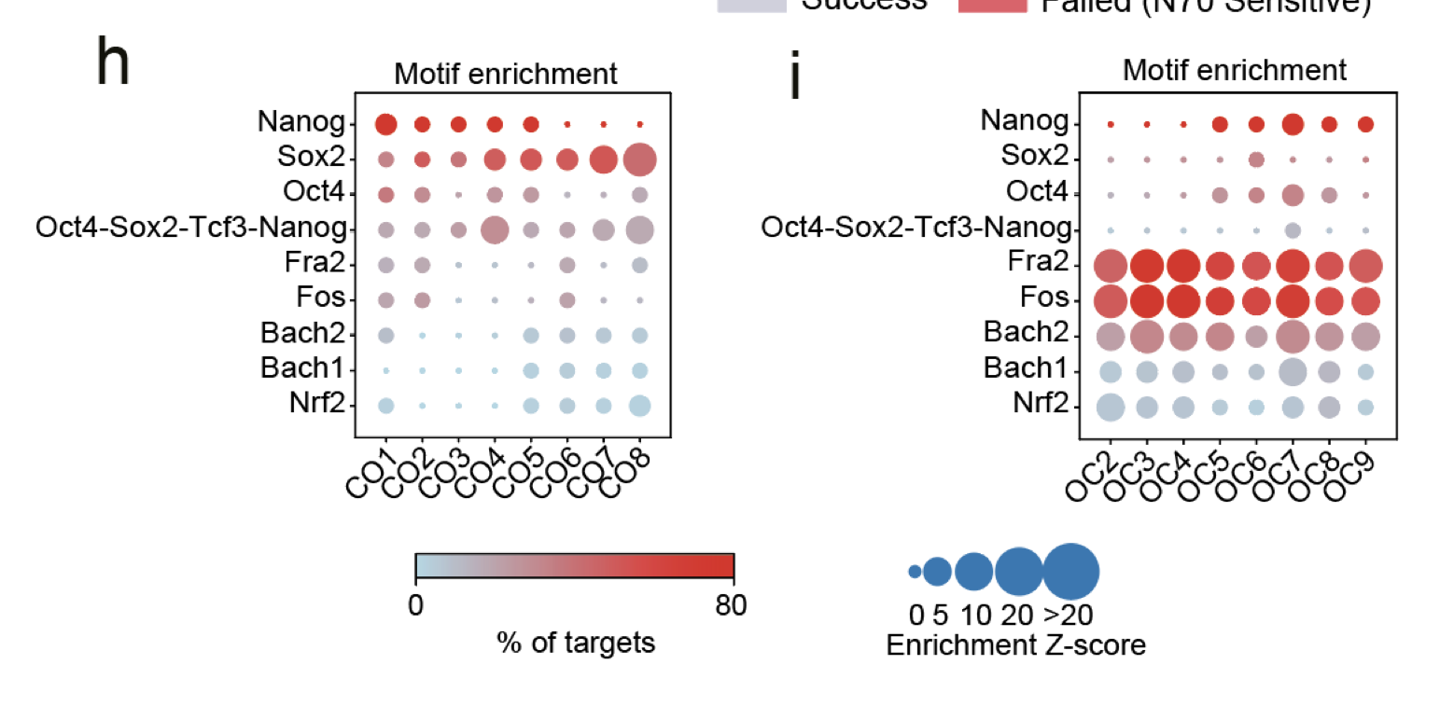
Motif analysis
Motif finding
  Meme + Tomtom
  HOMER
Motif display on specific region

Slide 9
Accessibility in selected regions
Specific regions
Selected genes (promoter)
Average profile
Boxplot

Slide 10
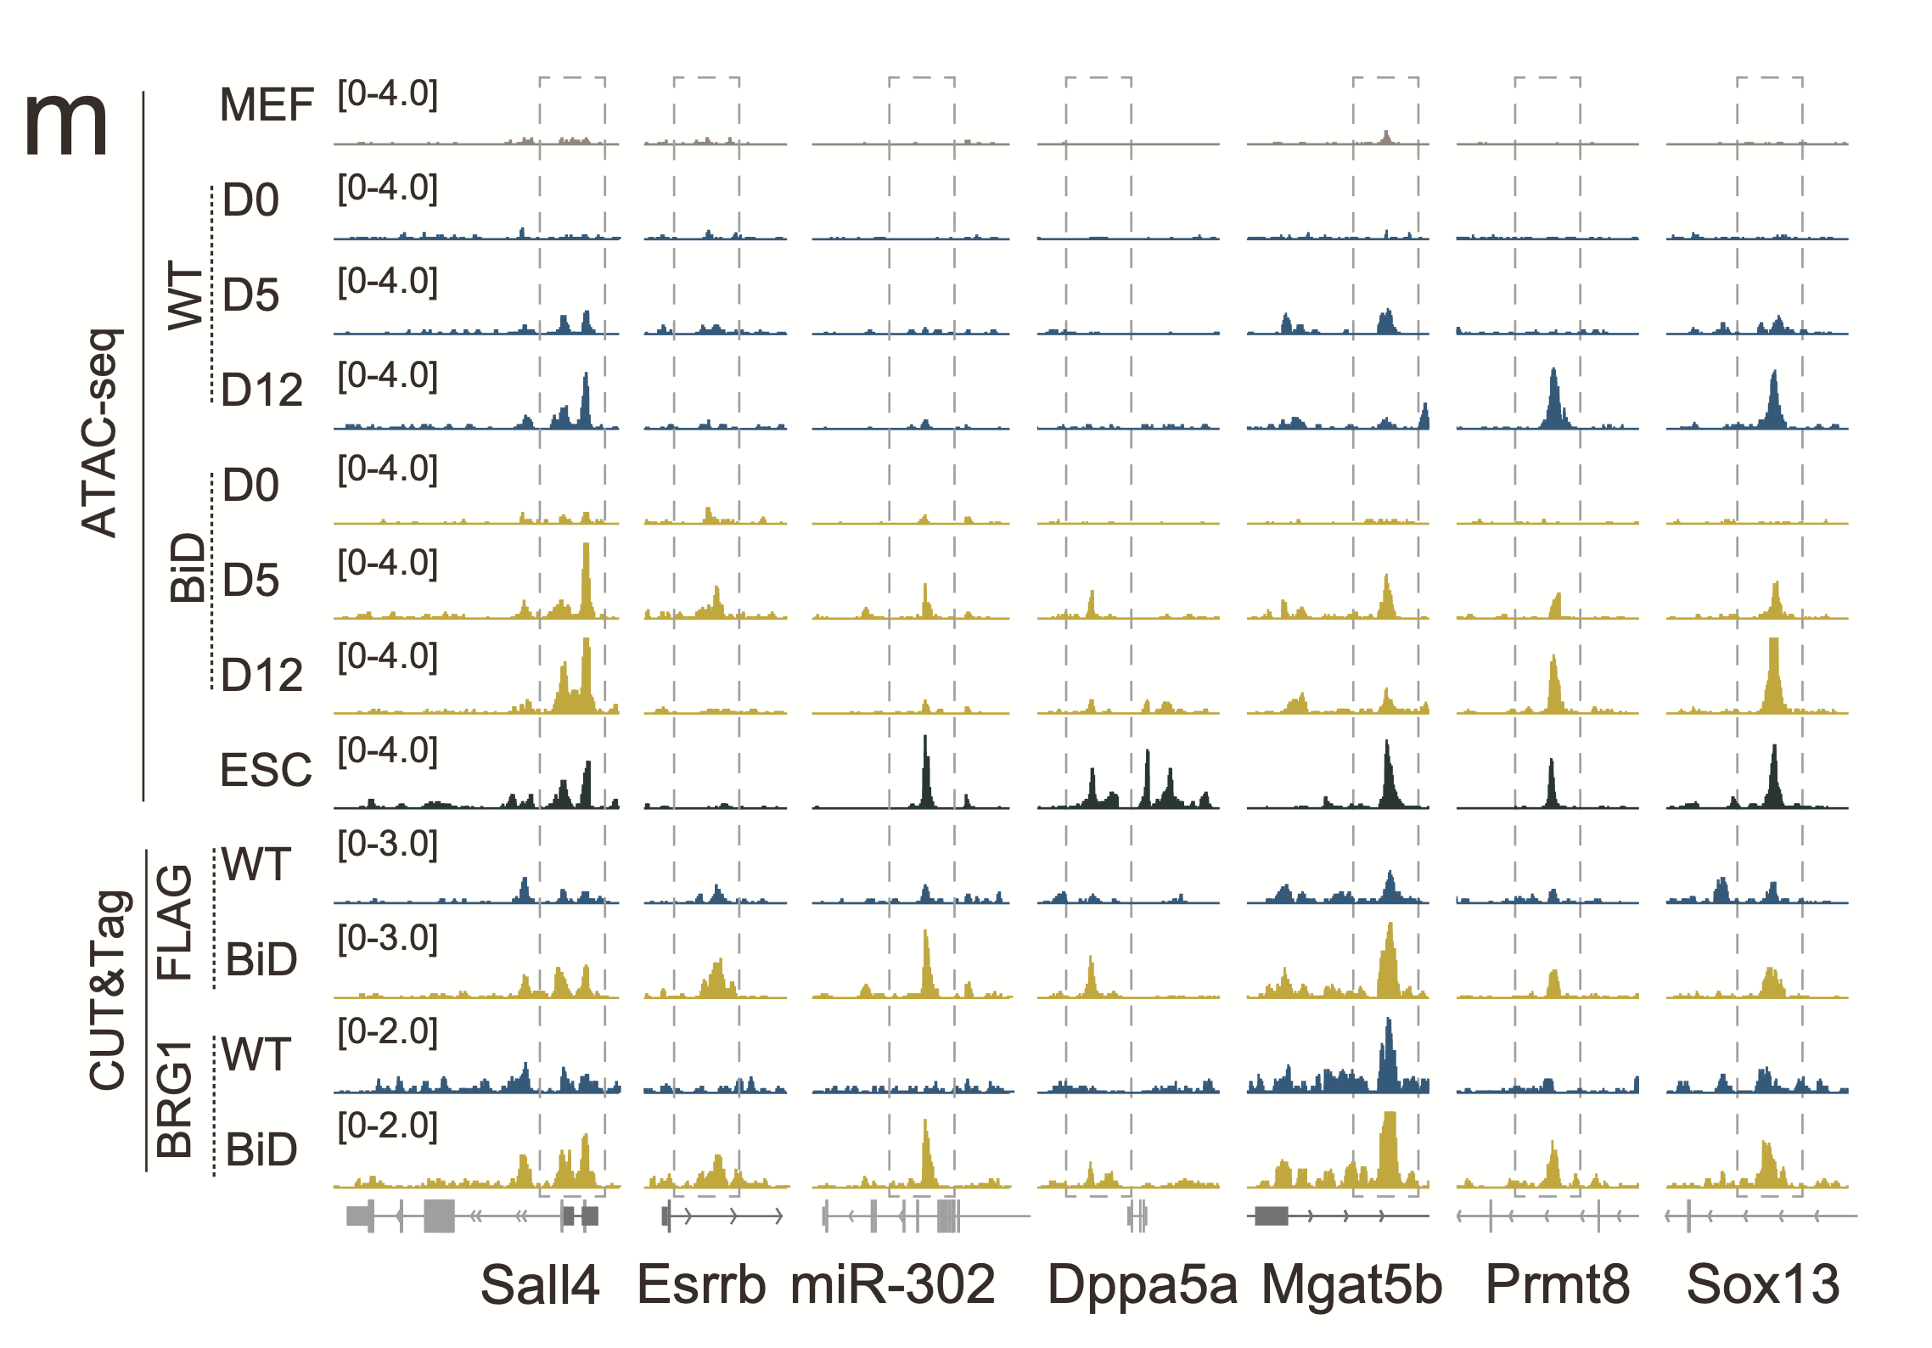
Visualization in IGV

Slide 11
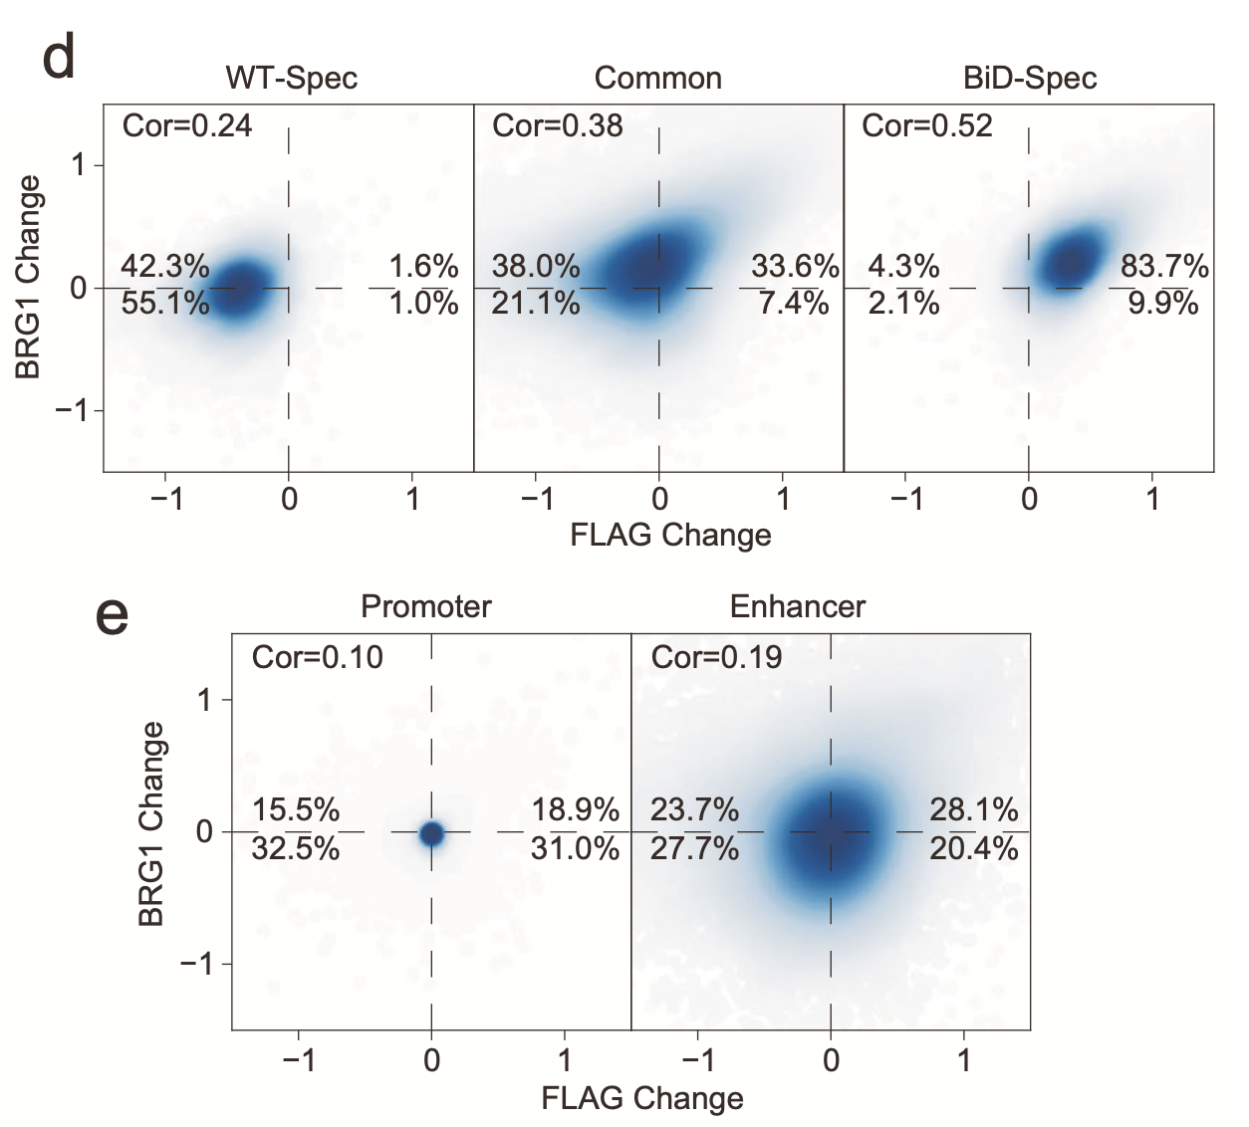
Correlation analysis
Replicates correlation(QC)
Similarity
Co-binding with other features

