Slide 1
ChIP-seq data analysis handbook
Chengchen Zhao
Shiyang Zeng
2017.12.13

Slide 2
Outline
Introduction
Analysis workflow
  Mapping
  Peak calling
  Quality control
  Motif finding
Downstream optional analysis
  Beta

Slide 3
Introduction

Slide 4
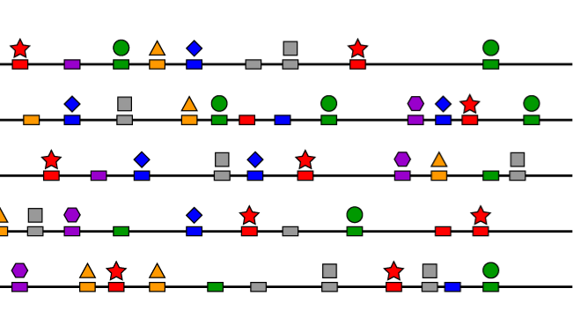
Introduction : the experimental process of ChIP-seq

Slide 5

1.TF/DNA Crosslinking in vivo

Slide 6

2.Sonication

Slide 7
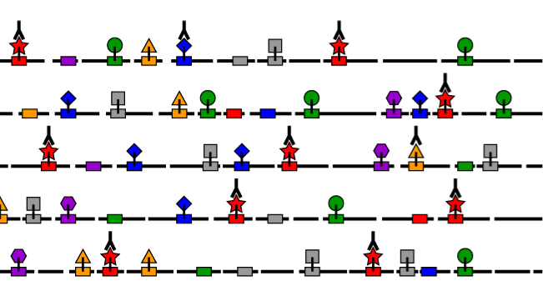
3. Binding with TF-specific Antibody

Slide 8
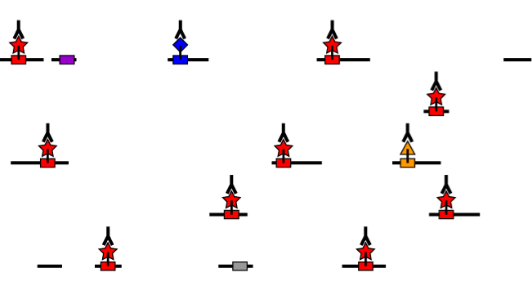
4.Immunoprecipitation

Slide 9
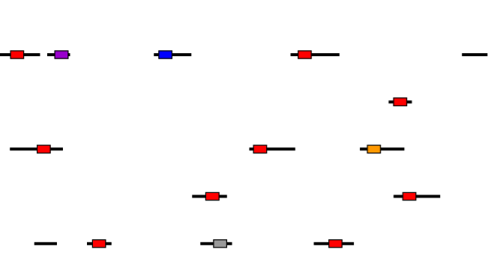
5.Reverse Crosslink and DNA Purification

Slide 10
6.Sequencing

Slide 11
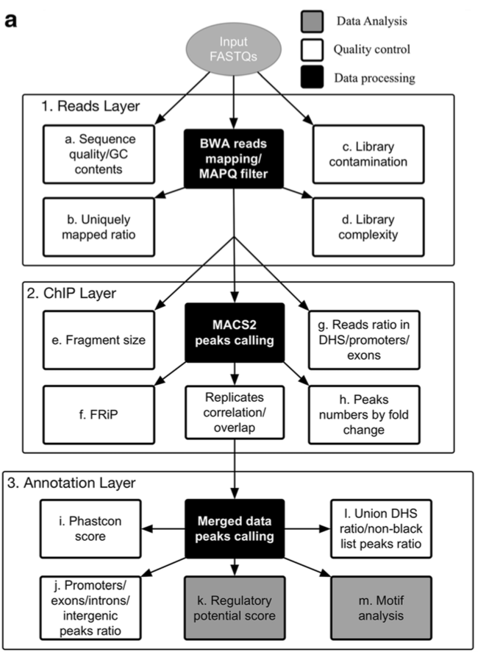
Analysis workflow
Mapping
Peak calling
Quality control
Motif finding
Qian Qin, et.al. 2016

Slide 12
Prior knowledge preparation

Slide 13
Local genomic files needed for analysis
Mapping index
  Bowtie2 index: *.bt2
  BWA index: *.bwt2
Genome annotation related files
  Whole genome fasta: *.fa
  Chromosome length information: *.len
  Gene models annotation from Refseq: *.gtf, *.refGene

Slide 14
Tools needed for analysis
samtools
  Download:
    http://samtools.sourceforge.net/
  SAM format:
    https://samtools.github.io/hts-specs/SAMv1.pdf
bedtools
  Download:
    http://bedtools.readthedocs.io/en/latest/
  BED format:
    https://genome.ucsc.edu/FAQ/FAQformat.html

Slide 15
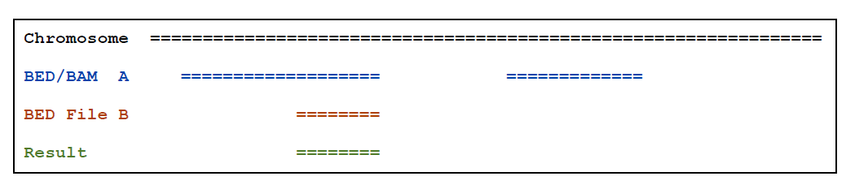
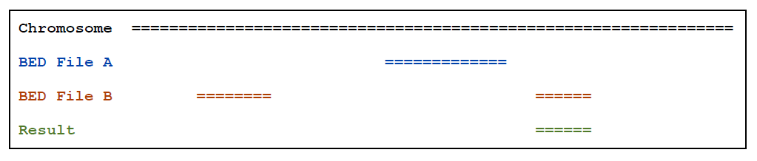
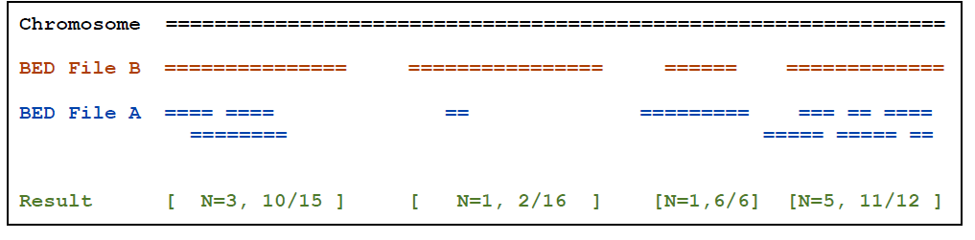
Server common examples of bedtools
intersectBed
closestBed
coverageBed

Slide 16
Fastq format
@SRR502763.1 WICMT-SOLEXA_3_FC200RJAAXX:4:1:905:189/1
TTCAGGACTCAGTTTTCTTCCTCTGT
+
IIIIIIIIIIIIIIIIIIIIIIIIII
@SRR502763.2 WICMT-SOLEXA_3_FC200RJAAXX:4:1:884:223/1
TTTCATCCGCACCACGGAGGCCCGCC
+
IIIIIIIIIIIIIIIII/I=BI5'$’
@seq identifier(/1 or /2 paired-end)
Sequence
+
Sequence quality values

Slide 17
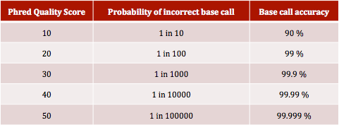
Sequence Phred quality score
Phred quality scores Q are defined as a property which is logarithmically related to the base-calling error probabilities P.
Q = -10 × log10P
Phred quality scores are logarithmically linked to error probabilities
ASCII encoding
S - Sanger Phred+33, raw reads typically (0, 40)
X - Solexa Solexa+64, raw reads typically (-5, 40)
I - Illumina 1.3+ Phred+64, raw reads typically (0, 40)
J - Illumina 1.5+ Phred+64, raw reads typically (3, 40)
L - Illumina 1.8+ Phred+33, raw reads typically (0, 41)

Slide 18
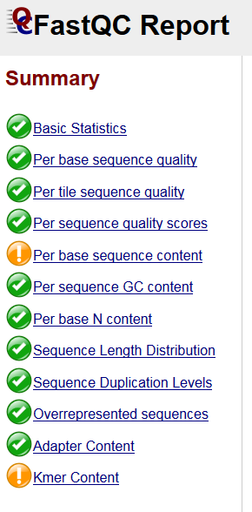
Reads level quality control -- FastQC
http://www.bioinformatics.babraham.ac.uk/projects/fastqc/
Run FastQC to check reads quality
  Input command line:
    fastqc input.fastq
  Ouput format: html webpage

Slide 19
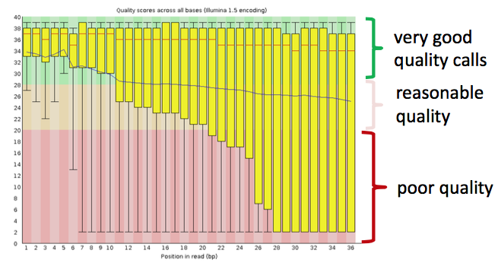
FastQC output: per base sequence
Data example
Quality value = −10 * log10 (error probability)
Quality = 10 => error rate = 10% => base call has 90% confidence
Quality = 20 => error rate = 1% => base call has 99% confidence
Quality = 30 => error rate = 0.1% => base call has 99.9% confidence

Slide 20
FastQC output: …

Slide 21
Mapping Software
Bowtie:
  For reads >50 bp Bowtie 2 is generally faster, more sensitive, and uses less memory than Bowtie 1.
  Bowtie 2 supports gapped alignment, it makes it better for snp calling. Bowtie 1 only finds ungapped alignments.
  Bowtie 2 supports a "local" alignment mode, in addition to the “end-to-end" alignment mode supported by bowtie1. However we don’t recommend "local" alignment mode for mapping of ChIP-seq data.
BWA:
  Bwa is a software package containing several related algorithms using the Burrows-Wheeler Transform. It works well even with indels.

Slide 22
Reads mapping by using Bowtie2
Command line usage:
bowtie2 [options]* -x <bt2-idx> {-1 <m1> -2 <m2> | -U <r>} [-S <sam>]
Typical parameters:
<bt2-idx> Index filename prefix (minus trailing .X.bt2).
<m1> Files with #1 mates, paired with files in <m2>.
<m2> Files with #2 mates, paired with files in <m1>.
<r> Files with unpaired reads.
<sam> File for SAM output (default: stdout)
-p/--threads <int> number of alignment threads to launch (1)
Example:
GSM307618
bowtie2_index=/mnt/Storage/home/zhaochengchen/Data/mm9/mm9
bowtie2 -q -p 10 -x ${bowtie2_index} -1 ${datapath}/${!sample}.R1.clean.fastq.gz -2 ${datapath}/${!sample}.R2.clean.fastq.gz -S ${sample}/${sample}.sam

Slide 23
Reads mapping by using BWA
Command line usage:
bwa mem [options] <idxbase> <in1.fq> [in2.fq]

Slide 24
Peak calling
i) Read extension and signal profile generation
  strand cross-correlation can be used to calculate fragment length
ii) Peak evaluation
  Look for fold enrichment of the sample over input or expected background
  Estimate the significance of the fold enrichment using:
    Poisson distribution
    negative binomial distribution
    background distribution from inputDNA
    model background data to adjust forlocal variation (MACS)

Slide 26
Peak calling by using MACS
Format converting:
Peak calling using MACS:
  Histone modification
  Transcription factor
samtools view -bt ${chrom_info} ${sample}/${sample}.sam -o ${sample}/${sample}.bam
macs14 callpeak -g hs -p 1e-5 --keep-dup 1 --nomodel --shiftsize 73 -t ${sample}.bam -c ${control_sample}.bam -n ${sample}.macs14
macs14 callpeak -g hs -p 1e-5 --keep-dup 1 -t ${sample}.bam -c ${control_sample}.bam -n ${sample}.macs14

Slide 27
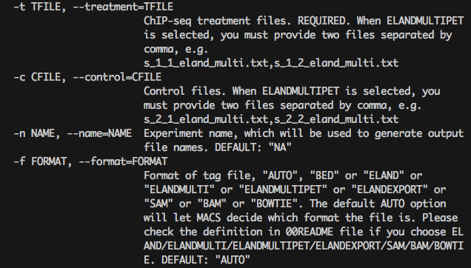

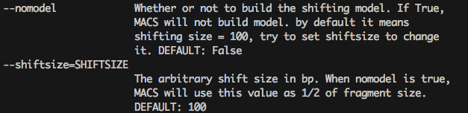
Typical parameters for MACS

Slide 28
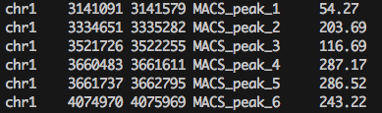
MACS14 output
Output files:
1. Excel peaks file (“_peaks.xls”) contains the following columns
Chr,start,end,length,abs_summit,pileup,-LOG10(pvalue),-LOG10(qvalue),name
2. “_summits.bed”: contains the peak summits locations for every peaks. The 5th column in this file is -log10qvalue
3. “_peaks.narrowPeak” is BED6+4 format file. Contains the peak locations together with peak summit, fold-change, pvalue and qvalue.
To look at the peaks on a genome browser you can upload one of the output bed files or you can also make a bedgraph file with columns :
chr, start, end, peak_name, fold_enrichment

Slide 29
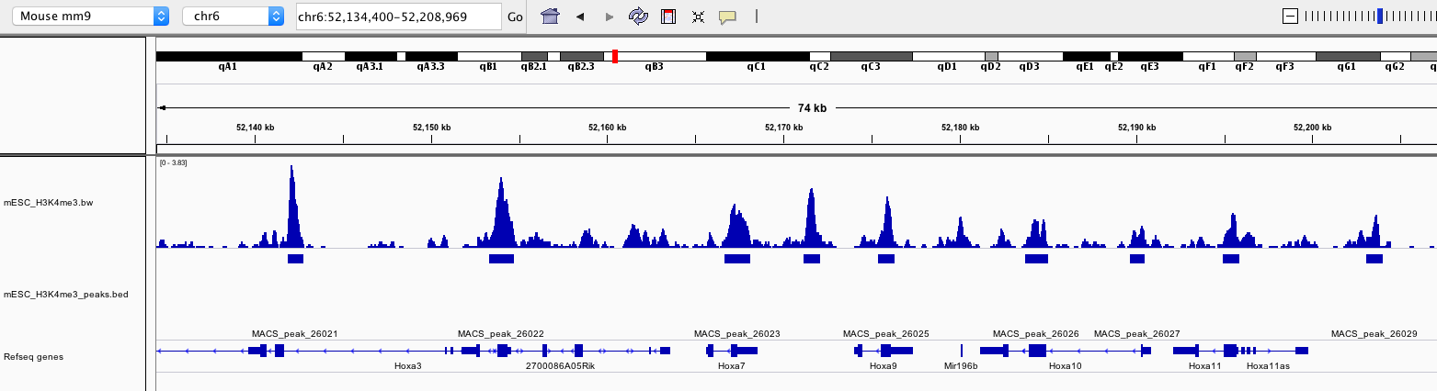
Visualisation of ChIP-seq data
Bigwig file generation
macs2 callpeak -g hs -B -q 0.05 --keep-dup 1 --nomodel --extsize 147 -t ${sample}/${sample}.bam -n ${sample} --outdir ${sample}
bedClip ${sample}/${sample}_treat_pileup.bdg ${chrom_info} ${sample}/${sample}.tmp.bdg
grep -v _ ${sample}/${sample}.tmp.bdg > ${sample}/${sample}.bdg
bedGraphToBigWig ${sample}/${sample}.bdg ${chrom_info} ${sample}/${sample}.bw

Slide 30
Normalization of ChIP-seq signal
MACS can save signal per million reads for fragment pileup profiles with --SPMR.
macs2 callpeak --SPMR -g hs -B -q 0.05 --keep-dup 1 --nomodel --extsize 147 -t bam/${sample}.bam -n ${sample} --outdir ${sample}.normalise
bedClip ${sample}.normalise/${sample}_treat_pileup.bdg ${chrom_info} ${sample}.normalise/${sample}.tmp.bdg
grep -v _ ${sample}.normalise/${sample}.tmp.bdg > ${sample}.normalise/${sample}.bdg

Slide 31
analysis of cis-regulatory elements
ceasBW -w normalise.bw/${sample}.bw -b ${sample}.macs14_peaks.bed -g ${refGene} -l ${chrom_info}

Slide 32
Motif finding
Motif finding software
  MDSeqPos
  Meme
for sample in SAMPLE1 SAMPLE2
do
mkdir ${sample}
MDSeqPos.py -w 600 \
-p 0.001 \
-m cistrome.xml \
-s hg \
-n ${sample} \
-O ${sample} \
${sample}_summits.bed \
hg19
done
fastaFromBed -fi /mnt/Storage/home/zhaochengchen/Data/hg19/hg19.fa -bed ${sample}_peaks.bed -fo ${sample}_peaks.fa
meme ${sample}_peaks.fa -dna -oc ${sample} -nostatus -time 7200 -maxsize 1000000 -mod zoops -nmotifs 30 -minw 6 -maxw 50 -revcomp

Slide 33
Downstream optional analysis
  Beta
for sample in SAMPLE1
do
mkdir ${sample}_BETA
BETA minus -p ${sample}_peaks.bed \
-g hg19 \
-n ${sample} \
-o ./${sample}_BETA
done

Slide 34
Comparing ChIP-seq across samples i.e. Co-localization or differential binding
To compare two samples you can use :
  1. intersectBed (finds the subset of peaks common in 2 samples or unique to one them)
  2. macs2 bdgdiff (find peaks present only in one of the samples)

