Slide 1
scRNA-seq analysis handbook
Chengchen Zhao
2017.12.20

Slide 2
Outline
scRNA-seq with reads barcoded
  using Dr.seq2
scRNA-seq without reads barcoded
  see RNA-seq analysis

Slide 3
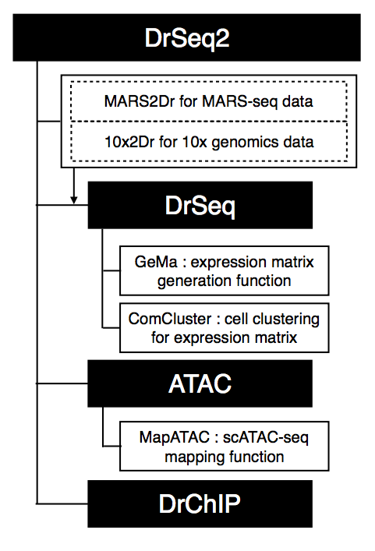
Dr.seq2 introduction
Dr.seq2 is a QC and analysis pipeline for parallel single cell transcriptome and epigenome data. Dr.seq2 provides QC and analysis for three major data types: single cell transcriptome data (DrSeq part), Drop-ChIP data (DrChIP part) and scATAC-seq data (ATAC part).
For single cell RNA-seq data, two additional step-by-step functions are included: 1. expression matrix generation for amounts of single cell RNA-seq datasets (GeMa step) and 2. cell clustering and analysis for the single cell expression matrix (comCluster step).
For different single cell datasets, Dr.seq2 uses sequencing files in FASTQ format or SAM format as input with relevant command. For transcriptome data, DrSeq uses two FASTQ files as standard input (one file contains the transcript reads and the other one contains cell barcode information.

Slide 4
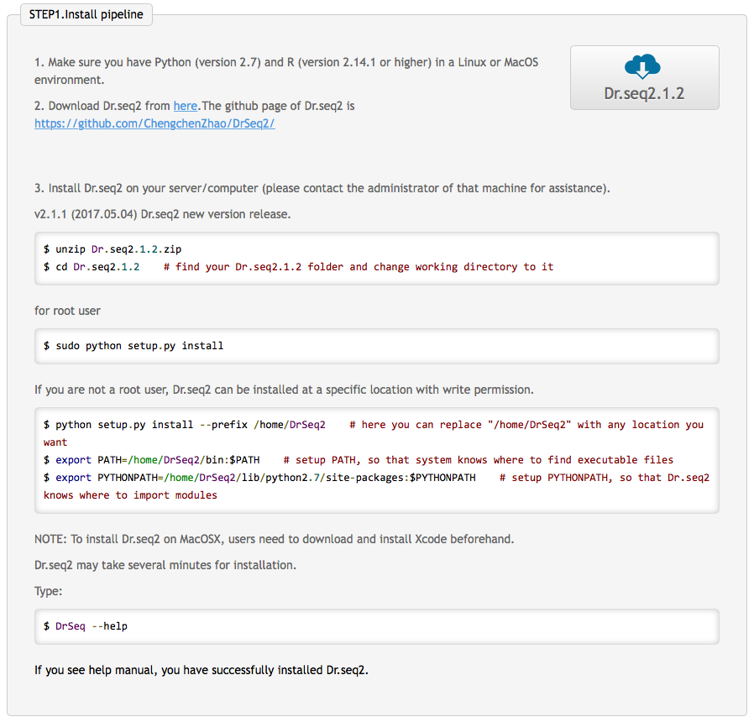
Dr.seq2 installation

Slide 5
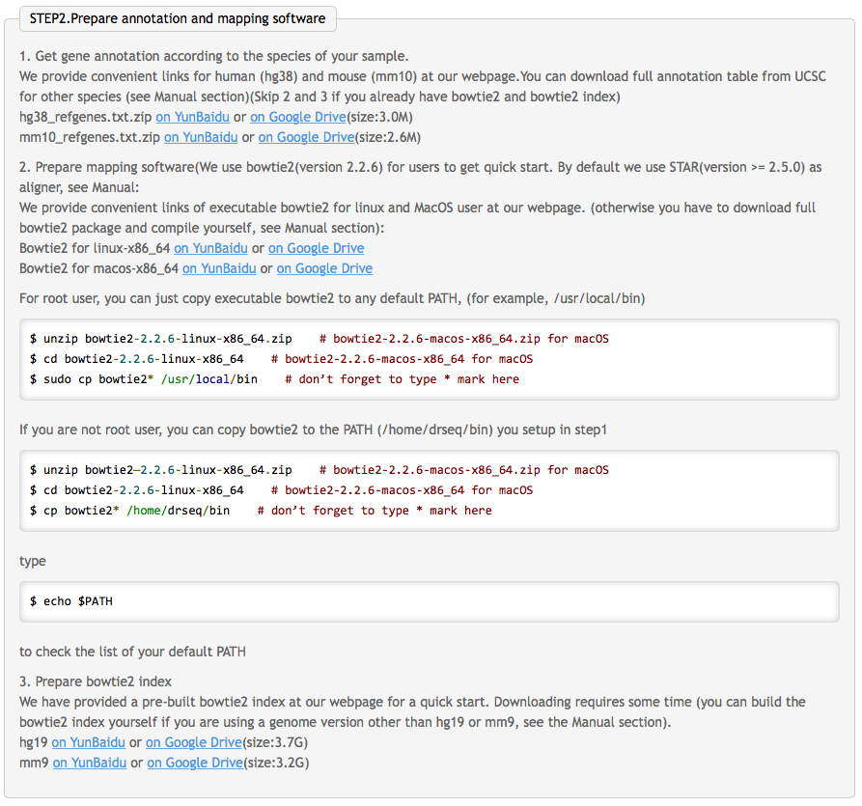
Prepare annotation and required softwares

Slide 6
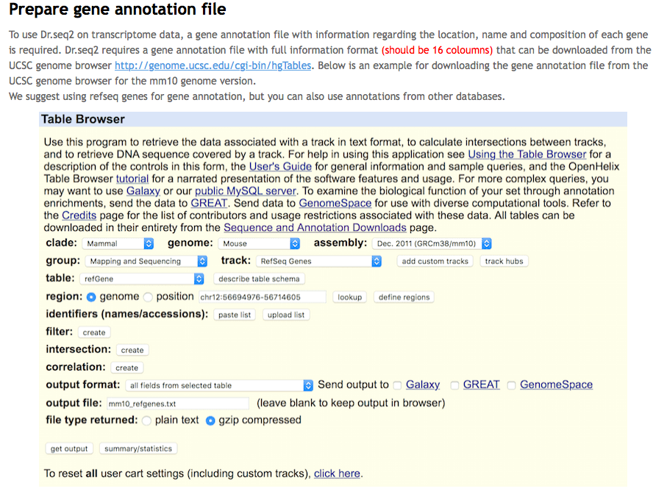
Prepare gene annotation file

Slide 7
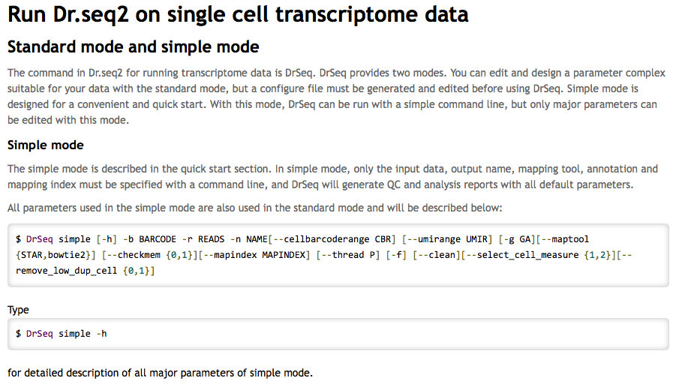
Run Dr.seq2 on single cell transcriptome data with reads barcoded in simple mode

Slide 8
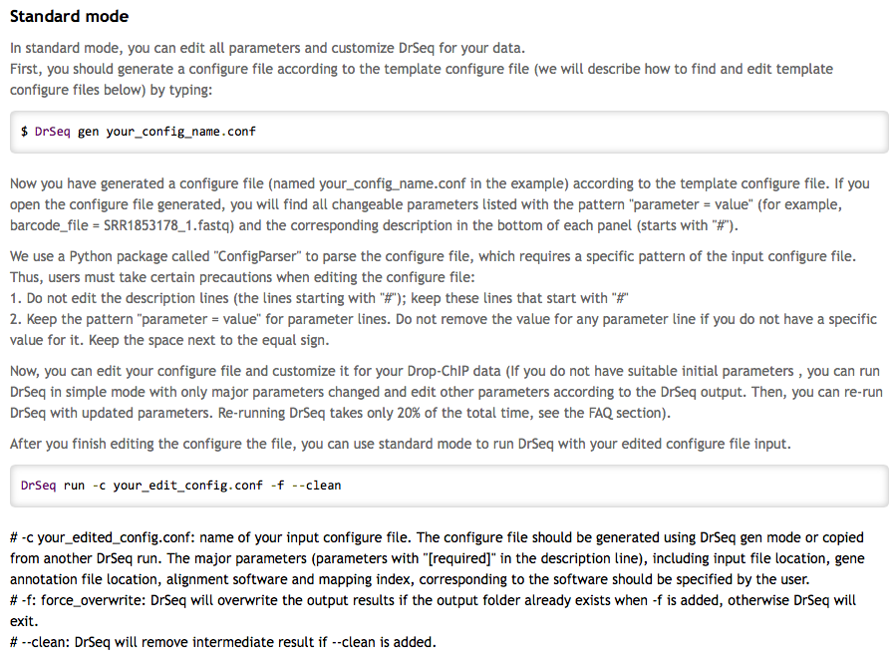
Run Dr.seq2 on single cell transcriptome data with reads barcoded in standard mode

Slide 9
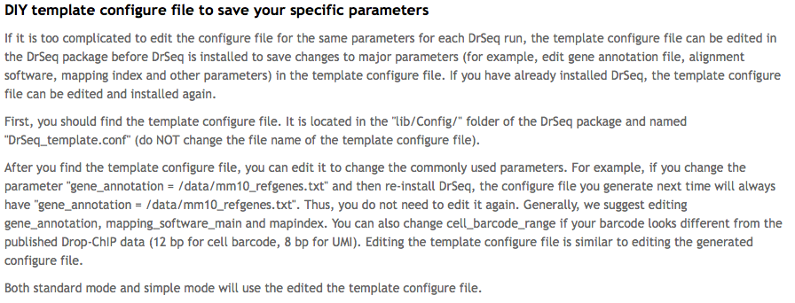

Slide 10

Cell clustering function
comCluster -i ${expression_matrix} -o ${out_name} --cell col --seed 1 -d 1 -z 1.64
Usage: comCluster -i <input_expression_files> -o output_name -c clustering_method -d dimension_reduction_method -z highvar_z -p select_pc_var --maxknum --custom_k --custom_d --rdnumber --cell --seed
comCluster : clustering for multiple expression matrix
Options:
--version show program's version number and exit
-h, --help Show this help message and exit.
-i INPUT_FILES, --input_files=INPUT_FILES
input files containing gene expression per
cell,multiple files should seperate by comma.This
parameter is required.
-o OUTPUT_NAME, --output_name=OUTPUT_NAME
output name for summary files.This parameter is
required.
-c CLUSTERING_METHOD, --clustering_method=CLUSTERING_METHOD
Method for cluster cells based on t-SNE output.This
parameter is required.Choose from 1(default) ,2 ,3 and
4.1(default) : k-means, use Gap statistics followed by
our 'first stable Gap' method to determine k;2 :
k-means, but use Gap statistics followed by
triditional 'Tibs2001SEmax' method to determine k
(Tibshirani et al (2001));3 : k-means with custom
determined k, k value is defined in following
parameter 'custom_k', this option is designed for
users who know the number of subgroup of the drop-seq
sample;4 : (make sure your R enviroment has library
'fpc' installed) Use dbscan as clustering method, the
(eps) parameter is defined in following parameter
'custom_d'
-d DIMENSION_REDUCTION_METHOD, --dimension_reduction_method=DIMENSION_REDUCTION_METHOD
Method of dimension reduction,1 strands for 't-SNE',2
strands for 'SIMLR',3 strands for 'PCA'.This parameter
is required.Default is 1.
-z HIGHVAR_Z, --highvar_z=HIGHVAR_Z
Z-score cutoff for highly variable genes selection.
-p SELECT_PC_VAR, --select_pc_var=SELECT_PC_VAR
Select topN PC until they explain 50% (default is 0.5,
eg. 0.3 for 30% variance) of total variance.
--maxknum=MAXKNUM Maximum k number for gap statistics, only take effect
when clustering_method = 1 or 2.
--custom_k=CUSTOM_K Only take effect when clustering_method = 3, cells
will be clustered to N group based on t-SNE result
according to user determined k.
--custom_d=CUSTOM_D Only take effect when clustering_method = 4, refer to
the parameter 'eps'(Reachability distance, see Ester
et al. (1996)) of dbscan. By default we set it to 2
according to the orginal Drop-seq paper, but it varies
a lot between differen datasets.
--rdnumber=RDNUMBER Set random number.
--cell=CELL Whether a column or a row strand for a cell.'col' for
column and 'row' for row.This parameter is required.
--seed=SEED Set seed to keep your result reproducible

