Slide 1
ATAC-seq data analysis handbook
Xiaolan Chen & Wen Wang
2017-12-20

Slide 2
Outline
Introduction
Analysis workflow
  Mapping
  Filtering
  Quality control
  Peak calling
  Motif finding

Slide 3
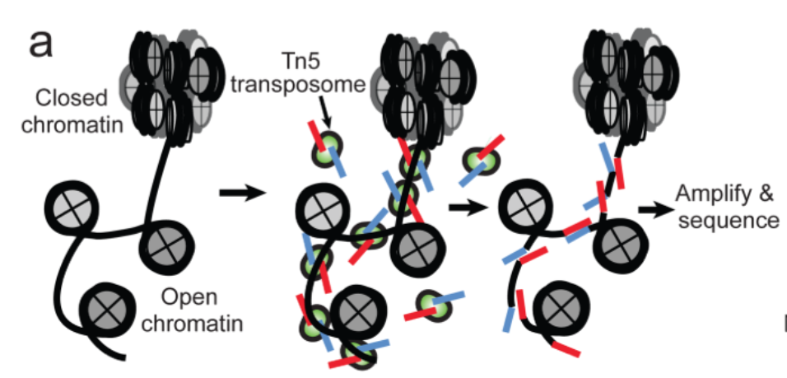
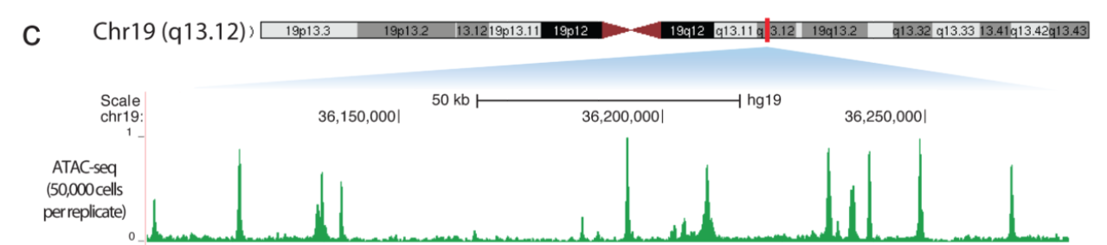
Introduction

Slide 4
Software preparation
Mapping
  Bowtie, Bowtie2
Peak calling
  MACS
Motif finding
  MDSeqPos, fimo
Others
  samtools, bedtools,fastqc

Slide 5
Reads mapping
Example:
  bowtie2 -p 8 -3 ${trim_length} –x ${bowtie2_index} -1 ${1}-R1.fastq -2 ${1}-R2.fastq -S ${sample}.sam
  samtools view -bS ${sample}.sam > ${sample}.bam
Parameters
-x Index filename prefix (minus trailing .X.bt2).
-1 Files with #1 mates, paired with files in <m2>.
-2 Files with #2 mates, paired with files in <m1>.
-3/--trim3 <int> trim <int> bases from 3‘/right end of reads (0)
-S File for SAM output (default: stdout)
-p/--threads <int> number of alignment threads to launch(1)

Slide 6
Reads filtering
By reads quality
  samtools view -H ${1}.bam > ${1}_filtered.sam
  samtools view -f 0x2 ${sample}.bam | awk 'NR % 2 == 1{mapq=$5;forward=$0} NR % 2 == 0{if($5>=30 && mapq>=30 && substr($3,1,3)=="chr" && $3!="chrM") print forward"\n"$0}' >> ${sample}_filtered.sam
  samtools view -bS ${1}_filtered.sam > ${sample}_filtered.bam
By fragment length
  Filter fragments shorter than 100bp and random one reads for following analysis
  bamToBed -bedpe -i ${1}_filtered.bam |) print $1"\t"$2"\t"$2+50"\tr"NR"\t0\t+"; else if($3-50<0) print awk '{print $1"\t"$2"\t"$6}' | sort -k1,1 -k2,2n | uniq | awk 'BEGIN{srand(1007)} {if($3-$2<=100) {if(rand()<0.5$1"\t0\t"$3"\tr"NR"\t0\t-"; else print $1"\t"$3-50"\t"$3"\tr"NR"\t0\t-"}}' | sort -k1,1 -k2,2g > OCR/${sample}_uniq_OCR_SE_reads.bed

Slide 7
Data visualization
Bigwig file preparation
Example:
  genomeCoverageBed -bga -scale ${coverage_constant} -i ${sample}.bed –g ${chrom_info} > ${sample}.bdg
  bedtools intersect –a ${sample}.bdg -b <(awk '{print $1"\t0\t"$2}’${chrom_info}) -wa -f 1.00 | sort -k1,1 -k2,2n >${sample}.bdg.tmp
  bedGraphToBigWig ${sample}_.bdg.tmp ${chrom_info} ${sample}.bw
  Tips:
    -scale Scale the coverage by a constant factor.
Software:
  IGV

Slide 8
Peak calling
Example:
  macs14 -t ${sample}.bed –n ${sample} -f BED –g ${genome size} --keep-dup all --nomodel –shiftsize ${shift_size}
  Output:
  ${sample}_peaks.bed
  ${sample}_peaks.xls
  ${sample}_summits.bed

Slide 9
Quality control
Fastqc
Fragment distribution
Correlation between samples

Slide 10
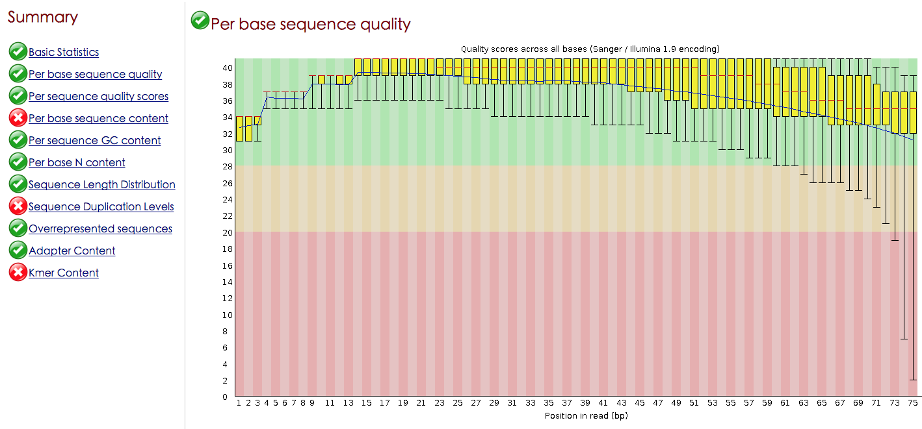
FastQC to check reads quality
Command:
  fastqc input.fastq
Example:

Slide 11
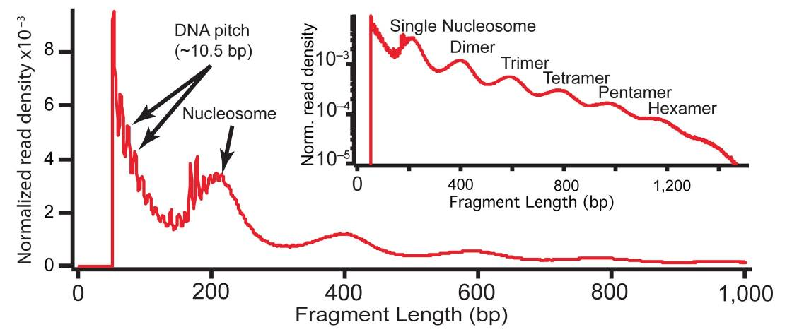
Fragment distribution
Command:
  bamToBed -bedpe -i $sample}.bam | awk '{print $1"\t"$2"\t"$6}' | sort -k1,1 -k2,2n | uniq > ${sample}_fragments.bed
  awk '{print $3-$2}' ${sample}_fragments.bed | sort | uniq -c | sort -k2,2g | awk 'BEGIN{print "fragment_length\tnumber"} {print $2"\t"$1}' > fragments_length.txt
  * plot distribution with R

Slide 12
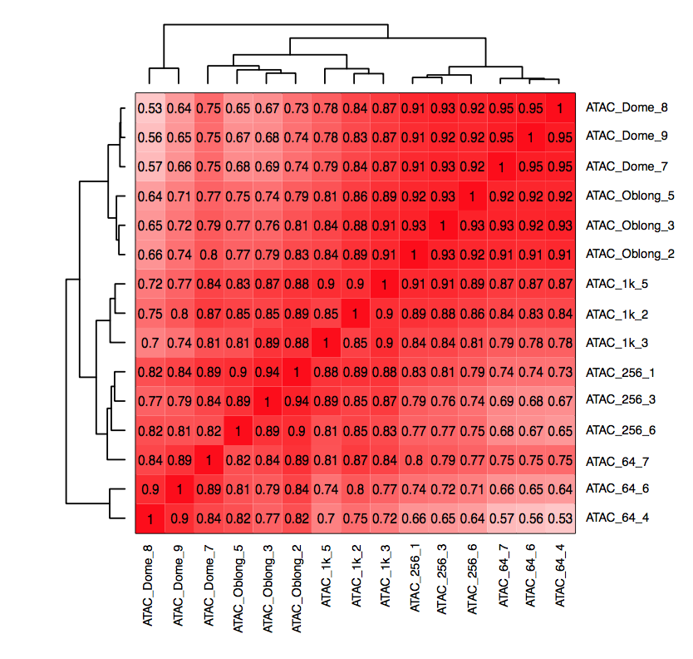
Correlation analysis with replicates
Correlation between replicates should be higher than non-replicates
Pearson correlation of reads count or average signals in all windows
  promoters, peaks, bins

Slide 13
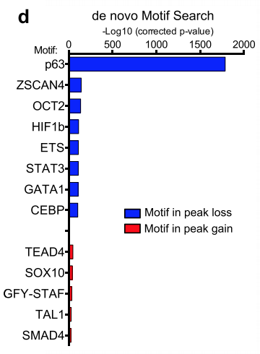
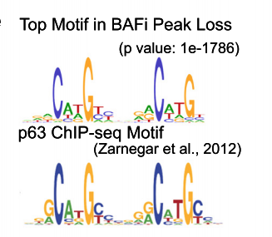
Motif finding
Command
  MDSeqPos.py -w 600 -p 0.001 -m cistrome.xml –s hs -n ${sample} -O ${sample} ${sample}_summits.bed hg19

