Slide 1
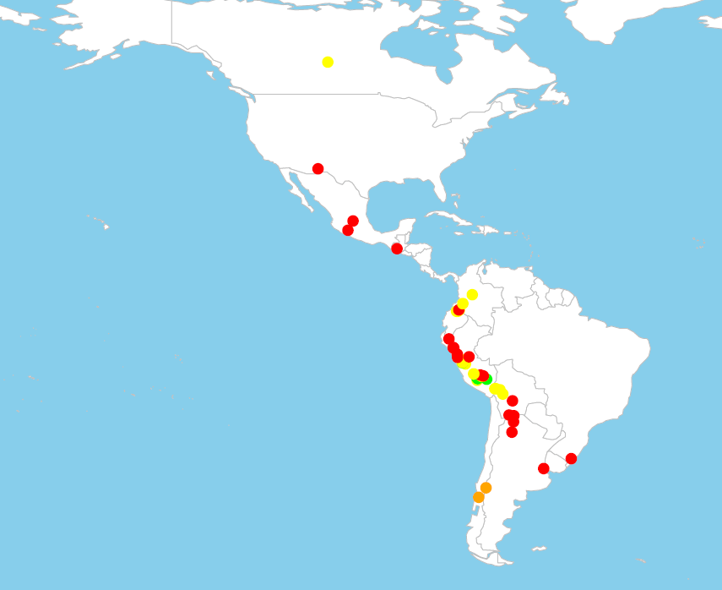
Candolleanum
Landrace
Outgroup
Wild

