Slide 1

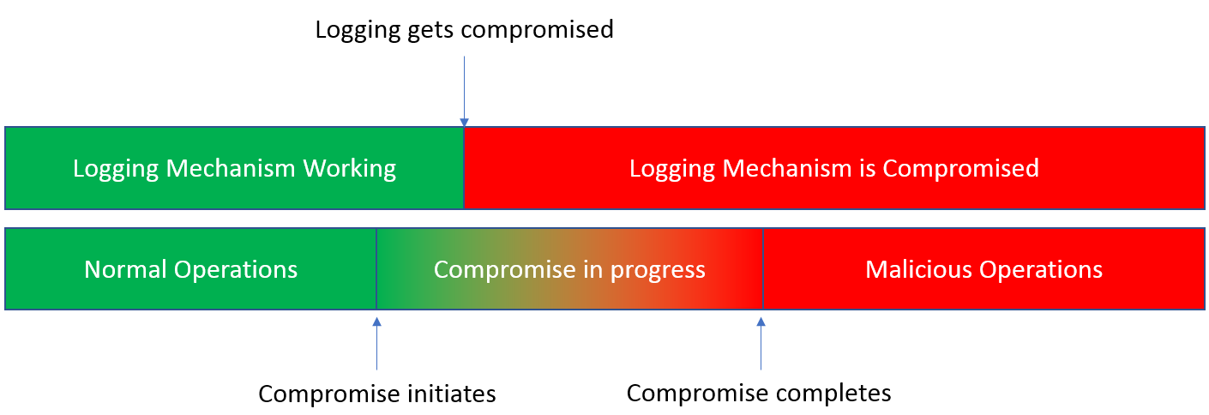
SnapShotter: A lightweight Intrusion Detection for PLCs
Chenglu Jin, Saeed Valizadeh, Mason Ginter, and Marten van Dijk
University of Connecticut
{chenglu.jin, saeed.val, mason.ginter, marten.van dijk}@uconn.edu
1. Motivation
4. Agents and logging mechanism
Industrial control systems are connected to the network, and therefore they are venerable to cyber attacks. E.g. Stuxnet targets SCADA systems.
Programmable logic controllers (PLCs) are one class of such devices mainly used for controlling the industrial processes.
Events?
Yes
Log(Time, Input, Output)
No
Encrypt Log by AES-128
2. Proposal
Attack Scenario:
Malicious adversaries have gained access to PLCs, and submitted any malicious logic to the PLCs to generate arbitrary outputs from the PLCs to further hurt the industrial processes.
Our Solution:
Stealthy logging mechanism, called SnapShotter Agent.
The status of each PLC is logged and sent to a central monitoring server in a secure and stealthy way periodically.
The integrity of the logs can be verified by the server.
The adversary is not able to infer whether he gets caught or not.
If an intrusion is detected, the server will restart the infected PLCs with a known clean state. This will carry on the normal operation of the industrial processes.`
Period End?
Update Key by SHA-256
No
Yes
Send Encrypted Logs to Server
5. Security Guarantees
Assumption: there exists a time window between the starting point of compromise and the moment that the logging mechanism gets compromised.
Obfuscated log of all events (normal or malicious) with forward secure key generation
Integrity of the logs can be verified
Hiding from an attacker with access to the device whether the log reports detection of malicious behavior.
The communication cannot be blocked, since the log is reported back at pre-defined time intervals.
3. SnapShotter
Each PLC device is required to run a light weight SnapShotter agent that periodically reports the device status back to the server
The server verifies the received log and the operation integrity
If the received log is tampered or the operation is not valid, the server raises an alarm
In case of an intrusion, the PLC device will be reset to a safe/clean state by the server
PLC
6. Performance Overhead
The measurement is done when the PLC is running simple HelloWorld logic.
The average execution time of one scan cycle increases by 21.6%, comparing with the original OpenPLC design.
SnapShotter Agent
Monitoring
Server
7. CONCLUSION
We have implemented a lightweight intrusion detection system to secure PLC systems by using simple and practical techniques such as PillarBox [1] .
REFERENCES
[1] Bowers, Kevin D., et al. "Pillarbox: Combating next-generation malware with fast forward-secure logging." International Workshop on Recent Advances in Intrusion Detection. Springer, Cham, 2014.

