Slide 1

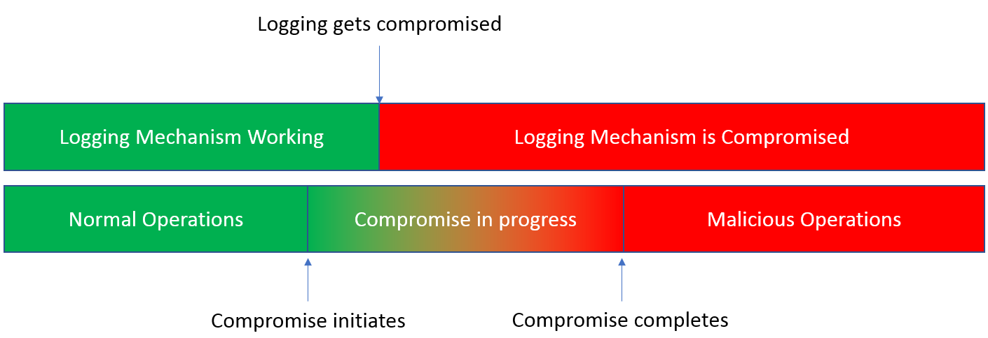
SnapShotter: A lightweight Intrusion Detection for PLCs
Chenglu Jin, Saeed Valizadeh, Mason Ginter, and Marten van Dijk
University of Connecticut
{chenglu.jin, saeed.val, mason.ginter, marten.van dijk}@uconn.edu
1. Motivation
PLC
In recent years, more and more industrial control systems, which were created before the Internet era, are connected to the network. Therefore, to understand, analyze and improve the security of such systems in the Internet era is a crucial task. Programmable logic controllers (PLCs) are one class of such devices mainly used for controlling the industrial processes. We investigate an attack scenario in which the malicious adversaries have gained access to PLCs, and submit any malicious logic to the PLCs to generate arbitrary outputs from the PLCs to further hurt the industrial processes.
SnapShotter Agent
Monitoring
Server
2. Proposal
5. Performance Overhead
We propose an stealthy logging mechanism to protect PLCs in such adversarial environments. The status of each PLC is logged and sent to a central monitoring server in a secure and stealthy way periodically. By means of the proposed scheme, the integrity of the logs can be verified by the server. In addition, and the adversary is not able to infer whether he gets caught or not. After an intrusion is detected, the server will restart the infected PLCs with a known clean state. This will carry on the normal operation of the industrial processes.
We have implemented a lightweight intrusion detection system to secure PLC systems by using simple and practical techniques such as PillarBox [1] .
Lower complexity and performance overhead can be reached with comparison to techniques which require software injection to the device firmware
IDS agents Merely forward the device status to the server
All the related heavy computations are offloaded to the server
Very small computational overhead in gathering and reporting critical device status messages to server
3. SnapShotter
Our defense mechanism can be summarized in security related information gathering and secure logging, sending the logs to a server for the purpose of analysis, incident identification and taking effective actions by the server to foil such incidents:
Each PLC device is required to run a light weight SnapShotter agent that periodically reports the device status back to the server
The server verifies the received log and the operation integrity
If the received log is tampered or the operation is not valid, the server raises an alarm
In case of an intrusion, the PLC device will be reset to a safe/clean state by the server
6. Security Guarantees
The implemented defense mechanism can guarantee detection of malicious incidents with very small false positives through:
Keeping an obfuscated log of all events (normal or malicious) taking place at the device
Exploiting the concept of forward secure key generation [1], integrity of the logs can be verified, i.e., whether the logs at the device have been tampered with by an adversary who is in control of the device
Hiding from an attacker with access to the device whether the log reports detection of malicious behavior
The log is reported back to the server at pre-defined time intervals This enables the server to act accordingly by either revoking the device from the network or by restoring it to a safe state.
4. Agents and logging mechanism
Here we should explain more what the agent is doing and possibly a figure would be nice
4. CONCLUSION
We have implemented a lightweight intrusion detection system to secure PLC systems by using simple and practical techniques such as PillarBox [1] .
REFERENCES
[1] Bowers, Kevin D., et al. "Pillarbox: Combating next-generation malware with fast forward-secure logging." International Workshop on Recent Advances in Intrusion Detection. Springer, Cham, 2014.

