Slide 1
Algorithm Analysis
and Design
Notes:
11/20/17
11/20/17

Slide 2
Module Information
Teaching
  Approx 40 lectures/labs
11/20/17
Notes:
11/20/17

Slide 3
Module Information
Why study algorithms?
  Algorithmic design is a foundation for efficient and effective programs
  Design techniques that we will study will help to solve a
  variety of Computer Science & Mathematics problems
  Being able to analyse algorithms in terms of efficiency and correctness is a fundamental part of Computer Science
  Many of these skills can be used when problem solving in
  future careers.
11/20/17
Notes:
11/20/17

Slide 4
Module Aims
The module aims are:
  The aim of this module is to enable students to analyse the amount of resources needed to solve a given
  computational problem and to compare the efficiency of
  different algorithms for that problem.
  Techniques for proving statements about the complexity of computational problems are also explored.
11/20/17
Notes:
11/20/17

Slide 5
Learning Outcomes
Knowledge and understanding: Upon completion, students should
be able to:
  decide whether a given problem can be solved exactly and in what time-scale, or determine if only approximations to their exact solution can be obtained
  be able to select the correct algorithmic design technique for a given
  problem
Computer related cognitive abilities:
  analyse an algorithm and determine its complexity class
  use a variety of strategies to design algorithms for typical classes of
  problems
  prove results about the limits of computation and the limits of efficient
  computation
11/20/17
Notes:
11/20/17
11/20/17
hej ty

Slide 6
Main Topics
Introduction to algorithm analysis and asymptotic
notation Complexity classes O, Ω, θ
Induction
Design Strategies - Brute Force, Knapsack Problem
4. Sorting & Searching
Insertion sort, Divide & Conquer,
Quick – Merge - Heap – Radix
5. Graphs and Digraphs
Directed and Undirected + Application and representation
Tree Traversal -- DFS and BFS
Binary Trees: Pre-order, In-order, Post-order
Application: Arithmetic exp., Polish notation, Reverse P. N.
Binary search
Decision tree
11/20/17
Notes:
11/20/17
11/20/17

Slide 7
Main Topics
Minimum Spanning Tree: Prim’s & Kruskal’s Algorithms
Shortest Path: Dijkstra’s & Floyd-Warshal Algorithms
6. String Matching
Brute force, finite Automata, Knuth-Morris-Pratt
(KMP) Algorithm
7. Dynamic programming & applications
Divide-and-conquer, Dynamic programming,
Backtracking, Matrix-chain product, Approximate
string matching
11/20/17
Notes:
11/20/17

Slide 8
Recommended Reading
Baase, S., Van Gelder; Computer Algorithms:
Introduction to Design and Analysis (any edition),
Addison-Wesley.
Skiena, S.;(1998);The Algorithm Design Manual, Telos, Springer Verlag, ISBN 0-387-94860-0.
Cormen, T.H., Leiserson, Ch. E., Rivest, R. L., Stein;
(any edition);
Introduction to Algorithms; MIT Press, Cambridge
Mass., London.
11/20/17
Notes:
11/20/17

Slide 9
What is an algorithm?
An algorithm is a sequence of unambiguous instructions
for solving a problem, i.e., for obtaining a required output for any legitimate input in a finite amount of time.
Problem
Algorithm
Input   Computer Output
The algorithm is the idea behind any computer program
11/20/17
Notes:
11/20/17

Slide 10
Why study algorithms?
The most obvious solution to a problem may not be
efficient.
  Consider the following problem:
    Given a map of n cities and traveling costs between them. What is the cheapest way to go from City A to City B?
    What are the possible ways you might solve this problem yourself?
    Let’s look at a concrete example on the next slide..
11/20/17
Notes:
11/20/17

Slide 11
Why study algorithms?
Given the following map of 8 cities and traveling costs between them. What is the cheapest way to go from Shenyang to Beijing?
2
3
Shenyang
X
U
3
8
5
7
4
Y
1
W
4
3
V
7
7
1
Z
Beijing
8
11/20/17
Notes:
11/20/17

Slide 12
A “Brute-force” Approach
If we try every path of length 1, 2, 3,... To find the best solution, there will be far too many to compute for a general “city map”
A better way to do this is to use Dijkstra’s Algorithm
  We shall see the basic idea of Dijkstra’s Algorithm on the next few slides
11/20/17
Notes:
11/20/17

Slide 13
Dijkstra’s Algorithm
To apply Dijkstra’s algorithm, we make the first city, “Shenyang”, the current ‘node’ and mark all other nodes as unvisited. We then find the distance to
each of the current node’s immediate neighbours (those cities connected to it via a line or ‘edge’)
2
Shenyang
X
3
U
3
8
5
7
4
Y
1
W
4
3
V
7
7
1
Z
Beijing
8
11/20/17
Notes:
11/20/17

Slide 14
Dijkstra’s Algorithm
We then visit the nearest unvisited node at each stage
2
Shenyang
X
3
U
3
8
5
7
4
Y
1
W
4
4
V
7
7
1
Z
Beijing
8
11/20/17
Notes:
11/20/17

Slide 15
Dijkstra’s Algorithm
City “U” is the next closest, so we make that the new current ‘node’, mark it as ‘visited’ and compute the minimal distance to each of “U”’s unvisited neighbours. If alternative cheaper paths are found, record this path and erase the more expensive one.
2
3
Shenyang
X
U
3
8
5
7
4
Y
1
W
4
4
V
7
7
1
Z
Beijing
8
11/20/17
Notes:
11/20/17

Slide 16
Dijkstra’s Algorithm
We then repeat this over and over until we eventually compute the cheapest path from “Shenyang” to “Beijing”.
This algorithm is much faster than the brute force method mentioned earlier.
2
3
Shenyang
X
U
3
8
5
7
4
Y
1
W
4
4
V
7
7
1
Z
Beijing
8
11/20/17
Notes:
11/20/17

Slide 17
Another Example
Example of a problem requiring an algorithm would be
a sorting problem:
Sorting Algorithm
<1, 5, 3, 8, 6, 9> Computer <1, 3, 5, 6, 8, 9>
11/20/17
Notes:
11/20/17

Slide 18
Algorithm
An instance of sorting array of names
{Mike, Bob, Sally, Jill, Jan}
Or list of numbers {154, 245, 36, 324, 645, 234}
An algorithm is a procedure that takes any of the possible
input instances and transforms it to the desired output.
InsertionSort(A)
for i = 1 to n-1 do
for j = i+1 downto 2 do
if (A[j] < A[j-1]) then
swap(A[j], A[j-1])
11/20/17
Notes:
11/20/17

Slide 19
5 conditions
Five conditions for an algorithm
  Input: Zero or more quantities (data) are supplied
  externally
  Output: At least one quantity (data) is produced
  Definiteness: Each instruction must be clear and
  unambiguous
  Finiteness: The algorithm is required to terminate
  after a finite number of steps
  Effectiveness: Every instruction must be sufficiently basic so that anyone can follow
11/20/17
Notes:
11/20/17

Slide 20
Algorithm
Algorithms are the most important, durable and original
part of CS.
They can be studied in a language- and machine-
independent way; usually described in pseudocode or as a flowchart.
This means that we need techniques that enable us to
compare algorithms without implementing them
11/20/17
Notes:
11/20/17

Slide 21
Description and properties of Algorithms
Once we designed an algorithm and described it in pseudo-
code, we have to check its:
Correctness
Termination
Efficiency (time / space complexity)
We may also be interested in its:
Simplicity (easy to understand and implement)
Optimality (best possible algorithm)
Two very important tools: RAM Model of computation and
asymptotic analysis of worst-case complexity
3 desirable properties for a good algorithm
11/20/17
Notes:
11/20/17

Slide 22
The RAM model
There are many models of computation possible
  Turing Machine, RAM, PRAM etc.)
  We will use the RAM (Random Access Machine) model.
Each operation takes
1 time step – simple op.
PC
Program
Memory
+,-,*,/,**,<,>,=, ≤, ≥,AND,OR,NOT,…
I/O instructions
Some functions (log, mod, …)
Loops & subroutines are not simple
11/20/17
Notes:
11/20/17

Slide 23
RAM (Random Access Machine) Model
machine-independent, language-independent
generic model of computation
  Operations executed one after another, not concurrently.
  Each memory access(read/write) takes one step.
  Each arithmetic or logical operation, comparison takes one step.
  Each step (basic operation) takes constant time.
  1 step ~ 10⁻⁶ sec = microsec
  Loops and subroutine calls are not basic operations.
Running time (or time complexity) = number of basic operations
executed (amount of work done), expressed as a function of the size n of the problem.
Space complexity = number of memory cells needed to solve the
problem, expressed as a function of the size n of the problem.
11/20/17
Notes:
11/20/17
11/20/17

Slide 24
RAM (Random Access Machine) Model
Criticism:
too simple, e.g.: multiplication versus addition or
memory access time.
The RAM model takes no notice of whether an item sits in cache or on the disk
We make an abstraction that is useful in general.
11/20/17
Notes:
11/20/17

Slide 25
Computational Complexity
For time complexity we can consider:
worst-case complexity
average-case complexity
For space complexity:
in-place algorithm: the amount of extra space is
constant with respect to the input size.
the maximum number of basic operations performed by
the algorithm on any input of size n W(n)
The number of memory cells used by a program.
If the input data have one natural form
Analyse the amount of extra space used
If the input can be represented in various forms
We consider space required for the input + extra space used
11/20/17
Notes:
11/20/17

Slide 26
Example
Procedure FindMax (L[1:n])
1. Max L[1]
2. for i 2 to n do
3. if (L[i] > Max) then
4. Max L[i]
5. i i+1
6. return Max
Find the largest entry in an array of n numbers
assignments: 1
increments: n-1
comparisons: n-1
assignments: at most n-1
Time: if assignment takes time c₁, increment takes time
c₂ and comparison takes time c₃ then the maximum total time is:
c₁n + c₂(n –1) + c₃(n –1) = (c₁+c₂+c₃)n – (c₂+c₃)
On RAM: as c₁ = c₂ = c₃ =1, we have: 3n-2
space: n + 3
11/20/17
Notes:
11/20/17

Slide 27
Optimal algorithm
An algorithm is optimal if there is no algorithm for that particular problem that performs fewer basic operations (in the worst case).
  It is thus the best possible
Lower bound for complexity
  a minimum number of operations proven to be needed to solve a problem (hence any algorithm will have to execute at least this many operations).
n-1 is a lower bound on the number of comparisons
needed
11/20/17
Notes:
11/20/17

Slide 28
Optimal algorithm
Examples:
Finding the maximum element: lower bound of n-1 comparisons ⇒ FindMax is optimal!
Matrix multiplication
best-known algorithm : c₁n^{2.376} operations
gap
best-known lower bound: c₂n² operations
Sorting
best-known algorithm: c₁n log n operations
optimality
lower bound: c₂n log n operations
11/20/17
Notes:
11/20/17

Slide 29
Time Complexity Analysis
Values of some important functions as n → ∞ (approx):
n
log₂ n
nlog₂ n
n²
n³
2^{n}
10²
6.6
6.6×10²
10⁴
10⁶
1.3×10³⁰
10⁴
13
1.3× 10⁵
10⁸
10¹²
..
For comparison, there are about 10⁸⁰ atoms in the observable
universe.
11/20/17
Notes:
11/20/17

Slide 30
Time Complexity Analysis
For a given algorithm, A, we denote:
  Worst case efficiency - T(n) is the maximum running time(interms of number of basic operations) for any input of size n.
  Average case - T_{avg}(n) is the average running time (in
  terms of number of basic operations executed on typical input of size n). Note: this is not the average of best and
  worst case.
  Best case - T_{best}(n) is the minimum running time (in terms
  of number of basic operations) for any input of size n.
In this module, we mostly focus on worst case efficiency of algorithms, given by T(n). When we say efficiency we will mean worst case time efficiency unless otherwise
stated.
11/20/17
Notes:
11/20/17

Slide 31
Which algorithm is the fastest?
Consider a problem that can be solved by 5 algorithms,
A₁, A₂, A₃, A₄, A₅ using different number of operations
(time complexity):
f₁(n)=50n + 20 f₂(n)=10nlog₂n + 100
f₃(n)=n² − 3n + 6 f₄(n)=2n²
f₅(n) = 2^{n}/8 − n/4 + 2
Algorithm A₁ requires f₁(n) operations on an input of size n, A₂ requires f₂(n) operations etc.
Which algorithm will be fastest?
  This will depend upon the size of the input n as we will now see..
11/20/17
Notes:
11/20/17

Slide 32
Which algorithm is the fastest?
n
1
2
4
8
16
32
64
128
256
512
f₁(n)
70
120
220
420
820
1620
f₂(n)
100
120
180
340
740
1700
3940
9060
20580
46180
f₃(n)
4
4
10
46
3910
16006
64774
1E+06
f₄(n)
2
8
32
128
512
2048
8192
32768
1E+05
5E+05
f₅(n)
2
2
3
32
8190
5E+08
2E+18
In this table, we can see the maximum number of
operations each algorithm (A₁, A₂, A₃, A₄, A₅) will require for various values of n.
11/20/17
Notes:
11/20/17

Slide 33
Which algorithm is the fastest?
n
1
2
4
8
16
32
64
128
256
512
f₁(n)
70
120
220
420
820
1620
f₂(n)
100
120
180
340
740
1700
3940
9060
20580
46180
f₃(n)
4
4
10
46
3910
16006
64774
1E+06
f₄(n)
2
8
32
128
512
2048
8192
32768
1E+05
5E+05
f₅(n)
8190
5E+08
2E+18
Highlighted in the (red) shaded boxes above, we see the fastest algorithm for that particular value of n. We are
usually interested in which algorithm is fastest for larger values of n.
11/20/17
Notes:
11/20/17

Slide 34
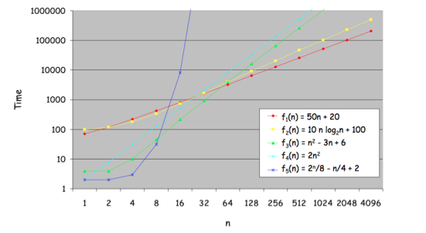
A (log-log) graph of the running times
11/20/17
Notes:
11/20/17

Slide 35
Polynomial versus exponential functions
Note that there is a huge difference between
  function involving powers of n (e.g., n, n², n³, called
  polynomial functions) and
  functions involving powering by n (e.g. 2^{n}, 3^{n}, called
  exponential functions)
Among polynomial functions, those with the same power are more comparable
  e.g. f₃(n) = n² −3n + 6 and f₄(n) = 2n²
11/20/17
Notes:
11/20/17

Slide 36
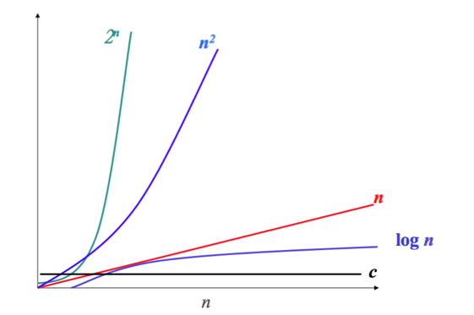
Relative growth rates
11/20/17
Notes:
11/20/17

Slide 37
Order of growth of important functions
We can define a hierarchy of functions, each having a
greater order of growth than its predecessor:
1 - constant
log_{a} n - logarithmic
n, n², n³, ... , n^{k} - polynomial
2^{n} - exponential
n! - factorial
We can further refine the hierarchy by inserting
nlogn between n and n²,
n² log n between n² and n³ etc.
11/20/17
Notes:
11/20/17

Slide 38
Order of growth of important functions (2)
1 - constant
log_{a} n - logarithmic
n, n², n³, ... , n^{k} - polynomial
2^{n} - exponential
n! - factorial
As we move down the list, successive functions have
greater order of growth than the previous ones.
As n increases, the values of the later functions increase much more rapidly than the earlier ones.
11/20/17
Notes:
11/20/17

Slide 39
Order of growth of important functions (3)
What about (log n)³ and n, which has the greater order of growth?
  Recall that n = 2^{log}₂ ^{n} , thus we are comparing (log n)³ and
  2^{log n} (8 = 2³ = 2^{log}₂⁸)
  We therefore see that (log n)³ is lower in the hierarchy
  than n
Similarly, we see that (log n)^{k} is lower than n in the
hierarchy for any constant k ≥ 1
11/20/17
Notes:
11/20/17

Slide 40
Order of growth of important functions (4)
When we have a function, we can classify it to some
function in the hierarchy:
    For example, given f(n) = 5n³ +3n² +7n+12
    The term with the highest power is 5n³
    The growth rate of f(n) is dominated by n³
This concept is captured by Big-O notation
11/20/17
Notes:
11/20/17

Slide 41
Big-O notation
Big-O notation is a way of comparing functions that
ignores multiplicative constants and small input sizes.
f(n)∈O(g(n)), which we readas “f(n) is of order g(n)”
  Roughly speaking, this means f(n) is at most a constant
  times g(n) for all large n
  Often also written as f(n) = O(g(n))
Examples:
  2n³ ∈ O(n³)
  3n² ∈ O(n²)
  2nlogn ∈ O(nlogn)
  n³ + n² ∈ O(n³)
11/20/17
Notes:
11/20/17

Slide 42
Big-O Exercise
Determine the order of growth of the following functions
  n³ + 3n² + 3
  4n² logn + n³ + 5n² + n
  2n² + n² logn
  6n² + 2^{n}
  n²⁰ + nlogn +1000n²
We should look for the term highest in the hierarchy
O(logn) < O(log² n) < O(√n) < O(n) < O(nlogn) < O(n²) < O(2^{n}) < O(n!)
11/20/17
Notes:
11/20/17
N^3
N^3
N^2logn
2^n
N^20

Slide 43
Big-O Exercise (2)
For each of the following, state if they are true or false
  n² logn + n³ + 3n² + 3 is of order O(n² logn)?
  n + 1000 is of order O(n)?
  6n²⁰ + 2^{n} is of order O(n²⁰)?
  2n³ + 5n² logn + n is of order O(n³)?
  2^{π} + n³ log(n)² +10⁶ n is of order O(n³)?
11/20/17
Notes:
11/20/17
N^3
Yes
2^n
Yes
n^3log(n)^2

Slide 44
A note on logarithms
For logarithmic functions, the order of the logarithm a > 1 does not matter under big-O notation since:
log_{a} n = log_{b} n / log_{b} a
making it possible to switch from one base to another
(with a new multiplicative constant)
11/20/17
Notes:
11/20/17

Slide 45
Big-O Notation - formal definition
f(n) ∈ O(g(n)) if there exists constants c > 0 and n₀ > 0,
such that
f(n) ≤ c.g(n) for all n > n₀
Alternatively ,we can write this in the form:
∃c > 0 ∃n₀ ≥ 0∀n ≥ n₀ : f(n) ≤ c.g(n)
Either of the above two definitions is the forma ldefinitionRecall that ∃ means “there exists” and ∀ means “for all”
11/20/17
Notes:
11/20/17

Slide 46
Big-O Notation – visualisation of f(n) ∈ O(g(n))
cg(n)
f(n)
n₀
n
Big Oh notation f(n) ∈ O(g(n))
11/20/17
Notes:
11/20/17

Slide 47
Proof of orders of growth
Question: Prove that 2n² + 4n ∈O(n²).
Proof:
  Since n ≤ n² for all n ≥ 1, then:
  2n² + 4n ≤ 2n² + 4n² = 6n² for all n ≥ 1
  Therefore by definition, 2n² + 4n ∈O(n²)
11/20/17
Notes:
11/20/17

Slide 48
Proof of orders of growth (2)
Question: Prove that n³ + 3n² + 3 ∈O(n³).
Proof:
  Since n² ≤ n³ and 1 ≤ n³ for all n ≥ 1, then:
  n³ + 3n² + 3 ≤ n³ + 3n³ + 3n³ = 7n³ for all n ≥ 1
  Therefore by definition, n³ + 3n² + 3 ∈O(n³)
f(n) might be complicated function
g(n) can be viewed as an estimate for f(n)
g(n) is one of the functions :
1, logn, n, nlogn, n² , n³ , . . ., 2^{n} , n!
11/20/17
Notes:
11/20/17

Slide 49
Big-Ω and Big-Θ Notation
We have seen that f(n))∈O(g(n)) means that f(n) has
smaller order of growth than g(n).
How do we represent that f(n) has a larger order of
growth? How about an equivalent order of growth?
For this,we use Big-Ω (pronounced Big-Omega) and
Big-Θ (pronounced Big-Theta) notation (resp.)
Intuitively, a function f(n) is said to be in Ω(g(n)), denoted
f(n) ∈ Ω(g(n)) if f(n) is bounded below by some positive
constant multiple of g(n) for all large n.
A function f(n)∈Θ(g(n)) if f(n) is bounded above and below by some positive constant multiple of g(n) for all large n.
11/20/17
Notes:
11/20/17

Slide 50
Big-Ω Notation
A function f(n) is said to be in Ω(g(n)), denoted f(n) ∈ Ω(g(n)) if f(n) is bounded below by some positive constant multiple of g(n) for all large n
f(n)
cg(n)
n₀
n
11/20/17
Notes:
11/20/17

Slide 51
Big-Ω Notation - formal definition
f(n) ∈ Ω(g(n)) if there exists constants c > 0 and n₀ > 0,
such that
f(n) ≥ c·g(n) for all n > n₀
We can prove that n³ ∈Ω(n²):
  n³ ≥ n² for all n ≥ 0
As we see, Big-Ω is a lower bound for a particular
function.
11/20/17
Notes:
11/20/17

Slide 52
Big-Θ Notation
A function f(n) is in Θ(g(n)) if f(n) is bounded above and
below by some positive constant multiple of g(n) for all
large n.
c₂ g (n)
f(n)
c₁ g (n)
n₀
n
11/20/17
Notes:
11/20/17

Slide 53
Big-Θ Notation - formal definition
f(n) ∈ Θ(g(n)) if there exists constants c₁ > 0, c₂ > 0 and n₀ > 0, such that
c₂·g(n) ≤ f(n) ≤ c₁·g(n) for all n > n₀
11/20/17
Notes:
11/20/17

Slide 54
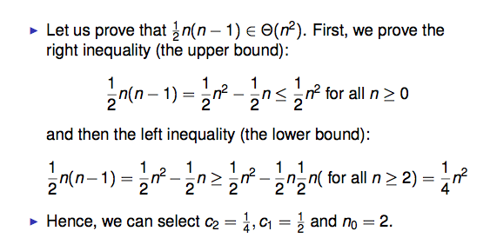
Big-Θ notation - proof technique
11/20/17
Notes:
11/20/17

Slide 55
Useful facts regarding O-notation
If f₁(n) ∈ O(g₁(n)) and f₂(n) ∈ O(g₂(n)), then
f₁(n) + f₂(n) ∈ O(max{g₁(n), g₂(n)})
Example: if an algorithm has two separate sections, one of which requires O(n³) and the second of which requires O(n⁵), the overall complexity of the algorithm is O(n⁵).
The analogous assertions are true for the Ω and Θ
notations as well.
    Ω(g₁(n)) + Ω(g₂(n)) → Ω(max{g₁(n), g₂(n)})
    Θ(g₁(n)) + Θ(g₂(n)) → Θ(max{g₁(n), g₂(n)})
11/20/17
Notes:
11/20/17

Slide 56
Useful facts regarding O-notation (2)
Multiplying by a constant does not change the asymptotic behaviour of a function
    O(c · g(n)) → O(g(n))
    Ω(c · g(n)) → Ω(g(n))
    Θ(c · g(n)) → Θ(g(n)),
    where c is a strictly positive number
11/20/17
Notes:
11/20/17

Slide 57
Useful facts regarding O-notation (3)
However, when multiplying two functions of n, both are
important:
  O(g₁(n)) ∗ O(g₂(n)) → O(g₁(n) ∗ g₂(n))
  Ω(g₁(n)) ∗ Ω(g₂(n)) → Ω(g₁(n) ∗ g₂(n))
  Θ(g₁(n)) ∗ Θ(g₂(n)) → Θ(g₁(n) ∗ g₂(n))
11/20/17
Notes:
11/20/17

Slide 58
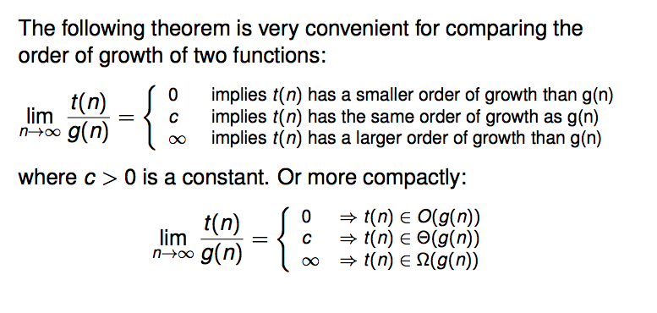
A very useful theorem
11/20/17
Notes:
11/20/17

Slide 59
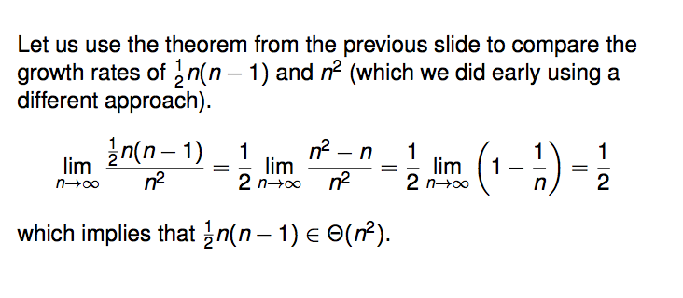
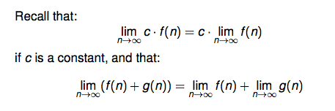
An Example
11/20/17
Notes:
11/20/17

Slide 60
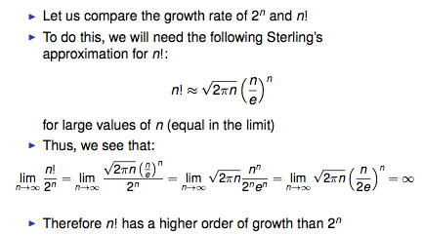
Example 2
11/20/17
Notes:
11/20/17

Slide 61
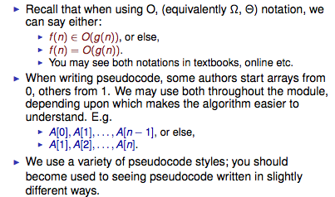
Some comments on notations in the module
11/20/17
Notes:
11/20/17

Slide 62
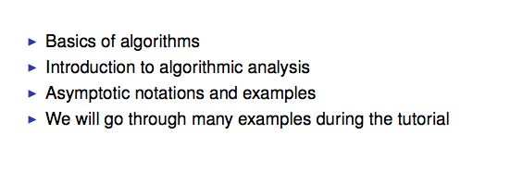
Conclusion
11/20/17
Notes:
11/20/17

