Slide 1
Induction
&
The analysis of Algorithms

Slide 2
Outline
Algorithms
Today we will study Mathematical Induction
  Induction is often used in the analysis of algorithms
Learning Outcomes – knowledge and understanding of induction
Subject specific skill – able to prove statements using induction

Slide 3
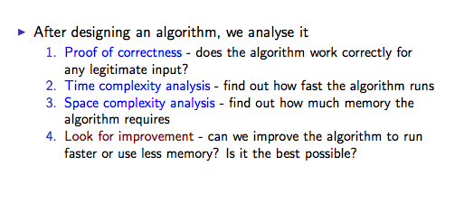
The analysis of algorithms

Slide 4
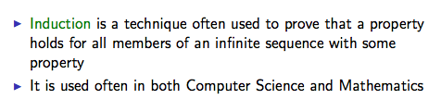
A typical analysis technique

Slide 5
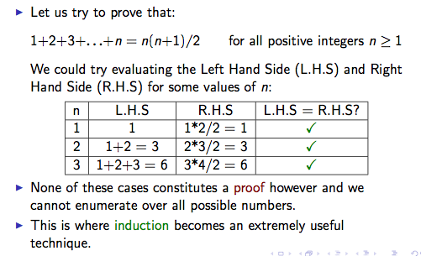
An example of where induction is useful

Slide 6
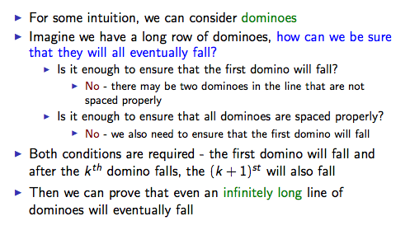
Intuition behind induction

Slide 7
Induction
Algorithms
To prove that a property holds for every positive
integer n :
Two steps
1. Base Step: Prove that the property holds for n = 1 (usually 0 or 1).
    Induction Step: Prove that if the property
    holds for n = k (for some positive integer k),
    then the property holds for n = k + 1
    Conclusion: The property holds for every
    positive integer n
Induction only works for integers!

Slide 8
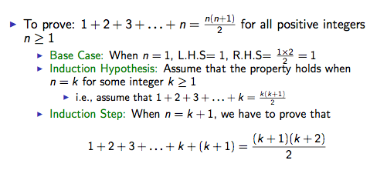
Example

Slide 9
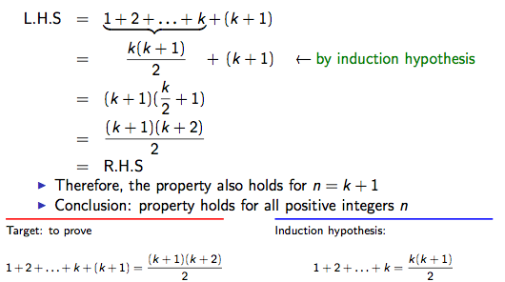
Example – Induction step

Slide 10
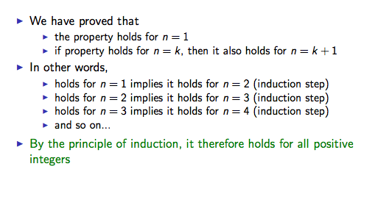
Example – Conclusion

Slide 11
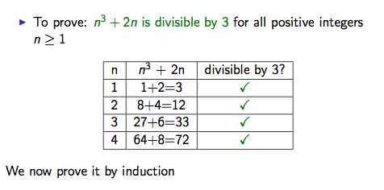
Example 2

Slide 12
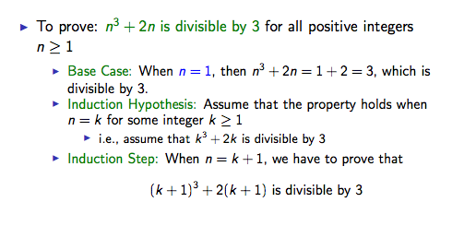
Example 2 - proof

Slide 13
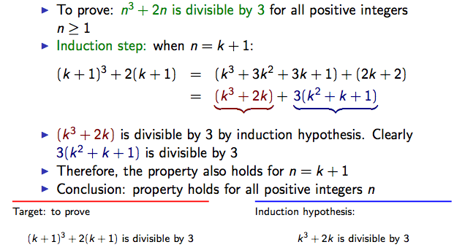
Example 2 – Induction step

Slide 14
Example 3
Algorithms
To prove that the sum of the first n odd numbers
is n²,
i.e. 1 + 3 + 5 + …. + (2n – 1) = n²
Base step: When n = 1, LHS = 1 = RHS.
Induction step: Assume that the property holds when
n = k for some integer k ≥ 1
1 + 3 + 5 + …. + (2k – 1) = k ²
⇒ 1 + 3 + 5 + …. + (2k – 1) + (2k + 1) = k² + (2k + 1)
⇒ 1 + 3 + 5 + …. + (2k + 1) = (k + 1)²
Hence, the property also holds for n = k + 1.
Conclusion: property holds for all positive integers n
i.e. 1 + 3 + 5 + …. + (2n – 1) = n²

Slide 15
Induction Conclusion
Note that the induction step means that if the property holds for some integer k, then it also holds for k + 1
It does NOT mean that the property must hold for k, nor for k+1
Therefore we MUST prove that the property holds for some integer n₀, which is the base case
Missing the base case will make the proof fail

