Slide 1
Dynamic Programming

Slide 2
Contents
Algorithm Design Techniques
2. Dynamic Programming
3. Shortest paths
4. Matrix-Chain Product
5. Approximate string matching

Slide 3
Algorithm Design Techniques
Divide-and-Conquer
Decompose the input
solve the smaller problems recursively
combine the solutions
Typical for Recursion
Sorting (Quicksort, Mergesort)

Slide 4
Example – Merge Sort
6 12 15 11 4 3 2 14 10 5 1 9 16 7 8 13
6 12 15 11 4 3 2 14 10 5 1 9 16 7 8 13
6 12 15 11 4 3 2 14 10 5 1 9 16 7 8 13
6 12 15 11 4 3 2 14 10 5 1 9 16 7 8 13
6 12 15 11 4 3 2 14 10 5 1 9 16 7 8 13
6 12 11 15 3 4 2 14 5 10 1 9 7 16 8 13
6 11 12 15 2 3 4 14 1 5 9 10 7 8 13 16
2 3 4 6 11 12 14 15 1 5 7 8 9 10 13 16
1 2 3 4 5 6 7 8 9 10 11 12 13 14 15 16

Slide 5
Algorithm Design Techniques
2. Greedy Method
  for optimization problems
  makes locally optimal choices at each step
  will these choices produce a globally optimal solution?
Graph manipulation algorithms
using greedy methods:
Prim’s algorithm
Kruskal’s algorithm
3
C
B
2
F
A
6
I
G
7
H
the tree so far
fringe vertices

Slide 6
Algorithm Design Techniques
3. Backtracking
if one can represent the solution space by a graph
Systematic way of exhaustive searching necessary
Use Depth First Search!
Example: analysis of board games: noughts-and-crosses, chess, Sudoku….

Slide 7
Game Trees
Algorithm Design Techniques
×
×
×
×
×
×
×
×
×
.
.
.
.
.
.
.
.
.
.
.
.
.
.
.
.
.
.
.
.
.
.
.
.
.
.
.
nodes are positions in a game and edges are moves

Slide 8
Algorithm Design Techniques
4. Dynamic Programming
Problems in which subproblems are not independent, i.e. subproblems share subsubproblems.
Dynamic programming solves every subsubproblem just once and then saves its answer in a table, avoiding the work of recomputing the answer everytime the subsubproblem is encountered.
Time/Space Trade-off By storing solutions to subproblems rather than recomputing them we traded space for time

Slide 9
Recursive computation
Fibonacci Number
F_{n}= F_{n-1}+ F_{n-2}
F₀=0, F₁=1
F₆
F₅
F₄
F₀ : 5
F₁ : 8
F₂ : 5
F₃ : 3
F₄ : 2
F₅ : 1
F₆ : 1
F₃
F₂
F₄
F₃
F₃
F₂
F₂
F₁
F₂
F₁
F₁
F₀
F₂
F₁
F₁
F₀
F₁
F₀
F₁
F₀
25
Θ(φ^{n}) operations
φ ≈ 1.6 (Golden ratio)
F₁
F₀
Recursive computation vs. Bottom-up computation
φ ≈ F_{n+1}/F_{n} =(1+√5)/2
Notes:
Overlapping Subproblems : A recursive algorithm revisits the same problem over and over again.

Slide 10
Bottom-up computation
Fibonacci Number
F_{n}= F_{n-1}+ F_{n-2}
F₀=0, F₁=1
+
F₆
+
F₅
F₄
4 saves
6 fetches
5 additions
+
F₄
F₃
F₅
F₄
+
F₃
F₂
15 operations
F₃
F₂
n-2 saves
n fetches
n-1 additions
+
F₂
F₁
F₁
F₀
F₁
F₀
3n-3 operations
Recursive computation vs. Bottom-up computation

Slide 11
Examples
1. Shortest paths
2. Matrix-Chain Product
3. Approximate string matching

Slide 12
Distance Matrix
Compute the Distance Matrix = All-Pairs Shortest Path problem
Given a weighted graph or digraph G = (V, E, W ) with V ={v₁, v₂ ,…, v_{n} },
represented by the weighted matrix with entries
w_{ij} = W (v_{i}, v_{j}) if i ≠ j and v_{i}v_{j} ∈ E
∞ if i ≠ j and v_{i}v_{j} ∉ E
0 if i = j
Compute the n × n matrix D defined by
d_{ij} = the distance from v_{i} to v_{j}.
One approach to computing D would be to use Dijkstra’s algorithm
repeatedly, starting over at each vertex.
To eliminate the data structures used in this algorithm we will use Floyd-Warshall’s algorithm to get more streamlined algorithm.

Slide 13
Example
4
2
6
1
2
1
3
2
6
4
3
3
6
5
5
4
3
2
7
0 4 ∞ ∞ ∞ 2
1 0 3 4 ∞ ∞
6 3 0 7 ∞ ∞
6 ∞ ∞ 0 2 ∞
∞ ∞ ∞ 5 0 ∞
∞ ∞ ∞ 2 3 0
0 4 7 4 5 2
1 0 3 4 6 3
4 3 0 7 9 6
6 10 13 0 2 8
11 15 18 5 0 13
8 12 15 2 3 0
W =
D =
w_{ij} = W(v_{i}, v_{j}) if i ≠ j and v_{i}v_{j} ∈ E
∞ if i ≠ j and v_{i}v_{j} ∉ E
0 if i = j

Slide 14
Dynamic Programming-Distance matrix
D^{(k)}[i, j] = the weight of a shortest path from v_{i} to v_{j} using only vertices
from {v₁, v₂ ,…, v_{k}} as intermediate vertices in the path.
(1) v_{k} is not used
(2) v_{k} is used
D^{(k)}[i, j] = min{D^{(k-1)}[i, j], D^{(k-1)}[i, k] + D^{(k-1)}[k, j]}
Shortest path from v_{i} to v_{j} using only {v₁, v₂ ,…, v_{k}}
v_{i}
v_{k}
v_{j}
Shortest path from v_{i} to v_{k}
using only {v₁, v₂ ,…, v_{k-1}}
Shortest path from v_{k} to v_{j}
using only {v₁, v₂ ,…, v_{k-1}}

Slide 15
Compute the Distance Matrix
W
D
D ⁽⁰⁾
D ⁽¹⁾
D ⁽²⁾
…….
D ^{(n)}
goes through
intermediate V
{v₁}
{v₁, v₂}
{v₁, v₂ ,…, v_{n} }
k
j
D ^{k-1}
(i,k )
(i,j )
i
(k,k )
(k,j )
k
D ^{(k)}[i,j ] = min {D ^{(k-1)}[i,j ], D ^{(k-1)}[i,k ] + D ^{(k-1)}[k,j ] }

Slide 16
Example
0 4 ∞ ∞ ∞ 2
1 0 3 4 ∞ ∞
6 3 0 7 ∞ ∞
6 ∞ ∞ 0 2 ∞
∞ ∞ ∞ 5 0 ∞
∞ ∞ ∞ 2 3 0
0 4 ∞ ∞ ∞ 2
1 0 3 4 ∞ 3
6 3 0 7 ∞ 8
6 10 ∞ 0 2 8
∞ ∞ ∞ 5 0 ∞
∞ ∞ ∞ 2 3 0
0 4 7 8 ∞ 2
1 0 3 4 ∞ 3
4 3 0 7 ∞ 6
6 10 13 0 2 8
∞ ∞ ∞ 5 0 ∞
∞ ∞ ∞ 2 3 0
W=
D⁽¹⁾=
D⁽²⁾=
0 4 7 8 ∞ 2
1 0 3 4 ∞ 3
4 3 0 7 ∞ 6
6 10 13 0 2 8
∞ ∞ ∞ 5 0 ∞
∞ ∞ ∞ 2 3 0
D ^{(k)}[i,j ] = min {D ^{(k-1)}[i,j ], D ^{(k-1)}[i,k ] + D ^{(k-1)}[k,j ] }
D⁽³⁾=
4
2
6
1
2
1
3
2
6
4
3
3
6
5
5
4
3
2
7

Slide 17



Example
D ^{(k)}[i,j ] = min {D ^{(k-1)}[i,j ], D ^{(k-1)}[i,k ] + D ^{(k-1)}[k,j ] }
0 4 7 8 ∞ 2
1 0 3 4 ∞ 3
4 3 0 7 ∞ 6
6 10 13 0 2 8
∞ ∞ ∞ 5 0 ∞
∞ ∞ ∞ 2 3 0
0 4 7 8 10 2
1 0 3 4 6 3
4 3 0 7 9 6
6 10 13 0 2 8
11 15 18 5 0 13
8 12 15 2 3 0
0 4 7 8 10 2
1 0 3 4 6 3
4 3 0 7 9 6
6 10 13 0 2 8
11 15 18 5 0 13
8 12 15 2 3 0
D⁽³⁾=
D⁽⁴⁾=
D⁽⁵⁾=
4
0 4 7 4 5 2
1 0 3 4 6 3
4 3 0 7 9 6
6 10 13 0 2 8
11 15 18 5 0 13
8 12 15 2 3 0
2
6
1
2
1
3
D⁽⁶⁾= D =
2
6
4
3
3
6
5
5
4
3
2
7

Slide 18
Example
0 4 ∞ ∞ ∞ 2
1 0 3 4 ∞ ∞
6 3 0 7 ∞ ∞
6 ∞ ∞ 0 2 ∞
∞ ∞ ∞ 5 0 ∞
∞ ∞ ∞ 2 3 0
0 4 ∞ ∞ ∞ 2
1 0 3 4 ∞ 3
6 3 0 7 ∞ 8
6 10 ∞ 0 2 8
∞ ∞ ∞ 5 0 ∞
∞ ∞ ∞ 2 3 0
0 4 7 8 ∞ 2
1 0 3 4 ∞ 3
4 3 0 7 ∞ 6
6 10 13 0 2 8
∞ ∞ ∞ 5 0 ∞
∞ ∞ ∞ 2 3 0
W=
D⁽¹⁾=
D⁽²⁾=
0 4 7 8 ∞ 2
1 0 3 4 ∞ 3
4 3 0 7 ∞ 6
6 10 13 0 2 8
∞ ∞ ∞ 5 0 ∞
∞ ∞ ∞ 2 3 0
0 4 7 8 10 2
1 0 3 4 6 3
4 3 0 7 9 6
6 10 13 0 2 8
11 15 18 5 0 13
8 12 15 2 3 0
0 4 7 8 10 2
1 0 3 4 6 3
4 3 0 7 9 6
6 10 13 0 2 8
11 15 18 5 0 13
8 12 15 2 3 0
D⁽³⁾=
D⁽⁴⁾=
D⁽⁵⁾=
0 4 7 4 5 2
1 0 3 4 6 3
4 3 0 7 9 6
6 10 13 0 2 8
11 15 18 5 0 13
8 12 15 2 3 0
D⁽⁶⁾= D =

Slide 19
Floyd-Warshall’s Algorithm
Procedure Floyd-Warshall_Shortest_Paths
Input: W adjacency matrix of weighted graph
Output: D a matrix with D[i,j] = the shortest distance from i to j.
begin
D := W;
for k:= 1 to n do
for i := 1 to n do
for j := 1 to n do
if D[i, k] + D[k, j] <D[i, j] then
D[i, j] := D[i, k] + D[k, j]
endif
endfor
endfor
endfor
end
D[i,j ] := min(D[i,j ] , D[ i,k ] + D[k,j ] )
Time complexity: Θ(n ³) operations
Space complexity: Only one n × n matrix
Very easy to implement

Slide 20
Floyd-Warshall Algorithm
Other problems that can be solved similarly:
Given a graph G, for all pairs of edges u,v,
decide if there is a path from u to v.
Given a graph G, for all pairs of edges u,v, determine
how many different paths from u to v exist.

Slide 21
Floyd-Warshall’s Algorithm
procedure Floyd_Warshall_reachability
Input: A, the nxn adjacency matrix of a graph G
Output: R, an nxn matrix with r_{ij}:= 1 if there is a path from i to j and r_{ij}:= 0 otherwise
begin
R:= A
for k:= 1 to n do
for i:= 1 to n do
for j:= 1 to n do
if r_{ik} =1 and r_{kj} = 1 then r_{ij}:= 1 endif
endfor
endfor
endfor
end.
Time complexity Θ(n³)
R can be obtained from A simply by changing
all entries < ∞ to true’s and all ∞ to false’s

Slide 22
Floyd-Warshall’s Algorithm
procedure Floyd_Warshall_Number_of_paths
Input: A, the nxn adjacency matrix of a graph G
Output: R, an nxn matrix with r_{ij} = the number of paths from i to j
begin
R:= A
for k:= 1 to n do
for i:= 1 to n do
for j:= 1 to n do
r_{ij}:= r_{ij} + r_{ik} *r_{kj}
endfor
endfor
endfor
end.
Time complexity Θ(n³)

Slide 23
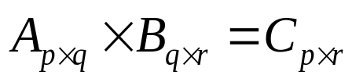
Matrix-Chain product
: pqr multiplications
: associative
pqr + prs vs. pqs + qrs multiplications
PROBLEM:
Given a chain A₁,A₂,· · · ,A_{n} of n matrices of dimensions d₀×d_{1’} d₁×d₂ , … ,.d_{n-1}×d_{n} (i.e. the matrix A_{i} has dimension d_{i-1}×d_{i})
fully parenthesize the product A₁A₂· · · A_{n} in a way that
minimises the number of scalar multiplications.

Slide 24
Matrix-Chain Product
A_{30×1} × B_{1×40} × C_{40×10} × D_{10×25}
((AB)C)D
A(B(CD))
(AB)(CD)
A((BC)D)
(A(BC))D
30 × 1 × 40 + 30 × 40 × 10 + 30 × 10 × 25 = 20,700
40 × 10 × 25 + 1 × 40 × 25 + 30 × 1 × 25 = 11,750
30 × 1 × 40 + 40 × 10 × 25 + 30 × 40 × 25 = 41,200
1 × 40 × 10 + 1 × 10 × 25 + 30 × 1 × 25 = 1,400
1 × 40 × 10 + 30 × 1 × 10 + 30 × 10 × 25 = 8,200
The way we parenthesize a chain of matrices can have a dramatic impact
on the cost of evaluating the product.
⇒ Determine the best order to carry out matrix multiplications.

Slide 25
Matrix-Chain Product
Compute A₁ × A₂ × …… × A_{n} , where A_{i} is of type d_{i-1} × d_{i}
Denote A_{i} × A_{i+1} × A_{i+2} × … × A_{j-2}× A_{j-1} × A_{j} = A_{i,j}
Let M(i, j) = the minimum number of multiplications needed
to compute A_{i} × …… × A_{j} for 1 ≤ i ≤ j ≤ n
Let us partition A_{i,j} by brackets into two parts:
(A_{i} × …… × A_{k}) × (A_{k+1} × …… × A_{j}) = A_{i,k} × A_{k+1,j}
M(i,k) M(k+1, j) d_{i-1}×d_{k} d_{k} × d_{j} ⇒ d_{i-1} × d_{k} × d_{j}
Therefore, we need:
M(i,k) + M(k+1, j) + d_{i-1} × d_{k} × d_{j} multiplications

Slide 26
Matrix-Chain Product
How can we partition A_{i} × …… × A_{j} by brackets into two parts?
A_{i} × (A_{i+1}× …… × A_{j})
(A_{i} × A_{i+1}) × (A_{i+2} × …… × A_{j})
………………………………
(A_{i} × …… × A_{k}) × (A_{k+1} × …… × A_{j})
………………………………
(A_{i} × …… × A_{j-2}) × (A_{j-1} × A_{j})
(A_{i} × …… × A_{j-1}) × A_{j}

Slide 27
Matrix-Chain Product
What is the corresponding number of multiplications?
A_{i} ×(A_{i+1}× … × A_{j}) ⇒ M(i, i) + M(i+1, j) + d_{i-1}d_{i} d_{j}
(A_{i} × A_{i+1}) × (A_{i+2} × … × A_{j}) ⇒ M(i, i+1) + M(i+2, j) + d_{i-1}d_{i+1}d_{j}
…………………………………………
(A_{i} × … × A_{k}) × (A_{k+1} × … × A_{j}) ⇒ M(i, k) + M(k +1, j) + d_{i-1}d_{k} d_{j}
…………………………………………
(A_{i} × … × A_{j-2}) × (A_{j-1} × A_{j}) ⇒ M(i, j-2) + M(j-1, j) + d_{i-1}d_{j-2} d_{j}
(A_{i} × … × A_{j-1}) × A_{j} ⇒ M(i, j-1) + M(j, j) + d_{i-1}d_{j-1}d_{j}
M(i,j) is equal to what?
What is the best?

Slide 28
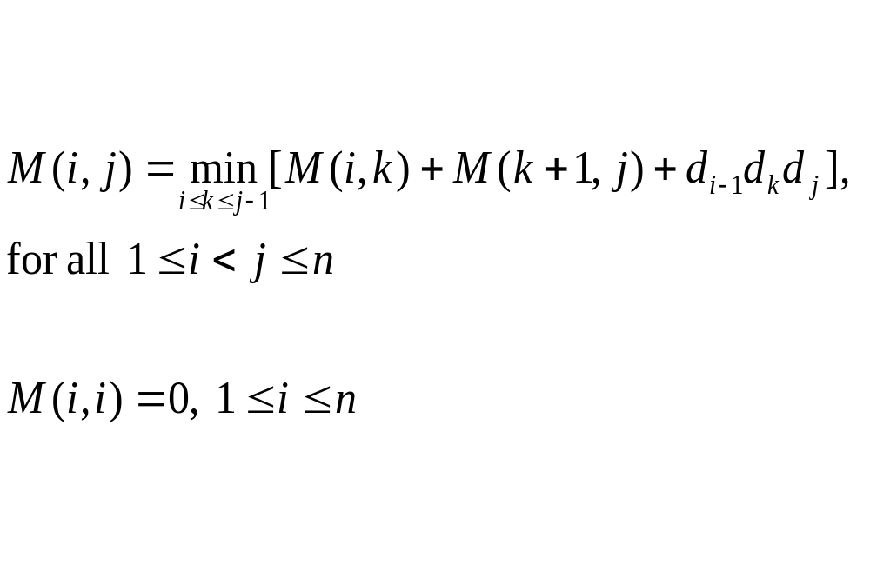
Matrix-Chain Product

Slide 29
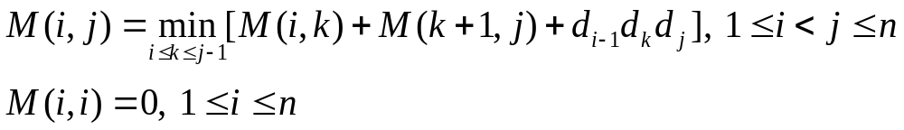
Matrix-Chain Product
1
j
n
1
0
Goal: M[1, n]
0
i
Current computation:
M[i, j]
Current diagonal | j-i|
n
0
Diagonal 1
M

Slide 30
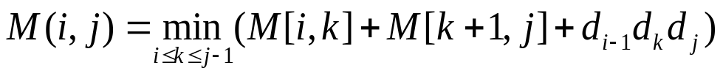
Procedure MatrixOrder
Procedure MatrixOrder
Input: array of integers d₀ , d₁ ,…., d_{n}
Output: multiplications, the optimal number of multiplications
factor: nxn matrix giving the positions of the parentheses
begin
for i:=1 to n do M[i,i]:= 0 end;
for diagonal:= 1 to n–1 do
{ Diagonal 1 is just above the main diagonal. }
for i:= 1 to n – diagonal do
j:= i + diagonal;
factor[i, j]:= the k that gives the minimum value for M[i,j]
end {for i}
end {for diagonal}
multiplications := M[1,n]
end {MatrixOrder} Θ (n³ ) time, Θ(n²) extra space
O(n)

Slide 31
Example
A₁ A₂ A₃ A₄
A × B × C × D
30 × 1 1 ×40 40 ×10 10 ×25
d₀ × d₁ d₁ × d₂ d₂ × d₃ d₃ × d₄
M =
0 1200
- 0 400
- - 0 10000
- - - 0
700
−
1
1
−
−
2
factor =
−
−
−
3
−
−
−
−
700
13200
12000
M(1,3) = min{M(1,1) + M(2,3) + d₀ d₁d₃, M(1,2) + M(3,3) + d₀ d₂d₃ }
0 400 30×1 ×10 1200 0 30×40 ×10
i=1 & j=3 k=1 k=2
k = 1

Slide 32
Example
A₁ A₂ A₃ A₄
A × B × C × D
30 × 1 1 ×40 40 ×10 10 ×25
d₀ × d₁ d₁ × d₂ d₂ × d₃ d₃ × d₄
M =
0 1200
- 0 400
- - 0 10000
- - - 0
700
−
1
1
650
−
−
2
3
factor =
−
−
−
3
−
−
−
−
11000
650
250
M(2,4) = min{M(2,2) + M(3,4) + d₁ d₂d₄, M(2,3) + M(4,4) + d₁ d₃d₄ }
0 10000 1×40 ×25 400 0 1×10 ×25
i=2 & j=4 k=2 k=3
k = 3

Slide 33
Example
A₁ A₂ A₃ A₄
A × B × C × D
30 × 1 1 ×40 40 ×10 10 ×25
d₀ × d₁ d₁ × d₂ d₂ × d₃ d₃ × d₄
M =
A₁×((A₂×A₃)×A₄)
0 1200
- 0 400
- - 0 10000
- - - 0
700
1400
−
1
1
1
650
−
−
2
3
factor =
−
−
−
3
−
−
−
−
8200
⁷⁰⁰ ^{0 30×10 ×25}
,M(1,3) + M(4,4) + d₀ d₃d₄ }
k=3
1400
13600
M(1,4) = min{M(1,1) + M(2,4) + d₀ d₁d₄, M(1,2) + M(3,4) + d₀ d₂d₄
0 650 30×1×25 1200 10000 30×40 ×2
i=1 & j=4 k=1 k=2
k = 1

Slide 34
A × B × C × D
A(B(CD))
k=1
A
AB
k=1
A(BC)
A((BC)D)
k=2
(AB)C
k=2
k=3
B(CD)
B
BC
k=2
k=3
(BC)D
C
CD
D

Slide 35
(AB)(CD)
k=2
A
AB
k=1
A(BC)
(AB)C
(A(BC))D
k=2
k=3
((AB)C)D
B(CD)
B
BC
k=2
k=3
(BC)D
C
CD
D

Slide 36
Approximate String Matching
Find close but not exact matches of the patterns.
Dynamic Programming solution
Application
  spelling corrector, speech recognition, pattern recognition, identifying sequences of amino acids.
Pattern P = p₁p₂· · · p_{m} Text T = t₁t₂· · · t_{n} m « n
A k-approximate match is a match of P in T that has at most k differences.
k is a nonnegative integer

Slide 37
Types of Differences
Types of differences we allow:
1. The corresponding characters in P and T are different.
2. P is missing a character that appears in T.
3. T is missing a character that appears in P.
revise
delete
Example: A 3-approximate matching
insert
T = …unescessaraly…
P = unnecessarily
T = …un escessaraly…
P = unne cessarily
The problem is to find a substring of T that provides a k-approximate match of P.

Slide 38
Dynamic Programming
D[i, j] = the minimum number of differences between p₁...p_{i}
and a segment of T ending at t_{j}.
P = ....p_{i}
T = ....t_{j}
D[i, j] is the minimum of the following three
1. If p_{i} = t_{j}, then D[i -1, j -1]; else D[i -1, j -1] + 1.
2. D[i -1, j] + 1 (the case where p_{i} is missing from T ).
3. D[i, j -1] + 1 (the case where t_{j} is missing from P ).
Initialisation: D[0, j] = 0, D[i,0]=i
Goal: find first (or all) j with D[m,j]≤k
1
n
0
0
· · · ·
0
1
1
D[i-1, j-1]
D[i-1, j]
Compute
column by
column
2
D[i, j-1]
D[i, j]
m
m

Slide 39
Example
k = 1
P= ‘happy’
T=‘Have a hsppy day’
D[0, j] = 0, D[i,0]=i
j
H a v e a h s p p y d a y .
0 0 0 0 0 0 0 0 0 0 0 0 0 0 0 0
i
h
1 1 1 1 1 1 1 1 0 1 1 1 1
2 2 1 2 2 2 1 2 1 1 2 2 2
3 3 2 2 3 3 2 2 2 2 1 2 3
4 4 3 3 3 4 3 3 3 3 2 1 2
5 5 4 4 4 4 4 4 4 4 3 2 1
a
p
p
y
O(nm) time
2m space

Slide 40
Applications
Application areas of Dynamic Programming e.g.:
Dynamic programming is the basis of comparison and
alignment routines - such as the unix diff routine.
Approximate String Matching,
Minimum Average Search Time in Binary Search Trees
All-Pairs Shortest Path Problem,
Morphing in Computer Graphics,
Data Compression for High Density Bar Codes,
Utilizing Grammatical Constraints for Telephone Keypads,
Stereo Vision for Robotic Applications

Slide 41
Applications
Bioinformatics
DP is the basis of sequence alignment algorithms for comparing
protein and DNA sequences.
Using dynamic programming it is possible for an algorithm to evaluate all possible ways of aligning one sequence against another in a reasonable time, even though the number of such possible alignments grows exponentially with the length of the two sequences.
In the bioinformatics application Dynamic Programming gives a
spectacular efficiency gain over a purely recursive algorithm. It
converts what would be an [infeasible] Θ(2^{n}) algorithm to an O(n²) one.
Less widely known applications of dynamic programming are in
parsing and in programs to play chess.
Notes:
The 'showcase' application for dynamic programming is in protein sequence alignment, for in this application it provides a stunning gain in efficiency. Using dynamic programming it is possible for an algorithm to evaluate all possible ways of aligning one sequence against another in a reasonable time, even though the number of such possible alignments grows exponentially with the length of the two sequences.

