Slide 1
Searching

Slide 2
Outline
Algorithms
Searching algorithms
Sequential Search
Binary Search
Decision trees
The optimality of binary search

Slide 3
Sequential Searching
Given a list of n integers ⟨L₁, L₂, L₃, ... , L_{n}⟩, we can
denote the i’th element of this list by L[i]
    For example, given L = ⟨10, 2, 4, 9, 7, 3, 5, 1⟩, then L[1] = 10, L[2]=2, L[3]=4, [4]=9 etc. up to L[8]=1
In programming, the list of elements ‘L’ here is called an array
Imagine that we would like to search this list to try to find a particular element x, if it is found we print “found”, otherwise we print “not found”

Slide 4
Searching in an unordered array
Searching for an element x in an unordered array of
elements
We sequentially compare each element of the array to x.
Complexity:
Worst case:
Average case: (1+2+…+n)/n = (n+1)/2 comparisons ⇒ Θ(n) algorithm
The algorithm is optimal.
1 | 2 | 3 | ... | ... |  |  |  | n-1 | n
23 | 15 | 9 | 79 | ... | 10 | 19 | 5 | 84 | 63
If x is the n^{th} element of the array
n comparisons ⇒ Θ(n) algorithm
Proc SeqSearch(L[1:n], n, x)
for index = 1 to n do
if x = L[index] then
ans := index (or ans := L[index])
end if
end for

Slide 5

Searching in an Ordered Array
Algorithms
Searching an element x in an ordered array. x=10
Sequential Search:
worst case ⇒ n ;
1
3
4
5
7
9
10
11
14
16
17
1
2
3
4
5
6
7
8
9
10
11
average case ⇒ (1+2+…+n)/n = (n+1)/2 (assuming x is in array)
compare x to every 4th entry, then compare to the 3 entries in the interval found :
1
3
4
5
7
9
10
11
10
14
16
17
1
2
3
4
5
6
7
8
9
10
11
worst case ⇒ + 3
Binary Search: compare to the middle entry, then search in the appropriate half using the same method recursively.
1
3
4
5
7
9
10
11
14
16
17
1
2
3
4
5
6
7
8
9
10
11

Slide 6
Binary Search
Binary search is more efficient way of searching when
the list is pre-sorted
Input: a list (or sequence) of n sorted numbers L[1], L[2], . . . , L[n] in ascending order and a number x
Idea of binary search:
1. Compare x with the middle element of the list (i.e. the
central element of the array);
2. If x is smaller than the middle element, focus only on
the first half of the list. If x is greater than the middle
element, the focus only on the right half of the list;
3. Reduces the size of the list at each step by half

Slide 7
Example of binary searching
Let ⟨1, 3, 5, 6, 9, 12,15,17⟩ be the sorted list and 15 the number we are trying to find (i.e. x=15).
Step 1 : ⟨1, 3, 5, 6, 9,12,15,17⟩
Step 2 : ⟨1, 3, 5, 6, 9,12,15,17⟩
Step 3 : ⟨1, 3, 5, 6, 9,12,15,17⟩ ✓

Slide 8
Example of binary searching
Every time we go through the loop we reduce the number of possibilities by at least half (e.g.16 → 8 → 4 → 2 → 1)
Therefore at most + 1 comparisons are required
Where denotes the ceiling function - the smallest integer not less than the decimal number x
    e.g. = 4,
    an equivalent floor function also exists - the largest integer not greater than x

Slide 9
Binary Search – complexity analysis
Algorithms
Algorithm BinarySearch(L, n, x)
Input: ordered array L of size n, x (item sought)
Output: index s.t. L[index]=x or index = 0 if x is not in L
1. first :=1; last := n; found :=false;
2. while first ≤ last and not found do
4. index := ⎣(first+last)/2⎦ ; {index of middle entry}
5. if x = L[index] then found :=true
6. else if x < L[index] then last := index -1
7. else first:= index +1;
8. end{if};
end{while};
if not found then index:=0 end
3 way comparisons

Slide 10
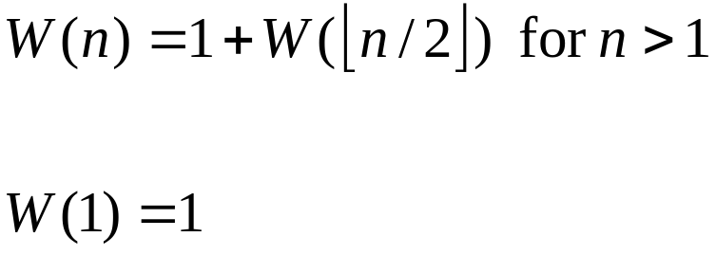
Binary Search-complexity analysis
Algorithms
Worst case: number of comparisons W (n) on an array with n entries
: recurrence relation
: boundary condition
3 way comparisons
How many entries are there in these sections?
If n is even
(n/2) – 1 n/2
If n is odd
(n – 1)/2 (n – 1)/2
There are at most ⌊n/2⌋ entries in the section
Notes:
By means of induction we can show the

Slide 11
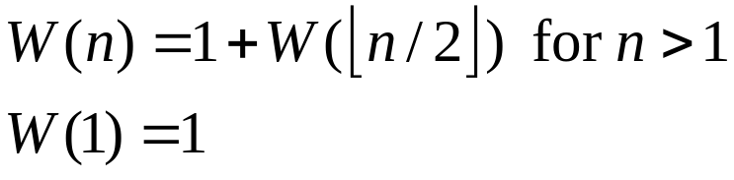
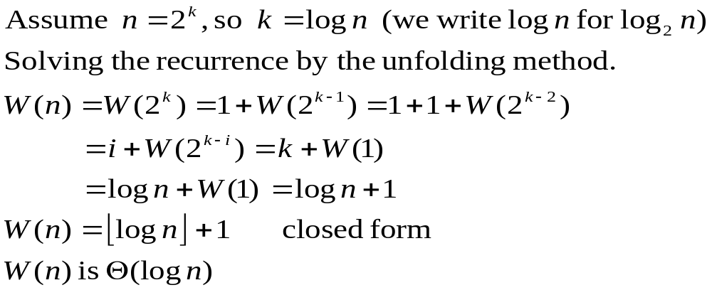
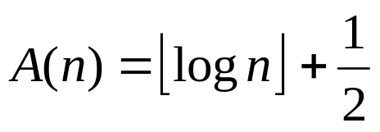
Binary Search-complexity analysis
Algorithms
Average case: number of comparisons A (n)
Notes:
By means of induction we can show the

Slide 12
Lower bound for searching: Decision Trees
Algorithms
For given n any algorithm can be represented as a decision tree.
1 2 3 4 5 6 7 8 9 10 11
The root is labelled with the index of the 1st entry in L to which the Alg. compares x
If x=L[i] then there is no branch if x>L[6] then compare x to L[9]
<
>
6
<
>
<
3
>
9
1
>
4
>
7
>
10
>
2
5
8
11
Notes:
The root

Slide 13
Decision Trees
Algorithms
Sequential Search
1
3
4
5
7
9
10
11
14
16
17
1
2
3
4
5
6
7
8
9
10
11
1
1
3
2
4
3
5
4
7
5
9
6
…

Slide 14
Decision Trees
Algorithms
compare x to every 4th entry
1
3
4
5
7
9
10
11
10
14
16
17
1
2
3
4
5
6
7
8
9
10
11
5
4
11
1
8
1
7
14
3
5
9
16
2
9
10
4
6
17
3
10
11
7

Slide 15
Decision Tree for Binary Search
Algorithms
Decision Tree corresponding to Binary Search
1
3
4
5
7
9
10
11
14
16
17
1
2
3
4
5
6
7
8
9
10
11
9
6
4
14
9
3
1
5
10
16
4
10
1
7
3
7
11
17
2
5
8
11

Slide 16
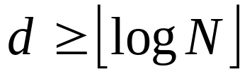
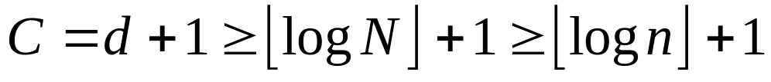
Decision Tree
Algorithms
The number of comparisons C performed in the worst
case equals the number of nodes on the longest path
from the root to a leaf.
d = the depth of the decision tree ( the number of
edges on the longest path from the root to a leaf)
C = d+1
N = the number of nodes in the tree
n = input size
N ≥ n
: lower bound
Binary Search is optimal!

Slide 17
Summary
Algorithms
Algorithms for searching in a sorted array:
Sequential search does n comparisons in the worst
case; it is Θ(n) in the worst case and on average
Binary search does ⎣log n⎦+1 comparisons in the
worst case; it is Θ(log n) in the worst case and on
average
Using decision trees we proved that any algorithm has to do at least ⎣log n⎦+1 comparisons
Binary search is optimal

