Slide 1
Design Strategies

Slide 2
Outline
Algorithms
Today we will study algorithmic design strategies’ - Brute Force
An algorithmic design strategy is a general approach to solving problems algorithmically that is applicable to a variety of problems from different areas of computing
  We will study the following areas:
    the definition of brute force, its applicability and limitations
    exhaustive search, including the traveling salesman problem, the knapsack problem and the assignment problem

Slide 3
Introduction
As we have already seen, there is more than one algorithm to solve a particular problem
  Each of these algorithms has its own time complexity to solve particular instances of the problem
  Throughout this module, we will study several ’algorithm design strategies’ which will allow us to design algorithms for a variety of different problems

Slide 4
Brute force
“Brute Force is a straight forward approach to solving a problem, usually directly based on the problem statement and definitions of the concepts involved.” - A. Levitin, Intro. to Alg.
  Usually the easiest strategy to apply and gives us an algorithm which is conceptually simple, but often inefficient
  Recall the idea of sequential searching that we studied last lecture

Slide 5
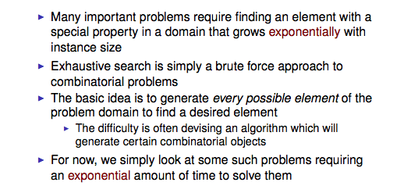
Exhaustive Search

Slide 6
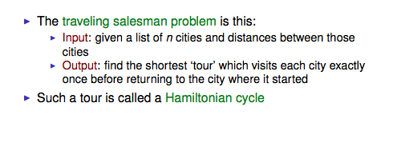
The traveling salesman problem

Slide 7
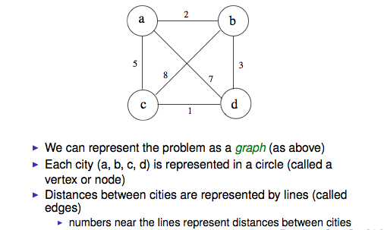
The traveling salesman problem

Slide 8
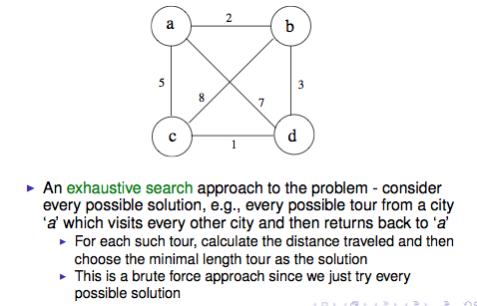
The traveling salesman problem

Slide 9
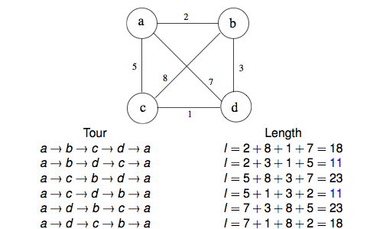
The traveling salesman problem

Slide 10
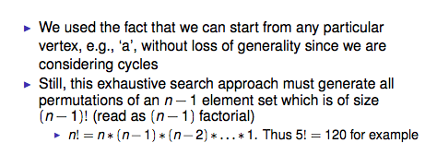
The traveling salesman problem

Slide 11
The knapsack problem
Let us now consider another problem, where the brute force approach of exhaustive search leads to an exponential number of possibilities
  The Knapsack Problem

Slide 12
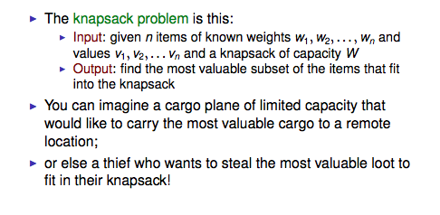
The knapsack problem

Slide 13
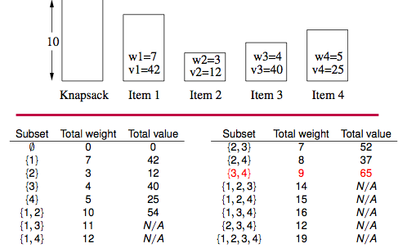
The knapsack problem

Slide 14
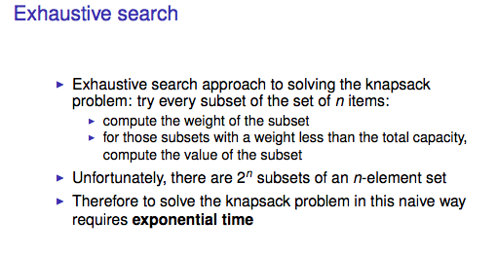
The knapsack problem

Slide 15
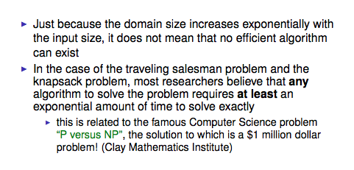
Exhaustive search

Slide 16
Conclusion
We have seen an algorithmic design strategy- brute force
Brute force often gives an algorithm which is simple to describe but they are also often inefficient
Later we will study another very useful design strategy called divide and conquer

