Slide 1
Sorting
Notes:
Arranging the elmnts of a set into order

Slide 2
Outline
Applications of Sorting
Sorting methods
Definition of sorting
Insertion sorting - worst case & average case behaviour
Lower bound for local interchange methods
Divide and Conquer - algorithm design method
Quicksort
Mergesort
Lower bound for sorting
Heapsort
Radix sort
Notes:
1 of the 1st intensely studied CS prob. U will c diff pts of view towards the same prob.

Slide 3
Applications
Sorting takes a lot of time in everyday computing
(25% of all mainframe cycles are spent sorting data;
sorting remains the most common algorithmic
problem in practice)
By understanding sorting, we obtain an amazing
amount of power to solve other problems
It is the most thoroughly studied problem in CS
In the design of algorithms similar ideas are used:
divide and conquer, specialised data structures,
randomised algorithms, lower bounds
Needed for new languages, new machines, rebuild
obsolete libraries, address new applications, simple
fundamental algorithms - ultimate in portable software
Notes:
One of the 1st intensely studied CS prob. U will c diff pts of view towards the same prob.
A sftwr comp stayed in busness for years on the strength of its better sort prog.

Slide 4
Applications
Sorting is the basic building block around which many
other algorithms are build
Searching
Closest pair
7, 4, 11, 28, 54, 91, 1, 14, 95, 23, 85, 89, 67, 72, 45, 48
1, 4, 7, 11, 14, 23, 28, 45, 48, 54, 67, 72, 85, 89, 91, 95
Element uniqueness
7, 4, 11, 28, 54, 91, 1, 14, 95, 28, 23, 85, 89, 4, 67, 72, 28, 45, 48
1, 4, 4, 7, 11, 14, 23, 28, 28, 28, 45, 48, 54, 67, 72, 85, 89, 91, 95
Frequency distribution
Selection
Computational Geometry and Computer Graphics:
e.g. Convex hulls
Notes:
Several good reason for stdying sorting alg. 1st they are of pract use as its done often, once a set of
items is sorted, other prob become easy.

Slide 5
Convex hull
Given n points in 2-d, what is the polygon of
smallest area that contains them all?
Notes:
CH of a geometric object is the smallest conv set containing that obj. S is Conv if p&Q in S then PQ in S

Slide 6
Convex hull
Sort the pts by x-coordinate, the pts can be inserted from left to right into the hull.
Partition the resulting set into a leftmost point, a rightmost point,
and the sets of points above and below the line between the two points.
When constructing the lower hull,
if we see that the point is above the line, we have violated convexity, and the middle point
is removed from the hull.

Slide 7
Convex hull

Slide 8
Convex hull
if we see that the point is above the line, we have violated convexity, and the middle point
is removed from the hull.

Slide 9
Convex hull

Slide 10
Convex hull

Slide 11
Convex hull

Slide 12
Convex hull

Slide 13
Convex hull

Slide 14
Convex hull

Slide 15
Convex hull

Slide 16
Convex hull

Slide 17
Convex hull

Slide 18
Convex hull

Slide 19
Convex hull

Slide 20
Convex hull

Slide 21
Convex hull

Slide 22
Convex hull

Slide 23
Convex hull

Slide 24
Convex hull

Slide 25
Convex hull
Notes:
The prob of finding CH find its prac appl. In Patern rec., Img Proc. C H gives a nice rep of the shape of
the pts.

Slide 26
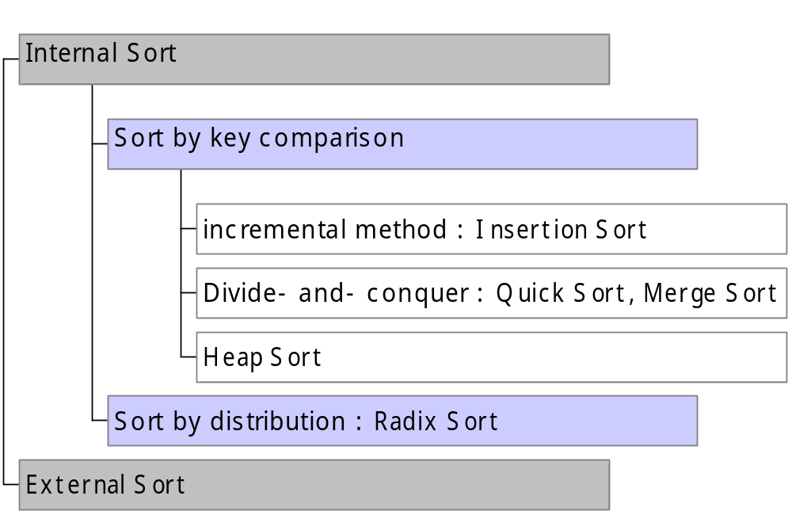
Sorting
Sorting

Slide 27
Sorting
Input: a sequence of n numbers a₁, a₂,··· ,a_{n}
Output: the permutation (reordering) of input sequence
such as a’₁ ≤ a’₂ ≤ ··· ≤ a’_{n}
Stable Sorting
  Any two equal numbers in the input list appear in the same order in the sorted list (useful if they are keys for a larger record).
Time complexity (Sort by comparison)
= the number of comparisons of keys
Notes:
All these alg will arrange elemts of a set in nondec order. Relative order of records with = key is mntad

Slide 28
Insertion Sort
Incremental approach
At each step a[1],…,a[j-1] has been sorted (j=2,…,n)
a[j] is inserted in the correct place among a[1],…,a[j-1], by shifting the elements larger than it to the right, so that a[1],…,a[j] becomes sorted.
Stable (does not change the relative order of elements with equal keys).
It is an online algorithm, it can sort a list as it receives it.
In-place sorting algorithm - Only requires a constant amount of extra memory space.
Notes:
We bgin with a seq of n El in arb order, asume we hv srted a1,...,aj-1. InPlace the inp is overrtn by otpt

Slide 29
Insertion Sort - Example
Incremental approach
3 2 4 1 8 6 5
2 3 4 1 8 6 5
Compare 2 to 3, 2 < 3
Copy 2 to a local var.
Move 3 into the vacancy.
2 3 4 1 8 6 5
temp := a[2]
a[2] := a[1]
a[1] := temp
2 3 1 4 8 6 5
2 1 3 4 8 6 5
1 2 3 4 8 6 5
1 2 3 4 8 6 5
1 2 3 4 6 8 5
1 2 3 4 6 5 8
in-place sort
1 2 3 4 5 6 8
Notes:
Shaded area sorted. Evry stp of I.S. Rmov an EL frm the inpt data insrting it in the corct pos in the alredy sorted list. Keep testing until we run out of EL to the L or EL to the L is smaler.

Slide 30
Insertion Sort
Algorithm InsertionSort
Input: array a of n elements (keys), a[1], a[2], …, a[n].
Output: array a with keys in non-decreasing order
for j:=2 to n do
{ Put a[j] into a[1],…,a[j-1]}
i:=j-1;
while i > 0 and a[i] > a[i+1]do
swap a[i+1] and a[i];
i := i – 1;
end{while};
end{for};
temp := a[i+1]
a[i+1] := a[i]
a[i] := temp
Notes:
4. There are still items to be sorted.

Slide 31
Insertion Sort
Algorithm InsertionSort –Another version
Input: array a of n elements (keys), a[1], a[2], …, a[n].
Output: array a with keys in non-decreasing order
for j:=2 to n do
key:=a[j];
{ Put a[j] into a[1],…,a[j-1] }
i:=j-1;
while i > 0 and a[i] > key do
a[i+1] := a[i];
i := i – 1;
end{while};
a[i+1] := key;
end{for};

Slide 32
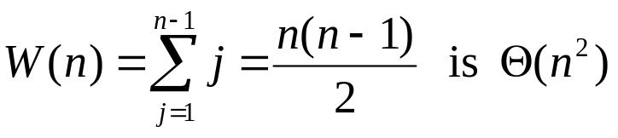
Insertion Sort
worst case
when?
a₁ > a₂ > a₃ > ··· > a_{n}
the keys are in reverse (i.e. decreasing) order
1 + 2 + 3 +…+ (n-1) comparisons
Best case?
Space complexity: in place algorithm
almost sorted
Require constant amount of extra memory space
Notes:
1+2+...+k = k(k+1)/2

Slide 33
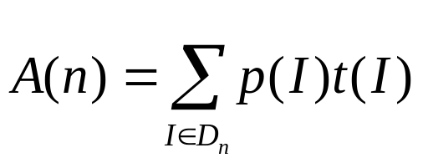
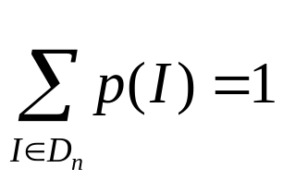
Insertion Sort
Average case behaviour
D_{n} … set of all possible inputs of the problem of size n
t(I) … number of basic operations performed on input I
W(n) = the maximum value of t(I)
W(n) … worst case complexity
p(I) … probability that input I occurs,
Average number of operations:

Slide 34
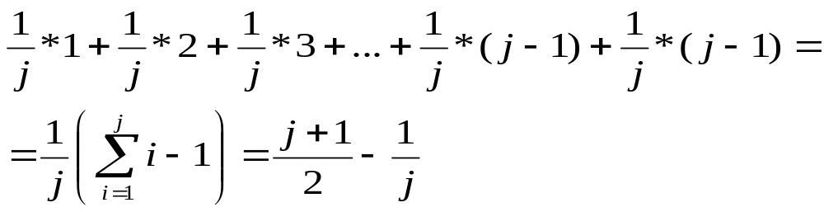
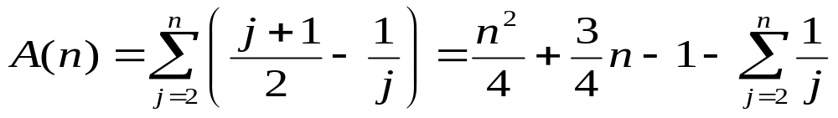
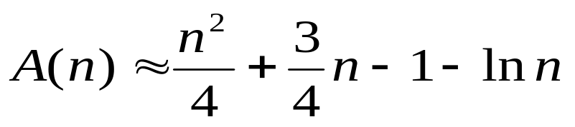
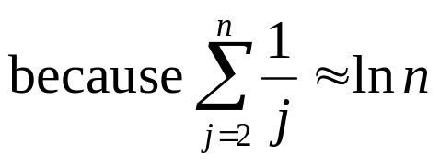

Insertion Sort
average behavior
j-th phase
a_{1,} a₂ ··· a_{j-2} a_{j-1}
a_{j}
j positions where a[j] may go
j-1 j-1 3 2 1
Number of comp.
We assume every position is equally likely
The prob. that a_{j} belong in any one
specified position = 1/j
(1/j) j – (1/j)1

Slide 35
Inversion
i 1 2 3 4 5
permutation π : ( 2 4 1 5 3 )
π(1)=2 π(2)=4 π(3)=1 π(4)=5 π(5)=3
inversion : a pair (π(i), π(j)) such that i < j and π(i) > π(j)
e.g. For the permutation above: (2,1), (4,1), (4,3), (5,3)
4 inversions
Assume that a sorting algorithm removes at most one inversion after each comparison. (this is the case when only neighbouring elements are swapped)
number of comparisons ≥ number of inversions of π
1st key belong in the 2nd position
Performed on the input π(1), ..., π(n) is at least

Slide 36
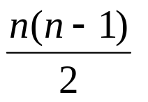
Lower bound for sorting by local swaps
Worst case for the number of inversions when?
Reverse order
: (5 4 3 2 1)
10 inversions
So any algorithm which only does local swaps will have to do at least n(n-1)/2 comparisons; it will therefore have an Ω(n²) worst case complexity.
average behaviour paired with
  permutation π ⇔ transpose permutation π(n), π(n–1),···, π(1)
  ( 2, 4, 1, 5, 3 ) ⇔ ( 3, 5, 1, 4, 2 )
  a pair (i, j) is an inversion in exactly one of π and transpose of π, therefore
  in both we always have a total of n(n-1)/2 inversions
  ⇒ on average n(n-1)/4 comparisons
So any algorithm which only does local swaps will have to do at least n(n-1)/4 comparisons on average; it will therefore have an Ω(n²) average case complexity.

Slide 37
Summary for algorithms based on local swaps
Algorithms based on local swaps:
are quadratic in both worst and average cases
are usually good for almost sorted input instances
Insertion sort, Bubble sort (see tutorial).

Slide 38
Algorithm Design Techniques
Divide-and-Conquer
Decompose the input
solve the smaller problems recursively
combine the solutions
Typical for Recursion
Sorting (Quicksort, Mergesort)
Selection (k-smallest number)

Slide 39

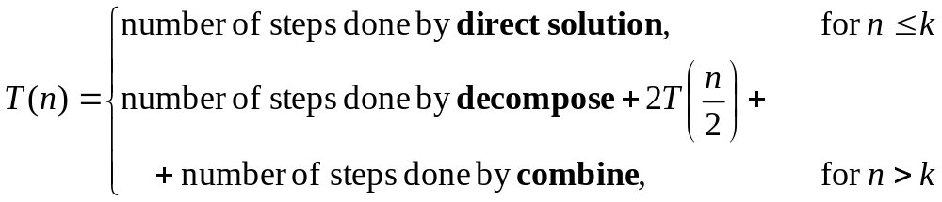
Divide and Conquer
Decompose the input
solve the smaller problems recursively
combine the solutions
Split into two equal-sized pieces
Direct solution: boundary condition for
If decompose and combine (added together) are Θ(n), then T(n) is Θ(n log n)

Slide 40
Quicksort (C.A.R. Hoare 1960)
first
last
x
Choose a pivot element & pull it out of the way & put in E[SplitPoint]
first
SplitPoint
last
≤ x
x
> x
Sort recursively
Sort recursively
By Quicksort
Procedure Quicksort(first, last)
if first < last then
pivot := first (or some other index, depending on a strategy)
Split(first, last, pivot, SplitPoint);
Quicksort(first, SplitPoint-1);
Quicksort(SplitPoint+1, last);
end{if}

Slide 41
Example
6 2 11 4 3 12 5 9 7 8
2 4 3 5 (6) 11 12 9 7 8
(2) 4 3 5
9 7 8 (11) 12
3 (4) 5
7 8 (9)
(7) 8
2 3 4 5 6 7 8 9 11 12

Slide 42
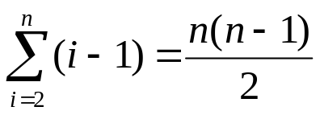
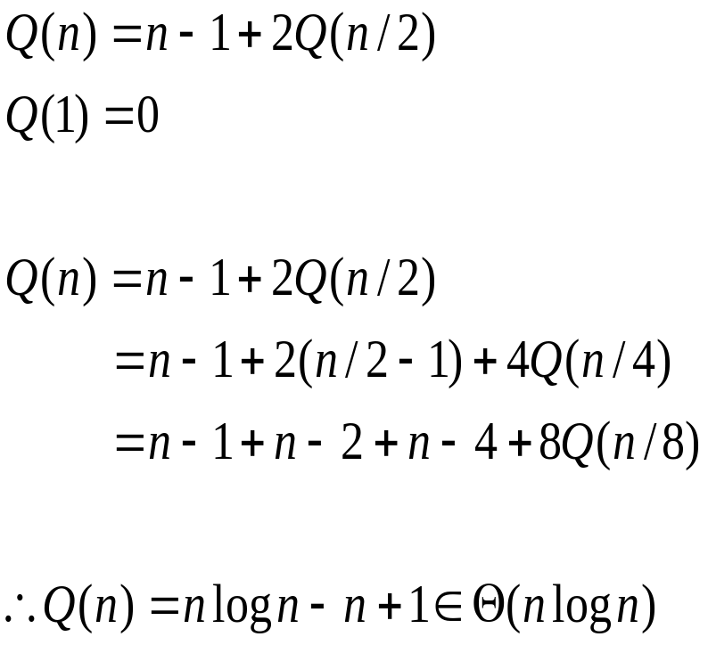
Analysis of Quicksort
worst case when?
When it is already sorted in ascending
order
Simple analysis of average number of comparisons, Q(n)
We assume equal split at each step and n = 2^{k} , so k = log n.
Recurrence equation
Partition does n-1 comp
& the subranges to be
sorted next have
i & n-1-i elements
We assume that they
of equal size n/2

Slide 43

Average Behaviour of Quicksort
Assume that the keys are distinct and that all permutations
are equally likely.
A(n) = the average number of key comparisons for lists of size n
A(n)~1.4(n+1)log n
So A(n) is

Slide 44
Space usage of Quicksort
The beginning and ending indices of all the sublists
yet to be sorted must be saved on a stack.
The split phase can be performed in place.
worst case : (n–1) pairs of the beginning and ending indices
⇒ Θ(n) extra space in the worst case
(the algorithm can be modified to require only Θ(log n) extra space in the worst case)
While the algorithm is working on one subrange
In the worst case, Partition splits off one entry at a time

Slide 45
Merge Sort (John von Neumann 1945)
Merge sorted lists A, B of length n and m into a sorted list C
A: a₁ a₂ a₃ . . . . . . a_{n-1} a_{n}
B: b₁ b₂ b₃ . . . b_{m-1} b_{m}
C:
while (both A and B are not empty)
compare the first remaining keys in A and B
move the smaller one to the next position in C
if A is empty, move the remaining keys in B to C
else, move the remaining keys in A to C

Slide 46
Merge Sort (John von Neumann 1945)
Merge sorted lists A, B of lengths n = 6 and m = 3.
A: 2 3 6 11 14 16
B: 4 9 10
C:
Merge(A, B, C)
if (A is empty)
rest of C = rest of B
else if (B is empty)
rest of C = rest of A
else
if (first of A < first of B)
first of C = first of A
Merge(rest of A, B, rest of C)
else
first of C = first of B
Merge(A, rest of B, rest of C)
return
3 6 11 14 16
6 11 14 16
11 14 16
10
9 10

Slide 47
Merge Sort (John von Neumann 1945)
Merge sorted lists A, B of lengths n = 6 and m = 3.
A: 3 6 11 14 16
B: 4 9 10
C: 2
Merge(A, B, C)
if (A is empty)
rest of C = rest of B
else if (B is empty)
rest of C = rest of A
else
if (first of A < first of B)
first of C = first of A
Merge(rest of A, B, rest of C)
else
first of C = first of B
Merge(A, rest of B, rest of C)
return
3 6 11 14 16
6 11 14 16
11 14 16
10
9 10

Slide 48
Merge Sort (John von Neumann 1945)
Merge sorted lists A, B of lengths n = 6 and m = 3.
A: 6 11 14 16
B: 4 9 10
C: 2 3
Merge(A, B, C)
if (A is empty)
rest of C = rest of B
else if (B is empty)
rest of C = rest of A
else
if (first of A < first of B)
first of C = first of A
Merge(rest of A, B, rest of C)
else
first of C = first of B
Merge(A, rest of B, rest of C)
return
3 6 11 14 16
6 11 14 16
11 14 16
10
9 10

Slide 49
Merge Sort (John von Neumann 1945)
Merge sorted lists A, B of lengths n = 6 and m = 3.
A: 6 11 14 16
B: 9 10
C: 2 3 4
3 6 11 14 16
6 11 14 16
11 14 16
10
9 10

Slide 50
Merge Sort (John von Neumann 1945)
Merge sorted lists A, B of lengths n = 6 and m = 3.
A: 11 14 16
B: 9 10
C: 2 3 4 6
3 6 11 14 16
6 11 14 16
11 14 16
10
9 10

Slide 51
Merge Sort (John von Neumann 1945)
Merge sorted lists A, B of lengths n = 6 and m = 3.
A: 11 14 16
B: 10
C: 2 3 4 6 9
3 6 11 14 16
6 11 14 16
11 14 16
10
9 10

Slide 52
Merge Sort (John von Neumann 1945)
Merge sorted lists A, B of lengths n = 6 and m = 3.
A: 11 14 16
B:
C: 2 3 4 6 9 10
Merge(A, B, C)
if (A is empty)
rest of C = rest of B
else if (B is empty)
rest of C = rest of A
else
if (first of A < first of B)
first of C = first of A
Merge(rest of A, B, rest of C)
else
first of C = first of B
Merge(A, rest of B, rest of C)
return
3 6 11 14 16
6 11 14 16
11 14 16
10
9 10

Slide 53
Merge Sort (John von Neumann 1945)
Merge sorted lists A, B of lengths n = 6 and m = 3.
A:
B:
C: 2 3 4 6 9 10 11 14 16
Merge(A, B, C)
if (A is empty)
rest of C = rest of B
else if (B is empty)
rest of C = rest of A
else
if (first of A < first of B)
first of C = first of A
Merge(rest of A, B, rest of C)
else
first of C = first of B
Merge(A, rest of B, rest of C)
return
3 6 11 14 16
6 11 14 16
11 14 16
10
9 10

Slide 54
Example
6 12 15 11 4 3 2 14 10 5 1 9 16 7 8 13
6 12 15 11 4 3 2 14 10 5 1 9 16 7 8 13
6 12 11 15 3 4 2 14 5 10 1 9 7 16 8 13
6 11 12 15 2 3 4 14 1 5 9 10 7 8 13 16
2 3 4 6 11 12 14 15 1 5 7 8 9 10 13 16
1 2 3 4 5 6 7 8 9 10 11 12 13 14 15 16
16 little sorted arrays Start with each element being one list
At each step pair up all the current lists and merge each pair
Merge adjacent subranges of one array

Slide 55
Example – Merge Sort
6 12 15 11 4 3 2 14 10 5 1 9 16 7 8 13
6 12 15 11 4 3 2 14 10 5 1 9 16 7 8 13
6 12 15 11 4 3 2 14 10 5 1 9 16 7 8 13
6 12 15 11 4 3 2 14 10 5 1 9 16 7 8 13
6 12 15 11 4 3 2 14 10 5 1 9 16 7 8 13
6 12 11 15 3 4 2 14 5 10 1 9 7 16 8 13
6 11 12 15 2 3 4 14 1 5 9 10 7 8 13 16
2 3 4 6 11 12 14 15 1 5 7 8 9 10 13 16
1 2 3 4 5 6 7 8 9 10 11 12 13 14 15 16

Slide 56
Merge Sort
Merge Sort algorithm: slices the array in two halves & sort the two halves of the list recursively and then merge the two lists.
Equivalently, start with each element being one list. At each step pair up all the current lists and merge each pair.
MergeSort(first, last)
if first < last then int mid=(first+last)/2
MergeSort(first, ⎣(first+last)/2⎦);
MergeSort(⎣(first+last)/2⎦+1, last);
Merge(first, ⎣(first+last)/2⎦, ⎣(first+last)/2⎦+1, last);
end.
first
mid
last

Slide 57
Analysis of Merge Sort
Complexity of merging two lists of length n₁ and n₂:
After each comparison, one key is moved to the merged list
⇒ at most (n₁ + n₂ –1) comparisons
Worst case : W(n) = W(⎣n/2⎦) + W(⎡n/2⎤) + n − 1
W(1) = 0
W(n) ≈ n log n − n
= Θ(n log n)
Average case ≈ Worst case
Mergesort does about 30% fewer comp. in the w.case than Quicksort in the av.case.
But it does more element movement on average.
Space complexity: an extra amount of n locations needed
not in-place

Slide 58
Space Usage of Merge Sort
Space Saving
  Suppose n ≥ m.
  Give an array A extra m locations.
  Merge from the ends (larger keys) of A and B.
not in-place
A
B
1 n n+m 1 m

Slide 59
Merge Sort (Janos von Neumann 1945)
Merge sorted lists A, B |A| = n = 6, |B| = m = 3.
A: 2 3 6 11 14 16
B: 4 9 10
2 3 6 11 14 16 * * *
2 3 6 11 14 * * * 16
2 3 6 11 * * * 14 16
2 3 6 * * * 11 14 16
2 3 6 * * 10 11 14 16
2 3 6 * 9 10 11 14 16
2 3 * 6 9 10 11 14 16
2 3 4 6 9 10 11 14 16
4 9
4

Slide 60
How fast can we sort?
Depends on the model
Quick sort & Merge sort in Θ(nlogn)
Insertion sort Θ(n²)
Can we do better than Θ(nlogn) ?
No comparison sorting algorithm run better than nlogn.
Outside the comp. sort it might get linear!
Why we need nlogn?
Decision Trees

Slide 61
Decision Trees (to recall)
For any n there is a class of searching algorithms (decision trees)
1 2 3 4 5 6 7 8 9 10 11
1
2
3
4
5
6
7
8
9
10
11
4
8
9
10
11
6
1
5
3
9
2
6
1
4
7
10
3
7
2
5
8
11

Slide 62
Decision Trees for sorting by comparisons
Assume that the keys are distinct. (a₁, a₂,··· ,a_{n})
Decision Tree
a₁ a₂ a₃
n = 3
If a[1]<a[2]
1:2
If a[1]>a[2]
2:3
1:3
a₁,a₂,a₃
1:3
a₂,a₁,a₃
2:3
a₁,a₃,a₂
a₃,a₁,a₂
a₂,a₃,a₁
a₃,a₂,a₁
a particular input → a path from the root to a leaf
the number of comparisons → path length
6 possible inputs ⇒ 6 leaves the tree must have at least n! leaves
number of comparisons in the worst case = depth of decision tree = 3
“height of the tree”
average number of comparisons
= average lengths of all paths from the root to a leaf = 2+2/3
=[(4x3)+(2x2)]/6

Slide 63

Lower bounds for Sorting by comparison
Worst case number of comparisons in the worst case = depth of decision tree
L : number of leaves in a decision tree ≥ n!
d: the depth of a decision tree
L ≤ 2^{d} T2,Q1(d)
d ≥ log L
d ≥ log n!
Any alg. must do at least ⎡log n!⎤ in the worst case
How close ⎡log n!⎤ is to n log n ?
So d is at least ⎡ n log n – 1.443n ⎤ key comp.
MergeSort is optimal !
Stirling approx.
n! ≥ (n/e)^{n}
log n! > n log (n/e)
n log n –n log e
= n log n – 1.443n
Average Behavior
  average path length ≥ ⎣log L⎦
  average number of comparisons ≥ ⎣log n!⎦ ~ n log n – 1.443n
very close

Slide 64
Heap
Heap : a binary tree such that
  All leaves are on, at most, two adjacent levels.
  All leaves on the lowest level occur to the left, and all levels except the lowest one are completely filled.
  The key in root is greater than equal to all its children, and the left and right sub-trees are again binary heaps.
50
1
2
24
3
30
20
4
5
21
18
6
7
3
Data Structure
  stored in an array level by level, left to right within each level
When new nodes are added to a heap, they must be added L to R
8
9
10
12
5
6
⎣i/2⎦
50 24 30 20 21 18 3 12 5 6
i
1 2 3 4 5 6 7 8 9 10
2i
2i+1
array index starts from 1

Slide 65
Heap
Data Structure when array index starts from 0
50 24 30 20 21 18 3 12 5 6
0 1 2 3 4 5 6 7 8 9
0
⎣(i-1)/2⎦
1
2
3
4
5
6
i
7
8
9
2i+1
2i+2

Slide 66
Fix Heap
50
24
30
20
21
18
3
12
5
6
The heap
If the elements are arranged in a heap
Then we can build a sorted sequence in reverse order
by repeatedly removing the element from the root
rearranging the elements still in the heap.
Delete maximum
* Copy the rightmost element on the lowest level (6) into K
* Delete 6

Slide 67
Fix Heap
50
vacant
24
30
24
30
20
20
21
18
3
21
18
3
12
5
6
12
5
Remove the key at the root
The rightmost leaf at the bottom level
has been removed.
K = 6 must be reinserted.

Slide 68
Fix Heap
50
vacant
30
24
30
24
30
24
vacant
20
20
21
18
3
20
21
18
3
21
18
3
12
5
6
12
5
12
5
The larger child of vacant
30 > K, It moves up and
vacant moves down

Slide 69
Fix Heap
50
30
24
30
24
30
24
vacant
20
20
21
18
3
20
21
18
3
21
18
3
12
5
6
12
5
12
5
30
24
18
20
21
3
vacant
12
5
The larger child of vacant
18 > K, It moves up and
vacant moves down

Slide 70
Fix Heap
50
30
24
30
24
30
24
20
20
21
18
3
20
21
18
3
21
18
3
12
5
6
12
5
12
5
30
30
24
18
24
18
20
21
3
20
21
6
3
12
5
12
5
Finally, since vacant is a leaf,
K=6 is inserted.
Before and after one iteration

Slide 71
Fix Heap
FixHeap(root, inserted key, last key)
Input: root, the position of the root; there is no key stored in the root
inserted_key, a key to be inserted in the heap
last_key, the index of the last key in the heap
Outline of algorithm
If inserted_key is larger or equal to the two keys in the children of the root, then insert inserted_key in position root and return.
Otherwise let root1 be the index of left or the right child of the root, whichever has a larger key of the two children.
Move the key of root1 into root.
FixHeap(root1, inserted_key, last_key)
return
2 comparisons
2d comparisons in the worst case on a heap with height d.

Slide 72
Heapsort
Create heap: put the keys in a tree (or the structure needed for the heap) in any order; the leaves are already heaps; then apply FixHeap bottom-up through the tree to make it into a heap.
Each time we remove the key from the root of the partial heap and then apply FixHeap to insert that key back in the partial heap in the correct place.
Sorting : by repeatedly removing the key from the root and the last key in the heap and applying FixHeap to insert the key removed from the last position in the heap back into a smaller heap.

Slide 73
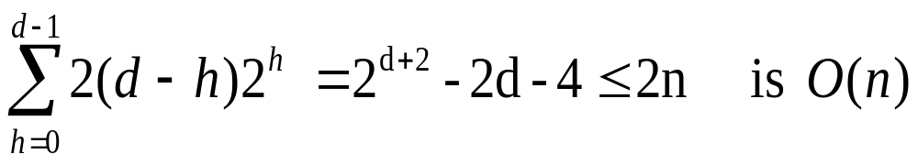
Construct Heap
Divide-and-Conquer
n: the number of nodes d: the depth of heap, d = ⎣log n⎦
the number of nodes at level h is 2^{h}
FixHeap for a heap with root at level h takes at most 2(d-h) operations
Start by rearranging elements near the leaves first and works its way up the tree
2^{d+1}-1=n, so 2^{d+2} -2d-4=2n+2-2d-4=2n-2d-2

Slide 74
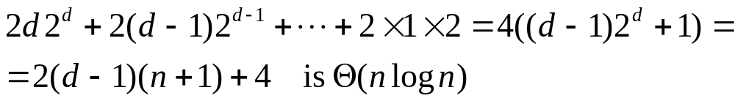
Heapsort
After the heap is constructed, we repeatedly remove the key in the root and then insert the last key back in a heap with one less elements, using FixHeap
n: the number of nodes d: the depth of heap, d = ⎣log n⎦
The key in the root is removed n times. We assume n = 2^{d+1} –1.
For the first 2^{d} times (while a key from the level d is also removed and inserted back), the heap has depth d, then for the next 2^{d-1} times the heap has depth d-1, and so on.
So the number of comparisons is:
2Σ(i 2^{i}) (i=1 to d) = 2[(d-1)2^{d+1} +2]
d = ⎣ log n ⎦
Worst case analysis Θ(n log n)
(Θ(n) for heap construction, Θ(n log n) for sorting)
Average behavior Θ(n log n)

Slide 75
Heap Sort (J.W.Williams 1964)
Heapsort ( a: array; n: integer );
{ Heap construction}
for i:= ⎣n/2⎦ to 1 by −1 do n/2 index of the root of right most leaf
FixHeap(i, a[i], n)
end{for}
{Repeatedly remove the key at the root and rearrange the heap.}
for heapsize:= n to 2 by −1 do
max:= a[1] ; index 1 always has max key
FixHeap(1, a[heapsize], heapsize−1) ;
a[heapsize]:= max put max (i.e. root) in last element
end{for}
end{Heapsort}
(root,inserted_key,last_key)
Fixheap(root,inserted_key,last_key)

Slide 76
Heap Sort
Heap construction
6
6
6
50
3
50
3
50
30
12
21
18
30
20
24
18
30
20
24
18
3
20
5
24
12
5
21
12
5
21
50
50
50
6
30
24
30
24
30
20
20
20
21
18
3
24
18
3
6
18
3
12
5
21
12
5
21
12
5
6
Key removed from the root, apply FixHeap to insert 6 in the correct place

Slide 77
Heap Sort
Selection phase
Replace the root with the last element on the last level
50
6
30
24
30
24
30
24
6
20
20
21
18
3
20
21
18
3
21
18
3
12
5
6
12
5
50
12
5
50
30
5
24
24
18
24
18
5
18
20
21
6
3
20
21
6
3
20
21
6
3
12
5
50
12
30
50
12
30
50
24
12
21
21
18
21
18
12
18
20
5
6
3
20
5
6
3
20
5
6
3
12
30
50
24
30
50
24
30
50

Slide 78
Heap Sort
21
3
20
20
18
20
18
3
18
12
5
6
3
12
5
6
21
12
5
6
21
24
30
50
24
30
50
24
30
50
20
6
18
12
18
12
18
12
6
3
5
6
21
3
5
20
21
3
5
20
21
24
30
50
24
30
50
24
30
50
5
12
3
12
6
5
6
5
6
3
18
20
21
3
18
20
21
12
18
20
21
24
30
50
24
30
50
24
30
50

Slide 79
Heap Sort
6
3
5
5
3
5
6
3
6
12
18
20
21
12
18
20
21
12
18
20
21
24
30
50
24
30
50
24
30
50
3
3
5
6
5
6
12
18
20
21
12
18
20
21
24
30
50
24
30
50

Slide 80
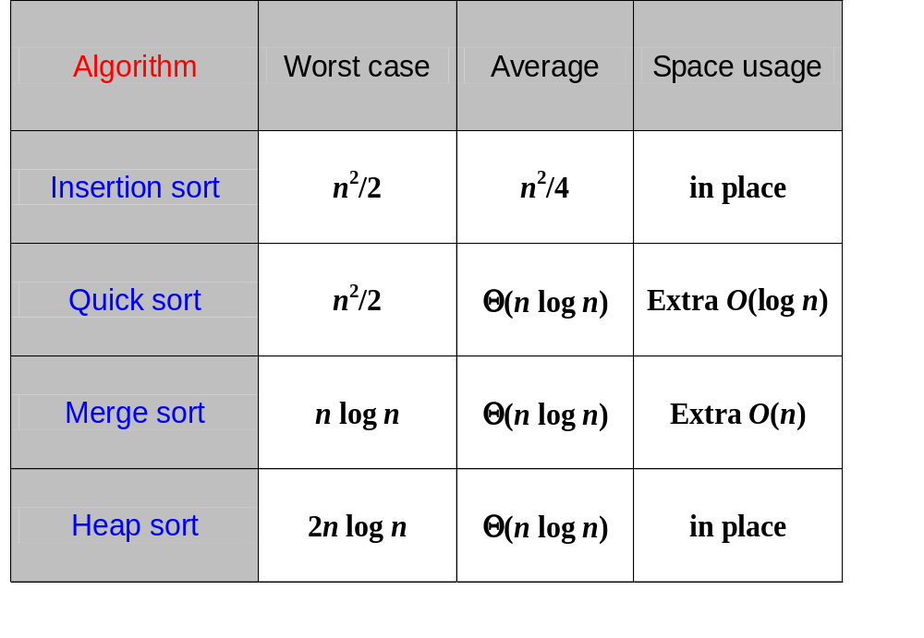
Summary of Sort by key comparison

Slide 81
Bucket Sort
Problem:
* given a large set of cards with names on them ( 1 name per card)
* alphabetize the cards
Possible solution:
* separate them into 26 (or fewer) different piles according to the first letter
* alphabetize the cards in each pile (by the same method, according to the second letter or by another method)
* concatenate the sorted piles
Another problem:
* the keys are 5-digit decimal integers
Possible solution:
* separate them into 10 piles (according to the first digit)
* sort each pile
* concatenate the sorted piles
00001-09,999
10,000-19,999
20,000-29,999
30,000-
40,000
50,000
60,000
70,000
80,000-89,999
90,000-99,999

Slide 82
Bucket Sort
Bucket Sort
k buckets (piles)
Distribute ⇒ Sort buckets ⇒ Concatenate buckets
three phases
keys
individually
Θ(n)
Θ(k (n/k)log(n/k))
= Θ(n log(n/k))
Θ(n)
Each key is examined once to
check in which bucket the key belongs
Combining buckets, at worst,
req. all elements to be copied
from the buckets into 1 list.
we have k buckets & each bucket does (n/k)log(n/k)
we assume that the input numbers are approximately uniformly distributed among the buckets.
Time complexity n log(n/k) = n log 10, which is Θ(n) if k = n/10
space : kn locations if using arrays i.e. Θ(n²)
2n+k if using linked lists i.e. Θ(n)
Trade-off between time and space
As k increases,
so does the speed
But so the amount
of space used.

Slide 83
Radix Sort
keys : five-digit numbers
1. Distribute the keys among 10 buckets according to the Least
Significant Digit.
2. Concatenate the contents of the buckets preserving the order in
each bucket.
3. Distribute the keys among 10 buckets according to the next least
significant digit.
4. Concatenate the contents of the buckets preserving the order in
each bucket.
……. 5 passes
The number of digits/ bits/ letters/ fields has to be constant (here 5).
Time : 5n, which is Θ(n)
Space : Θ(n) extra space for linked lists or for the link fields.
Distribute does Θ(n) and combine does Θ(n)
Linear in n

Slide 84
Radix Sort: Example
342
287
583
202
395
923
107
111
060
283
Start with least significant digit

Slide 85
Radix Sort: Example
342
287
583
202
395
923
107
111
060
283
Separate keys into groups based on value of current digit
Make sure not to disturb original order of keys

Slide 86
Radix Sort: Example
287
583
202
395
923
107
111
060
283
342
Bucket 0
1
2
3
4
5
6
7
8
9
Separate keys into groups based on value of current digit
Make sure not to disturb original order of keys

Slide 87
Radix Sort: Example
287
583
202
395
923
107
111
060
283
342
Bucket 0
1
2 342
3
4
5
6
7
8
9
Separate keys into groups based on value of current digit
Make sure not to disturb original order of keys

Slide 88
Radix Sort: Example
342
287
583
202
395
923
107
111
060
283
Bucket 0
1
2 342
3
4
5
6
7 287
8
9
Separate keys into groups based on value of current digit
Make sure not to disturb original order of keys

Slide 89
Radix Sort: Example
342
287
583
202
395
923
107
111
060
283
Bucket 0
1
2 342
3 583
4
5
6
7 287
8
9
Separate keys into groups based on value of current digit
Make sure not to disturb original order of keys

Slide 90
Radix Sort: Example
342
287
583
202
395
923
107
111
060
283
Bucket 0
1
2 342 202
3 583
4
5
6
7 287
8
9
Separate keys into groups based on value of current digit
Make sure not to disturb original order of keys

Slide 91
Radix Sort: Example
342
287
583
202
395
923
107
111
060
283
Bucket 0
1
2 342 202
3 583
4
5 395
6
7 287
8
9
Separate keys into groups based on value of current digit
Make sure not to disturb original order of keys

Slide 92
Radix Sort: Example
342
287
583
202
395
923
107
111
060
283
Bucket 0
1
2 342 202
3 583 923
4
5 395
6
7 287
8
9
Separate keys into groups based on value of current digit
Make sure not to disturb original order of keys

Slide 93
Radix Sort: Example
342
287
583
202
395
923
107
111
060
283
Bucket 0
1
2 342 202
3 583 923
4
5 395
6
7 287 107
8
9
Separate keys into groups based on value of current digit
Make sure not to disturb original order of keys

Slide 94
Radix Sort: Example
342
287
583
202
395
923
107
111
060
283
Bucket 0
1 111
2 342 202
3 583 923
4
5 395
6
7 287 107
8
9
Separate keys into groups based on value of current digit
Make sure not to disturb original order of keys

Slide 95
Radix Sort: Example
342
287
583
202
395
923
107
111
060
283
Bucket 0 060
1 111
2 342 202
3 583 923
4
5 395
6
7 287 107
8
9
Separate keys into groups based on value of current digit
Make sure not to disturb original order of keys

Slide 96
Radix Sort: Example
Bucket 0 060
1 111
2 342 202
3 583 923 283
4
5 395
6
7 287 107
8
9
Separate keys into groups based on value of current digit
Make sure not to disturb original order of keys

Slide 97
Radix Sort: Example
060
111
342
202
583
923
283
395
287
107
Bucket 0 060
1 111
2 342 202
3 583 923 283
4
5 395
6
7 287 107
8
9
060 111 342 202 583 923 283 395 287 107
The buckets can be combined in order before distributing on the next digit
The problem of sorting the buckets has been completely eliminated

Slide 98
Radix Sort: Example
060
111
342
202
583
923
283
395
287
107
Bucket 0
1
2
3
4
5
6
7
8
9

Slide 99
Radix Sort: Example
060
111
342
202
583
923
283
395
287
107
Bucket 0
1
2
3
4
5
6 060
7
8
9

Slide 100
Radix Sort: Example
60
111
342
202
583
923
283
395
287
107
Bucket 0
1 111
2
3
4
5
6 060
7
8
9

Slide 101
Radix Sort: Example
60
111
342
202
583
923
283
395
287
107
Bucket 0
1 111
2
3
4 342
5
6 060
7
8
9

Slide 102
Radix Sort: Example
60
111
342
202
583
923
283
395
287
107
Bucket 0 202
1 111
2
3
4 342
5
6 060
7
8
9

Slide 103
Radix Sort: Example
60
111
342
202
583
923
283
395
287
107
Bucket 0 202
1 111
2
3
4 342
5
6 060
7
8 583
9

Slide 104
Radix Sort: Example
60
111
342
202
583
923
283
395
287
107
Bucket 0 202
1 111
2 923
3
4 342
5
6 060
7
8 583
9

Slide 105
Radix Sort: Example
60
111
342
202
583
923
283
395
287
107
Bucket 0 202
1 111
2 923
3
4 342
5
6 060
7
8 583 283
9

Slide 106
Radix Sort: Example
60
111
342
202
583
923
283
395
287
107
Bucket 0 202
1 111
2 923
3
4 342
5
6 060
7
8 583 283
9 395

Slide 107
Radix Sort: Example
60
111
342
202
583
923
283
395
287
107
Bucket 0 202
1 111
2 923
3
4 342
5
6 060
7
8 583 283 287
9 395

Slide 108
Radix Sort: Example
60
111
342
202
583
923
283
395
287
107
Bucket 0 202 107
1 111
2 923
3
4 342
5
6 060
7
8 583 283 287
9 395

Slide 109
Radix Sort: Example
202
107
111
923
342
060
583
283
287
395
Bucket 0 202 107
1 111
2 923
3
4 342
5
6 060
7
8 583 283 287
9 395
202 107 111 923 342 060 583 283 287 395

Slide 110
Radix Sort: Example
202
107
111
923
342
060
583
283
287
395
Bucket 0 060
1 107 111
2 202 283 287
3 342 395
4
5 583
6
7
8
9 923

Slide 111
Radix Sort: Example
342
287
583
202
395
923
107
111
060
283
Bucket 0 060
1 107 111
2 202 283 287
3 342 395
4
5 583
6
7
8
9 923
60 107 111 202 283 287 342 395 583 923

Slide 112
Radix Sort: Example
060 11 342 202 583 923 283 395 287 107
342
287
583
202
395
923
107
111
060
283
202 107 111 923 342 60 583 283 287 395
060 107 111 202 283 287 342 395 583 923
Start with least significant digit
Separate keys into groups based on value of current digit
Make sure not to disturb original order of keys

Slide 113
Summary
Review of applications of sorting
Insertion sorting
Lower bound for local interchange methods
Divide and Conquer - algorithm design method
Quicksort
Mergesort
Lower bound for sorting by key comparisons
Heapsort
Bucket sort
Radix sort

