Slide 1
Graphs and Digraphs
Definitions

Slide 2
Outline
Directed and Undirected Graphs; Trees
Applications
Terminology
Representation of graphs

Slide 3
What is a Graph ?
Binary Relation x R y iff x≠y and x divides y.
V = {1, 2, 3, 4, 5, 6, 7}
E = {(x, y) | x R y, x,y∈V}
E = {(1,2), (1,3),(1,4),(1,5),(1,6),(1,7), (2,4),(2,6),(3,6)}
6
2
4
3
5
1
7

Slide 4
Applications
Graphs can be used to model:
  computer networks,
  Flowcharts,
  computer graphics
  finite automata
Graphs are also used in other disciplines to model the structure of objects:
  biology - evolutionary relationship
  chemistry - structure of molecules

Slide 5

Graph Definition
An undirected graph G is defined by a pair G =(V, E) where V is a set of vertices (or nodes) and E is a set of edges.
  Each edge is an unordered pair of vertices
  In a simple undirected graph, we have at most a single edge between any two vertices and no self loop (an edge from a vertex to itself)
  A multigraph allows more than one edge between two vertices
  A graph with every pair of its vertices connected by an edge is called complete

Slide 6
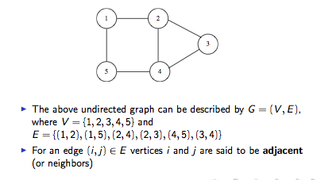
Undirected Graph

Slide 7
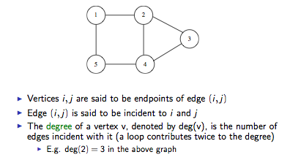
Undirected Graph

Slide 8
Graph Representation
To represent a graph, we can use an adjacency-list
which stores information about which vertex is adjacent
to which other vertex
This uses a data structure called a linked list which we shall now study

Slide 9

Linked list
A linked list is a list of elements (nodes) connected together like a chain
Each node contains two fields:
    “data” field: stores some data about the element
    “next” field: a pointer to link this node to the next node in the list

Slide 10
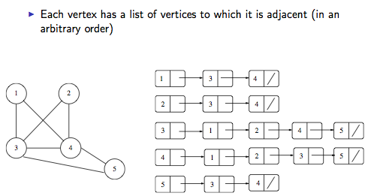
Adjacency list

Slide 11
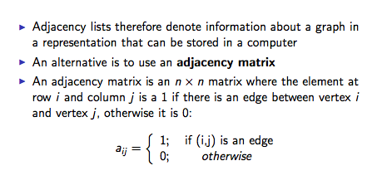
Adjacency lists and matrices

Slide 12
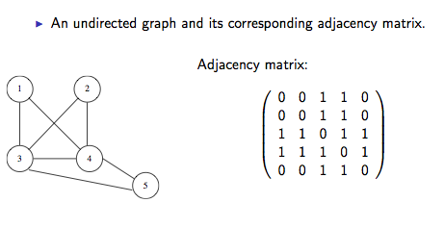
Adjacency matrix

Slide 13
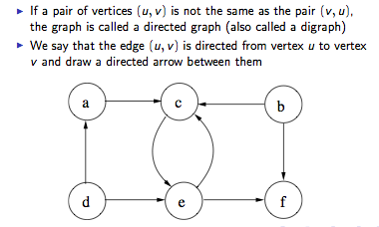
Directed graphs

Slide 14
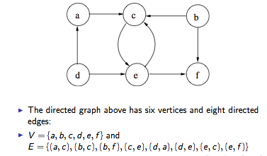
Directed graphs

Slide 15
Directed graphs
The in-degree of a vertex v is the number of edges leading to the vertex v
the out-degree of a vertex v is the number of edges leading away from vertex v

Slide 16
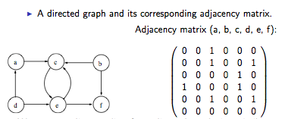
Adjacency matrix
We can use adjacency lists for directed graphs in a similar way to
as for undirected graphs

Slide 17
Store requirements – adjacency lists
When using adjacency lists to represent a simple graph G with n vertices and m edges:
  The storage requirements if G is undirected are n + 4m. We have n adjacency lists, 2m adjacency list elements (each edge is represented twice) and 2m pointers.
  The storage requirements if G is directed are n + 2m. We have n adjacency lists, m adjacency list elements and m pointers.

Slide 18
Store requirements – adjacency matrices
When using adjacency matrices to represent a simple graph G with n vertices and m edges:
  If G is undirected, we need to store n(n − 1)/2 elements (the matrix is symmetric)
  If G is directed, we need to store n(n − 1) elements
  For sparse graphs, adjacency lists use less space
  For dense graphs, adjacency matrices use less space
  Depending upon the problem, one representation may be more convenient than the other

Slide 19
Graphs
A path between vertex u and v is a sequence of edges (u₁,x₁), (x₁,x₂), . . ., (x_{n-1},v) where n > 1.
path length = the number of edges of a path, the length of this path is n
If all vertices in a path are distinct, the path is said to be simple
A cycle ( or circuit) is similar to a path, but u = v
Paths and cycles can be defined for directed or undirected graphs

Slide 20
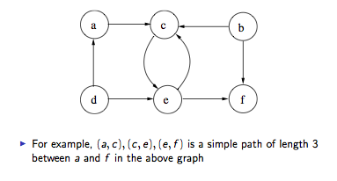
Directed graphs

Slide 21

Subgraphs

Slide 22
Trees
A tree is a connected graph with no cycles (acyclic).
A non connected graph with no cycles consists of several trees
and is called a forest.
A tree with n vertices will always have exactly n-1 edges.
A rooted tree is a tree in which one vertex has been designated as root.
Tree
Not a Tree

Slide 23
Trees
Other equivalent statements about a graph G being a tree:
  There is exactly one path between any two vertices in G
  G is connected and removal of one edge disconnects G
  G is acyclic (does not contain cycles) and adding one edge creates a cycle

Slide 24
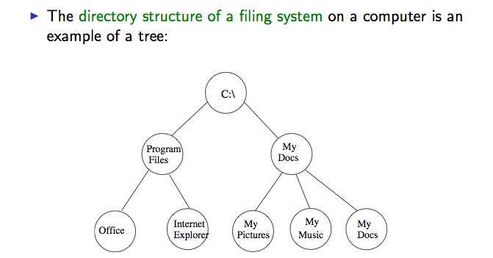
Tree – an example

Slide 25
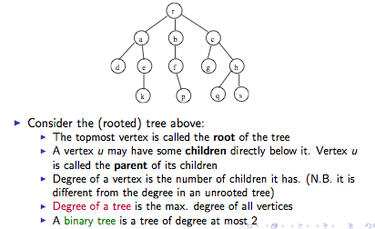
Trees - terminology

Slide 26
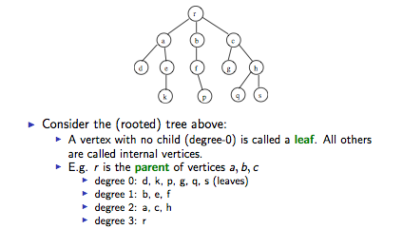
Trees - terminology

Slide 27
Trees - terminology
In a rooted tree we can arrange all vertices on levels:
we put on level i all the vertices which are at distance i from the root.
A binary tree is a rooted tree in which each vertex has at most two children. The children are usually designated as the left and the right child.
Level 0
Level 1
Level 2

Slide 28
Complete graphs - terminology
A graph is complete if there is an edge between any pair of vertices.
A complete graph on n vertices is denoted K_{n}
K₃
K₄
K₄

Slide 29
Weighted Graphs - terminology
4
B
L
Weighted Graph is a triple
G= (V, E, W )
Each edge e has a weight w(e)
( the weight can represent
cost, capacity, length etc.)
8
4
5
O
3
G
4
5
2
V = {B, L, O, G, R, U}
E = {{B,L}, {B,U}, {B,O}, {L,G}, {O,G},
{O,R}, {G,R}, {G,U}}
R
U

Slide 30
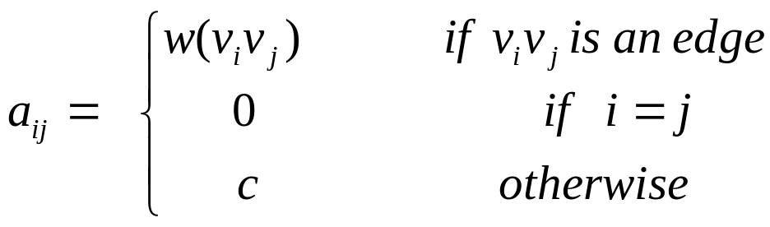
Graph Representation
For a weighted graph G =(V,E,W) , choose a constant c which is outside the range of edge weights:
25
0 25 ∞ ∞ ∞ ∞ ∞
∞ 0 10 14 ∞ ∞ ∞
5 ∞ 0 ∞ ∞ 16 ∞
∞ 6 18 0 ∞ ∞ ∞
∞ ∞ ∞ ∞ 0 ∞ ∞
∞ ∞ ∞ 32 42 0 14
∞ ∞ ∞ ∞ ∞ 11 0
1
2
5
10
14
6
3
18
4
16
32
42
11
5
6
7
14

Slide 31
Array of Adjacency lists
contains the weights
1
2
25
/
1
25
2
2
3
10
4
14
/
5
10
14
6
3
1
5
6
16
/
3
18
4
vertex
weight
link
16
4
2
6
3
18
/
32
42
11
5
/
5
6
7
14
6
4
32
5
42
7
14
/
7
6
11
/

Slide 32
Summary
Graph Definition
Applications
Important Terminology
Adjacency matrix and lists

