Slide 1
Graphs and Digraphs
Minimum Spanning Trees

Slide 2
Outline
Minimal spanning tree
Greedy algorithms
Prim’s algorithm
Kruskal’s algorithm

Slide 3
Spanning Trees
The following problem is very important in many practical situations:
    given a set of points, connect them in the cheapest possible way so that there will be a path between any two points
This problem arises when designing communications networks, transport networks, electrical networks etc. and tries to achieve the cheapest connectivity
We can represent the points by vertices, the connections by edges and the costs by edge weights

Slide 4
Spanning Tree
Spanning Tree of a connected undirected graph G :
a subgraph of G which is a tree and contains all vertices of G.
input graph
Different Spanning Trees
2
2
2
1
1
1
3
3
3
2
4
2
4
4
1
1
3
3
4
4

Slide 5
Minimum Spanning Tree
Spanning Tree of a connected undirected graph G :
a subgraph of G that is a tree and contains all the vertices of G.
a weighted graph → spanning tree with minimum weight:
Minimum spanning tree
(weight of tree = sum of the weights of its edges).
input graph
Different Minimum Spanning Trees
2
2
2
6
6
1
1
1
1
1
1
6
3
6
3
6
6
3
2
6
6
4
2
4
4
1
1
6
1
6
3
not an MSP
6
3
6
6
4
4

Slide 6
Minimum Spanning Tree
On the previous slide, we can see three possible spanning trees (others also possible)
    Note that in each case, adding another edge would introduce a cycle, meaning it would no longer be a tree
Our next question is this: how do we find a minimal spanning tree?
    To answer this, we introduce the concept of a greedy algorithm

Slide 7
Greedy Algorithm
We shall now look at the design strategy of a greedy algorithm:
  At every step, make the best move you can make
  Keep going until you’re done
  Advantages
    Don’t need to pay much effort at each step
    Usually finds a solution very quickly
    The solution found is usually not bad
Possible problem
    The solution found may NOT be the best one

Slide 8
Prim’s Minimum Spanning Tree Algorithm
Select an arbitrary vertex to start the tree;
while there are vertices not in the tree do
select an edge of minimum weight among all edges
between a vertex in the tree and a vertex not in
the tree;
add the selected edge and its end vertex
to the tree
end

Slide 9
Prim’s algorithm
Graph manipulation algorithms
Categories of vertices during finding MST.
- Tree vertices: in the tree
- Fringe vertices: adjacent to a tree vertex
- Unseen vertices: others
E
3
C
B
2
F
A
6
I
G
7
H
the tree so far
fringe vertices

Slide 10
Prim’s Minimum Spanning Tree Example
2
B
A
4
7
3
6
1
G
3
2
C
F
5
The unseen vertices adjacent
to B enter the fringe
I
4
H
6
2
8
2
E
1
D
B
4
C
2
B
A
3
G
G
3
7
A
7
F
F
The tree & fringe after
the starting vertex is selected
After selecting an edge and vertex
BG is not shown as AG is a better
choice (has lower w) to reach G

Slide 11
Prim’s Minimum Spanning Tree Example
2
B
B, G & F conn. to A through a single edge
A
4
A
B
7
3
6
7
3
Next V is the one nearest to A or B
1
G
3
2
C
G
F
5
I
H
F
B
4
2
2
A
B
A
6
2
8
A
B
A
B
4
7
4
7
3
4
7
G
E
1
D
7
3
6
G
3
C
3
C
G
G
C
F
1
F
5
F
F
I
H
I
4
H
2
E
A
B
A
B
A
B
B
7
4
7
4
A
G
G
7
G
5
3
C
5
3
C
3
2
C
G
C
F
F
F
5
F
I
H
I
4
H
I
H
I
H
6
4
6
8
2
4
6
8
E
1
D
E
D
E
D
E
D
weight=18

Slide 12
Prim’s Minimum Spanning Tree Example
2
B
Optimisation: for each vertex not in the tree, it suffices to consider
only the shortest of the edges that connect it to a tree vertex.
A
4
7
3
6
1
G
3
2
C
F
5
I
4
H
B
A
B
6
2
8
2
2
B
B
A
4
A
A
4
7
4
E
D
7
3
7
3
G
G
3
C
1
G
G
1
3
C
F
5
F
C
F
H
F
I
H
I
2
E
A
B
A
B
A
B
B
4
A
G
3
C
G
3
C
G
G
F
5
F
5
F
5
2
C
C
H
I
H
F
I
2
I
H
I
H
E
1
D
E
D
E
D
E
D
weight=18

Slide 13
Prim’s Minimum Spanning Tree Algorithm
Select an arbitrary vertex to start the tree;
while there are vertices not in the tree do
select an edge of minimum weight among all edges
between a vertex in the tree and a vertex not in
the tree;
add the selected edge and its end vertex
to the tree
end

Slide 14
Prim’s Minimum Spanning Tree Algorithm
greedy algorithm
time complexity = Θ(m +n ²) = Θ(n ²)
space complexity = an extra Θ(n)
2
B
A
4
7
3
6
1
G
3
2
C
F
5
I
4
H
6
2
8
2
E
1
D
A B C D E F G H I
0 2 4 7 3 3 1
-1 A B A A G G
T T Fr Un Un Fr T Fr Fr
Fringe W
Parent
status
MST data structure after adding G to the tree

Slide 15
Kruskal’s Minimum Spanning Tree Algorithm
Kruskal’s algorithm is another greedy algorithm which finds a minimal spanning tree
The basic idea is that at each stage, it tries to add the next minimal weight edge from the graph whilst not introducing cycles, until it reaches a connected graph (which is the minimal spanning tree)

Slide 16
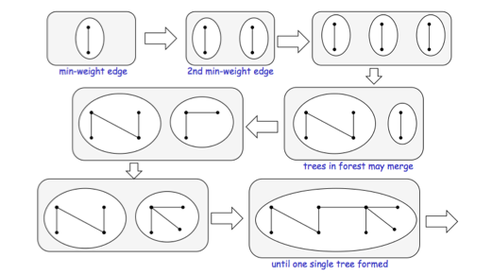
Basic idea of Kruskal’s algorithm

Slide 17
Kruskal’s Minimum Spanning Tree Algorithm
Sort the edges in increasing order of weight and put them in a list L;
count = 0;
while count <n–1 and L is not empty do
Let uv be the next edge in L;
Remove uv from L;
if uv does not introduce a cycle in T
add uv to T;
end
end.
2
DE(1)
GI (1)
AB(2)
CD(2)
CH(2)
E I (2)
AG(3)
GH(3)
BC(4)
HI (4)
F I (5)
BG(6)
EF(6)
AF(7)
DH(8)
A
B
7
3
6
4
1
G
3
2
C
F
5
I
4
H
6
2
8
2
E
1
D

Slide 18
Kruskal’s MST Example
DE(1)
GI (1)
AB(2)
CD(2)
CH(2)
E I (2)
AG(3)
GH(3)*
BC(4)*
HI (4)*
F I (5)
BG(6)^
EF(6)^
AF(7)^
DH(8)^
2
A
B
A
B
A
B
7
3
6
4
G
G
G
G
C
5
1
3
2
C
F
I
I
I
I
4
H
6
2
8
2
E
D
E
D
E
D
E
D
E
D
1
A
B
A
B
A
B
A
B
G
C
G
C
G
C
G
C
I
H
I
H
I
H
F
I
H
E
D
E
D
E
D
E
D
Terminate when all edges have been processed
weight=18

Slide 19
Kruskal’s Minimum Spanning Tree Algorithm
Sort the edges in increasing order of weight and put them in a list L;
count = 0;
while count <n–1 and L is not empty do
Let uv be the next edge in L;
Remove uv from L;
if uv does not introduce a cycle in T
add uv to T;
count = count +1
end
end.
Time complexity = Θ(m log m)

Slide 20
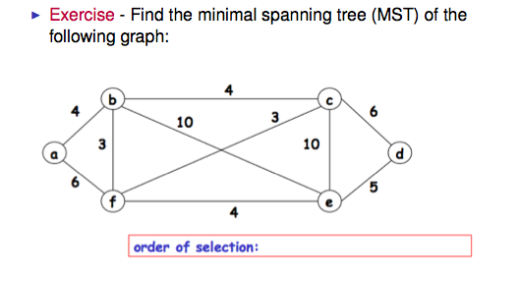
Exercise

Slide 21
The knapsack problem
In our final example, we will consider the knapsack problem and see if a greedy approach to solving the problem would work..

Slide 22
The knapsack problem
Input: given n items of known weights w₁, w₂, . . . , w_{n} and values v₁, v₂, . . . , v_{n} and a knapsack of capacity W
Output: find the most valuable subset of the items that fit into the knapsack

Slide 23
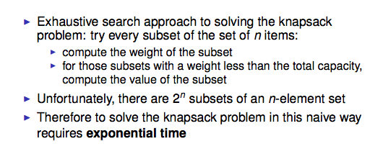
The knapsack problem

Slide 24
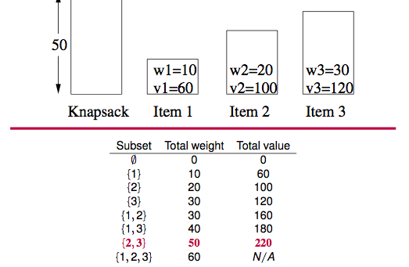
The knapsack problem

Slide 25
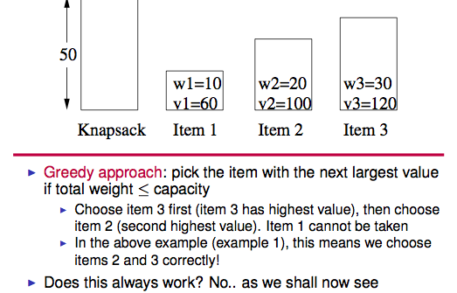
The knapsack problem

Slide 26
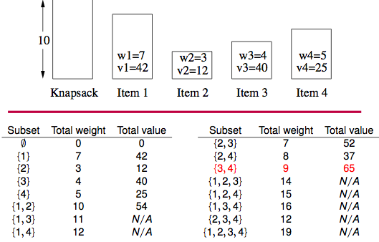
The knapsack problem

Slide 27
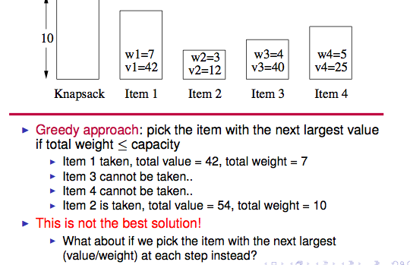
The knapsack problem

Slide 28
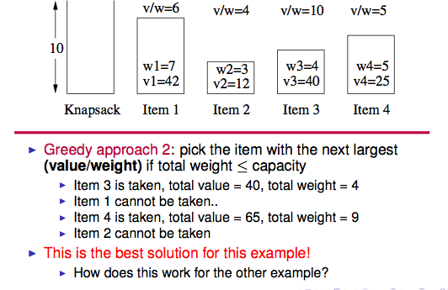
The knapsack problem

Slide 29
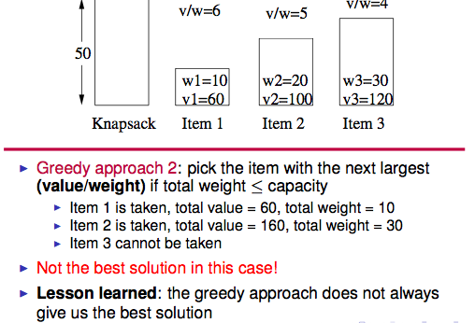
The knapsack problem

Slide 30
Summary
We have seen the definition of a minimal spanning tree
  We saw Prim’s and Kruskal’s algorithms (which uses a greedy approach) which can be used to find a minimal spanning tree
We saw that greedy algorithms make a locally optimal choice (do whatever seems best at the current time) but they may not produce the optimal solution

