Slide 1
MACIASZEK, L.A. (2007): Requirements Analysis and System Design, 3rd ed. Addison Wesley, Harlow England ISBN 978-0-321-44036-5
Appendix Fundamentals of Object Technology
© Pearson Education Limited 2007

Slide 2
Topics
Instance object
Class
Variables, methods, and constructors
Association
Aggregation and composition
Generalization and inheritance
Abstract class
Interface

Slide 3
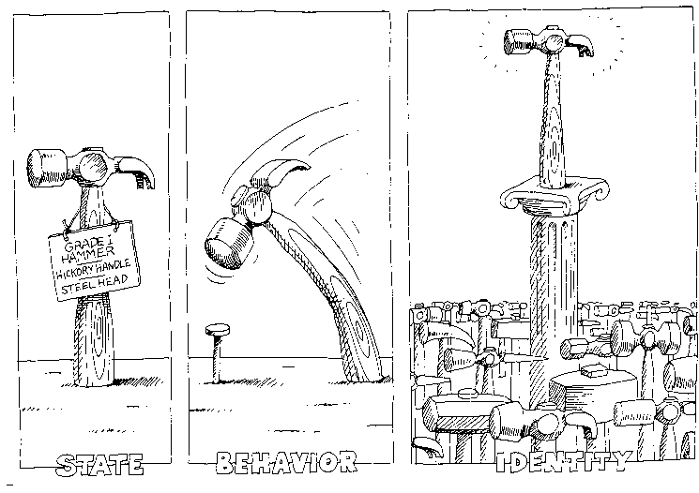
Fundamentals of OT
Object has
State
Behavior
Identity (equal ≠ identical)
Objects and natural systems
BOOCH, G. (1994): Object Oriented Analysis and Design with Applications, 2nd ed,
The Benjamin/Cummings Publ

Slide 4
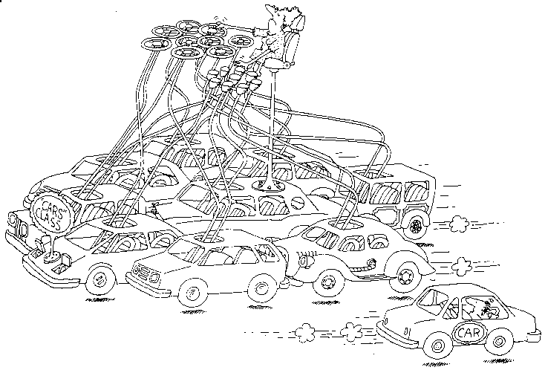
Instance object
Class
an abstraction (generic description) for a set of objects
a class for objects (but better to avoid the term “object class” because a class can be instantiated into an object – “object class object’ would sound a bit strange)
Instance object
an instance of a class
object, instance, but not object instance
Class object
an instantiated class (everything in an object oriented system is an object)
BOOCH, G. (1994): Object Oriented Analysis and Design with Applications, 2nd ed,
The Benjamin/Cummings Publ

Slide 5
Object notation
objectname: classname
attributename: [type] = value
anonymous object
classname suppressed
No compartment for operations in objects!
Exception – prototypical (delegation-based) languages, such as Self or Newton

Slide 6
How do objects collaborate?
a role that many objects can play
a message invoking an operation on an object
(numbers do not imply any sequence of execution)

Slide 7
How objects identify each other?
object identifier - OID
Object longevity
Persistent object
outlives the execution of the program
swizzling to convert persistent OID (disk address) to transient OID (memory address)
Transient object

Slide 8
OIDs to implement associations

Slide 9
Transient link
How does an object know the OID of another object if there is no persistent link?
Previous access to an object still “memorized” in some program variable
Search on the database
A “map” object that associates objects to other objects by logical identifiers (primary keys) or similar means
Creating a new object

Slide 10
Message passing
crs_ref.getCourseName(out crs_name)
in, out, and in/out arguments
Most OO languages do not make such distinction explicit
Java
message arguments of primitive data types are passed by value
act as input arguments
the change of argument values not possible because the operation acts on a copy of the argument
“pass by value” for non-primitive data types results in the operation receiving the reference of the argument, not its value
the reference can be used to access and possibly modify the attribute values within the passed object
the above eliminates the need for explicit in/out arguments
return type of an operation substitutes a need for explicit out arguments
operation can return only one return value or no value at all (void)
however, it can return non-primitive type (i.e. an object of any complexity)

Slide 11
Class, attributes
Class – an “overloaded” term!

Slide 12
Role names / attributes designating a class
analysis model
implementation model

Slide 13
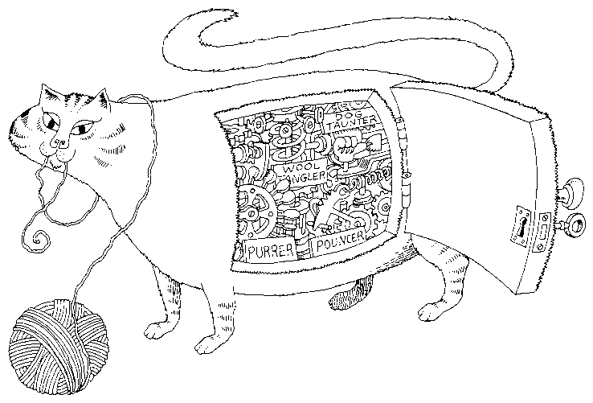
Attribute visibility
private attributes and public operations
operations encapsulate attributes
BOOCH, G. (1994): Object Oriented Analysis and Design with Applications, 2nd ed, The Benjamin/Cummings Publ

Slide 14
Operations in object collaboration

Slide 15
Operation, visibility, scope, class object
method – procedure that implements an operation
message name = method name
signature = list of formal arguments of a method
visibility ≠ scope
instance scope when operation invoked on instance object (findEmpAge())
class scope when operation invoked on class object (findAverageAge())
Class object
most prog. lang. do not instantiate class object
they only provide a syntax to refer to the class name in order to access a class-scope attribute or call a class-scope operation → static attribute/operation
Example → next slide

Slide 16
Class-scope attributes and operations – example

Slide 17
Variables, methods, constructors
Variable – name for a storage space
data member – variable declared in a class
instance variable (instance scope)
class variable (class scope)
local variable – variable declared in a method body
Method – implementation of an operation
method prototype = name + signature + return type
overloaded methods – same names, different signatures
Constructor
special “method” to instantiate objects of the class
constructor name = class name
constructor has no return type
class must have at least one constructor
invoked with the new keyword
Student std22 = new Student(); //default constructor

Slide 18
Association

Slide 19
Association degree
Binary
Unary (singular)
Ternary

Slide 20
Association multiplicity
0..1
0..n
1..1
1..n
n

Slide 21
Association link and extent
Link – association instance
represents a rolename
can be a collection of references
Extent – set of association instances
in the figure, the extend of the association is five (five links)

Slide 22
Association class
Parameterized type

Slide 23
Composition and aggregation
Aggregation
aggregation by reference
Composition
aggregation by value
Properties:
Transitivity
Asymmetry
Existence dependency
Implemented by buried references or inner classes → next slides

Slide 24
Implementing aggregation by buried reference
not different to association
by means of variable with private visibility
however, in Java, classes cannot have private visibility
subset classes must have public or package visibility

Slide 25
Implementing aggregation by inner classes
public class Book
{
private String title;
private Chapter[] ch;
private TableOfContents toc;
public Book(...)
{ ...
toc = new TableOfContents();
ch = new Chapter[numberChapters];
for (int i=0; i<numberChapters; i++)
ch[i] = new Chapter();
}
public Void displayToc()
{
toc.generate();
return;
}
private class TableOfContents
{
private Void generate()
{...
}
}
}
outer class instantiates inner objects in its own constructor
inner class can be private (accessible only from outer class)

Slide 26
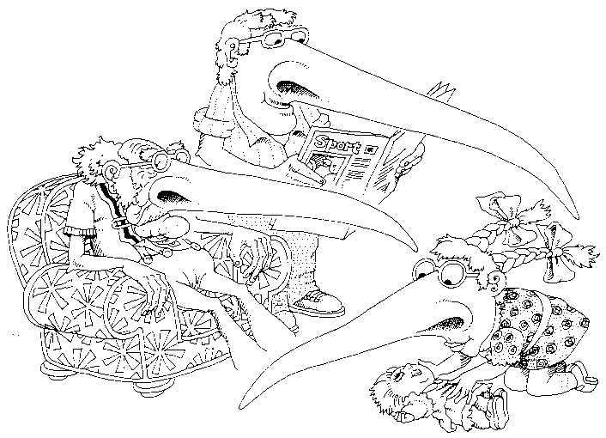
Generalization
A subclass inherits the structure and behavior of its superclass
Not a good visualization
of generalization.
Subclasses inherit types, not values
(a nose not a long nose)!
BOOCH, G. (1994): Object Oriented Analysis and Design with Applications, 2nd ed,
The Benjamin/Cummings Publ

Slide 27
Generalization
public class Person { private String fullName; private Date dateOfBirth; public Person() {...} public int age(){ return getYear() - getYear(dateOfBirth); } } public class Employee extends Person { private Date dateHired; private int salary; private int leaveEntitlement; private int leaveTaken; public Employee() {...} public int remainingLeave(){ return leaveEntitlement - leaveTaken; } }

Slide 28
Polymorphism
public class Manager extends Employee
{
private Date dateAppointed;
private int leaveSupplement;
public Manager()
{...}
public int remainingLeave()
{
int mrl;
mrl = super.remainingLeave() + leaveSupplement;
return mrl;
}
}
The same signature
(operation name and the number and type of arguments)

Slide 29
Multiple inheritance

Slide 30
Multiple classification
Multiple inheritance
A class may have many superclasses, but a single class must be defined for each object
Multiple classification
An object is simultaneously the instance of two or more classes
The problem arises if Person is specialized in few orthogonal hierarchies
Person can be Employee or Student, Male or Female, Child or Adult, etc.
Without multiple classification
need to define classes for each legal combination between the orthogonal hierarchies
ChildFemaleStudent etc.

Slide 31
Dynamic classification
An object does not only belong to multiple classes but it can gain or lose classes over its lifetime
A Person object can be just an employee one day and a manager (and employee) another day
In most current object-oriented programming environments, an object cannot change its class after it has been instantiated (created)

Slide 32
Abstract class
Parent class that will not have direct instance objects
Abstract class cannot instantiate objects because it has at least one abstract operation
public abstract class VideoMedium
{
public abstract Double rentalCharge();
}
public class VideoDisk extends VideoMedium
{
public VideoDisk()
{...}
public Double rentalCharge()
{
return null;
}
}

Slide 33
Interface vs abstract class
Interface – a definition of a semantic type with attributes (constants only) and operations but without actual declarations (implementations) of operations
classes that implement the interface provide the declarations
Abstract class has undesirable effect of the fragile base class problem
Unlike abstract classes
interfaces are helpful for modeling situations that ask for multiple inheritance
interface does not implement (even partially) any of its methods
but still, pure abstract class ≠ interface
in case of interface, any class in the system can implement it, not just the subclasses
a class can implement any number of interfaces
interface defines a reference type that separates client objects from the implementation changes in the supplier objects
the implementation of the interface can change and the client object may not be affected

Slide 34
Multiple implementation inheritance not allowed in Java

Slide 35
Implementing Java interface
public interface VideoMedium
{
Double rentalCharge();
}
public class VideoPlayer
extends VideoEquipment
implements VideoMedium
{
public VideoPlayer()
{...}
public Double rentalCharge()
{
return null;
}
}

Slide 36
Using interface to eliminate dependency to supplier
public class ChargeCalculator
{
VideoMedium theVideo;
public Double getRentalCharge()
{
return theVideo.rentalCharge();
}
}

Slide 37
Summary
Each object has a state, behavior and identity
There are instance objects and class objects
Class defines attributes and operations
There are three kinds of relationships – association, aggregation, generalization
Generalization provides the basis for polymorphism and inheritance
Commercial programming environments support multiple inheritance directly (C++, C#) or by means of interfaces (Java)
Multiple and dynamic classification is still not supported commercially
Abstract classes and interfaces are important in modeling

