Slide 1
MACIASZEK, L.A. (2007): Requirements Analysis and System Design, 3rd ed. Addison Wesley, Harlow England ISBN 978-0-321-44036-5
Chapter 10 Tutorial-style Review and Reinforcement
© Pearson Education Limited 2007

Slide 2
Topics
Use case modeling
Activity modeling
Class modeling
Interaction modeling
Statechart modeling
Implementation models
Object collaboration design
Window navigation design
Database design

Slide 3
Tutorial – OnLine Shopping
Buying computers over Internet from the manufacturer.
Computers classified into servers, desktops and portables.
Customer can select standard configuration or can configure his/her own configuration.
For each new configuration, the system can calculate price.
To place order, the customer must fill out the shipment and payment information.
The system sends a confirmation e-mail message to the customer with details of the order.
Customer can check the order status online at any time.
Moreover, the system needs to
verify the customer’s credentials and payment method,
request the ordered configuration from the warehouse,
print an invoice, and
request the warehouse to ship the computer to the customer.

Slide 4
1. Use case modeling

Slide 5
Use case modeling – actors
Consider the following requirements:
3. The customer may choose to order a computer online or may request that the salesperson contact him/her to explain order details, negotiate the price, etc. before the order is actually placed.
7. The warehouse obtains the invoice from the salesperson and ships the computer to the customer.

Slide 6
Use case modeling – use cases
Consider the following requirements:
3. The customer may choose to order a computer online or may request that the salesperson contact him/her to explain order details, negotiate the price, etc. before the order is actually placed.
7. The warehouse obtains the invoice from the salesperson and ships the computer to the customer.

Slide 7
Use case diagram
Display Standard
Build Computer
Computer Configuration
Configuration
Order Configured
Computer
Verify and Accept
Customer
Customer Payment
<<extend>>
Request
Salesperson Contact
Print Invoice
Display
Order Status
Warehouse
Inform Warehouse
Salesperson
about Order

Slide 8
Documenting use cases
Order Configured
Computer
Use case | Order configured computer
Brief description | This use case allows a Customer to enter a purchase order. This includes providing a shipment and invoice address as well as payment details.
Actors | Customer
Preconditions | Customer points Internet browser to the computer manufacturer’s order entry web page. The page displays the details of a configured computer together with its price.
Main flow | The use case begins when the Customer decides to order ... The system requests that the Customer enters ... The Customer chooses the Purchase function ... The system assigns a unique order number ... The system e-mails the order number and ...
Alternative flows | The Customer activates the Purchase function before ... The Customer chooses the Reset function to revert to ...
Postconditions | If the use case was successful, the purchase order is recorded in the system’s database. Otherwise, the system’s state is unchanged.

Slide 9
2. Activity modeling

Slide 10
Actions
Order Configured
Computer
3 | The Customer chooses the Purchase (or similarly named) function to send the order to the manufacturer. | Get Purchase Details
4 | The system assigns a unique order number and a customer account number to the purchase order and it stores the order information in the database. | Store Order
5 | The system e-mails to the Customer the order number and the customer number, together with all order details, as the confirmation of the order’s acceptance. | Email Order Details

Slide 11
Activity diagram
Order Configured
Computer

Slide 12
3. Class modeling

Slide 13
Classes
6 | The details of the transaction, including an order number and a customer account number, are emailed to the customer, so that the customer can check the status of the order online. | Order, Customer, (OrderStatus)
7 | The warehouse obtains the invoice from the salesperson and ships the computer to the customer. | Invoice, (Salesperson), (Shipment),Computer, Customer
Do we need the Shipment class if we know that the shipment is the warehouse responsibility and it is therefore out of the scope?
Is OrderStatus a class or an attribute of Order?
Is Salesperson a class or an attribute of Order and Invoice?

Slide 14
Attributes

Slide 15
Associations
Notes:
Order is from a single Customer, but Customer may place many Orders.
Order is not accepted unless the Payment has been specified (hence, one-to-one association).
Order does not have to have an associated Invoice, but Invoice is always related to a single Order.
An Order is for one or many ConfiguredComputers. A ConfiguredComputer may be ordered many times or not at all.

Slide 16
Aggregations

Slide 17
Class diagram

Slide 18
4. Interaction modeling

Slide 19
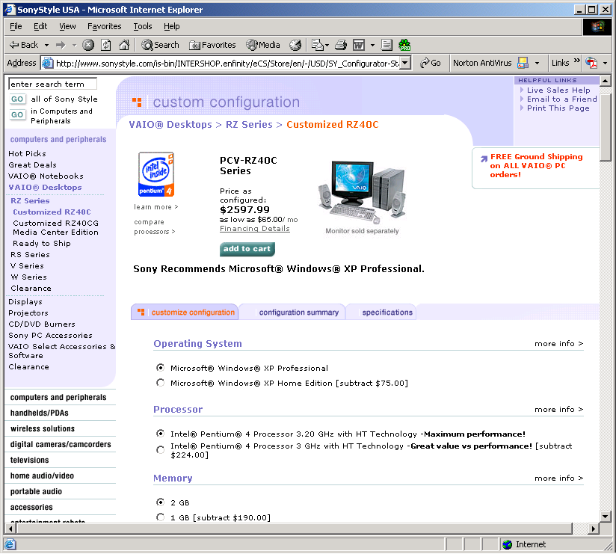
Custom computer configuration webpage

Slide 20
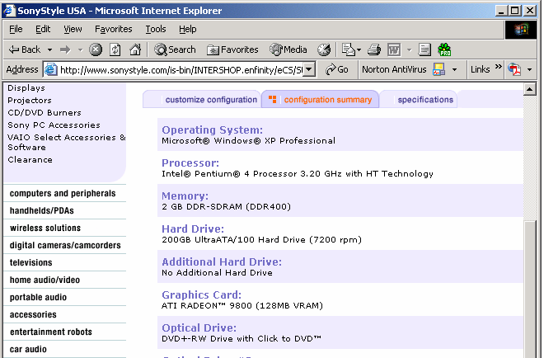
Configuration summary webpage

Slide 21
Sequence diagram
Display Current
Configuration
Notes:
The submit() method sends a getCurrentConf() to EComputer. EComputer is an abstract class, so in reality the message will be sent to either EStandardComputer or EConfiguredComputer (Figure 10-11). The model assumes that PCustomConfiguration knows if the actor modified the standard configuration and it can, therefore, resolve to which concrete class the getCurrentConf() message should go.
Because PCustomConfiguration has an EComputer object, it could directly request all details. However, the model in Figure 10-14 makes EComputer to combine all information (computerName, itemDescr, and price) and then return all this information (in a Java collection) to PCustomConfiguration. In fact, EConfigurationItem is itself a collection of objects and getItemDescr() works on this collection. The model does not explain how exactly the getPrice() method works.
When equipped with all requested information, PCustomConfiguration constructs a new PConfigurationSummary web page. The constructor receives all information in the argument of the new() message. As a result, the constructor of PConfigurationSummary contains a self-method display(), so that the current configuration can be displayed on the screen.

Slide 22
Communication diagram
Display Current
Configuration

Slide 23
Class methods

Slide 24
5. State machine modeling

Slide 25
States and transitions
Notes:
The initial state of Invoice is Unpaid. There are two possible transitions out of the Unpaid state. On the partial payment event, the Invoice object goes into the Partly Paid state. Only one partial payment is allowed. The final payment event, when in an Unpaid or Partly Paid state, fires a transition to Fully Paid state. This is the final state.

Slide 26
Statechart diagram
Notes:
The initial state is New Order. This is one of the Pending states – the other being Back Order and Future Order. There are two possible transitions out of any of the three states nested in the Pending state.
The transition into the Canceled state is guarded by the condition [canceled]. It would be possible – without violating the statechart modeling rules – to replace the guard by the event cancel. The transition to the state Ready to Ship is labeled with a complete description containing the event, guard and action.

Slide 27
6. Implementation models

Slide 28
Subsystems
Notes:
Services of a subsystem are encapsulated by interfaces.
As an example, the entity subsystem implements the Einterface interface, which can be used by the control and mediator subsystems.

Slide 29
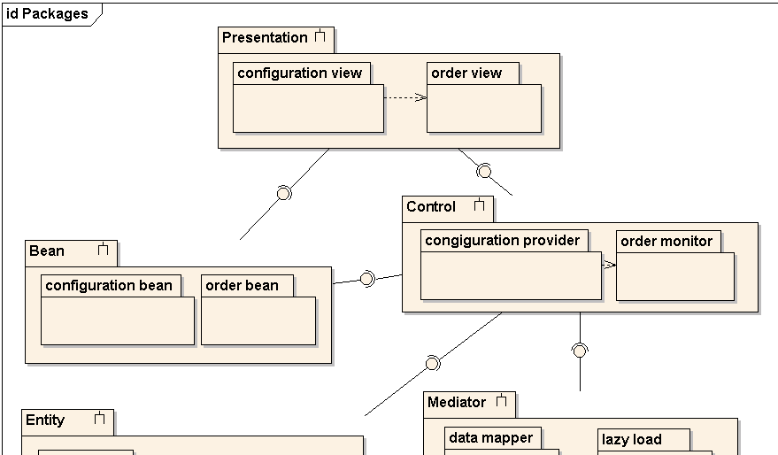
Packages (1 of 2)

Slide 30
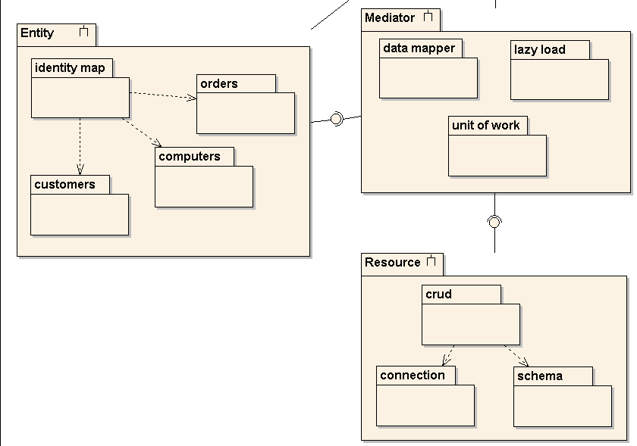
Packages (2 of 2)

Slide 31
Components
Notes:
A component is a cohesive functional unit with clear interfaces so that it becomes a replaceable part of the system.

Slide 32
Nodes – deployment diagram
Notes:
The deployment architecture capable of supporting more sophisticated web applications includes four tiers of computing nodes:
Client with browser.
Web server.
Application server.
Database server.
The browser of the client node can be used to display static or dynamic pages. Scripted pages and applets can be downloaded and run within the browser. Additional functionality can be supplied to the client’s browser with objects such as ActiveX controls or JavaBeans. Running application code on the client, but outside the browser, may satisfy other UI requirements.
The web server handles page requests from the browser and dynamically generates pages and code for execution and display on the client. The web server also deals with the customization and parameterization of the session with the user.
The application server is indispensable when distributed objects are involved in the implementation. It manages the business logic. The business components publish their interfaces to other nodes via component interfaces such as CORBA, DCOM or EJB.
The business components encapsulate persistent data stored in a database, probably a relational database. They communicate with the database server via database connectivity protocols such as JDBC, SQLJ or ODBC. The database node provides for a scalable storage of data and multi-user access to it.

Slide 33
7. Object collaboration design

Slide 34
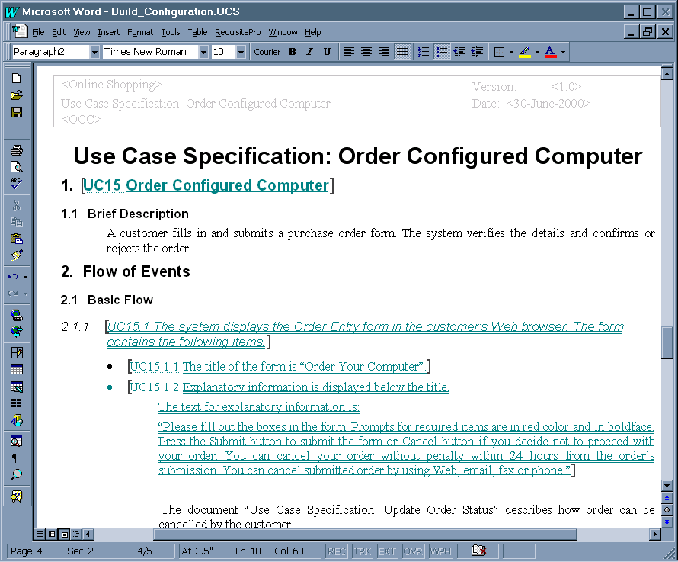
Use case document

Slide 35
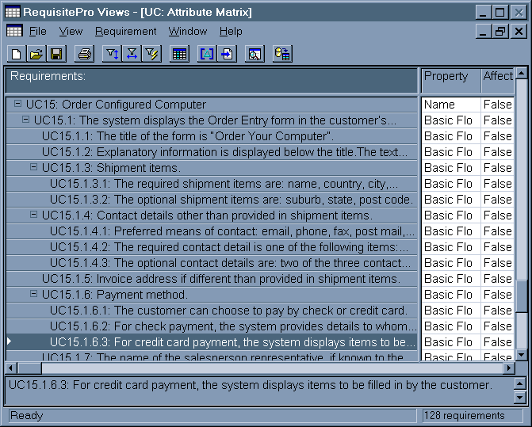
Requirements management in a CASE tool

Slide 36
GUI prototype

Slide 37
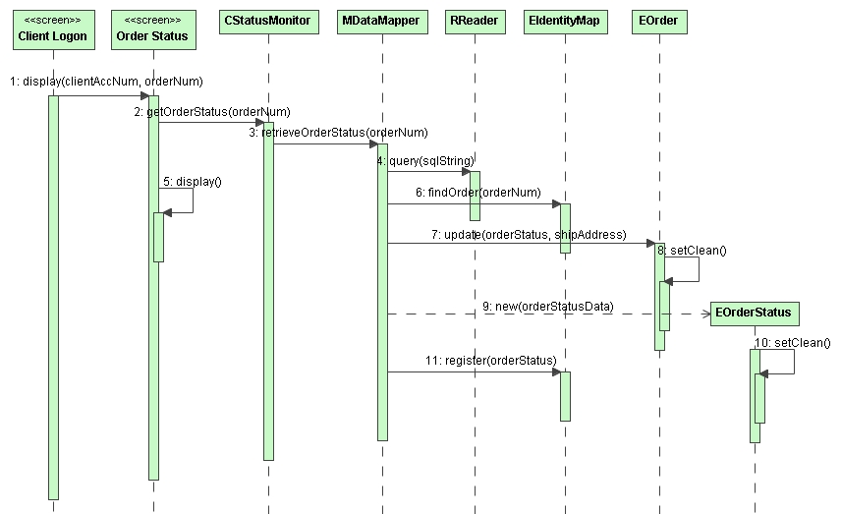
Sequence diagram
Notes:
Sequence diagram for ‘Display Order Status’.
Assume the Data Mapper knows that the memory cache does not contain a “clean” order status information and a trip to the database is necessary. Once the status information is obtained from the database, the memory cache needs to be refreshed. Assume that the refreshing means updating EOrder and creating a new EOrderStatus object.
Note that MDataMapper proceeds immediately to the database and returns the order status data to the Order Status screen via CStatusMonitor (of course, the “screens” could be modeled as presentation object, e.g. POrderStatus, but we opted for the notation of the UX storyboards profile). The Order Status screen uses the display() message to render the data to the screen. At the same time, MDataMapper takes care of refreshing the entity objects in the memory cache. First, it updates EOrder. Next, it creates a new EOrderStatus. The model does not explain what should be done to link EOrderStatus to its EOrder object.

Slide 38
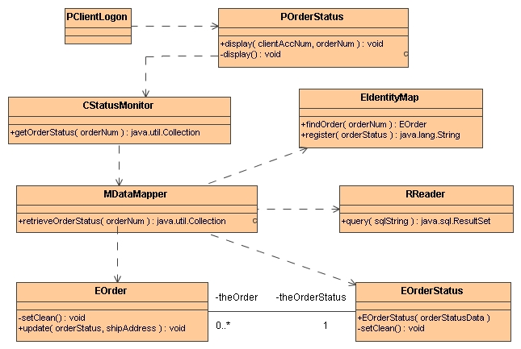
Design-level class diagram

Slide 39
8. Window navigation design

Slide 40
User experience (UX) elements

Slide 41
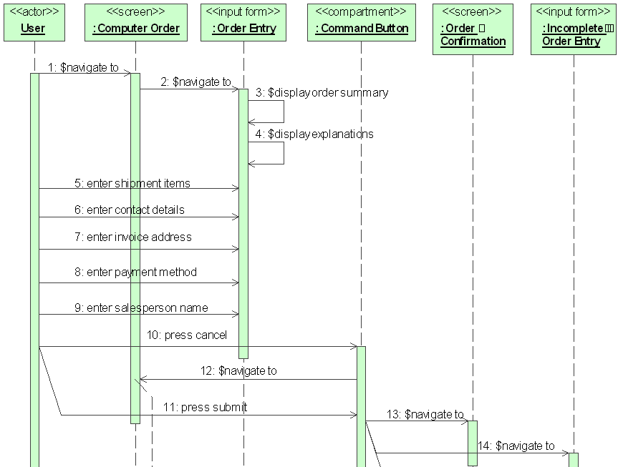
Behavioral UX collaboration

Slide 42
Structural UX collaboration

Slide 43
9. Database design

Slide 44
DB schema

Slide 45
DB schema with referential integrity constraints

Slide 46
Referential integrity design

Slide 47
Summary
use case modeling
activity modeling
class modeling
interaction modeling
statechart modeling
implementation models
object collaboration design
window navigation design
database design

