Slide 1
MACIASZEK, L.A. (2007): Requirements Analysis and System Design, 3rd ed. Addison Wesley, Harlow England ISBN 978-0-321-44036-5
Chapter 2 Requirements Determination
© Pearson Education Limited 2007

Slide 2
Topics
From business processes to solution envisioning
Functional and nonfunctional requirements
Requirements elicitation
traditional methods and modern methods
Requirements negotiation and validation
Requirements management
Requirements business model
system scope, business use case model, business glossary, business class model
Requirements document

Slide 3
1. From business processes to solution envisioning
IT solutions address business problems
IT solutions are enablers of business innovation
IT solution is an infrastructure service (a commodity)

Slide 4
What is an IT solution?
A business solution
Implementation of a business process
Sometimes an enabler of business innovation
An infrastructure service
A commodity

Slide 5
BPMN - Business Process Modeling Notation
Developed by a consortium Business Process Management Initiative
Managed by the OMG within the task force Business Modeling & Integration Domain Task Force (BMI DTF)
Dedicated to modeling business processes defined as activities that produce something of value to the organization or to its external stakeholders
UML activity diagrams – a competing notation
A goal is to map these notations to an executable language
in particular to the Business Process Execution Language (BPEL) – a standard for process execution in systems based on the Service Oriented Architecture (SOA)

Slide 6
Process hierarchy modeling
A process may contain other processes (sub-processes)
An atomic activity within a process is called a task
A process hierarchy diagram – not part of BPMN
A business process can be performed manually or an automated service
A process has at least one input flow and one output flow
When the process gains the control, it performs its activity, typically by transforming the input flow into the output flow
A process can be atomic or composite

Slide 7
Process hierarchy diagram - notation

Slide 8
Process hierarchy model (advertising expenditure)
Notes:
Example 2.1 (advertising expenditure)
Consider the problem statement for Advertising Expenditure (Section 1.6.5) and construct a process hierarchy diagram for it. There is no need to attempt a complete decomposition of high-level processes. It is sufficient (for illustration purpose) to decompose a single selected high-level process.
Consider the following additional observations:
The problem statement describes the main workflow of processes involved in gathering advertisements’ details and measuring advertising expenditures. However, the supporting management processes are not explicitly listed. At least two of these processes constitute an important part of the process hierarchy model. These processes are concerned with the management of contacts and with the management of contracts and accounts receivable.
Contact management involves activities such as negotiation of new customers, on-going management of existing customers, tracking contact management activities, and the management of suppliers of advertising information
Contracts and accounts receivable consist of such tasks as negotiation of contracts, invoice creation, monitoring of contracts, invoice processing and payments, and sales analysis.

Slide 9
BPMN flow objects
BPMN offers four basic categories of modeling elements
Flow objects
Events
Activities
Gateways
Connecting objects
Pools (Swimlanes)
Artifacts

Slide 10
BPMN – events and activities
An event is something that “happens”.
There are various types of events, such as timer, error, or cancel.
An activity represents some work that must be done.
This could be a task or a sub-process.

Slide 11
BPMN – gateways
A gateway is used to control the divergence and convergence of multiple sequence flows.

Slide 12
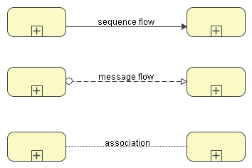
BPMN – connecting objects
The connecting objects (or connectors) are used to connect flow objects
in order to define the structure of a business process.
A sequence flow is used to show the order in which the activities will be performed in a process.
A message flow is used to show the flow of messages (data) between two business entities (two process participants) that are prepared to send and receive them.
An association is used to associate flow objects or to associate artifact with a flow object.

Slide 13
BPMN – pools (swimlanes)
A pool represents a business entity (participant) in a process.
It acts as a “swimlane” mechanism to organize activities into separate visual categories in order to illustrate different functional capabilities or responsibilities.
Pools represent sets of self-contained processes.
Accordingly, the sequence flow may not cross the boundary of a pool.
Participants in various pools can communicate via message flows or associations to artifacts.

Slide 14

BPMN – artifacts
Artifacts provide additional modeling flexibility by allowing to extend the basic notation to respond to specific modeling situations, such as for so-called vertical markets (e.g. telecommunication, hospitals or banking).
Data objects represent data required or produced by activities.
A group is a grouping of activities that does not affect the sequence flow of the process. The grouping can be used for documentation or analysis purposes (e.g. to identify the activities of a distributed transaction across pools).
Annotations provide additional text information for the reader of a business process diagram.

Slide 15
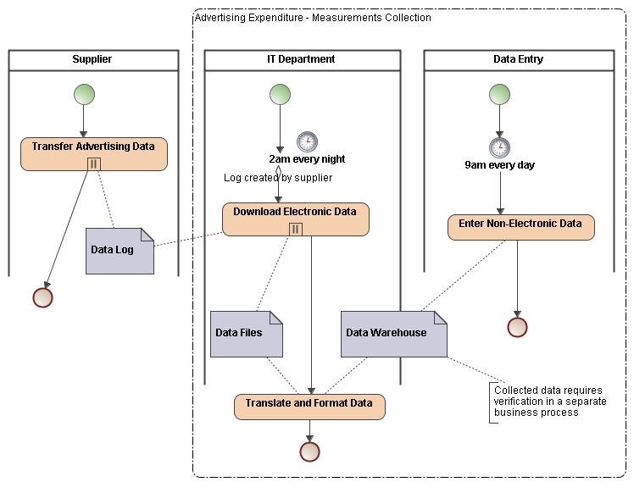
Business process model (advertising expenditure)
Notes:
Example 2.2 (advertising expenditure)
Consider the problem statement for Advertising Expenditure (Section 1.6.5) and the process hierarchy diagram in Example 2.1 (Section 2.1.12). Construct a business process diagram for the process “Measurement Collection”.
Consider the following additional observations about measurement collection:
The major data collection is electronic transfer from the data suppliers. This process occurs on a daily basis and in the majority of cases is performed automatically in the middle of the night. The data is collected from television stations, radio stations, press publishers, and cinema outdoor advertisers. A specialized communications package is used for data transfer from the data logs located at the suppliers. The supplier is responsible for placing the contents of the previous day’s advertising log to a dedicated file server prior to data downloading process that typically begins at 2pm every night.
For data not collected electronically, the data requires entering from the source documents. This type of collection applies mostly to press – advertisements in newspapers and magazines, but also advertising catalogues delivered to households.
Each of the suppliers of information have unique formats in which they provide their data. The first process performed on this data is to convert it to a standard format so that uniform processing can be performed on it. In the case of television, some networks provide a single file which firstly needs to be split into the individual station components
Figure 2.7 is a business process diagram for Example 2.2. It shows both an external Supplier process and the two processes managed by internal business entities (shown as the pools called IT Department and Data Entry). The diagram takes advantage on intermediate event timers in the IT Department and the Data Entry pools. It also indicates that Transfer Advertising Data and Download Electronic Data are multiple-instance sub-processes. Three data objects engaged in the process are also modeled.

Slide 16
Solution envisioning
Solution envisioning is a business value-driven approach to delivering an IT service (i.e. not merely a software system)
to solve an As-Is business problem or
to foster a To-Be business innovation.
Solution envisioning makes a close connection between business and IT stakeholders and integrates business strategy methods and software development capabilities.
It is about the three “E-s”
efficiency, effectiveness, and edge

Slide 17
Three phases of solution envisioning process
Business capability exploration – determines business capabilities understood as the capacities relating to how a business IT solution can deliver specific results.
This phase describes capability cases – solution ideas making the business case for each capability.
Solution capability envisioning – aims at developing the capability case into a solution concept and at ensuring that the solution is agreed upon by the stakeholders.
The solution concept takes the business context as input and produces future scenarios for new ways to work as output.
The solution concept converges on the ultimate solution architecture and is developed in solution envisioning workshops.
Software capability design – decides on system implementation technologies, develops software capability architecture, and elaborates the business case with project plans and risk analysis.
Software capability design is an activity in software modeling.
Notes:
“The (first) phase is completed when an understanding is reached on the nature of the business problems and on the specific results a solution will need to bring about. This understanding is documented in a preliminary vision of the proposed solution that can be communicated to a broader set of stakeholders for evaluation and further decision making within an envisioning workshop.” (Polikoff et al., 2006, p.156).

Slide 18
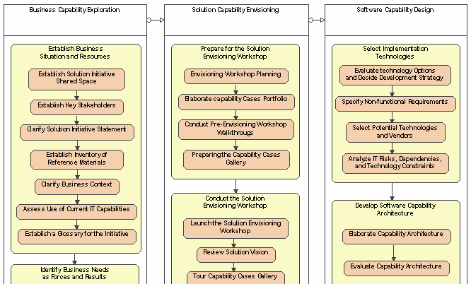
Three phases of solution envisioning process

Slide 19
Implementation strategy and capability architecture
In the first phase of the solution envisioning process, capability cases function as multiple solution sketches to allow many solution possibilities to be explored.
Later on, the selected capability cases become technical blueprints for the solution.
Finally, three prevalent implementation strategies need to be considered:
Custom development
performed in-house and/or
contracted out to consulting and development firms.
Package-based development that derives the solution by customizing pre-existing software packages, such as COTS, ERP or Customer Relationship Management (CRM) systems.
Component-based development that builds the solution by integrating software components sourced from multiple vendors and business partners and likely to be based on SOA and/or MDA.

Slide 20
Review Quiz 2.1
What is the name of the most popular language for visual modeling of business processes that aims at bridging the gap between business and IT people?
What are the four categories of modeling elements in BPMN?
Can a sequence flow connect two pools?
What is the name of a business value-driven approach to delivering an IT service to solve an As-Is business problem or to foster a To-Be business innovation?
What is the main modeling outcome of software capability design?
What are the three distinct implementation strategies to be considered in solution envisioning process
Notes:
Business Process Modeling Notation (BPMN).
Flow objects, connecting objects, pools, and artifacts.
No, it can’t. Pools can communicate via message flows or via associations to common artifacts.
Solution envisioning.
Capability architecture.
Custom development, package-based development, and component-based development.

Slide 21
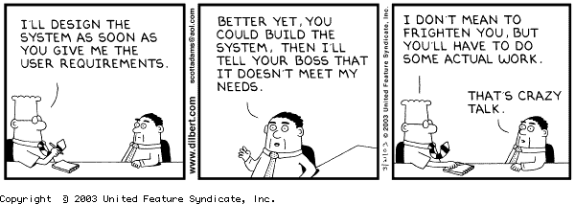
Requirements Engineering
Least technical phase of system development
Demands social, communication and managerial skills
Delivers a (mostly narrative) definition of user requirements

Slide 22
Overview
What is Requirements Engineering (RE)?
Why is RE important?
What is a requirement?
Types of requirements
What is the requirements process?
Who does it?

Slide 23
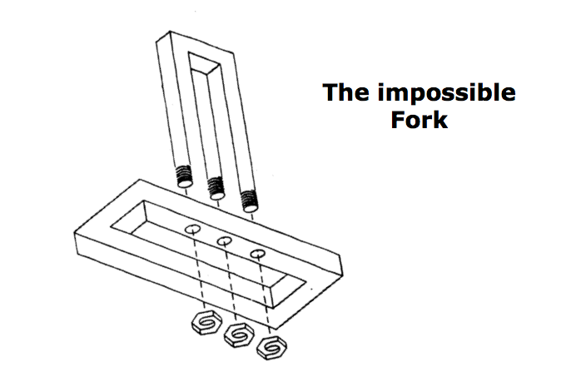
Can you develop this system?
Notes:
Among the most famous as well as the most interesting of all impossible figures is the impossible trident.
The outline of the middle prong merges into the outline of the two outer prongs. In addition, the middle prong appears to drop to a level lower than the two outer prongs. The paradox is quite powerful, because within it are various impossibility sources.
Can you build this? The question has, however, several possible answers. The first immediate answer might be no, because it is physically impossible. But we are engineers, let’s try. Let’s find out, if we can build it, and if not, what the problem is. Maybe we can fix the original problem specification.
----------------------------------------------

Slide 24
Can you develop this system?
Notes:
Cover up parts of the figure. If you cover the bottom half, you will find that the top part of the figure is entirely possible. In this case, you interpret the foreground figure as being built of flat faces constituting two rectangular prongs.

Slide 25
Can you develop this system?
Notes:
Now look at only the bottom half of the figure. You interpret this figure as built of curved surfaces constituting three separate cylindrical lines.
The two parts that are joined in this figure have different interpretations of their shapes when they are perceived separately.
Furthermore, when you join the two parts, surfaces that have one interpretation (part of the foreground figure), get a different interpretation (part of the background).
So the answer is: No, we cannot build this as it is drawn. The figure violates the basic distinction between background and elements of an object.
It has ambigous surfaces. In software engineering terminology the drawing has ambiguous requirements. One or more objects can be interpreted in two mutually exclusive ways.
To make this possible to develop, only one of the mutually exclusive objects has to be selected. Objects must have their own identity, they cannot overlap.
The answer to the question “Can we develop this” depends on what we mean by developing.
Even the question was imprecise: if we mean: “Can it be built as three-dimensional object?”, then the answer is “no”, because of the irresolvable conflict between the background and the foreground. However, be warned that the japanese artist Shigeo Fukuda has been able to construct 3-dimentional art pieces.
----------------------------------------------

Slide 26
Can you develop this system?
The impossible
Fork
Notes:
Can you build this? The question has, however, several possible answers. The first immediate answer might be no, because it is physically impossible. But we are engineers, let’s try. Let’s find out, if we can build it, and if not, what the problem is. Maybe we can fix the original problem specification.

Slide 27
What is Requirements Engineering?
Requirements engineering is a term often used for a systematic approach to acquire, analyse, validate, document and manage requirements.
Typically a cyclic or iterative process.
Requirements validation may include prototype construction and evaluation.
Applied at both system and software levels, often with interleaved system architecture design.

Slide 28
What is a Requirement?
A condition or capability needed by a user to solve a problem or achieve an objective.
A condition or capability that must be met or possessed by a system or system component to satisfy a contract, standard, specification or other formally imposed document.
A documented representation of a condition or capability as in 1 or 2.
from IEEE Standard Glossary of Software Engineering Terminology

Slide 29
Requirements Engineering Products
Primary outcome is a requirements specification
essentially a contract between client and developer
basis for all subsequent development and verification processes
Secondary outcome is usually system and software acceptance test criteria

Slide 30
Why is RE important?
Most faults observed in a software project are from incorrect, incomplete, or misinterpreted functional specifications or requirements.
Glass’ Law
“On average, 40% of the requirements specified in the Feasibility and Requirements phase of the lifecycle were redefined in the subsequent four lifecycle phases… on average Digital spent 50% more than budgeted.”
Hutchings and S. Knox: “Creating products customers demand”, Communications of the ACM, May 1995

Slide 31
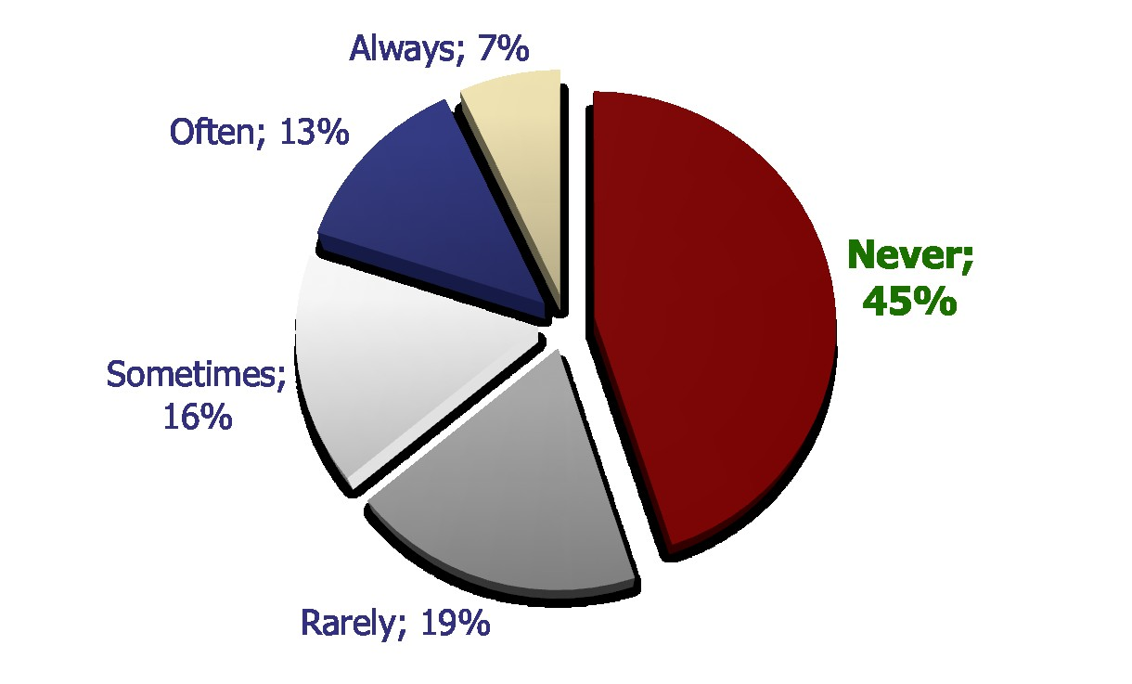
Use of Waterfall-Specified Features
Johnson, J. ROI – It's Your Job. XP 2002.

Slide 32
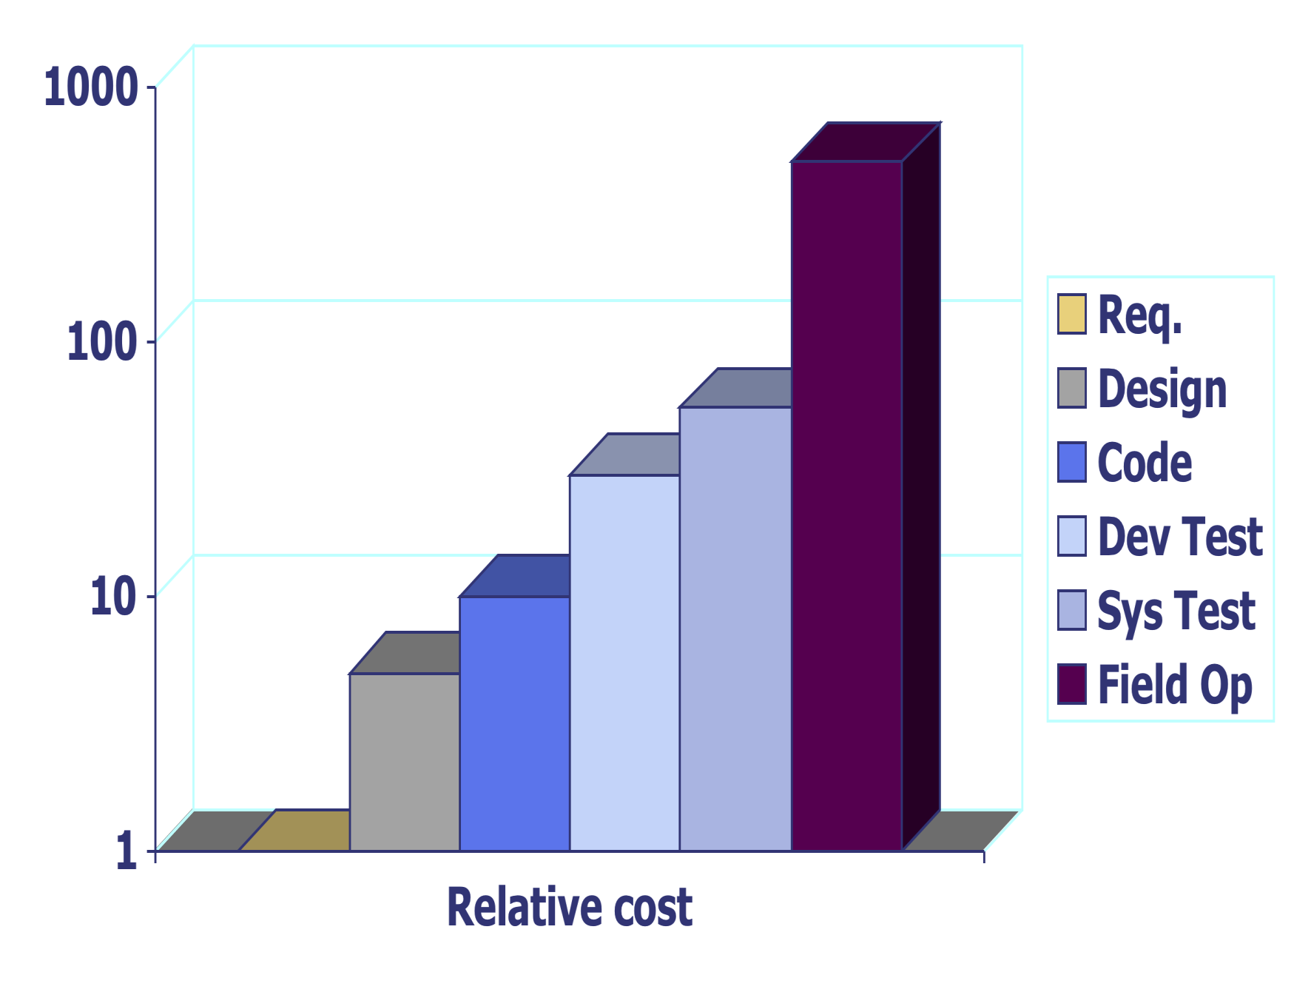
Relative Cost to Correct Requirement Faults

Slide 33
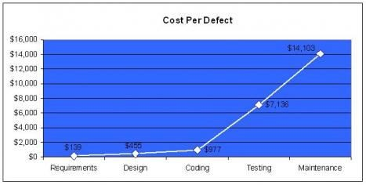
Cost per Defect
Capers Jones, Software Assessments, Benchmarks,
and Best Practices, Addison-Wesley, 2000.

Slide 34
Average Software Quality Costs
Defect Origins | Defect Potential | Removal Efficiency | Delivered Defects
Requirements | 1.00 | 77% | 0.23
Design | 1.25 | 85% | 0.19
Coding | 1.75 | 95% | 0.09
Documents | 0.60 | 80% | 0.12
Bad Fixes | 0.40 | 70% | 0.12
Total | 5.00 | 85% | 0.75
Defects per function point
Capers Jones, 2012

Slide 35
Best in Class Software Quality Costs
Defect Origins | Defect Potential | Removal Efficiency | Delivered Defects
Requirements | 0.40 | 85% | 0.08
Design | 0.60 | 97% | 0.02
Coding | 1.00 | 99% | 0.01
Documents | 0.40 | 98% | 0.01
Bad Fixes | 0.10 | 95% | 0.01
Total | 2.50 | 96% | 0.13
Defects per function point
Most often observed in CMM level 3 or TSP projects
Capers Jones, 2012

Slide 36
Poor Software Quality Costs
Defect Origins | Defect Potential | Removal Efficiency | Delivered Defects
Requirements | 1.50 | 50% | 0.75
Design | 2.20 | 50% | 1.10
Coding | 2.50 | 80% | 0.50
Documents | 1.00 | 70% | 0.30
Bad Fixes | 0.80 | 50% | 0.40
Total | 8.00 | 62% | 3.05
Defects per function point
Most often observed in large plan-driven projects, > 10K function points
Capers Jones, 2012

Slide 37
Why is RE important? (Cont.)
Helps earlier detection of mistakes, which are much more costly to correct if discovered later
Forces clients to articulate and review requirements
Enhances communications between participants
Helps record and refine requirements
All this is about producing good requirements!

Slide 38
What Happens if Requirements are Wrong?
System may be delivered late and cost more than originally expected.
Customer and end-users are not satisfied with the
system.
may not use its facilities or may even decide to scrap it altogether
System may be unreliable in use with regular system errors and crashes disrupting normal operation.
If the system continues in use, the costs of maintaining and evolving the system are very high.

Slide 39
Benefits of Good Requirements
Agreement among developers, customers, and users on the job to be done and the acceptance criteria for the delivered system.
Sound basis for resource estimation
cost, personnel quantity and skills, equipment, and time
Improved system usability, maintainability, and other quality attributes.
Achievement of goals with minimum resources
less rework, fewer omissions and misunderstandings

Slide 40
Advice / Perspective
… a systematic approach to finding, documenting, organizing, and tracking the changing requirements of a system [RUP]
In practice it is impossible to produce a complete and consistent requirements document [Somerville]
Getting the requirements right is critical for success
Requirements are rarely right at the start of a large project
Expect change
Manage it
Agile mantra “Embrace Change”
Notes:
Emphasise that while the descriptions in this lecture focus on big up-front requirements and documentation, that many of the principles are still the same in agile methods with light weight requirements documentation and management.

Slide 41
Functional Requirements
Requirements (or capabilities) for functions (specific behaviour) that must be performed by the system
e.g. read a bar code, change a user name, maintain a temperature
Primary focus of most requirements activities

Slide 42
Non-Functional Requirements
System properties and constraints
e.g. reliability, response time and storage requirements.
Non-functional requirements may be more critical than functional requirements.
if not met, system is pointless

Slide 43
NFR Sources
Product requirements
behavioural constraints
e.g. execution speed, reliability, etc.
Process requirements
restrictions on the development process
e.g. standards to follow, etc.
External requirements
factors external to the system
e.g. inter-operability, legislative requirements, etc.

Slide 44
NFR Examples
Product requirement
User interface for LIBSYS shall be implemented as simple HTML without frames or Java applets.
Process requirement
System development process and deliverable documents shall conform to the process and deliverables defined in XYZCo-SP-STAN-95.
External requirement
System shall not disclose any personal information about customers apart from their name and reference number to the operators of the system.

Slide 45
Requirements (Cont.)
Relationship between the quality / cost / timeliness / etc. of the product and the quality of the process.
Both functional and non-functional requirements are essential for successful software.
both must be verified
consequently must be testable
non-functional requirements (NFR) should be measurable
Notes:
Reflect back on problem of the “user credit card details shall be secured” non-func req from the previous slide.

Slide 46
Verifiable
Imprecise requirements cannot be verified
NFR should be a measurable statement
System should be easy to use by experienced controllers and should be organised in such a way that user errors are minimised.
vs.
Experienced controllers shall be able to use all the system functions after a total of two hours training. After this training, the average number of errors made by experienced users shall not exceed two per day.

Slide 47
Measures
Property Metric
Speed Processed transactions/second, User/Event response time, Screen refresh time
Size M Bytes
Ease of Use Training Time, Number of help screens
Reliability Mean time to failure, Prob. of unavailability, Rate of failure, Availability
Robustness Time to restart after failure, % of events causing failure, Prob. of data corruption on failure
Portability % of target dependent statements, number of target systems

Slide 48
Requirements Conflicts
Conflicts between different requirements are common in complex systems
efficiency vs. safety
usability vs. security

Slide 49
Classification of Non-Functional Req.
According to the ISO standard
Safety requirements
Security requirements
Interface requirements
Human engineering requirements
Qualification requirements
Operational requirements
Maintenance requirements
Design constraints

Slide 50
Non-Functional Requirements Examples
Safety Requirements
System shall not permit operation unless the operator guard is in place.
Security Requirements
Only the system administrator can change system data.
All system data must be backed up every 24 hours.
Interface Requirements
Interaction with other existing or proposed systems.
e.g. specific databases, API’s for other systems

Slide 51
Non-Functional Req. Examples (cont.)
Human Engineering Requirements (usability)
Adequacy requirements – system does what is required
Learning requirements – time needed to learn the facilities of the system
(Error) handling requirements – error rate of the end-users
Recovering requirements – time to restart after system failure

Slide 52
Non-Functional Req. Examples (cont.)
Qualification Requirements (set V&V targets)
Queensland government requires certification to the quality standard ISO 9001 (Quality management systems) for its major software suppliers.
Operational Requirements
(Components of) an industrial or military control system may have to withstand extreme heat or cold, to survive vibration, movement, sudden impact, etc.
System efficiency or performance
limits on memory and processor speed are often consequences of the operational environment

Slide 53
Non-Functional Req. Examples (cont.)
Maintenance Requirements
Software readability, flexibility/portability and testability
Design Constraints
Use database X because of user familiarity
Use algorithm Y for function Z because of user preference

Slide 54
Sources of Requirements
Various Stakeholders
Users
e.g. customers or end-users – user requirements
Other Stakeholders
e.g. marketing experts, regulators, managers, business owners, developers
Non-Human Sources
e.g. other devices or systems in the environment

Slide 55
Requirements Engineering Process
Requirements Elicitation and Analysis
Requirements Specification
Requirements Validation
Requirements Management

Slide 56
Who Does It?
User organisation (Domain competent)
Universities prepare requirements specifications for student enrolment systems (Si-net)
Developer organisation (IT competent)
IT companies (e.g. Technology 1) prepare
requirements specifications for their clients
Third party organisation (Domain and IT competent) Consulting companies (e.g. Accenture) prepare requirements specifications for their clients
Notes:
Mention risks associated with each of these approaches.

Slide 57
Summary
Requirements engineering is concerned with eliciting, analysing, documenting, validating and managing requirements.
The process, and the specification it produces, is the primary link between the user and the system developer.
Requirements specification is the basis for all subsequent development activity, and must guide all decisions that determine the resultant product quality.
Requirements engineering is the key to product quality.

Slide 58
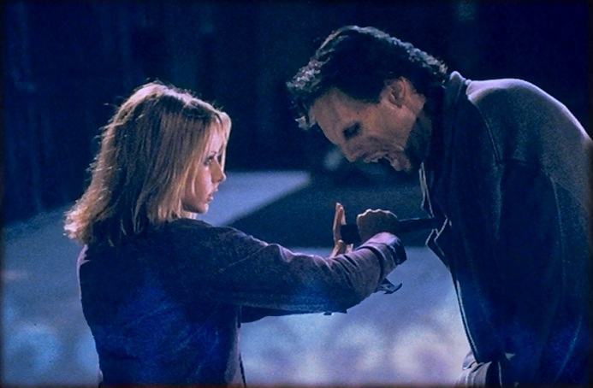
Requirements Elicitation
How do you know what your stakeholders want?
http://buffy.wikia.com/wiki/Stake

Slide 59
Overview
Requirements elicitation principles
Requirements elicitation activities
Requirements elicitation techniques
Product of the elicitation phase
59

Slide 60
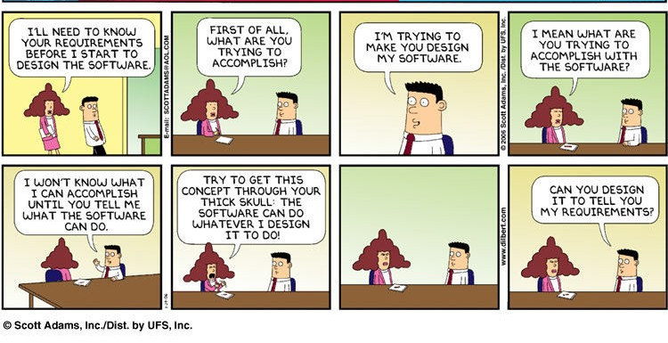
60

Slide 61
Requirements Elicitation Principles
System development is motivated by a problem
Aim of requirements elicitation is to understand the problem clearly
Problem can only be understood by discovering who or what is affected by the problem
Several activities should be covered
Analysing the problem
Identifying requirements sources
Eliciting requirements from these sources
61

Slide 62
Activity #1: Analysing the Problem
Identifying goals (project motivation)
e.g. the current system is costly to maintain (problem) => reduce maintenance cost (goal)
Identifying constraints on the solution
e.g. retain existing OS look-and–feel, constraints on resources (time, people, budget)
Defining the scope of the problem (boundary of the system)
what is external to the problem (the environment)
what is internal to the problem (the core of the system)
Assessing the risks (e.g. financial, technical, …)
Estimating an approximate project cost
62

Slide 63
Activity #2: Identifying Requirements Sources
Stakeholders
anyone who will be affected by the system or who will influence decisions about the system
represent roles such as a job that someone does, a type of user, or an operational area such as a department
elicit requirements from representatives of roles – many different viewpoints
for completeness and consistency
Domain
Operational environment
Organisational environment
Application domain
63

Slide 64
Operational Environment
Typical information that you might discover
Other existing (sub) systems that will interact with the system
interface requirements such as prescribed protocols
timing constraints for a real-time system
How the system will be used at run-time
reliability, availability, and performance requirements
Will the system be cross-platform?
hardware or design constraints
Is safety an issue?
safety requirements

Slide 65
Organisational Environment
Typical information that you might discover
Who will use the system and for what?
What form does this environment take and why?
How fixed is this environment?
Can our solution change it?
Does the organisation have requirements about the quality of the system or process?

Slide 66
Application Domain
Provides knowledge of the general area where the system is applied.
Can be gathered from various sources
stakeholders
textbooks
operating manuals
heads of the people working in that area

Slide 67
Activity #3: Eliciting Requirements
Two main goals
find out what the stakeholders ‘need’
collect information about what it is feasible for the stakeholders to have
Not all of the stakeholders’ requirements will be realistic
Not all of the information will be useful
At this stage, just collect it!

Slide 68
Elicitation Challenges
Stakeholders & users may not be able to describe their tasks well
make assumptions
leave things unstated
No-one knows everything
Requirements conflict
Implicit requirements
e.g. changing user names
68

Slide 69
Elicitation Process
Preparation
Elicitation
Analysis
Specification

Slide 70
Preparation – Sources of Requirements
Stakeholders
Users
identify classes of users
how will they use the system?
Environment
application domain
organisation
operations

Slide 71
Know Your Users – User Role Modelling
What types of people will use the system?
each will have different goals
Don’t think of an anonymous user
over simplification
Identify different user roles
brainstorm initial set
group related roles
consolidate roles
refine roles
Don’t get stuck on organisational roles

Slide 72
User Role Modelling Example University Student Information System
Undergrad Students
Academic Staff
Admin Staff
Chancellery Staff
Postgrad Students
Casual Academic Staff
Research Students
Course Coordinators
IT Support
Full-Time Students
Program Director
Web Dev Team
Part-Time Students
Teaching Support Staff
External Students

Slide 73
Example Roles Refined
Students
Academics
Admin Staff
IT Services
Chancellery
Coursework
Teaching Staff
Research
Program Director
External
Teaching Support Staff

Slide 74

Personas
Fictitious character representing a user role
Makes important roles more realistic
mock person, including photo & profile
Mae Koh – Program Director
manages BEng in Software College
accesses enrolment data, including offers and acceptances
allocates teaching staff based on enrolments
reduces allocation changes at start of semester

Slide 75
Application Domain
Knowledge of area in which system is used
Sources
manual
books
journals
users

Slide 76
Organisation
Structure
most IT systems reflect organisation structure
How fixed is the structure
is the system meant to change it?
Policies and practices

Slide 77
Operations
Other system dependencies
interface requirements
timing constraints
Execution environment
platform
reliability & performance
Criticality
mission
safety

Slide 78
Requirements Elicitation Techniques
Interviews
Workshops
Focus Groups
Observations
Questionnaires

Slide 79
Elicitation Challenges
Stakeholders and users may not be able to describe their tasks well
make assumptions
leave things unstated
No-one knows everything
Requirements conflict
Implicit requirements
e.g. changing user names

Slide 80
Interviews
Effective for understanding problem and eliciting general requirements
Prepare questions in advance
discussion needs a starting point
primarily open-ended questions
strawman model if you have some data
Suggest ideas & alternatives
users may not realise what is possible
80

Slide 81
Interview Skills
Active listening
paraphrase what you understand
Clarify what’s unclear
draw me a diagram
card sorting
Maintain focus
81

Slide 82
Workshops
Structured meeting
formal roles
clear goals
Multiple stakeholders
resolve conflicting requirements
quickly gather broad system usage
82

Slide 83
Focus Groups
Less structure
still need clear goals
Exploratory discussion
needs
preferences
expectations
Broad stakeholder representation
Gather broad-based ideas
83

Slide 84
Observations
Observe how users perform their tasks
learn workflow
Users often cannot describe everything they do
too many fine details
habitual tasks
Time consuming
silent observation
interactive
84

Slide 85
Questionnaires
Inexpensive and easily administered to remote sites
Collect data from many users
May feed into interviews or workshops
Good questionnaires difficult to write
85

Slide 86
Good Questionnaires
Answer options for all possibilities
Answer choices mutually exclusive
Avoid phrasing that implies a correct answer
Closed questions for statistical analysis
Open questions to gather ideas
Short
86

Slide 87
Prototyping
Show end-users and stakeholders what facilities the system can provide
Wide range of prototyping techniques
Paper / whiteboard / computer mock-ups of screen designs
Demo versions of software features
Valuable tool for clarifying unclear requirements and developing user interface
Helps establish overall feasibility and usefulness of the system before high cost development is incurred

Slide 88
Prototyping (cont.)
Should be used carefully, can lead to
Premature design
False expectations
Distraction
Also a requirements validation tool!

Slide 89
Independent Elicitation Techniques
Discover information on your own
System interface analysis
User interface analysis
Document analysis

Slide 90
System Interface Analysis
Look at other systems’ functionality
what does your system need to do?
what can you use?
Data exchange
including formats & validation rules
Services

Slide 91
User Interface Analysis
Study existing systems
what do they do?
how are they used?
What should be
replicated?
avoided?
Good way to learn existing system & processes

Slide 92
Document Analysis
Business process descriptions
Existing system documentation
user manuals
specifications
what must be kept
what can be improved
Industry standards or legislation
Gain understanding of domain or system

Slide 93
Analysing Existing Artifacts
What system are you replacing?
Bespoke cobbled-together software?
Less formal systems?
emailed Excel files?
Paper based systems?
That’s not the end of the problem!
May not be a one-to-one mapping
You don’t want the limitations of the old system
Often turns out you’re not replacing it after all
“Envisioned world problem”

Slide 94
Getting Entrepreneurial …
Ask your competitors’ customers!
What set of people will I need to like it to get a purchase?
Each of those has needs
“Minimum viable product” (Eric Ries)
“Kill a feature every week” (Dave McLure)
A/B testing
Mock website

Slide 95
Product of the Elicitation Phase
Requirements documentation including a requirements definition
May use a pre-defined requirements document template developed by a standards organisation
IEEE, ISO, …
defines structure and style of the document
May use less formal documentation and tools
User Stories
Jira

Slide 96
10 Soft Skills Required for Req. Analysts
Active Listening
Interviewing and Questioning
Analytical (abstraction & evaluation)
Facilitation (help groups build trust)
Observation
Writing
Organisation
Modelling
Interpersonal
Creativity

Slide 97
Requirements Elicitation
capture the unique character of the organization
general time-independent business rules and processes
Class – an abstraction that describes a set of objects
with common attributes, operations, relationships, and constraints
Use case – a major functional unit

Slide 98
Review Quiz 2.2
What is the name of the profession charged with the responsibility to elicit and document domain knowledge requirements and use case requirements?
What are the two main kinds of requirements?
What are the three forms of closed-ended questions in questionnaires?
Notes:
Business Analyst.
Functional requirements (service statements) and non-functional requirements (constraint statements; supplementary requirements).
Multiple-choice questions, rating questions, and ranking questions.

Slide 99
3. Requirements negotiation and validation
elicited requirements need to undergo careful negotiation and validation with all stakeholders

Slide 100
Requirements negotiation and validation
Because requirements
overlap and conflict → requirements dependency matrix
next slide
may be ambiguous or unrealistic
may remain undiscovered
may be out of scope
sometimes out of the “project” scope, but in the scope of the “information system”
req too difficult to implement and should be done manually, may be of low priority, may be implemented in hardware
frequently done in parallel with requirements elicitation
inseparable from the production of requirements document
negotiation starts from the draft req doc
validation reviews and approves the doc

Slide 101
Requirements dependency matrix
Requirement | R1 | R2 | R3 | R4
R1
R2 | Conflict
R3
R4 |  | Overlap | Overlap

Slide 102
Requirements risks and priorities
Risk is a threat to the project plan
Risks determine project’s feasibility
Risk analysis identifies requirements that are likely to cause development difficulties
Prioritisation allows easy re-scoping of the project when faced with delays

Slide 103
Risk Categories
Technical
Performance
Security
Database integrity
Development process
Political
Legal
Volatility

Slide 104
Review Quiz 2.3
What kinds of dependencies between requirements are made explicit in a requirement dependency matrix?
What is the name of a risk category associated with a scenario in which a requirement is likely to keep changing or evolving during the development process?
Notes:
Conflicting requirements and overlapping requirements.
Volatility risk.

Slide 105
4. Requirements Management
requirements identification and classification
requirements hierarchies
change management
requirements traceability

Slide 106
Requirements identification and classification
Natural language statements
‘The system shall schedule the next phone call to a customer upon telemarketer’s request.’
Identification and classification scheme
Unique identifier (automatically generated)
database generated, if possible
including version number, if possible
Sequential number with document hierarchy
the seventh requirement in the third section of the second chapter would be numbered 2.3.7
Sequential number with requirement’s category
where the categories of requirements can be: function requirement, data requirement, performance requirement, security requirement, etc

Slide 107
Requirements hierarchies
Parent-child relationships
Reflect varying abstraction levels
1. “The system shall schedule the next phone call to a customer upon telemarketer’s request.”
1.1 “The system shall activate Next Call push button upon entry to Telemarketing Control form or when the previous call has terminated.”
1.2 “The system shall remove the call from the top of the queue of scheduled calls and make it the current call.”
1.3 etc.

Slide 108
Change management
A requirement may change, be removed, or a new requirement may be added
Downstream cost of change
Strong management policies needed to
document change requests
assess a change impact
effect the changes
Requirements changes should be stored and tracked by a software configuration management tool

Slide 109
Requirements traceability
A critically important part, of change management
A suspect trace – after change to any element in a traceability relationship
More in Chapter 9

Slide 110
Review Quiz 2.4
What are the techniques for identifying requirements?
What is the name of a tool dedicated to change management?
What is a suspect trace?
Notes:
Unique identifier, sequential number within document hierarchy, and sequential number within requirements category.
Software configuration management tool.
A suspect trace is an indication in a traceability matrix that a relationship between two linked requirements could have been invalidated as a result of changes to any of these two linked requirements or other related requirement.

Slide 111
5. Requirements business model
a high-level visual representation of elicited, negotiated and validated requirements

Slide 112
Requirements business model

Slide 113
Context diagram – notation

Slide 114
Telemarketing – problem statement
A charitable society sells lottery tickets to raise funds. The fundraising is done in campaigns to support currently important charitable causes. The society keeps a list of past contributors (supporters). For each new campaign, a subset of these supporters is pre-selected for telemarketing and/or direct mail contact.
The society uses some innovative schemes to gain new supporters. The schemes include special bonus campaigns to reward supporters for bulk buying, for attracting new contributors, etc. The society does not randomly target potential supporters by using telephone directories or similar means.
To support its work, the society decided to contract out the development of a new telemarketing application. The new system is required to support up to fifty telemarketers working simultaneously. The system must be able to schedule the phone calls according to pre-specified priorities and other known constraints.
The system is required to dial up the scheduled phone calls. Unsuccessful connections must be re-scheduled and tried again later. Telephone callbacks to supporters must also be arranged. The conversation outcomes, including ticket orders and any changes to supporter records, ought to be maintained.

Slide 115
Telemarketing example
Telemarketing
The campaigns are planned on recommendation from the society trustees
The campaigns have to be approved by the local government
The design and planning of campaigns is supported by a separate Campaign Database application system
There is also a separate Supporter Database that stores and maintains information about all past and present supporters – used to select supporters to be contacted in a particular campaign
Orders from supporters for lottery tickets are recorded during telemarketing for perusal by the Order Processing system
Order Processing System maintains status of orders in the Supporter Database

Slide 116
System scope model – context diagram

Slide 117
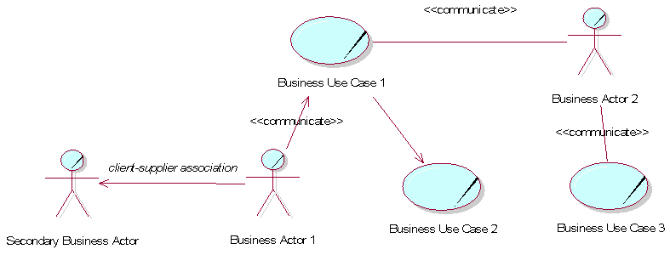
Business use case diagram – notation
communication relationship
Business use case ≡ system feature; IS process and/or manual activity
Business actor = primary and/or secondary (external/internal dichotomy)

Slide 118
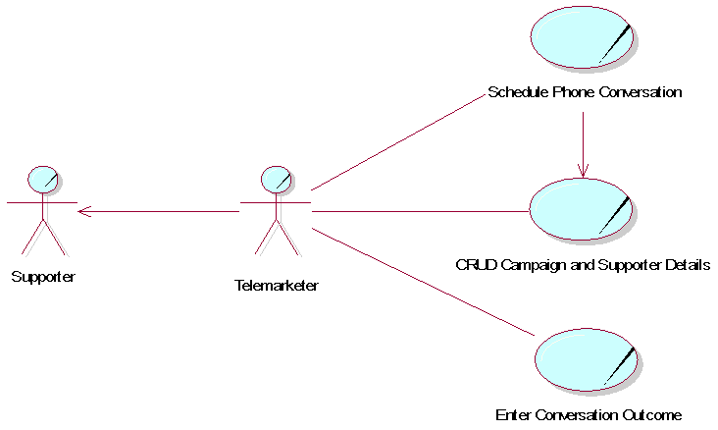
Business use case diagram - telemarketing

Slide 119
Business glossary
Term | Definition
bonus campaign | A special serious of activities, conducted within a campaign, to additionally entice supporters to buy the campaign tickets. Typical examples are giving free tickets for bulk or early buying or for attracting new supporters. A particular kind of bonus campaign can be used in many campaigns.
campaign | A government approved and carefully planned series of activities which are intended to achieve a lottery objective.
draw | An act of randomly choosing a particular lottery ticket as a winning ticket.
lottery | A funds raising game of chance, organized by the charity in order to make money, in which people (supporters) buy numbered tickets to have a chance of winning a prize if their number is chosen in a draw.
placement | Acquisition of one or more lottery tickets by a supporter during telemarketing. The placement is paid by a supporter with a credit card.

Slide 120
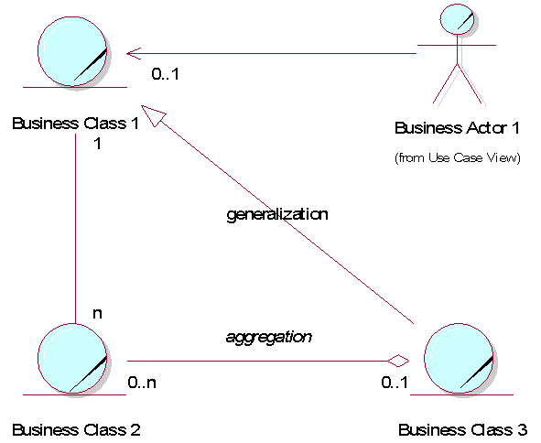
Business class diagram – notation

Slide 121
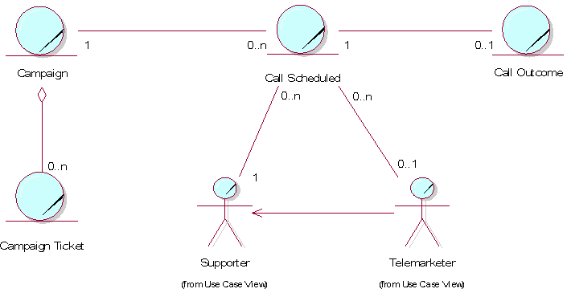
Business class diagram - telemarketing
1. The emphasis in the system is on call scheduling. The call scheduling itself is a procedural computation, i.e. the solution to it is algorithmic and computational. Nevertheless, the scheduled call queues and the outcomes of calls must be stored in some data structure.
2. Information about actors is stored in classes.

Slide 122
Review Quiz 2.5
What is another name for a business use case?
What is the name of a relationship representing the flow of events between actors and use cases?
What are the three main categories of relationships between business classes?
How is the optional participation between business classes visualized in UML?
Notes:
System feature.
Communication relationship.
Association, generalization, and aggregation.
It is visualized in the multiplicity definition by putting a 0 (zero) value on the relevant end of the association.

Slide 123
6. Requirements document
a tangible outcome of the requirements determination phase
produced according to an organization-approved template

Slide 124
Requirements document

Slide 125
Project preliminaries
Targets managers and decision makers
Begins with purpose and scope of the project
Makes a business case for the system
Identifies stakeholders
Offers initial ideas for the solution
including off-the-shelf solutions
off-the-shelf does not dispense with the need for RASD
Includes an overview of the rest of the document

Slide 126
System services
What the system must accomplish
Likely to account for more than half of the entire document
Contains high-level requirements business models
Context diagram (the system scope)
Business use case diagram (function requirements)
Business class diagram (data requirements)
main attributes, but no operations
Business glossary moved to the Appendix

Slide 127
System constraints
Interface requirements
‘look and feel’ only
Performance requirements
response times, but also reliability, availability, throughput indicators
Security requirements
access privileges
Operational requirements
hardware/software environment
Political and legal requirements
Other constraints
usability
maintainability

Slide 128
Project matters
Open issues
Future requirements
Current requirements to be implemented in the future – enhancements
Potential problems when the system is deployed
Preliminary schedule
Human and other resources
Planning charts (PERT, Gantt)
Preliminary budget
Project cost – range rather than figure
In some cases, better estimation possible (e.g. function point analysis)

Slide 129
Appendices
Glossary
Terms
Acronyms
Abbreviations
Documents and forms
examples of completed (filled in) forms
References
books and other published sources
meetings’ minutes, memoranda, internal documents

Slide 130
Review Quiz 2.6
How can functional requirements be classified?
How can any out-of-scope, but relevant, requirements be addressed in a requirements document?
Notes:
Functional requirements can be classified into function requirements and data requirements.
They can be listed in the “Open Issues” section.

Slide 131
Homework
Write 3 questions to elicit requirements of how people would like to access event results from the Olympics website.
Ask at least 2 people to answer your questions.
Bring a list of the key features required to tomorrow’s lecture.
© Richard Thomas, 2016-2017

Slide 132
Summary
Analysis of business processes drives development of information systems
Choice of implementation strategy determines the capability architecture of the system
Requirements determination is about discovering requirements and documenting them
Two lines of discovery – from domain knowledge and use cases
Methods of requirements elicitation include interviewing customers and domain experts, questionnaires, observation, study of documents and software systems, prototyping, JAD and RAD
Requirements negotiation and validation to resolve overlaps and conflicts
Requirements have to be managed
Requirements business model uses diagrams – Context Diagram, Business Use Case Diagram, and Business Class Diagram
Resulting document is called the Requirements Document

