Slide 1
MACIASZEK, L.A. (2007): Requirements Analysis and System Design, 3rd ed. Addison Wesley, Harlow England ISBN 978-0-321-44036-5
Chapter 4 Requirements Specification
© Pearson Education Limited 2007

Slide 2
Topics
Architectural prerogatives
State specifications
Behavior specifications
State change specifications

Slide 3
1. Architectural prerogatives
software architecture:
addresses nonfunctional requirements (software qualities)
“It’s the key to achieving intellectual control over a sophisticated system’s enormous complexity”

Slide 4
Architectural design
Design
detailed
architectural
Object dependencies → complexity and adaptiveness (supportability)
Architectural model
hierarchical layers
restrictions on object inter-communications to minimize dependencies

Slide 5
Model-View-Controller (MVC)
Model objects represent data objects
View objects represent user interface (UI) objects
Controller objects represent mouse and keyboard events

Slide 6
Core J2EE Architecture
The user communicates with the system from the Client tier
The EIS tier (called also the Resource tier) is any persistent information delivery system
The user accesses the application via the Presentation tier (known also as the Web tier)
The Business tier contains application logic
The Integration tier establishes and maintains connections to data sources

Slide 7
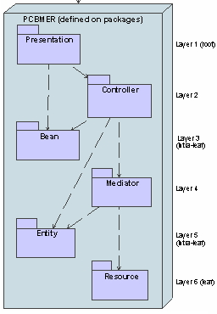
The Core PCBMER framework
Presentation represents the screen and UI objects on which the beans can be rendered
Bean represents the data classes and value objects that are destined for rendering on user interface
Controller represents the application logic
Entity contains classes representing business objects
Mediator manages business transactions, enforces business rules, instantiates business objects in the Entity layer, and in general manages the memory cache of the application
Resource is responsible for all communication with external persistent data sources

Slide 8
Architectural principles
DDP – downward dependency principle
UNP – upward notification principle
NCP – neighbor communication principle
APP – acquaintance package principle
EAP – explicit association principle
CEP – cycle elimination principle
CNP – class naming principle

Slide 9
DDP, UNP, NCP
DDP (downward dependency principle)
higher PCBMER layers depend on lower layers
lower layers should be designed to be more stable
UNP (upward notification principle)
upward communication that minimizes object dependencies
lower layers rely on interfaces and event processing (publisher/subscriber protocols) to communicate with objects in higher layers
NCP (neighbor communication principle)
objects can communicate across layers only by using direct neighbors
chains of message passing

Slide 10
APP, EAP
APP (acquaintance package principle)
separate layer of interfaces to support more complex object communication under strict supportability guidelines
subsystem of interfaces only
other objects in the system can use these interfaces, and pass them in arguments to method calls, instead of concrete objects → classes in non-neighboring subsystems can communicate without knowing the concrete suppliers of services (and, therefore, without creating dependencies on concrete classes)
EAP (explicit association principle)
legitimizes run-time object communication in compile-time data structures

Slide 11
CEP, CNP
CEP (cycle elimination principle)
cyclic dependencies, between classes and other structures (methods, packages, subsystems)
unavoidable, but can be neutralized
extra classes to reduce a network of calls to a hierarchy
purposeful use of interfaces
CNP (class naming principle)
name of each class and each interface in the system should identify the subsystem/package layer to which it belongs
ensuring that each class begins with a single letter identifying the PCBMER layer (i.e. P, C, etc.)
EVideo means that the class is in the entity subsystem
IMVideo means that the interface is in the mediator subsystem

Slide 12
Review Quiz 4.1
What is the necessary and the most important condition to building into the software the quality of supportability?
Which MVC objects represent user interaction events?
Which Core J2EE tier is responsible for establishing and maintaining connections to data sources?
Which PCBMER layer is responsible for establishing and maintaining connections to data sources?
Notes:
The prior architectural design, conforming to some recognized architectural framework, is such a condition.
Controller objects.
The Integration tier.
The Resource layer.

Slide 13
2. State specifications
provide a structure (or static) view of the system
the main task is to define classes in an application domain

Slide 14
State
Object state is determined by the values of its attributes and associations
State specification
Model of data structures
Static view on the system
Class operations left out in initial specs
Emphasis on entity classes (‘business objects’)

Slide 15
Modelling classes
Cornerstone of OO development
a system is a set of collaborating objects
Iterative and incremental process
CASE tool
for collaborative development
for personal productivity otherwise

Slide 16
Discovering classes
No two analysts will come up with identical class models for the same application domain
Discovering classes
Noun phrase
Common class patterns
Use case driven
CRC
Mixed

Slide 17
Noun phrase approach
Nouns considered candidate classes
Three kinds of candidate classes
Irrelevant (can be skipped)
Relevant
Fuzzy
Assumes that the Requirements Document is complete and correct

Slide 18
Common class pattern approach
Derives candidate classes from the classification theory of objects
One possible classification pattern
Concept (e.g. Reservation)
Event (e.g. Arrival)
Organization (e.g. Department)
People (e.g. Passenger)
Place (e.g. TravelOffice)
Just a guidance
Only loosely bound to user requirements
Possible naming misinterpretations

Slide 19
Use case driven approach
Assumes that
Use Case Diagrams (and possibly some high-level Sequence Diagrams) have been developed
Narrative descriptions for each use case exist
Similar to the noun phrase approach
Function-driven (problem-driven)
Relies on the completeness of use case models

Slide 20
CRC approach
CRC – class, responsibilities, collaborators
More than a technique for class discovery
Animated brainstorming sessions
Identifies classes from the analysis of how objects collaborate to perform business functions (use cases)
Suitable also for
Verification of classes discovered with other methods
Determination of class properties

Slide 21
Mixed approach
Use elements of all four previous approaches
Middle-out rather than top-down or bottom-up
One possible scenario
Initial classes – domain knowledge
Common class patterns approach to guide
Noun phrase approach to add more classes
Use case approach to verify
CRC to brainstorm

Slide 22
Guidelines for class discovery
Statement of purpose
Description for a set of objects
Singleton classes
Houses a set of attributes
Class or attribute?
Houses a set of operations
what does the class do?

Slide 23
Example 4.1 – University Enrolment
Consider the following requirements for the University Enrolment system and identify the candidate classes
Each university degree has a number of compulsory courses and a number of elective courses.
Relevant
Fuzzy
Degree
CompulsoryCourse
Course
ElectiveCourse

Slide 24
Example 4.1 – University Enrolment
More requirements
Each course is at a given level and has a credit-point value
A course can be a part of any number of degrees
Each degree specifies a minimum total credit points value required for degree completion
Students may combine course offerings into programs of study suited to their individual needs and leading to the degree in which a student is enrolled

Slide 25
Example 4.1– University Enrolment (solution)
Relevant classes | Fuzzy classes
Course | CompulsoryCourse
Degree | ElectiveCourse
Student | StudyProgram
CourseOffering

Slide 26
Example 4.2 – Video Store
Consider the following requirements for the Video Store system and identify candidate classes
The video store keeps an extensive library of current and popular movie titles in stock. A particular movie may be held on videotapes or disks.
Relevant
Irrelevant
MovieTitle
VideoStore
VideoTape
Stock
VideoDisk
Library

Slide 27
Example 4.2 – Video Store
More requirements
A movie can be rented for a particular rental duration (expressed in days), with a rental charge for that period.
The video store must be able to answer immediately any enquiries about a movie's stock availability.
The current condition of each tape and disk must be known and recorded, together with generic information about the percentage of videotapes and disks in excellent renting condition.

Slide 28
Example 4.2 – Video Store (solution)
Relevant classes | Fuzzy classes
MovieTitle | RentalRates
VideoMedium
VideoTape
VideoDisk

Slide 29
Example 4.3 – Contact Management
Consider the following requirements for the Contact Management system and identify the candidate classes
The system supports the function of “keeping in touch” with all current and prospective customers so as to be responsive to their needs and to win new contracts for products and services offered by the organization.
The system stores the names, phone numbers, postal and courier addresses, etc. of organizations and contact persons in these organizations.
The system allows employees to schedule tasks and events that need to be carried out with regard to relevant contact persons. Employees schedule the tasks and events for other employees or for themselves.
A task is a group of events that take place to achieve a result. The result may be to convert a prospective customer to a customer, to organize product delivery, or to solve a customer’s problem. Typical types of event are phone call, visit, sending a fax, and arranging for training.

Slide 30
Example 4.3 – Contact Management (solution)
Relevant classes | Fuzzy classes
Organization | CurrentOrg
Contact | ProspectiveOrg
Employee | PostalAddress
Task | CourierAddress
Event

Slide 31
Specifying classes
Class Name
Singular noun
Recommendation – multiple words joined; each word starting with a capital letter (e.g. PostalAddress)
Meaningful
Short (less than 30 characters)
Class Properties
Attributes (initially those that capture interesting object states)
Recommendations
start with a small letter; capitalise successive words (streetName)
Operations (can be delayed till later analysis stages or even till design)

Slide 32
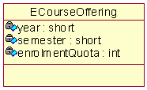
Example 4.4 – University Enrolment
Refer to Example 4.1
Consider the following additional requirements from the Requirements Document
A student’s choice of courses may be restricted by timetable clashes and limitations on the number of students who can be enrolled in the current course offered.

Slide 33
Example 4.4 – University Enrolment
More requirements
A student’s proposed program of study is entered in the on-line enrolment system.
The system checks the program's consistency and reports any problems.
The problems need to be resolved with the help of an academic adviser.
The final program of study is subject to academic approval by the delegate of the Head of Division and it is then forwarded to the Registrar.

Slide 34
Example 4.4 – University Enrolment (solution)

Slide 35
Example 4.5 – Video Store
More requirements
The rental charge for entertainment items (such as movie) differs depending on the item category and on the entertainment medium containing the item. In general, an entertainment medium can be a video medium or just a sound medium. A video medium can be a VCR tape, DVD or game CD. A music CD is a sound medium, but some music CDs are available in video formats, such as VCD or DVD-A.
The system stores information about employees and identifies the employee responsible for each rental transaction performed on behalf of a customer.
A separate transaction is generated for renting for different durations. Items in each rental transaction can relate to more than one medium (as long as all items are rented for the same duration). A medium can contain movies, TV programs, games, or music.
The employees of the video store tend to remember the codes of the most popular movies. They frequently use a movie code, instead of movie title, to identify the movie. This is a useful practice, because the same movie title may have more than one release by different directors.

Slide 36
Example 4.5 – Video Store (solution)

Slide 37
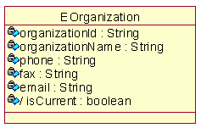
Example 4.6 – Contact Management
Refer to Example 4.3 and consider the following additional information
A customer is considered current if a contract with that customer exists for the delivery of our products or services. However, contract management is outside the scope of our system.
Fuzzy
CurrentOrg
ProspectiveOrg

Slide 38
Example 4.6 – Contact Management
Reports on contacts based on postal and courier addresses (e.g. find all customers by post code)
Date and time of the task creation are recorded
The "money value" of a task can be stored
Events for the employee are displayed on the employee's screen in the calendar-like pages (one day per page).
The priority of each event (low, medium or high) is visually distinguished on the screen
Not all events have a “due time” - some are “untimed”
Event creation time cannot be changed, but due time can.
Event completion date and time are recorded
The system stores identifications of employees who created tasks and events, who are scheduled to do the event (“due employee”), and who completed the event

Slide 39
Example 4.6 – Contact Management (solution)

Slide 40
Discovering associations
Side effect of discovering classes
Some attributes are associations
“Dry-run” of use cases to discover more associations
Avoid ternary associations
Cycles of associations that do not commute

Slide 41
Specifying associations
Naming associations
small letters; capitalising the first letters of successive words (e.g. empTask)
Naming association roles
Determining multiplicity
can be omitted initially
Role names for recursive associations

Slide 42
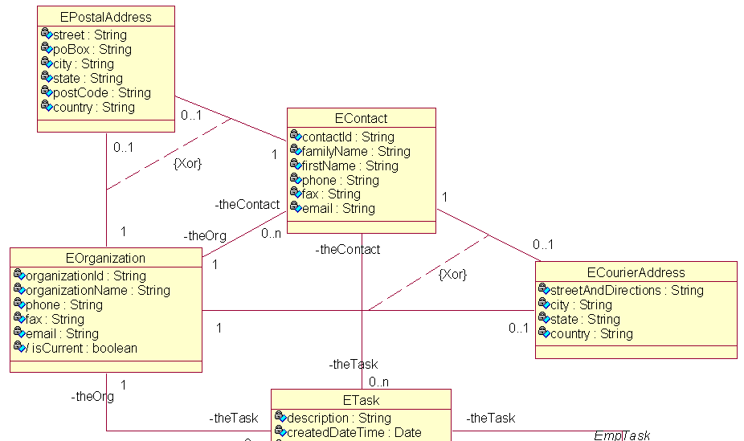
Example 4.8 – Contact Management (solution – 1)

Slide 43
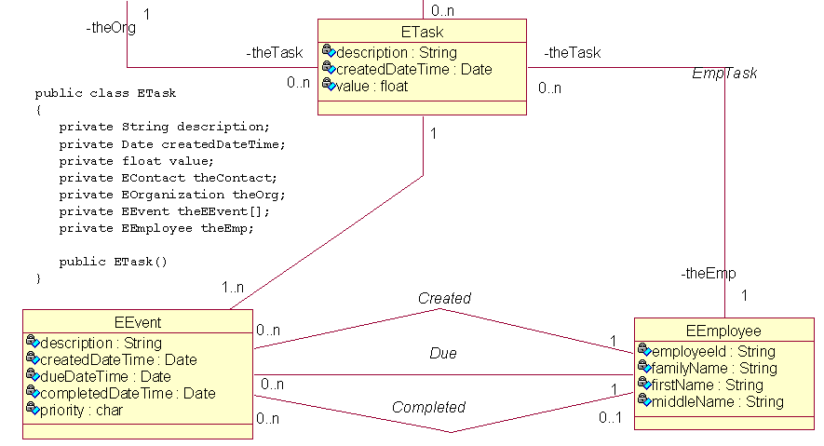
Example 4.8 – Contact Management (solution – 2)

Slide 44
Modeling aggregation and composition
Four semantics for aggregation possible
ExclusiveOwns (e.g. Book has Chapter)
Existence-dependency
Transitivity
Asymmetricity
Fixed property
Owns (e.g. Car has Tire)
No fixed property
Has (e.g. Division has Department)
No existence dependency
No fixed property
Member (e.g. Meeting has Chairperson)
No special properties except membership

Slide 45
Discovering aggregation
Discovered in parallel with discovery of associations
Litmus test phrases
“has”
“is-part-of”
Can relate more than two classes

Slide 46
Specifying aggregation
UML supports
Aggregation
By-reference semantics
Hollow diamond
Corresponds to Has and Member aggregations
Composition
By-value semantics
Solid diamond
Corresponds to ExclusiveOwns and Owns aggregations

Slide 47
Example 4.9 – University Enrolment
Consider the following additional requirements
Student’s academic record to be available on demand.
Record to include information about the student’s grades in each course that the student enrolled in (and has not withdrawn without penalty).
Each course has one academic in charge of a course, but additional academics may also teach in it.
There may be a different academic in charge of a course each semester.
There may be different academics for each course each semester.

Slide 48
Example 4.9 – University Enrolment (solution)

Slide 49
Modeling generalization
Common features abstracted into a more generic class
Subclasses inherit (reuse) superclass features
Substitutability – subclass object is a legal value for a superclass variable
e.g. a variable holding Fruit objects can have an Apple object as its value)
Polymorphism – the same operation can have different implementations in different classes
Abstract operation – implementation provided in subclasses
Abstract class – class with no direct instance objects
a class with an abstract operation is abstract

Slide 50
Discovering and specifying generalization
Some discovered in parallel with discovery of associations
Litmus test phrases
“can-be”
“is-a-kind-of”
Multiple inheritance possible
Solid line with an arrowhead pointing to the superclass

Slide 51
Example 4.10 – Video Store
The classes identified so far imply a generalization hierarchy rooted at the class EntertainmentMedium
They also imply a parallel generalization hierarchy rooted at a class that can be named EEntertainmentItem or EEntertainmentItemCategory
To capture some state differences between classes in the generalization hierarchy originating from the class EEntertainmentMedium, assume that the storage capacity of an EDVD allows multiple versions of the same movie to be held, each in a different language or with different endings.
There is no need to decipher the peculiarities of game and music CDs in the model.

Slide 52
Example 4.10 – Video Store (solution)

Slide 53
Modeling interfaces
Interfaces
do not have attributes (except constants), associations or states
only have operations, but all operations are implicitly public and abstract
operations are declared (i.e. turned into implemented methods) in classes which implement these interfaces
Interfaces do not have associations to classes but they may be targets of one-way associations from classes
this happens when an attribute that implements an association is typed with an interface, rather than with a class
the value of any such attribute will be a reference to some class that implements the interface
An interface may have a generalization relationship to another interface
an interface can extend another interface by inheriting its operations

Slide 54
Discovering and specifying interfaces
Interfaces are not discovered from the analysis of the application domain
Determined based on design considerations
fundamental for enforcing architectural frameworks, such as the PCBMER framework
interface reveals only a limited portion of the behavior of an actual class
Class that uses (requires) the interface can be indicated by a dashed arrow pointing to the interface
the arrow can be stereotyped with the keyword «use»
Class that implements (realizes) the interface is indicated by a dashed lined with a triangular end
line can be stereotyped with the keyword «implement»

Slide 55
Example 4-11 – Contact Management
Consider classes EContact and EEmployee
some attributes in common (firstName, familyName)
operations that provide access to these attributes can be extracted into a single interface.
There is a need to display information about overdue events to the screen
presentation-layer class has the responsibility to display a list of overdue events together with names of contacts and employees, as well as with the additional contact details (phone and email) to contacts
Propose a model such that the presentation class uses one or more interfaces implemented by EEmployee and EContact to support part of the “display overdue events” functionality

Slide 56
Example 4-11 – Contact Management

Slide 57
Modelling and specifying objects
Only to exemplify
illustrate complex relationships between objects
demonstrate changes to objects over time
illustrate object collaboration

Slide 58
Example 4.12 – University Enrolment

Slide 59
Review Quiz 4.2
What is the CRC approach used for?
What are role names used for?
What does transitivity mean in the context of aggregations?
A subclass object may be a legal value for a superclass variable. Associated with that observation is the principle of what?
Notes:
The CRC (class–responsibility–collaborators) approach is a technique for class discovery.
Role names can be used to explain more complicated associations, in particular self-associations (recursive associations that relate objects of the same class).
Transitivity means that if a subset object C is a part of a subset object B and B is part of another subset object A, then C is necessarily a part of A.
The principle of substitutability.

Slide 60
3. Behavior specifications
an operational view of the system
use cases in the application domain and which classes are involved
interactions reveal layers of classes other than entity classes

Slide 61
Behavior specification
Depicted in use cases
Determines which classes are involved in execution of use cases
main class operations identified
message passing between objects captured
control classes and boundary classes considered
Computations modeled in Activity Diagrams
Interactions modeled in Sequence Diagrams or Communication Diagrams

Slide 62
Use Cases Review
Complete piece of functionality
main flow
alternative flows
Externally visible functionality
Initiated by an actor
Delivers an identifiable value to an actor

Slide 63
Example 4.15 – Video Store

Slide 64
Example 4.15 – Video Store (Rent Video)
Brief Description | A customer wishes to rent a video tape or disk that is picked from the store’s shelves or that has been previously reserved by the customer. Provided that the customer has a non-delinquent account, the video is rented out once payment has been received. If the video is not returned in a timely fashion, an overdue notice is mailed to the customer.
Actors | Employee, Scanning Device
Preconditions | Video tape or disk is available to be hired. Customer has a membership card. Scanner devices work correctly. Employee at the front desk knows how to use the system.
Notes:
Get students to critique this use case description.
Brief Description: Not very brief.
Actors: Scanning Device – is it really an actor?
Pre-conditions: All, except the first, are not pre-conditions they are covered by alternative scenarios.

Slide 65
Example 4.15 – Video Store (Rent Video)
Main Flow | A customer may ask an employee about video availability (including a reserved video) or may pick a tape or disk from the shelves. The video and the membership card are scanned and any delinquent or overdue details are brought up for the employee to query the customer about. If the customer does not have a delinquent rating, then he/she can hire up to a maximum of eight videos. However, if the rating of the customer is “unreliable,” then a deposit of one rental period for each tape or disk is requested. Once the amount payable has been received, the stock is updated and the tapes and disks are handed to the customer together with the rental receipt. The customer pays by cash, credit card or electronic transfer. Each rental record stores (under the customer’s account) the check-out and due-in dates together with the identification of the employee. A separate rental record is created for each video hired. The use case will generate an overdue notice to the customer if the video has not been returned within two days of the due date, and a second notice after another two days (and at that time the customer is noted as “delinquent”).
Notes:
Get students to critique this use case description.
Highlights the value of a structured format for use case descriptions. Much harder to break this out into test cases.

Slide 66
Example 4.15– Video Store (Rent Video)
Alternative Flows | A customer does not have a membership card. In this case, the ‘Maintain Customer’ use case may be activated to issue a new card. An attempt to rent too many videos. No videos can be rented because of the customer’s delinquent rating. The video medium or membership card cannot be scanned because of damage to them. The electronic transfer or credit card payment is refused.
Postconditions | Videos are rented out and the database is updated accordingly.
Notes:
Get students to critique this use case description.
Alternative scenarios are a little vague.
Post-conditions: prefer not to mention database.

Slide 67
Activity Diagram Review
Activity Diagrams
Flow of logic
sequential control
concurrent control
Can be used at different levels of abstraction
define execution of a use case
define execution of an operation

Slide 68
Example 4.17 – Video Store (solution)
Scan Customer
Verify
Card
Customer
Rent Video
use case (excerpt)
Scan Video
Medium
[ is delinquent ]
Initiate Rent
[ is unreliable ]
Transaction
[ deposit refused ]
Remove Excessive
Request
Videos
[ more than 8 videos ]
Deposit
[ 8 videos or less ]
Create Rental Record
for Each Video

Slide 69
Modelling interactions
Sequence Diagrams
show an exchange of messages between objects arranged in a time sequence
more useful in analysis
Communication Diagrams
emphasize the relationships between objects along which the messages are exchanged
more useful when reviewing a design
Can be used to determine operations in classes

Slide 70
Message sequences
Actions in Activity Diagrams are mapped to messages in Sequence Diagrams
Message can be
Signal
denotes asynchronous inter-object communication
sender continues executing after sending the signal message
implies event processing
Call
denotes synchronous invocation of an operation
return message can return some values to the caller or it can just acknowledge that the operation completed
implies message passing

Slide 71
Example 4.18 – UE (centralized interaction)
Enter Program of Study
use case

Slide 72
Example 4.18 – UE (distributed interaction)

Slide 73
Modelling public interfaces
Determined by the set of operations that the class offers as its service
In analysis
Signature of each operation is defined
Operation name
List of formal arguments
Return type
In design
Algorithm of a method that implements the operation is defined
Operation can have
Instance scope
Class (static) scope (underline operation name)

Slide 74
Discovering class operations
From Sequence Diagrams
Message to an object must be serviced by an operation in that object
From expected object responsibilities, including the CRUD operations
Create – a new object instance
Read – the state of an object
Update – the state of an object
Delete – i.e. destroy itself

Slide 75
Example 4.19 – UE (centralized interaction)

Slide 76
Example 4.19 – UE (distributed interaction)

Slide 77
Review Quiz 4.3
Do use cases have the possibility of representing concurrent flow of control?
Can activity diagrams be constructed before a class model is developed?
A message can denote an asynchronous inter-object communication. How is such a message called?
What UML modeling technique is most useful for discovering class operations?
Notes:
No, they don’t. Activity diagrams can represent concurrent flow of control.
Yes, they can. This is possible because activity diagrams do not explicitly visualize the classes of objects that perform the actions.
A signal.
Sequence diagrams.

Slide 78
4. State change specifications
many engineering and real-time applications are all about state changes
in business applications the modeling of state changes is typically done towards the end of the analysis
many of the state change specifications define exceptional conditions in the system.

Slide 79
State change specifications
State machine diagrams
For each class that exhibits an interesting dynamic behavior
Changes to some attributes signify state changes

Slide 80
Specifying object states
State transition fires when a certain event occurs or a certain condition is satisfied
transition line does not have to be labeled with an event name
condition itself (written in square brackets) can fire the transition
Transition can be triggered by
Signal event
Call event
Change event
Time event

Slide 81
Example 4.19 – Video Store
event
argument
guard
action
entry action

Slide 82
Review Quiz 4.4
Do state machine diagrams represent the sequence of state changes?
Will the state change always occur when the relevant transition to that state has been fired?
Notes:
No, they don’t. State machine diagrams are not specific about sequences of state changes, even if such sequences may be expected.
Not necessarily. An entry action may be specified and it will then need to satisfactorily completed before the state change can take place.

Slide 83
Homework
Create a simple class diagram for GEMS
focus on classes and associations
Create a simple sequence diagram
for the typical scenario from the use case description you wrote previously
Bring both of these diagrams to the next lecture
hand drawn diagrams are ok

Slide 84
Summary
The critical importance of architecture in system development (MVC → J2EE → PCBMER)
State specifications describe the IS world from the static perspective of classes, their attribute content and their relationships
There are many methods of class discovery
Class diagrams visualize classes and relationships : associations, aggregations and generalizations
Behavioral specifications describe the IS world from the operational (functional) perspective
Use case diagrams provide simple visualization – each use case is given narrative specification
Other behavioral diagrams include activity diagrams, interactions diagrams, and addition of operations to classes.
State change specifications describe the IS world from the dynamic perspective
State machine diagrams allow modeling of state changes

