Slide 1
MACIASZEK, L.A. (2007): Requirements Analysis and System Design, 3rd ed. Addison Wesley, Harlow England ISBN 978-0-321-44036-5
Chapter 5 Moving from Analysis to Design
© Pearson Education Limited 2007

Slide 2
Topics
Advanced class modelling
Advanced generalization and inheritance modelling
Advanced aggregation and delegation modelling
Advanced interaction modelling

Slide 3
1. Advanced class modelling
stereotypes, constraints, derived information, visibility, qualified associations, association class, parameterized class, etc

Slide 4
Extension mechanisms
Specify how specific UML model elements are customized and extended with new semantics by using
stereotypes
constraints
tag definitions
tagged values
UML profile
extends a reference metamodel (i.e. UML itself)
coherent set of extensions, defined for specific purposes

Slide 5
Stereotypes
Extends an existing UML modelling element
varies semantics of an existing element
not a new model element

Slide 6
Comments and constraints
Comment - text string attached to a model element
UML note
Constraint - semantic relationship among model elements that specifies conditions and propositions that must be maintained as true
enclosed in braces {...}
constraint
comment

Slide 7
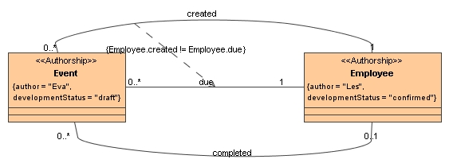
Constraint on association

Slide 8
Tags
Tag definition – a property of a stereotype and is shown as an attribute of a class rectangle that contains the stereotype declaration.
Tag value – “a name–value pair that may be attached to a model element that uses a stereotype containing a tag definition.”
the keyword is called a tag
like constraints, tag values represent arbitrary textual information and are written inside curly braces
like stereotypes and constraints, a few tags are predefined in UML
typical use of tags is in providing project management information

Slide 9
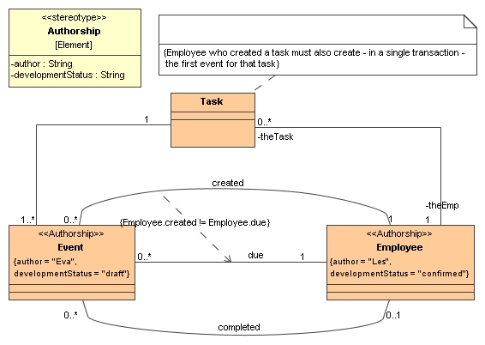
Tags – example
tag definition
tag values

Slide 10
Visibility and encapsulation
+ for public visibility
– for private visibility
# for protected visibility
~ for package visibility

Slide 11
Protected visibility
protected
protected properties in the base class are accessible in derived classes (subclass)

Slide 12
Accessibility of inherited class properties
dateStart and
computeDuration()
of ECampaign
not accessible in
EBonusCampaign
Inheriting a property does not necessarily mean that the property is accessible by objects of a derived class
Private properties of the base class remain private to the base and are inaccessible to objects of the derived class

Slide 13
Package visibility
Visible to all other classes in the package
Protected (and public) give package access, but not vice versa
derived classes cannot access properties with package visibility if the derived and the base class are in different packages
package Campaigns;
class EBonusCampaign extends ECampaign
{
int ticketBookSize;
public int getBookSize()
{
return 0;
}
}

Slide 14
Derived information
A kind of constraint that applies (most frequently) to an attribute or an association.
Computed from other model elements.
It does not enrich the semantics of an analysis model.
can make the model more readable
Knowledge of what information is derived is more important in a design model.
optimization of access to information needs to be considered
Notation for derived information is a slash (/) in front of the name of the derived attribute or association.

Slide 15
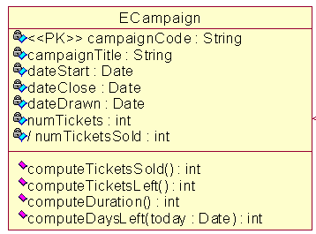
Derived attribute
derived attribute

Slide 16
Derived association
derived association

Slide 17
Qualified association
Qualified association has an attribute compartment (a qualifier) on one end of a binary association.
an association can be qualified on both ends but this is rare
Compartment contains one or more attributes that can serve as an index key for traversing the association from the qualified source class via the qualifier to the target class on the opposite association end

Slide 18
Association class
Typically used if there is a many-to-many association between two classes and each association instance (a link) has its own attribute values
Can be only one instance of SalaryHistoryAssociation for each pair of linked instances of Employee and SalaryLevel

Slide 19
Replacing association class with a reified class
Reified class – if there is a need for many instances of SalaryHistoryAssociation for each pair of linked instances of Employee and SalaryLevel
Typically when modelling temporal (historical) information

Slide 20
Review Quiz 5.1
What is the most important extension mechanism of UML?
How are role names called in UML 2.0?
What is the default visibility in Java (i.e. if the visibility is not specified)?
Can reified class replace association class without any loss of semantics?
Notes:
Stereotype.
Association end names.
Package visibility.
Yes, reified class can always replace association class without any loss of semantics (but the converse is not true).

Slide 21
2. Advanced generalization and inheritance modelling
Generalization is a useful and powerful concept, but it can also create many problems
Intricate mechanisms of inheritance

Slide 22
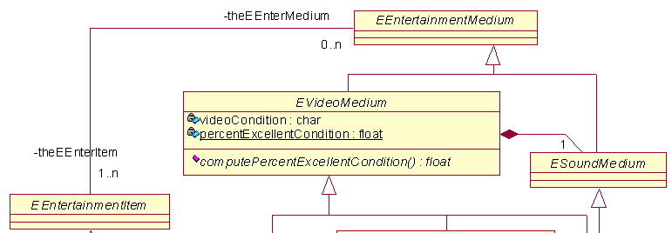
Generalization and substitutability
Generalization introduces new classes, it can reduce the overall number of association and aggregation relationships in the model
The benefits of generalization arise from the substitutability principle – a subclass object can be used in place of a superclass object

Slide 23
Inheritance versus encapsulation
Encapsulation demands that an object’s state (attribute values) be accessible only through the operations in the object’s interface.
Encapsulation is orthogonal to inheritance and query capabilities and has to be traded off against these two features.
Encapsulation refers to the notion of the class, not the object.
in most object-oriented languages (with the exception of Smalltalk) an object cannot hide anything from another object of the same class

Slide 24
Interface inheritance
When generalization is used with the aim of substitutability, then it may be synonymous with the notion of interface inheritance (subtyping, type inheritance).
Interface inheritance provides a means of achieving multiple implementation inheritance in languages that do not support such inheritance (like in Java).
There is a difference between the notions of interface and abstract class.
interface can be thought of as a pure abstract class – no attributes or implementation

Slide 25
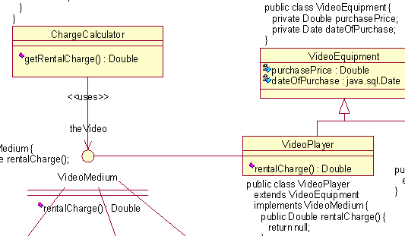
Interface and implementation inheritance

Slide 26
Implementation inheritance
Generalization can be used to imply substitutability, and it can then be realized by interface inheritance
involves only the inheritance of contract fragments – operation signatures
However, generalization can also be used (deliberately or not) to imply code reuse, and it is then realized by an implementation inheritance
involves the inheritance of code – implementation fragments
Implementation inheritance – also called subclassing, code inheritance, or class inheritance – combines the superclass properties in the subclasses and allows them to be overridden with new implementations when necessary.

Slide 27
Extension inheritance is OK

Slide 28
Restriction inheritance is problematic

Slide 29
Convenience inheritance is not OK

Slide 30
Evils of implementation inheritance
Fragile base class
Overriding and callbacks
Multiple implementation inheritance

Slide 31
Fragile base class
Change in a superclass automatically affects the existing subclasses
Changes of superclass’ public interfaces are particularly troublesome
changing the signature of a method
splitting the method into two or more new methods
joining existing methods into a larger method
‘Insanity is inherited; you get it from your children’

Slide 32
Reusing the superclass’ code
Subclass can inherit method implementation and introduce no changes to the implementation.
Subclass can inherit the code and include it (call it) in its own method with the same signature.
Subclass can inherit the code and then completely override it with a new implementation with the same signature.
Subclass can inherit code that is empty (i.e. the method declaration is empty) and then provide the implementation for the method.
Subclass can inherit the method interface only (i.e. interface inheritance) and then provide the implementation for the method.

Slide 33
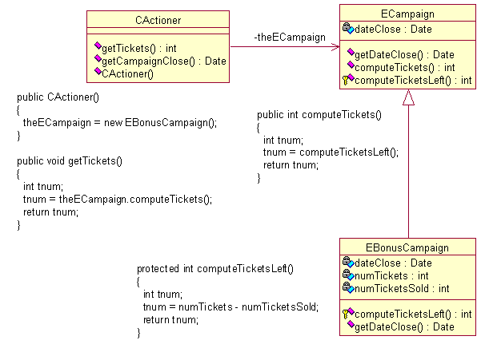
Overriding and down-calls
computeTicketsLeft() is overridden in EBonusCampaign and this overridden method is called
computeTickets() uses ECampaign’s method because EBonusCampaign
(referenced by theECampaign)
does not have its own, overridden,
version of computeTickets ()).

Slide 34
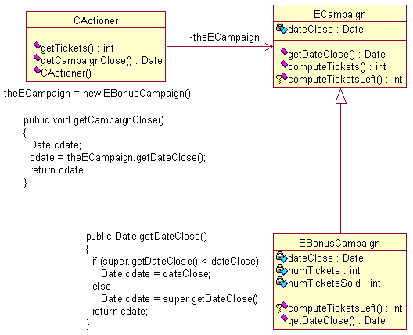
Overriding and up-calls
getDateClose() in EBonusCampaign is called
getDateClose() contains a call to super – an up-call (callback) from a subclass to its superclass.

Slide 35
Multiple inheritance
Multiple interface inheritance
multiple supertyping
merging of interface contracts
Multiple implementation inheritance
multiple superclassing
merging of implementation fragments
exaggerates the problems due to the fragile base class, overriding, and callbacks
some problems result from the lack of support in object systems for multiple classification
Java recommends using multiple interface inheritance to provide solutions that otherwise would require multiple implementation inheritance

Slide 36
Review Quiz 5.2
What related principle makes generalization useful?
How does inheritance compromise encapsulation?
What concept can be used in lieu of multiple implementation inheritance?
Notes:
The substitutability principle.
By allowing subclasses to access protected attributes directly.
Interface inheritance.

Slide 37
3. Advanced aggregation and delegation modelling
Aggregation is the most powerful technique for managing the complexity of large systems through the allocation of classes to hierarchical layers of abstraction

Slide 38
Putting more semantics into aggregation
Aggregation (and its stronger variation – composition) is a containment relationship
composite class contains one or more component classes
In programming environments, aggregation is implemented in the same way as conventional associations
More semantics needed
“ExclusiveOwns” aggregation
“Owns” aggregation
“Has” aggregation
“Member” aggregation

Slide 39
ExclusiveOwns aggregation

Slide 40
Owns aggregation

Slide 41
Has aggregation

Slide 42
Member aggregation

Slide 43
Generalization vs aggregation

Slide 44
Delegation and prototypical systems
Computational model of inheritance is based on the notion of a class
However, it is possible to base the computational model on the notion of an object
uses aggregation
referred to as delegation – when an outer object cannot complete a task, it can call on the methods in one of its component objects (inner objects)
functionality of the system is implemented by including (cloning) the functionality of existing objects in the newly required functionality
existing objects are treated as prototypes for the creation of new objects
inner object’s interfaces may or may not be visible to objects other than the outer object

Slide 45
Delegation versus inheritance
Delegation can model inheritance and vice versa
same system functionality can be delivered with inheritance or with delegation
From the reuse point of view, delegation comes very close to inheritance → an outer object reuses the implementation of the inner object
Inheritance – control is always returned to the originating object after the service has been accomplished
self-recursion always happens
sharing and reuse is normally determined statically
anticipatory sharing
Delegation – once control has been passed from an outer to an inner object, it stays there
self-recursion has to be explicitly planned
sharing and reuse is determined dynamically
unanticipatory sharing

Slide 46
Review Quiz 5.3
How is aggregation implemented in typical programming environments?
Which kind of aggregation needs to be specified with the “frozen” constraint?
What does aggregation use to reuse the implementation of component objects?
Notes:
It is implemented as conventional associations – by acquiring references between composite and component objects.
The ExclusiveOwns aggregation.
Delegation.

Slide 47
4. Advanced interaction modelling
sequence diagrams concentrate on the sequence of messages
communication diagrams emphasize object relationships

Slide 48
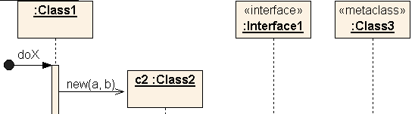
Lifelines
A lifeline box can be named to represent
unnamed instance of a class (:Class1)
named instance of a class (c2:Class2)
a class, i.e. an instance of a metaclass (:Class3) – show static method calls to a class itself
instance conforming to an interface (:Interface1)

Slide 49
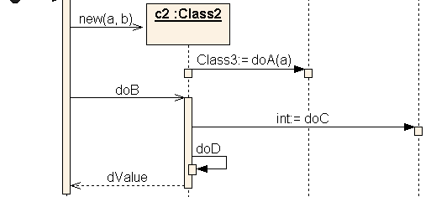
Messages
synchronous messages in which the caller blocks, i.e. it waits for a response – a filled arrow head (doA, doC, doD)
asynchronous messages in which the caller does not block, thus allowing multi-threaded executions – an open arrow (doB)
object creation messages – a line with an open arrow (new(a,b))
reply messages that transmit output values to the caller – a dashed line with an open arrow (dValue)

Slide 50
Interactions – notation by example

Slide 51
Interactions – more concepts
Time when the flow of control is focused in an object is called an execution specification (previously called an activation)
Return result from a message can be shown by a reply message
or the return variable can be shown in the message syntax (e.g. Class3 = doA(a) or int = doC)
Found message (doX) – represents a message whose sender is not specified
Object destruction is indicated by a large X
Lifeline represented by an interface (:Interface1) or an abstract class implies that the called method executes from a class that implements the interface or a concrete class that inherits from the abstract class

Slide 52
Accounting for basic technology
Servlet is a Java program deployed and run inside a Web server.
typically, a servlet does not have a graphical user interface (GUI) and, therefore, can cleanly belong to the Controller layer.
GUI is supplied by the servlet’s clients, such as a server page or an applet.
Java Server Pages (JSP) are HTML pages with Java code pieces embedded in them.
JSPs belong to the Presentation layer.
JavaBeans are Java classes that can store data and follow predefined rules allowing to get() and set() the data.
Java provides a mechanism that allows JSP form values to be automatically loaded/unloaded from/into beans.
JavaBeans reside in the Bean layer.

Slide 53
Sequence diagram using JSP/servlet/JavaBean

Slide 54
Fragments
Piece of interaction is called an interaction fragment.
Interactions can contain smaller interaction fragments called combined fragments.
Semantics of a combined fragment is determined by the interaction operator
alt – alternative fragment for if-then-else conditional logic expressed in guard conditions
opt – option fragment that executes if guard condition is true
loop – loop fragment that is repeated many times subject to the loop condition
break – break fragment that executes instead of the rest of the enclosing fragment if the break condition is true
parallel – a parallel fragment that allows for interleaved execution of contained behaviors

Slide 55
Fragments – notation

Slide 56
Fragments - example

Slide 57
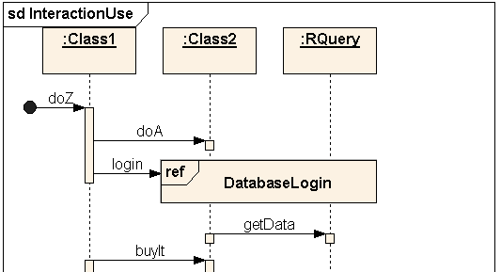
Interaction uses
A reference to an interaction from an enclosing interaction is called an interaction use.
enclosing interaction is labeled with the tag sd (sequence diagram)
interaction use is labeled with the tag ref (reference) and it refers to another sd interaction

Slide 58
Review Quiz 5.4
What interaction modeling concept needs to be used to specify multi-threaded execution?
What interaction modeling concept needs to be used to specify interaction from unknown sender?
What architectural layer does a servlet belong to?
What tag is used to label interaction use?
Notes:
Asynchronous messages.
Found message.
The Controller layer.
The ref (reference) tag.

Slide 59
Summary
Stereotypes are the main extensibility technique of UML. In the extensibility task, they are assisted by constraints and tags.
Protected visibility permits control of encapsulation within the inheritance structures. Package visibility comes handy where private visibility is too restrictive.
An intriguing aspect of class modeling is the choice between an association class and a reified class.
The concept of generalization and inheritance is a double-edged sword in system modeling.
The concept of aggregation and delegation is an important modeling alternative to generalization and inheritance.
Sequence diagrams are the preferred visual tool for interaction modeling. They can be enriched with combined fragments and interaction uses.

