Slide 1
MACIASZEK, L.A. (2007): Requirements Analysis and System Design, 3rd ed. Addison Wesley, Harlow England ISBN 978-0-321-44036-5
Chapter 6 System Architecture and Program Design
© Pearson Education Limited 2007

Slide 2
Topics
Distributed physical architecture
Multilayer logical architecture
Architectural modeling
Principles of program design and reuse
Collaboration modeling

Slide 3
1. Distributed physical architecture
Architectural design has physical and logical aspects
The client/server (C/S) architecture can be extended to represent an arbitrary distributed system

Slide 4
What is design?
Once the technical details include software / hardware considerations, an analysis model becomes a design model
architectural design is the description of a system in terms of its modules
layered organization of classes and packages
the assignment of processes to computing facilities
reuse and component management
detailed design is the description of the internal workings of each module (use case)
algorithms and data structures
collaboration models required for the realization of use cases

Slide 5
Distributed physical architecture
Logical architecture
client and server are logical concepts
client – computing process that makes requests of the server process
server – computing process that services the client requests
Physical architecture
allocates processing components to computer nodes
UML deployment diagrams
Distributed physical architecture
peer-to-peer architecture
multi-tier architecture
database-centric architecture

Slide 6
Peer-to-peer architecture
Distributed processing system in which any process or node in the system may be both client and server
Special consideration – minimization of network traffic while maximizing the overall system throughput
Distributed database system – when it is possible in a single request to combine data from two or more database servers
Notes:
The need for distribution can arise from many factors, such as:
a requirement for specialized processing on a dedicated machine
the need to access the system from various geographical locations
economic considerations when using multiple small machines may be cheaper than a large pricey computer
a supportability requirement to ensure that future extensions to the system can scale up nicely

Slide 7
Tiered architecture
PCBMER layers
Programmable client
Browser client
control
mediator
Business transaction
presentation
bean
entity
resource
Database
Server
Servlets
JSP
Business components
Web Server
Application Server
EJB beans
Notes:
An application service is what each single program executing on a database does. A business service is what a database enforces as business rules on all executing programs. This business rules enforcement is frequently done programmatically (by means of database triggers and stored procedures).
As a result, a three-tier architecture can be presented as consisting of application services, business services, and data services. Alas, the above distinction between an application and business service is not always followed. It is frequent, for example, to use the name application server to mean a tier that handles business components and that also takes care of business rules (while still providing a separate thread of the application service to each program). At the same time, a web server is given the task of handling GUI presentation issues.
When the application logic is compiled into the client then we talk about a thick client architecture (‘a client on steroids’). The thick-client assumes workstations for the user-program interaction. Normally, a thick-client architecture uses only two tiers (thick client and database server).
When the application logic is compiled into the server, then we talk about a thin client architecture (‘a skinny client’). The thin-client assumes network computers for the user-program interaction. It also assumes that the client is a web browser accessing HTML pages, Java applets, beans, servlets, etc.

Slide 8
Database-centred architecture
Modern databases are active – they can be programmed
stored procedures
triggers
Notes:
We need to decide which parts of the system should be programmed into the client and which into the database. The ‘programmable’ parts to consider include:
User interface.
Presentation logic.
Application (control) function.
Integrity logic.
Data access.

Slide 9
Review Quiz 6.1
Which architectural style defines only a single type of system element?
What is the middle tier in the three-tier architecture?
By what programming means are enterprise-wide business rules implemented in a database?
Notes:
The peer-to-peer architectural style. A peer is the only system element.
Business logic and enterprise-wide business rules.
By triggers.

Slide 10
2. Multilayer logical architecture
Without a clear architectural design and rigorous processes, large software projects are likely to fail.

Slide 11
Complex, not complicated!
Unrestricted communication between objects cannot be permitted in system modelling
Networks of intercommunicating objects are bad news
number of communication paths between objects grows exponentially with the addition of new objects
Successful systems are organized in hierarchies
Hierarchies reduce the complexity from exponential to polynomial
typically only objects in adjacent layers communicate directly

Slide 12
Complexity
Computing paradigm shifted from algorithms to interaction
complexity “in the wires”
Kinds of complexity
Problem complexity – complexity of the problem domain itself
known as a computational complexity
Algorithmic complexity – aiming at measuring the efficiency of software algorithms
diminishing relevance (at least from the viewpoint of software adaptiveness) due to the shift of computing paradigm from algorithms to interactions
not completely irrelevant, just more specialised

Slide 13
Complexity
Kinds of complexity
Structural complexity – aiming at establishing relationship between the structure of the software and the ease of its maintenance and evolution
measurements are applied to dependencies between software objects
Cognitive complexity – measuring the effort required to understand the software
i.e. to capture the program’s flow of logic and measure the flow’s various properties

Slide 14
Spatial cognitive complexity
Spatial complexity metrics
measure the distance that a software engineer must move within the code to build a mental model of it
distance in lines of code from a call to the function’s definition
lines of code measure lacks relevancy for more modern programming practices
distorted meaning of “spatial” – skip these lines of code to get to the function definition

Slide 15
Structural complexity
Structural complexity metrics address dependencies between objects.
“A dependency signifies a supplier/client relationship between model elements where the modification of the supplier may impact the client model elements. A dependency implies the semantics of the client is not complete without the supplier.”
If all dependencies in a system are identified and understood, the system is said to be adaptive.
i.e. the system is understandable, maintainable and scalable
Dependencies can be identified for objects of varying granularity.
services, components, packages, classes, methods

Slide 16
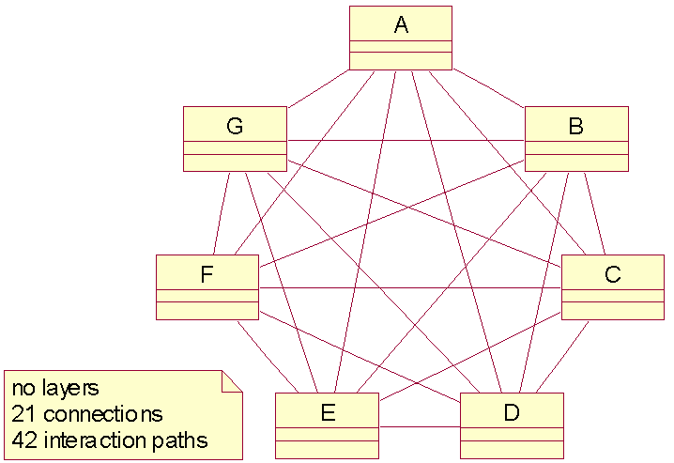
Structural complexity of networks
Notes:
Note that we measure the complexity with regard to the number of classes, not objects. In programs, the objects – not the classes – send messages to other objects, of the same or different class. This introduces additional difficulty to the programmer responsible for delivering the application logic and managing the program’s variables and other data structures. The main challenge, however, is not an individual program’s complexity but the complexity of the entire system of programs.
An object can only send a message to another object if there is a persistent or transient link between them. The transient (run-time) links are resolved within a single program invocation and, therefore, they do not add to the complexity of the whole system. The persistent (compile-time) links, on the other hand, exist only if there is a connection (e.g. association) defined in the class model. The classes can be shared and reused across many programs.

Slide 17


Structural complexity of hierarchies
First part of the formula computes the number of potential single-directional paths between all classes in each layer.
Second part of the formula computes the number of potential single-directional paths between the classes in each two adjacent layers.

Slide 18
Design Patterns
“Each pattern describes a problem which occurs over and over again in our environment, and then describes the core of the solution to that problem, in such a way that you can use this solution a million times over, without ever doing it the same way twice.”
– Christopher Alexander. A Pattern Language. Oxford University Press, 1977.
A solution to a problem in a context.

Slide 19
Design Patterns Motivation
Software Design is Hard
Software is soft – it changes early and often
Software is peopleware – designers are people
But successful designs (and designers) do exist!
So how can we capture their knowledge to build software?
Inspiration
Christopher Alexander – 60’s architect
with all that implies ...

Slide 20
Design Patterns Aims
Transmit design experience
So that real human programmers can use it
Build up an engineering handbook for software
Establish a working vocabulary for program design
Build flexible, long-lived software
Reusable — reuse implies change

Slide 21
A Common Language
Patterns form a common language within which to think and talk about programming
For example
Each window is a composite, with decorators providing titles and scroll bars
To save memory, each image is a flyweight

Slide 22
Patterns Capture Hidden Structure
Patterns tend to cut across the predominant partitioning of the subject area
addressing system problems and relationships that may be obscured by the perspective from one part of the system
Patterns complement OO design
focusing on important constructs that help objects to work together more effectively

Slide 23
Pattern Form
Pattern Name
short descriptive moniker to identify and describe it
e.g. Capacity Bottlenecks, Chicken and Egg, …
Intent
short statement summarising what problem it solves
e.g. Builder – Separate the construction of a complex object from its representation so that the same construction process can create different representations.
Problem
description of the problem to be solved
may be a short question or problem summary
may be a paragraph illustrating a need

Slide 24
Pattern Form – cont.
Context
history of other patterns that were applied to this problem
specifies constraints that may invalidate the pattern
critical section for understanding a pattern
Forces
describes what makes the problem difficult
provides understanding of how to tailor the pattern
e.g. For a peripheral to be able to reject new work when the system is overloaded, it must be able to recognize when the system is overloaded. But having the bottleneck processor take up valuable time to inform the peripherals would further reduce its capacity. …

Slide 25
Pattern Form – cont.
Solution
provides the detail so that a designer knows how to solve the problem, but is not specific to one domain
Sketch
visual description of the solution
typically class and interaction diagrams, but any diagram that aids understanding may be used
should not be so detailed as to constrain the solution
Resulting Context
indicates what forces were resolved
new problems that may arise from using this pattern
what other patterns could be used in conjunction with this pattern

Slide 26
Architectural patterns
When used in the context of architectural design, a design pattern is called an architectural pattern.

Slide 27
Observer Pattern
Common problem: synchronising state and/or responses across a collection of objects in response to an event
When there are changes in the state of the Subject, we keep the Observers up to date
Observers watch or listen for changes…
Also known as a broadcast-subscription model
Scenario 1: Weather monitoring system
Sensor notes change in temperature (Subject)
Observers: Client GUIs displaying temp
Observers: Weather modelling systems

Slide 28
Observer Pattern Structure

Slide 29
Observer Pattern
aConcreteSubject :
aConcreteObserver :
anotherConcreteObserver :
attach(aConcreteObserver)
attach(anotherConcreteObserver)
setState()
notifyObservers()
A collection of observers
update()
getState()
update()
getState()

Slide 30
How it Works
Work with Subject and Observer classes, and specify the relationships between them
In GUI libraries, this is usually done via an Interface
ActionListener, WindowListener, TextListener, …
Subject has one or more Observers
Subject will notify the Observers when things change
In response, Observers will update
Update can be a query of the Subject state
Or simply a specified action (usual for buttonClicks, say)
The magic behind GUI events and responses

Slide 31
Observer: GUI Conceptually
EmployeeDAO
EmployeeDisplayForm
Employee
Subject
Observer
Notes:
Employee is given to EmployeeDisplayForm as a concrete Subject.
Employee only knows of EmployeeDisplayForm as an Observer.

Slide 32
Observer & GUIs
Most GUIs use the Observer pattern
But, they need to know where to display each part of an object
window / form will have many widgets
need to identify which fields are displayed in which widget
See Properties, Bindings and Views in JavaFX

Slide 33
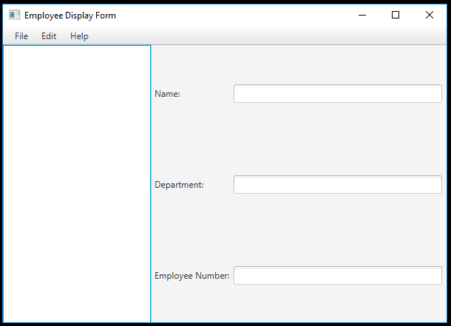
Observer & GUIs
Each widget is an observer
Model is a Bean
properties are Observables

Slide 34
Observer in Architecture
Subject
+attach(Observer):void
+detach(Observer):void
+notify():void
«interface»
Observer
+update():void
observers
*
RealTimeTempField
+update():void
MonitoredTemp
-temperature : int
+getTemp():int
+setTemp(newTemp : int):void
subject
HeaterController
-heater : HeatingUnit
+update():void
subject

Slide 35
: MonitoredTemp
h : HeaterController
: Heater
r : RealTimeTempField
attach(h)
attach(r)
setTemp(25)
notify()
update()
getTemp()
25
turnOff()
update()
getTemp()
25
display()

Slide 36
Pros & Cons
Very loose coupling between Subject and Observers
but tight coupling between observers and subject
New observers can be added without changing Subject
Objects which change the state of the Subject may be completely unaware of the Observer collection
may be a far greater impact than local change

Slide 37
Façade
“a higher-level interface that makes the subsystem easier to use”.
The goal is to “minimize the communication and dependencies between subsystems”.

Slide 38
Façade example

Slide 39
Abstract Factory
Provides “an interface for creating families of related or dependent objects without specifying their concrete classes”
Enables the application to behave differently by accessing one of several families of objects hidden behind the abstract factory interface
a configuration parameter value can control which family should be accessed
A variation of the Façade pattern

Slide 40
Abstract Factory

Slide 41
Abstract Factory example

Slide 42
Chain of Responsibility
“Avoid coupling the sender of a request to its receiver by giving more than one object a chance to handle the request”
Variant of the concept of delegation
Implemented by a common interface or container-contained model
messages not handled by one object are sent to the next in the chain until a suitable handler is reached

Slide 43
Chain of Responsibility

Slide 44
Chain of Responsibility example

Slide 45
Mediator
“Promotes loose coupling by keeping objects from referring to each other explicitly, and it lets you vary their interaction independently”
Place complex processing rules, including complex business rules, in dedicated Mediator class(es)
relieves other implicated objects (called colleagues in the pattern) from doing the processing by exchanging possibly very many messages to do the job
colleague objects become more independent from the business rules and, therefore, more reusable

Slide 46
Mediator

Slide 47
Mediator example

Slide 48
Model – View – Controller (MVC)
One of the first architectural patterns
developed by the Smalltalk community
Model – the application or data object
View – its screen presentation
Controller – defines how the user interface reacts to input
When the Model’s data changes it notifies its Views. Each View can then update itself.
allows multiple Views on a single Model
View uses a Controller object to implement a particular response strategy. To implement a different strategy, simply replace the Controller.
can be done at run-time

Slide 49
MVC
Views
c
a
b
a
b
c
Model

Slide 50
MVC – Internal Patterns
MVC uses a number of design patterns internally
Most significant ones
Observer, Composite and Strategy
Others
Factory Method and Decorator
See the Gamma text for more details of these design patterns

Slide 51
Pattern Languages
Collection of patterns that build on each other to generate a system
patterns solve single problems
pattern languages make patterns more powerful
Provides relationships between patterns indicating when to use other patterns to resolve different forces
top level pattern attacks the broad problem
it points to smaller patterns that refine the solution for specific contexts

Slide 52
Pattern Language Example
Minimize Human Intervention
Sico First
and Always
Five Minutes of
no Escalation
Messages
Fool me
Once
People
Know Best
Riding Over
Transients
Try all
Hardware Combos
Leaky Bucket
Counters

Slide 53
Generative Patterns
The structures of these patterns are not solutions, instead they generate solutions
it is a means for letting the problem resolve itself over time
Why are generative patterns important?
most real problems go deeper than their surface symptoms
Name: Hands in View
Problem: The skier fails to commit downhill resulting in slides, backward falls and “yard sales”.
Solution: Concentrate on keeping the hands in view. Bring them into sight immediately after each pole plant and turn.

Slide 54
References
Design Patterns – Elements of Reusable Object-Oriented Software
Gamma, Helm, Johnson, Vlissides
text and CD
Patterns of Enterprise Applications Architecture
Fowler
Pattern Languages of Program Design
volumes 1 to N
Pattern Hatching: Design Patterns Applied
Vlissides
Hillside Group patterns pages
http://hillside.net/

Slide 55
Being Patterns Literate
Keep a journal
collect design patterns that you use
or that you see others using
Read about other developers / designers and note what they do
Read Gang of Four!
play Patterns Pursuit ©

Slide 56
Review Quiz 6.2
What are the two main, and contrasting, computational models?
Is structural complexity computed with regard to program’s classes or program’s objects?
What is the name of the pattern that defines a higher-level interface that makes the subsystem easier to use?
Which pattern makes it possible to enforce the NCP (neighbor communication) principle?
Notes:
The Turing machine model based on algorithms and an open interaction model.
Classes.
The Façade pattern.
Chain of Responsibility.

Slide 57
3. Architectural Modelling
Architectural modelling is supported by facilities for implementation modelling
Beyond implementation models, UML supports architectural modelling through constraints designed into class diagrams

Slide 58
Packages
Represent group of classes (or other modeling elements, e.g. use cases)
Can be nested
Relationships
dependency, nesting and generalisation
Element can only be owned by one package, but can “appear” in other packages
Notes:
In UML, architectural modeling is supported by facilities for implementation modeling (Section 3.2.6). Implementation models are centered on such concepts as a node, component, package, subsystem. Beyond implementation models, UML supports architectural modeling through various constraints designed into class diagrams. The main such facility is the visualization of dependency relationships in class and other models.

Slide 59
Packages – example

Slide 60
Components
Component – deployable part of the system, piece of implementation, software program
Unit of independent deployment (never deployed partially).
Unit of third-party composition (i.e. sufficiently documented and self-contained to be ‘plugged into’ other components by a third-party).
Has no persistent state (i.e. cannot be distinguished from copies of its own).
Replaceable part of a system, i.e. it can be replaced by another component that conforms to the same interface.
Fulfills a clear function and is logically and physically cohesive.
May be nested in other components.
Notes:
Components are typically perceived as binary executable (EXE) parts of the system. But the component can also be a part of the system that is not directly executable (e.g. a source code file, data file, DLL (Dynamic Link Library), or database stored procedure).
A component diagram shows components and how they relate to each other. Components can be related by dependency relationships. A dependent component requires the services of the component pointed to by the dependency relationship. The use of dependency relationships on components has been discussed in Section 3.2.6.2.

Slide 61
Component versus package
At the logical level, every class belongs to a single package
At the physical level, components are implemented by at least one class
components provide services, delivered by class operations
should accessed via an interface
Packages are typically larger architectural units than components
tend to group classes in a horizontal way – by static proximity of classes in the application domain
Components are vertical groups of classes with behavioural proximity
may come from different domains but they contribute to a single piece of business activity, perhaps a use case

Slide 62
Package and components – example

Slide 63
Component versus class and interface
Like classes, components realise interfaces
Difference 1
component is a physical abstraction deployed on some computer node
class represents a logical thing that has to be implemented by a component to act as a physical abstraction
Difference 2
component reveals only some interfaces of the classes that it contains (other interfaces are encapsulated by the component and (if the component is re-used) may not be even accessible to the developer, never mind the user)
interface (set of visible methods) that a component realizes may be implemented in a separate class
dominant class (dominant class represents the interface of the component)
class manifests all its interfaces to the developer
but not necessarily to the user

Slide 64
Component interfaces – example

Slide 65
Nodes
Node is a computational resource (a run-time physical object) in a deployment diagram
has memory and some computing capability
connection relationships link the nodes

Slide 66
Components and nodes
Nodes are locations on which components run (components are deployed on a node)
A node, together with its components, is sometimes called a distribution unit

Slide 67
Review Quiz 6.3
What kinds of relationships are used to relate packages?
Does a component have a persistent state?
Can a class implement more than one component?
Notes:
Generalization and dependency relationships.
No, it does not (the component cannot be distinguished from copies of its own; in any given application, there will be at most one copy of a particular component).
Yes, it can.

Slide 68
4. Principles of program design and reuse
Program design concentrates on one application program at a time.

Slide 69
Program design – overview
System design
architectural structure → framework
architectural detail → framework’s front-end (GUI) and back-end (database)
program design → extends GUI and DB design and concentrates on one application program at a time
Program’s execution logic is split between client and server processes
based on architectural structure

Slide 70
Class cohesion and coupling
Good program design ensures well-balanced cohesion and coupling of classes
Class cohesion is the degree of inner self-determination of the class
measures class independence
the stronger the cohesion the better
Class coupling is the degree of connections between classes
measures the class interdependence
the weaker the coupling the better
however, the classes have to be ‘coupled’ to cooperate

Slide 71
Cohesion and coupling heuristics
Two classes should either not be dependent on one another or one class should be only dependent on the public interface of another class
Attributes and their related methods should be kept in one class
this heuristic is frequently violated by classes that have many public accessor (get, set) methods
A class should represent a single logical concept
unrelated information, e.g. when a subset of methods operates on a proper subset of attributes, should be moved to another class
System logic should be distributed as uniformly as possible
classes share work uniformly

Slide 72
Measuring Cohesion
Technique to determine if a class is functionally cohesive is to write a sentence describing the purpose of the object
Short, clear and unambiguous description implies good cohesion
If the sentence is a compound sentence, contains a comma, or more than one verb, then it is probably performing more than one function and is probably sequential or communicational cohesive
If the sentence contains time related words (such as first, next, then, etc.) then it is probably sequential or temporal cohesive
Words like Initialise, clean-up, etc. imply temporal cohesion
If the predicate doesn’t contain a single specific object following the verb, it is probably logically cohesive
Functionally cohesive classes can always be described by way of their elements using a compound sentence
But, if the above language is unavoidable while still completely describing a class’ purpose, then the class is probably not functionally cohesive

Slide 73
Kinds of class coupling
X contains Y or it has an attribute (data member or instance variable) that refers to an instance of Y
X has a method that references an instance of Y by any means, such as it uses a parameter or local variable of type Y or the object of type Y was returned to it from a message
X calls on services of (sends messages to) Y
X is a direct or indirect subclass of Y
X has a method with an input argument of class Y
Y is an interface and X implements that interface

Slide 74
Law of Demeter
Target of a message can only be one of the following objects
The method’s object itself
this in C++ and Java
self and super in Smalltalk
Object that is an argument in the method’s signature
Object referred to by the object’s attribute (including an object referred to within a collection of attributes)
Object created by the method
Object referred to by a global variable
Strong Law of Demeter restricts the coupling induced by inheritance by limiting the third rule to the attributes defined in the class itself

Slide 75
Accessor methods and mindless classes
A class should decide its own destiny
class can restrict other classes from accessing its own state by limiting the accessor methods in its interface
accessor methods define the observer (get) or mutator (set) operations
Class with many accessor methods risks becoming mindless
There are situations when a class has to open up to other classes
whenever there is a need to implement a policy between two or more classes
Notes:
Suppose that we have two classes Integer and Real and we need to implement a ‘policy’ for the conversion between integer and real numbers. In which of the two classes is the policy to be implemented? Do we need a Converter class to implement the policy? Either way, at least one of these two classes must allow accessor methods and it will then become ‘mindless’ with regard to that policy.
A famous quote from Page-Jones is in place: ‘On an object-oriented farm there is an object-oriented milk. Should the object-oriented cow send the object-oriented milk the uncow_yourself message, or should the object-oriented milk send the object-oriented cow the unmilk_yourself message?’ (Page-Jones at OOPSLA’87.)

Slide 76
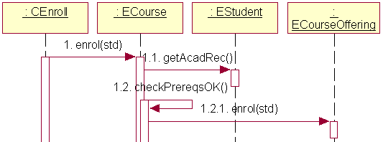
ECourse as policy maker
Notes:
Example 6.4 (University Enrolment)
Assume that we need to add a student to a course offering. To do so, we need to do two checks. Firstly, we have to find out prerequisite courses for the course offering. Secondly, we have to check the student’s academic record to establish whether the student satisfies the prerequisites. With this knowledge, we can decide whether the student can be added to the course offering.
Consider that a message enrol() is to be sent by a control object :Cnrol. Consider that three classes – ECourseOffering, ECourse, and EStudent – collaborate to accomplish the task. EStudent knows how to get the academic record, and ECourse knows how to find its prerequisites. Our task is to design a range of possible interaction diagrams to solve the problem. Discuss the pros and cons of different solutions.
Figure 6-15 illustrates the first solution by means of both a sequence diagram and a collaboration diagram. The control object CEnroll initiates the transaction by sending the enrol() message to ECourse. ECourse asks EStudent for the academic record and checks it against its prerequisites. ECourse decides if EStudent can be enrolled and requests that ECourseOffering adds EStudent to its list of students.
The scenario in Figure 6-15 gives too much power to the class ECourse. ECourse is the policy maker. EStudent is mindless. The solution is unbalanced but there is no clear way out.

Slide 77
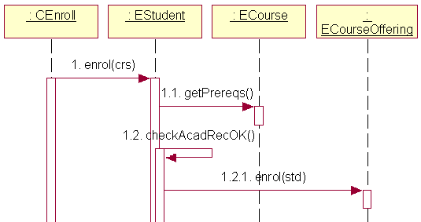
EStudent as policy maker
Notes:
We could switch the emphasis from ECourse to EStudent to obtain the solution presented in Figure 6-16. Now CEnroll asks EStudent to do the main job. EStudent invokes an observer method getPrereq()on ECourse. EStudent decides if the enrolment is possible and instructs ECourseOffering to enroll the student.

Slide 78
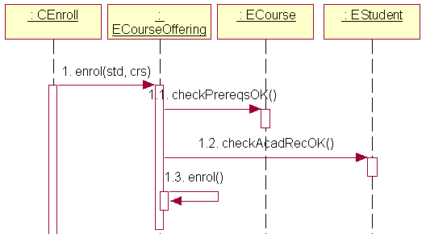
ECourseOffering as policy maker
Notes:
Figure 6-17 illustrates a more balanced solution in which ECourseOffering is the policy maker. The solution is impartial with regard to ECourse and EStudent but it makes these two objects quite idle and mindless. ECourseOffering acts like the ‘main program’ (a ‘God’ class in Riel’s parlance (Riel, 1996)).

Slide 79
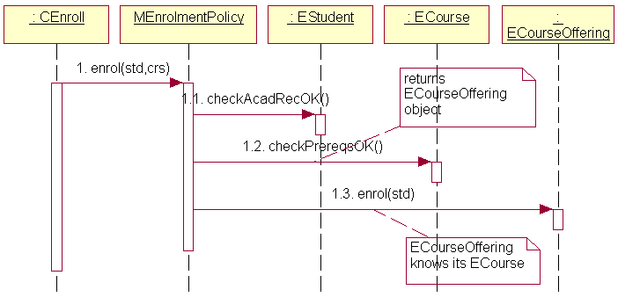
MEnrolmentPolicy as policy maker
Notes:
All solutions so far are distributed in nature, very much as advocated in Section 4.3.3.3. A centralized solution is also possible. Such a solution could rely on CEnroll as the policy maker. However, a better approach would be to have separate class for the task. Such class could be placed in the PCMEF’s mediator layer and could be called MEnrolmentPolicy.
The mediator class MEnrolmentPolicy in Figure 6-18 decouples the three entity classes from the enrolment policy. This is beneficial because any changes to the enrolment policy are encapsulated in a single mediator class. However, there is a risk that the class MEnrolmentPolicy can grow into a ‘God’ class.

Slide 80
Dynamic classification and mixed-instance cohesion
Dynamic classification (object can dynamically change its class) if not supported → mixed-instance cohesion
class with mixed-instance cohesion has some features that are undefined for some objects of the class
partial solution is to extend generalization hierarchy by identifying new subclasses
Evening course offerings are only available to part-time students.
There is a small extra fee if a part-time student wants to enroll in an evening course offering.
Notes:
Some methods of the class apply only to a subset of objects in that class and some attributes make sense only for a subset of objects.
For example, the class Employee may define objects that are ‘ordinary’ employees and managers. A manager is paid an allowance. Sending a message payAllowance to an Employee object does not make sense if that Employee object is not a manager.
To eliminate the mixed-instance cohesion, we need to extend the generalization hierarchy to identify Employee subclasses such as OrdinaryEmployee and Manager. However, an Employee object may be an OrdinaryEmployee one day and a Manager another day, or vice versa. To eliminate the mixed-instance cohesion we need to allow objects to dynamically change classes at run time – the proverbial catch-22 situation, if dynamic classification is not supported.

Slide 81
Further reduction of mixed-instance cohesion
A part-time student may have a preference for daytime course offerings (i.e. eveningPreference = ‘False’) and no extra fees are then paid
Notes:
Figure 6-20 extends the design to eliminate this second aspect of mixed-instance cohesion. The class DayPrefPartTimeStudent does not have the method payExtraFee(crsoff). But what if a DayPrefPartTimeStudent is forced to take an evening course offering because there are no more places available in daytime course offerings? Perhaps, some other fee would then apply. Should we specialize further to derive a class UnluckyDayPrefPartTimeStudent?
The alternative is to restrict the depth of the inheritance hierarchy, eliminate the need for dynamic classification, and reintroduce a certain amount of mixed-instance cohesion. For example, we can hang on to the class model in Figure 6-19 and resolve the problem of the evening preference by allowing an object to respond differently to the message payExtraFee(crsoff) depending on the value of the attribute eveningPreference. This can be programmed with an if statement as shown in the pseudocode below:
method payExtraFee(crsoff) for the class PartTimeStudent
if eveningPreference = ‘False’
return
else
do it
end method
Although the use of if statements in an object-oriented code signifies an abandoning of inheritance and polymorphism, it may be unavoidable for purely pragmatic reasons. Rather than struggling with the dynamic classification, the programmer introduces the dynamic semantics to a class. An object responds differently to the same message depending on its current local state. A statechart diagram would be used to design the dynamic semantics for the class. Admittedly, the cohesion of the class suffers in the process.

Slide 82
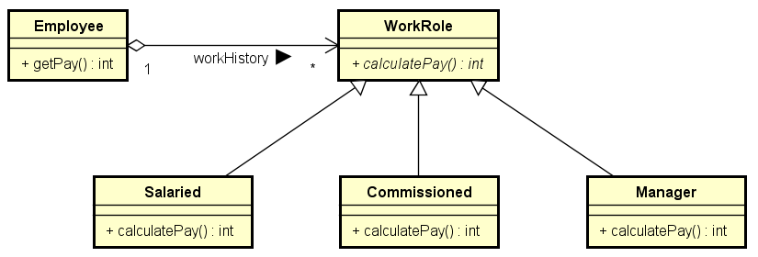
Roles for Dynamic Classification
Statically typed languages
Often a role can capture dynamic nature of classification

Slide 83
Reuse Strategy
Reuse granularity
the class
the component
the solution idea
Reuse strategies
Class libraries
Frameworks
Analysis and design patterns

Slide 84
Class Libraries
Class libraries emphasise code reuse at a class level
programmer ‘fills the gaps’ in the program by making calls to concrete classes in some library of classes
main body of the program is not reused – it is written by the programmer
Two kinds (levels) of class libraries
Foundation libraries
foundation classes provided by object programming environments
e.g. collections (such as Set, List or Index)
Architecture libraries
available as part of a system software
e.g. object database system

Slide 85
Framework reuse
A framework emphasises design reuse at a component level
framework provides the skeleton of the program
programmer ‘fills the gaps’ in this skeleton (customizes it) by writing the code that the framework needs to call
A framework is a customisable application software
e.g. ERPS (Enterprise Resource Planning Systems) such as SAP, PeopleSoft, Baan, or J.D. Edwards
Object-oriented frameworks for IS development (“business objects”) are proposed within distributed component technologies such as J2EE/EJB and .NET
Notes:
Apart from concrete classes (for the framework itself), a framework provides a large volume of abstract classes to be implemented (customized) by the programmer.
While frameworks are an attractive reuse proposition, they also have a number of drawbacks. Perhaps the most significant one is that the generic ‘lowest common denominator’ solutions, which they deliver, are sub optimal or even obsolete. As a result, they do not give a competitive advantage to their adopters and can create a maintenance burden when chasing state-of-the-art solutions.

Slide 86
Pattern reuse
A pattern is a documented solution that has been shown to work well in a number of situations
Patterns emphasize application of reuse to the development approach
represent good development practices
can apply to the analysis or design phase (hence, analysis patterns and design patterns)
Notes:
Pattern reuse is largely conceptual, though many design patterns contain sample code for the programmer’s reuse. The scope of a design pattern (e.g. Gamma et al., 1995) is that of an interaction sequence – typically larger than a class but smaller than a component. The scope of an analysis pattern (e.g. Fowler, 1997) depends on the level of modeling abstraction at which the pattern applies.

Slide 87
Review Quiz 6.4
What term is used to define the degree of inner self-determination of the class?
Mixed-instance cohesion results from a particular weakness of object-oriented programming environments. What is that weakness?
How can the design reuse at the component level be called?
Notes:
Class cohesion.
The lack of support for dynamic classification.
Framework reuse.

Slide 88
5. Collaboration Modelling
In passing, we have used the term collaboration freely, sometimes exchangeably with the term interaction.
Starting from UML 2.0, the notion of collaboration has gained precision and has been placed within the context of so called composite structures.

Slide 89
Composite structure and collaboration
Composite structure refers to “a composition of interconnected elements, representing run-time instances collaborating over communications links to achieve some common objectives.”
“Collaboration describes a structure of collaborating elements (roles), each performing a specialized function, which collectively accomplish some desired functionality. … A collaboration is represented as a kind of classifier and defines a set of cooperating entities to be played by instances (its roles), as well as a set of connectors that define communication paths between the participating instances.”

Slide 90
Collaboration
Role
may have a type to which the instances of the role are bound
type is a classifier, typically a class
meaningful only within a collaboration (the same object can play different roles in different collaborations)
Connector – a relationship between two roles
meaningful only within a collaboration
“may be an instance of an association, or it may represent the possibility of the instances being able to communicate because their identities are known by virtue of being passed in as parameters, held in variables or slots, or because the communicating instances are the same instance.”

Slide 91
Collaboration – example

Slide 92
Composite structure
Alternative notation to model collaborations
A kind of a class diagram
Frequently modeled in parallel with interaction diagrams
Useful to represent a collaboration as a reusable pattern

Slide 93
Composite structure – example

Slide 94
Composite collaboration
Composite collaboration
consists of (is implemented in terms of) subordinate collaborations
can represent a use case and subordinate collaborations can represent requirements of the use case
can show a nested structure of subflows and requirements of a use case

Slide 95
Composite collaboration – example

Slide 96
Use case document – example
Use Case | CRUD Product
Brief Description | This use case enables the user of the AE system to maintain information about products. It includes facilities to view (read) a list of products, create a new product, delete a product and update the information about a product.
Actors | Data Collection Employee, Data Verification Employee, Valorization Employee, Reporting Employee
Preconditions | The actor possesses system privileges to maintain products. Any Employee can view a list of products. Only Data Collection and Data Verification Employees can create, update or delete products.
Main Flow | Basic Flow This use case starts when an Employee chooses to work with Products by selecting the Maintain Products option of the AE system. The system retrieves and displays the following information for all products in a browse window. The Read Products subflow is performed.

Slide 97
Use case document – example (cont.)
Use Case | CRUD Product
Main Flow | Basic Flow Subflows 2.1 Read Products The following information is displayed in the AE Row Browser window: product_name, category_name, notes, created_by, last_modified_by, created_on, last_modified_on. The information is displayed in a tabular (columns and rows) view, with vertical and horizontal scroll bars, if necessary. The display is named Products and all columns are named. ...
Alternative Flows | AF1 The system will not allow creating/updating a product with product_name that already exists in the database. AF4 The system will not allow opening any two update/delete dialog box windows for the same product by more than one user.
Postconditions | After a product is successfully created/updated, the browser window highlights the row with that product information. After a product is successfully deleted, the browser window is refreshed and highlights the first visible row.

Slide 98
GUI – example

Slide 99
Collaboration model – example

Slide 100
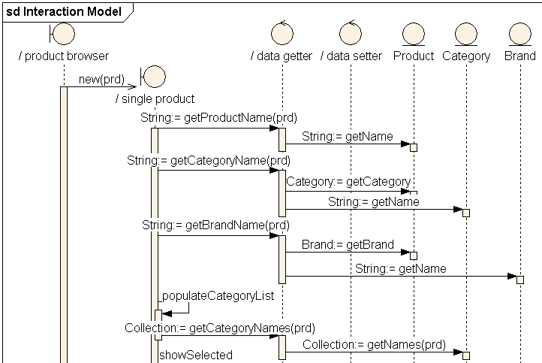
Sequence diagram – example (excerpt)

Slide 101
Composite structure diagram – example

Slide 102
Review Quiz 6.5
In what collaboration model are the roles always typed (have a type explicitly defined)?
Do collaboration models identify messages?
Notes:
Composite structure diagram.
No, they do not. Interaction models serve that purpose.

Slide 103
Summary
Typical IS applications are based on the client/server architectural principle
Most important mechanism for handling software complexity is hierarchical layering of system architectures.
Architectural modeling encompasses allocation of software elements (classes, interfaces, etc.) into packages, components and nodes
A well-designed program maximizes class cohesion while minimizing class coupling
Reuse is a major design consideration affecting the architectural as well as the detailed design issues
Detailed design concentrates on collaborations
collaboration model specifies roles and the connectors between the roles needed to accomplish some desired functionality.
composite structure diagrams can be used to visualise collaborations.
there are well-defined mappings between the use cases and collaborations, collaborations and interactions, and interactions and composite structure.

