Slide 1
MACIASZEK, L.A. (2007): Requirements Analysis and System Design, 3rd ed. Addison Wesley, Harlow England ISBN 978-0-321-44036-5
Chapter 7 Graphical User Interface Design
© Pearson Education Limited 2007

Slide 2
Topics
From GUI prototype to implementation
Guidelines for GUI design
Desktop GUI design
Web GUI design
Modeling GUI navigation

Slide 3
1. Principles of GUI design
GUI clients can be divided into programmable clients on desktop platforms and browser clients on Web platforms
GUI design is a multidisciplinary activity.

Slide 4
About user interfaces
Server solutions make the software
Client solutions sell the software
Programmable client – a thick client with a program residing and executing on it and with access to the client’s machine storage resources
Browser client – a thin client (e.g. web client) representing a web-based UI and using server to obtain its data and programs
UI design is a multidisciplinary activity

Slide 5
From UI prototype ...

Slide 6
... via design ...
Notes:
Figure 7-2 shows how Maintain Organization window can potentially be presented during the system design phase. As can be seen, the designer opted for a dialog box with tabbed pages and a number of other look-and-feel changes. The changes have been made to conform to the Microsoft Windows GUI design principles and to accommodate functional requirements overlooked in the initial prototype.
The design in Figure 7-2 still has problems with regard to the look-and-feel, implementation constraints, as well as with regard to satisfying functional requirements. As a result, the final implemented window is again different, as demonstrated in Figure 7-3.

Slide 7
... to implementation
Notes:
The implemented window in Figure 7-3 disallows a drop-down list for selecting organization name (a dialog box is a secondary window opened to allow updating a particular organization). The classification possibilities of organization are now disabled for editing (because an organization cannot have its classification changed by the user of this system). Other changes include larger sizes of fields, introduction of a group of fields called History, etc.

Slide 8
Guidelines for good GUI design
User in control
Consistency
Personalization and customization
Forgiveness
Feedback
Aesthetics and usability

Slide 9
User in control
User’s perception of control
No mothering
Feedback (an hourglass, wait indicator, or similar)
GUI window
GUI window
SQL
SQL
Procedure
Procedure
User event
User event
Rule or
User event
exit processing
User event
Perform
Perform
GUI
GUI
event
User event
event
User event
User event
User event
Call to window
Call to window
Call to external
Call to external
program
Call to SQL
program
procedure
procedure
GUI window
GUI window
External program
SQL Procedure
External program

Slide 10
Consistency
Conformance to the GUI vendor’s standards
Conformance to the naming, coding and other GUI-related standards developed internally by the organization
GUI developer must not be too creative or innovative in the interface design!

Slide 11
Personalisation and customisation; forgiveness
Personalisation and customisation = adaptability
GUI personalisation – customisation for personal use
includes the user’s locale information
GUI customisation – administrative task of tailoring the software to different groups of users
Forgiveness
support for an explorable interface
multi-level undo operation
Notes:
An example of personalization is when a user reorders and resizes columns in a row browse (grid) display and saves these changes as his/her personal preference. Next time the program is activated, the personal preferences are taken into account.
An example of customization is when the program can operate differently for novice and advanced users. For instance, the novice users may be offered an explicit help and extra warning messages for user events perceived to be dangerous.
The implementation of forgiveness into the interface is a particular challenge in multi-user database applications. The user who withdrew (and spent) money from the bank account cannot possibly undo this operation! He/she can only rectify the problem by depositing the money back into the account in another transaction. Whether or not a forgiving interface should be warning the user of the consequences of cash withdrawal is a debatable issue (and the one that relates to the personalization guideline).

Slide 12
Feedback; Aesthetics and usability
Feedback
spin-off of the first guideline – the user in control
visual and/or audio cues to inform the user of what’s going on when the control is temporarily with the program
Aesthetics and usability → user satisfaction
Aesthetics are about the system’s visual appeal
Usability is about the ease, simplicity, efficiency, reliability, and productivity in using the interface
Notes:
There are many golden rules for an aesthetic and usable design (Galitz, 1996; Constantine and Lockwood, 1999). The issues to consider include the fixation and movement of the human eye, the use of colors, the sense of balance and symmetry, the alignment and spacing of elements, the sense of proportion, the grouping of related elements, etc.
The guideline of aesthetics and usability turns the UI developer into an artist. It is good to remember in this context that ‘simple is beautiful’. In fact, simplicity is frequently considered as yet another UI guideline, strongly related to the aesthetics and usability guideline. Simplicity in complex applications is best achieved by the ‘divide and conquer’ approach – the progressive disclosure of information so that it is shown only when needed, possibly in separate windows.

Slide 13
Review Quiz 7.1
How are GUI clients classified?
What is the principal GUI design guideline?
What user guideline is most closely related to the guideline of user in control?
Notes:
GUI clients are classified into programmable clients on desktop platforms and browser clients on
Web platforms.
User in control.
Feedback.

Slide 14
2. Desktop GUI design
Two main aspects of UI design: design of windows and design of windows’ input and editing controls
GUI containers - primary and secondary windows
Together, containers, menus, and controls constitute GUI components - theSwing library

Slide 15
Primary window

Slide 16
Example 7.2 (AE) – primary window

Slide 17
Primary window – row browser

Slide 18
Primary window – multi-pane row browser

Slide 19
Primary window – tree browser

Slide 20
Secondary window
Typically modal with respect to the primary window – user must respond and close the secondary window before interacting with any other window of the application
Modeless secondary windows are possible but not recommended
Does not have any ‘bars’ – a menu bar, toolbar, scroll bars, or status bar
User events are achieved with command buttons (action buttons)

Slide 21
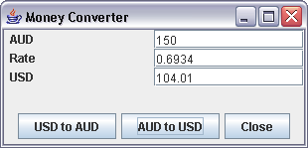
Secondary window – dialog box

Slide 22
Secondary window – tab folder

Slide 23
Secondary window – drop-down list

Slide 24
Secondary window – message box

Slide 25
Menus
Notes:
The UI components include menus and toolbars. In the Java Swing library, the names of the classes imply the provided functionality of menus, e.g. JMenuBar, JMenu, JMenuItem, JCheckBoxMenuItem, JRadioButtonMenuItem.
Menu items are grouped in lists. The lists can be opened by means of actions called pull-down, cascading, or pop-up (the latter is activated by pressing the right mouse button).
Menu items have the responsibility to respond to user events by firing some processing. Normally menu items are launched by the mouse click. More frequently used menu items may have accelerator keys implemented for them. An accelerator key allows launching the menu item from the keyboard without opening the menu list. Also, a quicker access to a menu item in an open list is provided by typing the initial (underlined) letter of the item name.

Slide 26
Toolbars
Notes:
Selecting from menu lists and using accelerator keys are still not the most efficient ways of activating menu actions. For most frequently-used menu items, the UI designer should provide toolbar buttons. A toolbar contains actions and controls that duplicate functionality of most useful menu items.
A toolbar can be placed in a fixed position in the window frame or it can be floatable, i.e. it can be undocked from a frame into a separate small window and position elsewhere on the screen’s real estate (Maciaszek and Liong, 2004). Swing supports toolbars with the JToolBar class. Figure 7-17 shows examples of toolbars.

Slide 27
Buttons and other controls
Notes:
Menus and toolbars are manifestations of event processing implemented in the user interface. Similar manifestation of event processing is provided by UI controls. Controls are designed to intercept, understand, and implement user events. In general, controls can be divided into:
actions buttons (inherited in Swing from an abstract class called AbstractButton)
other controls (inherited directly from a root abstract class called JComponent)
The differences between various buttons are sometimes subtle, so some explanation may be in place. JButton fires an event as soon as it pressed and pops up again (unless the event result in a new window and hides the button). By contrast, JToggleButton remains pushed down (after mouse click at it) until it is pressed again.
JRadioButton and JCheckBox are two categories of JToggleButton. JRadioButton is used to implement a group of buttons such that only one of these buttons is selected at any one time. JCheckBox is an independent control that can be set to either true (with a checkmark) or false (without a checkmark).
JList, JTree, and JComboBox are controls with direct applicability to the implementation of some containers discussed earlier. So, JList is used in the implementation of a row browser (Section 7.3.1.1), JTree in the implementation of a tree browser (Section 7.3.1.2), JComboBox in the implementation of a drop-down list (Section 7.3.2.3).

Slide 28
Review Quiz 7.2
What is the main characteristic that distinguishes primary from secondary windows?
What GUI component is a property page part of?
What GUI component is an accelerator key related to?
Notes:
The existence of the menu bar and toolbar in primary windows.
Property page is Windows’ name for a tab of a tab folder.
Menu item.

Slide 29
3. Web GUI design
Web application is a Web system that allows its users to execute business logic with a web browser
An Internet client browser renders web pages on a computer screen.
Web server delivers the web pages to the browser

Slide 30
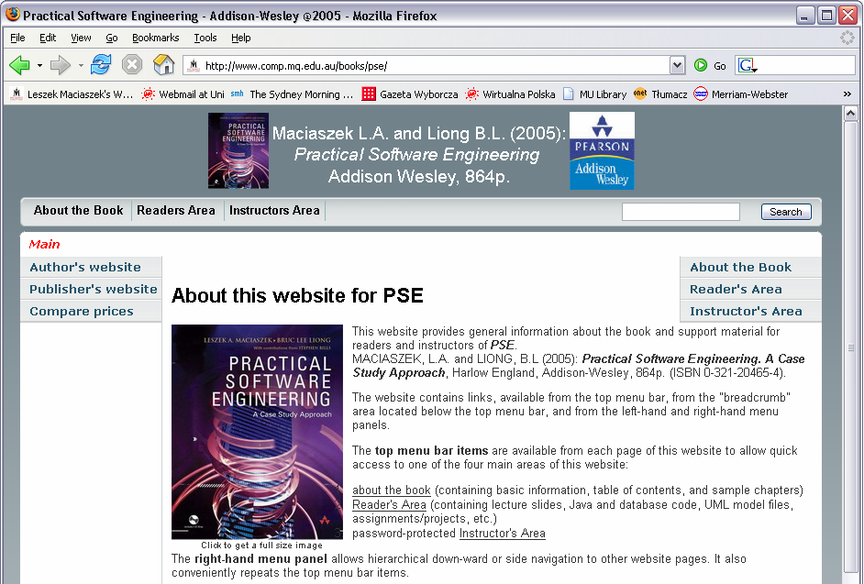
Web page

Slide 31
Web application
Web application
client browser
web server
can include an application server to manage the application logic and to monitor the application state
a simple technique to monitor state is to store a cookie in the browser
Scripts and applets are used to make the client page dynamic
script is a program interpreted by the browser
applet is a compiled component that executes in the browser’s context but it has only limited access to other resources of the client computer (for security reasons)
Server pages – scripts executed by the server on a web page

Slide 32
Web application – enabling technologies
Data access libraries to allow scripts in server pages to access the database
ODBC (Open Database Connectivity)
JDBC (Java Database Connectivity)
RDO (Remote Data Objects)
Enabling technology for the web server – scripted HTML (HyperText Markup Language) pages
ASP (Active Server Pages)
JSP (Java Server Pages)
Enabling technology for web pages
client scripts (JavaScript or VBScript)
XML (eXtensible Markup Language) documents
Notes:
Clients use HTTP (Hypertext Transfer Protocol) to obtain web pages from the web server. The page may be scripted or it may contain compiled and directly executable DLL (Dynamic Link Library) modules, e.g. ISAPI (Internet Server Application Programming Interface), NSAPI (Netscape Server Application Programming Interface), CGI (Common Gateway Interface) or Java servlets (Conallen, 2000).
The cookie serves as a primitive mechanism for maintaining connection between the client and the server in what is otherwise a connectionless Internet system. More sophisticated mechanisms for connecting clients and servers turn the Internet into a distributed object system. In a distributed object system, objects are uniquely identified with OIDs (Section 3.1.1.3) and they communicate by obtaining each other’s OIDs. The principal mechanisms are CORBA, DCOM and EJB. In these technologies, objects can communicate without using HTTP (Hypertext Transfer Protocol) or going through a web server (Conallen, 2000).

Slide 33
Deployment architecture tiers
Client with browser
to display static or dynamic pages
scripted pages and applets can be downloaded and run within the browser
Web server
handles page requests from the browser
dynamically generates pages and code for execution and display on the client
Application server
manages the business logic
indispensable when distributed objects are involved in the implementation
Database server
provides for a scalable storage of data and multi-user access to it
business components encapsulate persistent data stored in a database and communicate with the database server

Slide 34
Content design
How a website’s or Web application’s visual content is presented to a user in a Web browser
The audience of a website or application not known to the designer
Content goals
Billboard
Publishing
Portal
Special interest, public interest and non-profit organizations
Blog
Virtual gallery
E-commerce, catalog and online shopping
Product support
Intranet and extranet

Slide 35
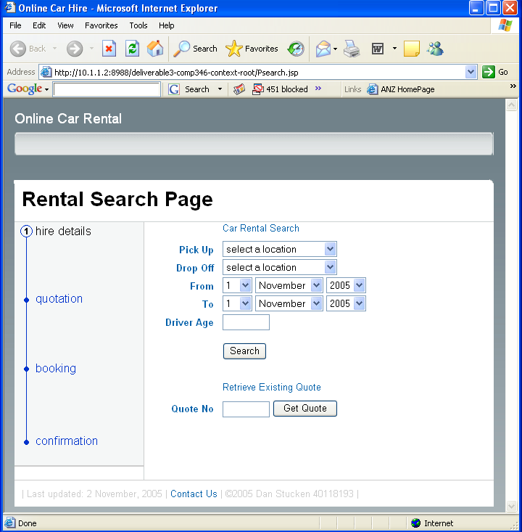
Forms

Slide 36
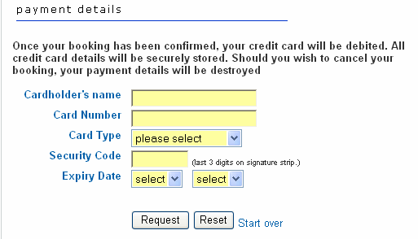
Form fields

Slide 37
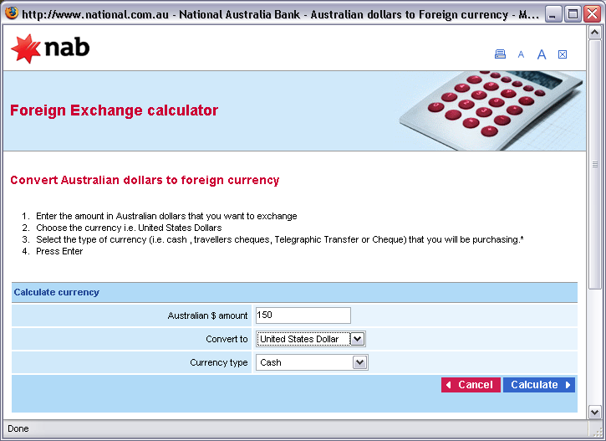
Form design for data entry

Slide 38
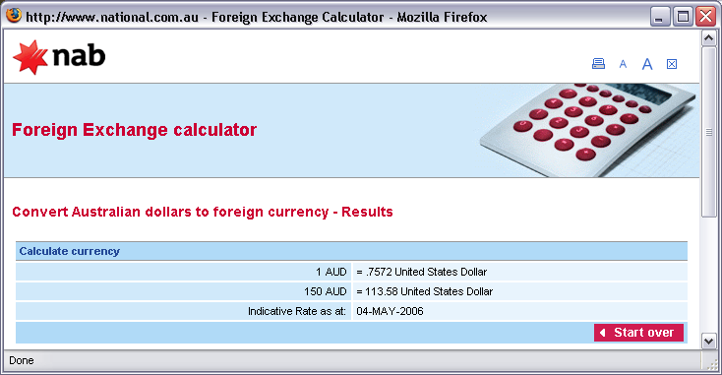
Form design for data display

Slide 39
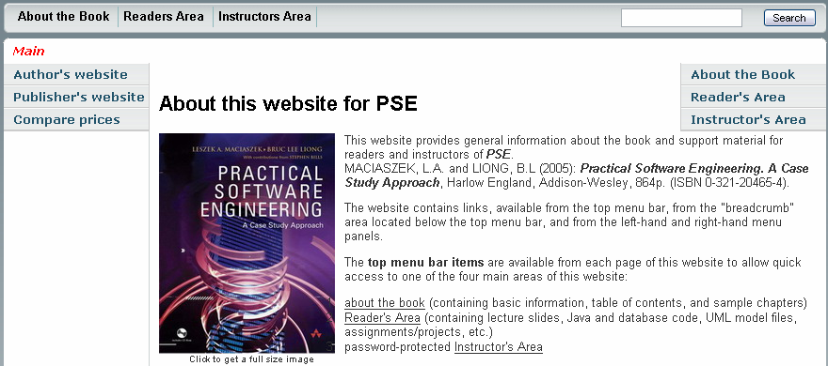
Navigation – menus and links
Left-hand menu
Top menu
Right-hand menu
Links

Slide 40
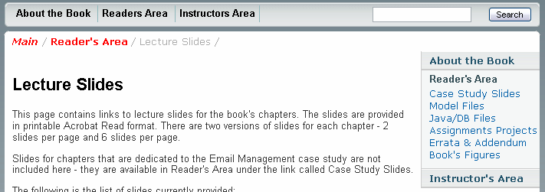
Navigation – breadcrumb and submenu
submenu
breadcrumb

Slide 41
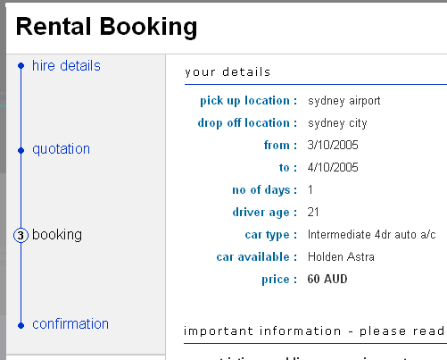
Navigation panel

Slide 42
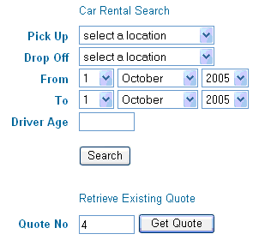
Navigation – buttons
buttons

Slide 43
Using GUI frameworks to leverage Web design
GUI framework – any technology, software library or other GUI-directed system software that developers can use to leverage GUI design
Typical frameworks: the Swing library, Java Server Faces, Struts, Spring and so on
The MVC dilemma – separation and elimination of cycles between Presentation and Control

Slide 44
Addressing the MVC dilemma
Related technologies divide into
centralised (known as Model 1)
decentralised (Model 2)
In Model 1, each Presentation object is paired with a Control object
as in Java Swing or Microsoft Foundation Classes (MFC)
In Model 2, advocated by the Core PCBMER framework, a physical separation exists between Presentation and Control

Slide 45
MVC dilemma – example (initial design)

Slide 46
MVC dilemma – example (dependencies in initial design)

Slide 47
MVC dilemma – example (using Struts)

Slide 48
MVC dilemma – example (dependencies when using Struts)

Slide 49
Review Quiz 7.3
What are the GUI components for programming user events in Web applications?
What is the most primitive mechanism for maintaining a connection between the Web client and the server?
What is the affordance of a link?
Notes:
Menu items, buttons and links.
Cookie.
The affordance of a link is that it moves to another web page.

Slide 50
4. Modelling GUI navigation
To the user, the application appears as a set of collaborating screens (windows or web pages).
The task of the GUI designer is to organize the dependencies between screens in a coherent, easy to understand structure.

Slide 51
Window navigation
GUI design – through prototyping or UI layout tools – does not inform how the windows can be actually navigated by the user
A window navigation model consist of diagrams visualizing screen containers and components and showing how the user can traverse from one window to another
User eXperience (UX) storyboards – a UML profile for window navigation

Slide 52
User experience (UX) storyboards
Add actor characteristics to the use case
Includes definition of actor’s computer familiarity, domain knowledge, frequency of accessing the system, etc.
Add usability characteristics to the use case
Usability characteristics include helpful hints (e.g. how to make the UI easier to use or easier to implement) and any rigorous requirements that must be conformed to (e.g. system response time, acceptable error rates, learning times)
Identify UX elements
Refers to the identification of the UI containers and components
Specially stereotyped class model is used to represent UX elements
Model the use case flows with the UX elements
UX-driven behavioral collaboration modeling
UML sequence and collaboration diagrams are used to depict the interaction between the user and the UI presentation screens or between the presentation screens themselves
Model screen navigation links for the use case
UX-driven structural collaboration modeling
Stereotyped UML class diagrams are used to depict associations along which the navigation between UX elements takes place
Notes:
All in all, the UX storyboards aim at giving justice to the UI design as an inherent part of systems design. They represent the modeling aspects of the UI design and are concerned with issues such as (Kozaczynski and Thario, 2003):
user presentation screens,
user-instigated screen events that the system must react to,
data that the system displays to the screen,
data that the user enters on the screen for further processing,
screen’s decomposition to smaller areas that should be managed separately from other areas,
transitions (navigation) between screens.

Slide 53
Modeling UX elements – class stereotypes
UML classes can be stereotyped as
<<screen>>
defines a window or a web page rendered on the screen
<<input form>>
represents a window’s container or a web page form through which the user can interact with the system by entering data or by activating some actions
<<compartment>>
represents any region of a screen that can be reused by multiple screens (e.g. a toolbar)

Slide 54
Modeling UX elements – field tags
Three most interesting tags specify if a field is
editable
indicates if the field can be modified by the user or not
visible
indicates if the field is displayed on the screen or hidden from the user’s view
but still accessible to the program
selectable
indicates if the field can be selected
highlighted or otherwise shown as active
For example
{editable = true, visibility = visible}
{editable = false, visibility = hidden}
Notes:
Alternatively, the fact that a field is visible can be indicated by marking it with a public visibility icon (a plus (+) symbol in front of the name in the UML standard). For hidden visibility, a private visibility marker (a minus (-) sign) can be used.

Slide 55
Example 7.7 (AE) – UX elements for primary window

Slide 56
Behavioral UX collaboration
Two categories of actions in UX classes
User actions – any UI events coming from the user
Environmental actions – any UI events coming from the system
Navigation to a new screen is one of the most noticeable environmental action
UX profile recommends to distinguish environmental actions with a dollar sign prefixing the action’s name
UX flows of events capture the behavioral aspect of a UX collaboration
UML interaction diagrams (sequence and/or collaboration diagrams) are used to represent UX flows of events

Slide 57
Example 7.4 (CM)

Slide 58
Example 7.4 (CM) – UX elements

Slide 59
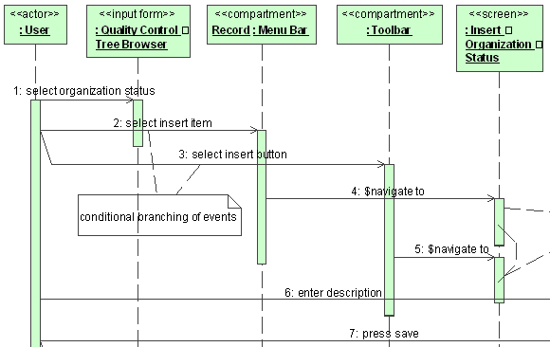
Example 7.4 (CM) – behavioral collaboration

Slide 60
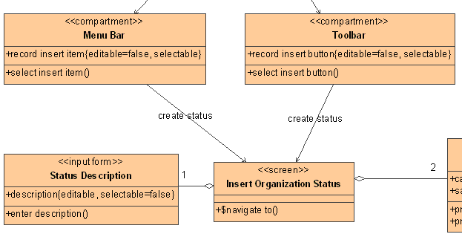
Example 7.4 (CM) – structural collaboration

Slide 61
Review Quiz 7.4
What is the name of a UX stereotype representing screen regions?
How is a hidden field modeled in a UX storyboard?
What UML diagram is used for modeling a behavioral UX collaboration?
Notes:
<<compartment>>.
By a tag value called visible.
Sequence diagram.

Slide 62
Summary
GUI design is a multidisciplinary activity requiring the combined expertise of different professions
Design must adhere to the guidelines published by the manufacturer of a windows interface
Design of a desktop GUI requires familiarity with the various containers and components available for a particular client platform.
Modern web applications place their own demands on UI design
Window navigation captures possible navigation paths between application windows and other UI elements

