Slide 1
Unit Testing (Part 2)
Chapter 4

Slide 2
Overview
Unit Testing Strategy
Drivers and Test Doubles
Test Doubles
Examples and how they can be used to make it easier to test some parts of a system

Slide 3
Learning Objectives
Understand some issues on creating useful unit tests
Identify and choose between different Test Doubles when creating tests

Slide 4
Test Doubles
There are times in testing when we need to use Test Doubles, which are units that are used to replace a real parts of the system for test purposes. Some examples:
Databases
Code that is not ready yet
External hardware
Components that do not return values
The issue is talked about widely in unit testing literature, but there is some different terminology for the same ideas.
We will use the definitions provided by Meszaros, author of xUnit Test Patterns.
Notes:
If you want to learn more about some unit testing approaches after this course, you may find the book a useful list of patterns. Some of the patterns will feel obvious when you read them, but that is partly the point of patterns. The patterns are written down to help document good practice and what has worked in different areas when testing systems. The book is part of a series from the Addison-Wesley publishers, which talks about good engineering practices. It is part of the Martin Fowler series, who is a developer that we will talk about in relation to TDD/Refactoring at the end of this module.

Slide 5
The problem: dependencies
A program can have a lot of dependencies between units

Slide 6
The problem: dependencies
Want to focus on one unit.
How can we decouple the unit and test it?
SUT

Slide 7
The problem: dependencies
Meszaros, talks about the Depended-on Component (DOC) – this is part of the system that the SUT needs to use during tests. There are times when we want to control how the DOC interacts with the SUT
DOC
SUT
Notes:
Meszaros is author of xUnit Test Patterns

Slide 8
Test Doubles and Driver Modules
Test Double：is used to simulate the modules that the SUT will interact with. These are typically used to process limited situations (‘pre-set data’)
Driver module：is used to exercise the SUT. It receives testing data, transmits related to tested module, starts tested module and collects the results.

Slide 9
The role of the driver
Driver
Test result
Test case
Test unit
TestDouble1
TestDouble2
TestDouble3

Slide 10
Traditional unit testing strategies
Top-down unit testing strategy
Test the top level first. Create test-doubles for units called by the top-level. Create driver for top-level. Then, use the tested unit as the driver for next level.
Bottom-up unit testing strategy
Test the bottom modules first. Create a driver module for it. When tested, move to next module up, creating a new driver. The tested lower-level module can be used instead of a stub.
Isolation testing
Do not consider the relationship between modules. Design test doubles and driver for every unit.

Slide 11
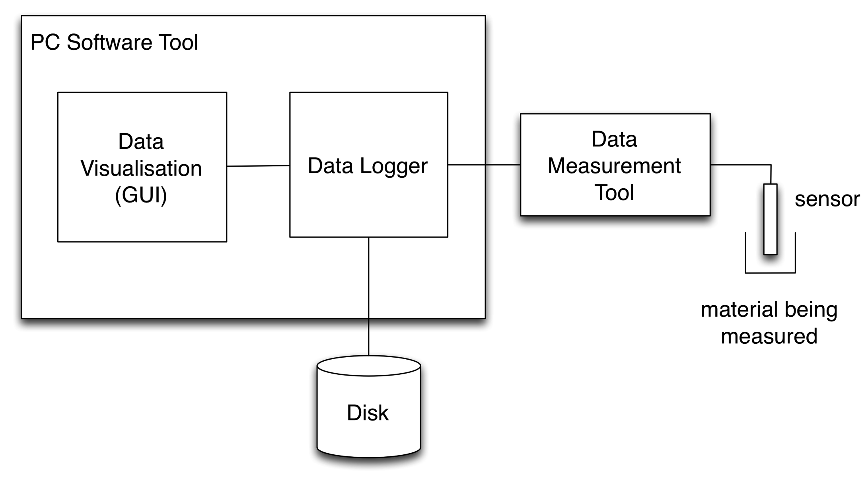
Example: Data Gathering Software
Notes:
We talked about this piece of software. There were two main developers – one for the PC Software Tool and one for the software on the Data Measurement Tool. The software in the sensor was to be provided by the client company. The sensor had a defined interface and an earlier version of the sensor was available for some testing.
Different levels of test doubles needed – one to allow the data logger to be created. However, the data measurement tool was not available – there was only one prototype piece of hardware and that was being used to develop the measurement software. So, we used a Test Double to replace the Data Measurement Tool. We could also look at replacing the process to write out to disk. This was so that we could more easily test the values being written to the ‘disk’.

Slide 12
Motivation
We want to check the interactions that the SUT makes with the DOC
We might want to check how the SUT interacts with the DOC, e.g. does it call method1() first and then method2() after that?
The DOC might not return values that we can check
We want the DOC to return specific values to the SUT to test a specific issue
We want to log values received by the DOC so that we can check them during verification

Slide 13
Types of Test Double
Dummy Object
Test Stub
Mock Object
Fake Object
Notes:
dummy object: 用于填充参数列表，不被实际使用（有些情况下可能使用null）
test stub: 用于接受特定的输入参数调用，然后返回特定的值；不在约定范围的调用没有响应或都是采用默认响应。交互完全在待测系统内部，它不会返回内容给测试用例，此外也不会对SUT内部的输入进行验证。
mock object: 主要的特点是它还会对调用进行验证，若碰到不在预期范围的调用还会抛出异常
fake object: 拥有几乎和实际对象一样的功能，一般为了规避生产环境复杂性或真实系统还没有研发出来而引入替代系统或模块，最常见情况如通过内存数据库来代替实际生产数据库等

Slide 14
Dummy Objects
An SUT requires a data value as part of the test
It does not matter what value is actually in the data value, it just needs to exist
Example: Shopping Basket, testing the checkout feature requires a customer object, but it is not actually used.
In some situations, the value null might be used. It depends on what the SUT will do with the value.

Slide 15
Test Stub
A unit that allows us to insert some logic to respond to calls from the SUT
Responds with correct values (Responder)
Responds with errors, e.g. an exception (Saboteur)
Log values (Test Spy)
Example: Data Logging Software
Notes:
Test Spy – Example is trying to send emails. Rather than send out a lot of emails, we could insert a Test Spy which will log each email so that we can check if all of the details were correctly sent through to the DOC. The logged emails can be checked as part of the verification process.

Slide 16
Mock Objects
An SUT needs to call methods in the DOC
We might want to confirm that the SUT makes:
The correct number of calls
The calls are in a specific order
That specific data is transferred to the DOC
A Mock Object is setup with information about what calls it should expect. It might also be setup with details of the data it should expect.
A lot of unit testing is checking the state after an interaction.
Mock Objects are testing the behaviour of the interaction between the SUT and DOC

Slide 17
Mock Objects: Example
The SUT needs to send log messages when it receives certain data.
The SUT might need to make several calls to the logging unit.
We want to check that the calls to the logging unit are made in the correct order.

Slide 18
Fake Objects
An object that replaces the functionality of the DOC
Possibly simplified behaviour
It does not need to return specific values or log values or return errors
The DOC connection may run slowly for testing
The DOC might not exist yet
Example: In Memory Database

Slide 19

For the data logging software, what type of test double can be used to replace the data Measurement Tool?
Dummy Object
Test Stub
Mock Object
Fake Object
(Pick One)
Notes:
B

Slide 20
Which of the following statements are true?
Mock Objects are used to return set test data from a DOC back to the SUT
Mock Objects are used to check the interactions between the SUT and the DOC
Mock Objects are used to provide simple implementations of DOCs, such as an In Memory Database
Notes:
A-test sub
B-correct
C-fake object

Slide 21
Summary
Testing Practice
Some issues related to testing with JUnit
Test Doubles
Different top-level approaches for replacing the functionality of part of the system during testing

Slide 22
Any Questions?
Notes:
I am very happy to be asked questions during the course, in the lecture and laboratory sessions.

