Slide 1
Software Quality Assurance and Test Management
Chapter 8

Slide 2
Overview
Software Methodologies and Risk
Quality Assurance and Quality Control
Test Metrics
Test Planning and Test Case Recording
Bug Reporting
Test teams

Slide 3
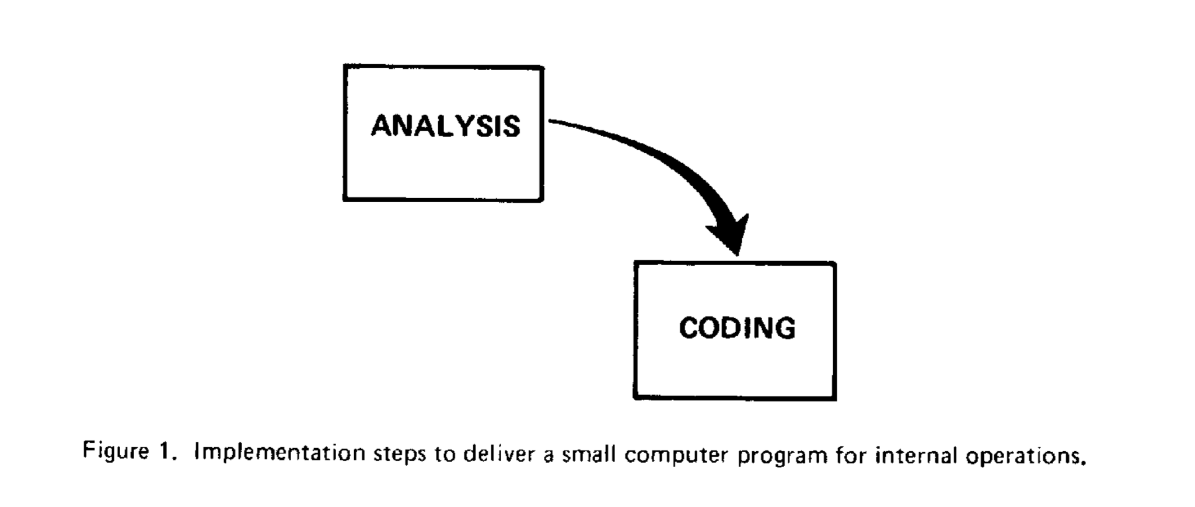
"There are two essential steps common to all computer program developments, regardless of size or complexity. There is first an analysis step, followed second by a coding step, as depicted in Figure1.” [1]
[1] Royce, W. (1970) Managing the Development of Large Software Systems. Proceedings of IEEE WESCON 26 (August): 1–9 (Online) http://www-scf.usc.edu/~csci201/lectures/Lecture11/royce1970.pdf (Accessed 2018-09-19).
Notes:
This is from a paper that Winston Royce wrote about software development. Winston Royce is the person who is credited with the Waterfall Methodology for software development.
He goes on to write “This short, very simple implementation concept is in fact all that is required if the effort is sufficiently small and if the final product is to be operated by those who built it – as is typically done with computer programs for internal use. It is also the kind of development effort for which most customers are happy to pay, since both steps involve genuinely creative work which directly contributes to the usefulness of the final product. An implementation plan to manufacture a larger software system, and keyed only to these steps, however, is doomed to failure. Many additional development steps are required, none contribute as directly to the final product as analysis or coding, and all drive up the development costs. Customer personnel typically would rather not pay for them, and development personnel would rather not implement them. The prime function of management is to sell thee concepts to both groups and then enforce compliance on the part of development personnel.”

Slide 4
Steps in Software Development
Winston Royce said that there are more steps necessary for building a software system.
What steps (stages) are needed to build software systems?

Slide 5
Software Development Methodology
There are several different ways to build software.
Waterfall
Spiral
Incremental
Rapid Prototyping
Agile
well, this is really lots of different approaches. Which ones do you know?
Why do we talk about methodologies?
Notes:
A methodology gives us a way to structure our work. It gives a common way to talk to our team about what we expect. It sets expectations on what steps we will follow as we aim to deliver the software.

Slide 6
Why do we test software?
To have confidence that the system meets it’s requirements?
Customer satisfaction – meeting their business needs
Developer satisfaction – customer sign-off (getting paid?)
To produce a high-quality product?
What is Quality?
To reduce (minimize) the risk that we fail to achieve the above?

Slide 7
Testing and Risk
Project Risks
Supplier Issues – e.g. do we need information about components (hardware, software) from suppliers?
Organisation Issues – e.g. do we have staff available to work on the project?
Technical Issues – e.g. have we done something similar? Are we using a new toolkit?
Product Risks
Failure prone software, incorrect functions, data migration issues, …
Level of Risk – probability of risk occurring * impact if it did happen

Slide 8
Are there any aspects of building software that are not described by the methodologies?

Slide 9
Quality Assurance, Quality Control
Manage the process (Quality Assurance, QA)
For example, detail quality audit that checks if the specified processes are being followed
Focus on the process and not the product
Production and review of test plans
Recording test results
Review of test results
Aiming to prevent issues
Manage the product (Quality Control, QC)
For example, testing and code reviews
Focus on product, identifying deficiencies and suggesting improvements
Aiming to detect issues

Slide 10
Quality attributes
Somerville lists some possible ways to judge quality for software.
These are difficult to judge.
Safety | Understandability | Portability
Security | Testability | Usability
Reliability | Adaptability | Reusability
Resilience | Modularity | Efficiency
Robustness | Complexity | Learnability
Table taken from Software Engineering, Tenth Edition. Figure 24.2.

Slide 11
Software Standards
Can standards documents help us to develop quality software?
ISO 9001 – A set of standards about Quality Management
Encourages you to look at the whole organisation
Encourages the need for management to take the lead
Encourages putting the customer first
Encourages managing the risks
ISO/IEC/IEEE 29119 – Software Testing Standards (in 5 parts)
Definition of good practice to follow for a testing process

Slide 12
The benefits of standards
Sommerville lists three reasons why standards are important:
Standards capture wisdom that is of value to the organisation
Standards provide a framework for defining what quality means in a particular setting
Standards assist continuity when work carried out by one person is taken up and continued by another.
We also need the organisation and team to ‘own’ the standards and processes. Why is this a good idea?

Slide 13
Test Metrics
Measure the progress of testing in an organisation and on projects
Help to understand issues about project progress and testing
Organisation – general metrics to indicate quality
E.g. number of defects per thousand lines of code (KLOC)
Is this too general?
Project
E.g. Percentage of successful tests in a testing phase. How many of the planned tests have been completed?
Process
E.g. statistics about when a defect is found. What if a large number are found at system or user testing?
Product
E.g. test coverage – high coverage is desirable
Testability – how easy is it to specify and perform tests?
E.g. does low test coverage suggest problems with the testabilty of the system?
Notes:
Organisation Example: A company identifies that it currently has 2.5 bugs per KLOC. Is that a problem? Does it allow an organisation to compare the outputs from different product teams? If it wants to bid on a new project, are there any requirements from the customer that state what a measure of bugs / KLOC should be? How would this affect the process? It is OK to set a new goal, e.g. we need to have 2 bugs / KLOC, but it is important to look at how that can be achieved. This measure can be useful for general comparisons, but one needs to understand the issues at a deeper level before goals are set at this level.
Process Example: Data is gathered about the number of bugs found at different stages of a product. If it was shown that customers identify 15% of new bug reports, system testing identified 45% of bugs, integration testing identified 20% of bugs and unit testing revealed the remaining 20%. Does this suggest any problems with our process? It might do. Again, the numbers are a starting point. We should look at the types of bugs found in system and integration testing and ask if they could be identified at earlier stages. For example, should these bugs have been found at the unit testing stage? If so, how can we improve the process to help improve this?
Product Example: If we look at different areas of the product, we could look to see how many bugs are identified in each area. So, are we finding a high level of bugs in networking, or data storage, or user interface, … If we do see particular problems in areas of the product, where the number of bugs seems very high compared to other areas, can we look at the detail and see if there are ways to improve?

Slide 14
Good use of metrics?
Early detection of issues
Collecting the metrics can help to manage our process. For example, we can prompt people to fix bugs before adding more functionality
Make this part of your team’s quality process
Review processes early
Setting goals?
Performance – how many bugs a tester is expected to find a week
How many bugs a developer can be assigned before they must fix bugs
Good discussion in the Microsoft book

Slide 15
Test Planning and Test Case Recording
How do we record the planning and sets of test cases?
Test Planning
Documents should be available to the whole team
Need an easy way to track changes to documents
Use version control software?
Test Cases
Where should these be stored? Text documents? Spreadsheets? Database?
This does depend on the project, but you want an easy way for testers to enter and track test cases.

Slide 16
Exercise: What should be recorded in a bug report?
On your own: Think about what items should be included in a bug report.
In groups: Discuss your ideas with those around you.
As a class: we will discuss your ideas.

Slide 17
Bug Reports….

Slide 18
Possible Bug Report Information
Title (short description)
Categories (e.g. missing feature, incorrect operation, …)
Detail (long description)
Actual results and expected results
Steps to reproduce
Important to help users think through this part of a bug report.
Test environment (hardware, other processes, …)

Slide 19
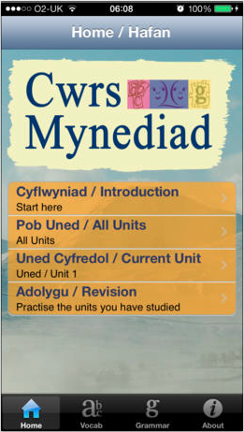
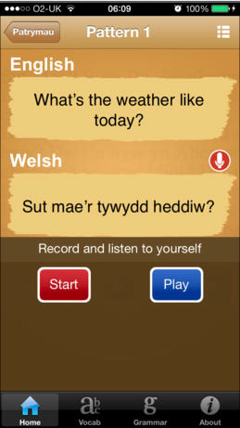
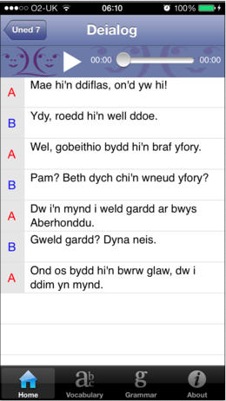
Example sound bug in an iPhone application
Notes:
There is a question on this application in the next slide.

Slide 20

Look at the following short bug titles. Which one do you think is the best description?
The sound isn’t working when I hit the Arrow
The sound does not work
I cannot hear sound when I am working in Unit 3.
I cannot start a recording if the play button was pressed first.
The recording button does not work on the sound recording screen.
Notes:
We talked a bit about the application. Sound is used in several parts of the application.

Slide 21
Apple’s Bug Reporting Tool
Apple uses two approaches to gathering bug report details: developer focused and consumer focused

Slide 22
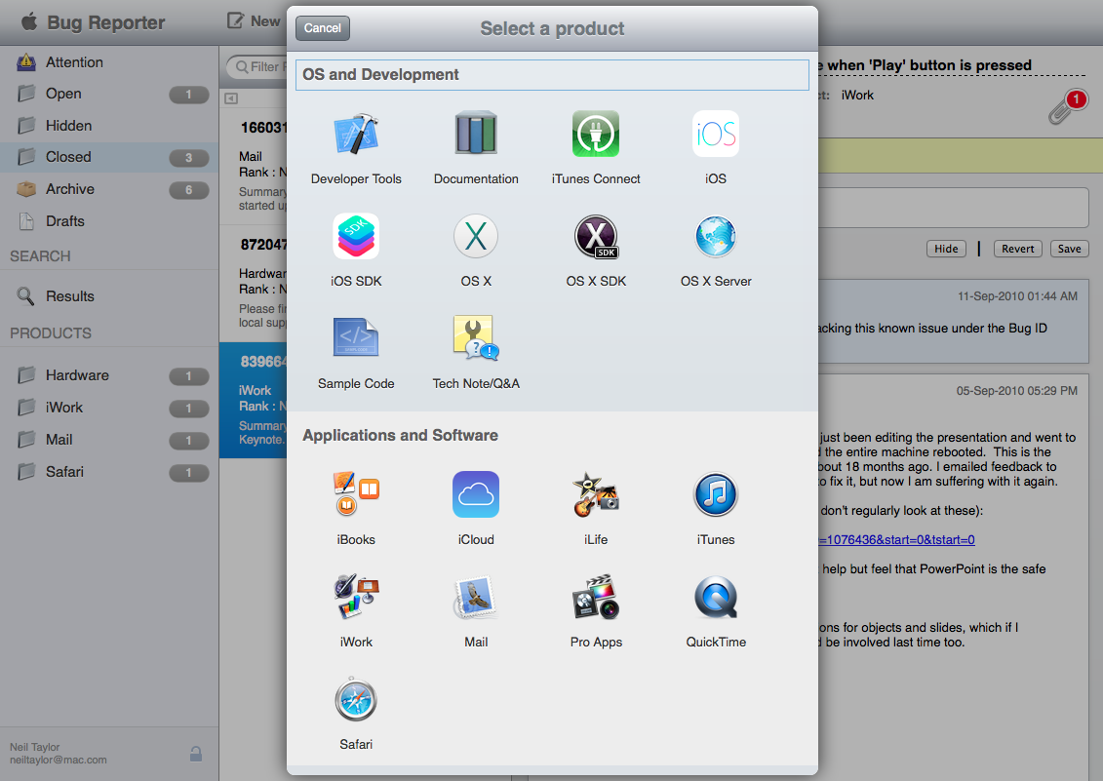
Notes:
The above screen is from Apple’s bug reporting software that can be used by anyone with an Apple ID. I would expect that this is mostly used by the developers who write applications for Apple devices. The first stage is to identify the product area.

Slide 23
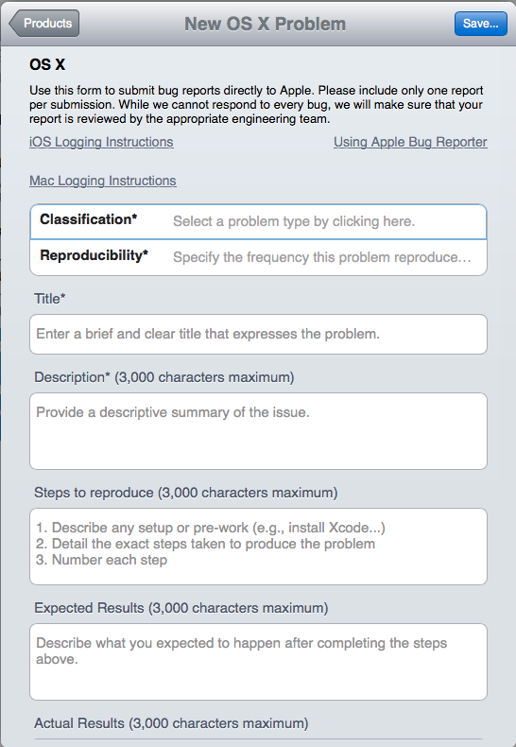
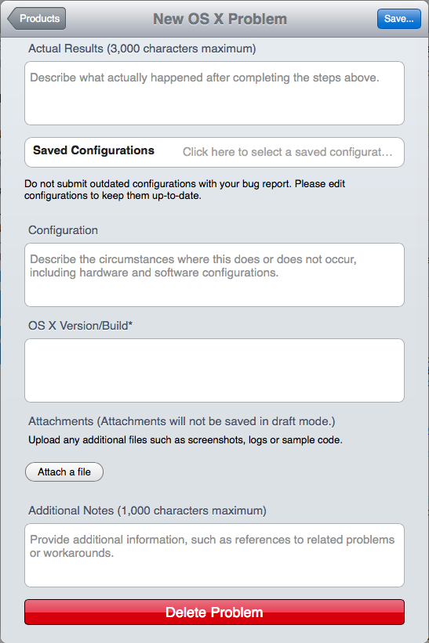
Notes:
The next stage is to provide details.

Slide 24
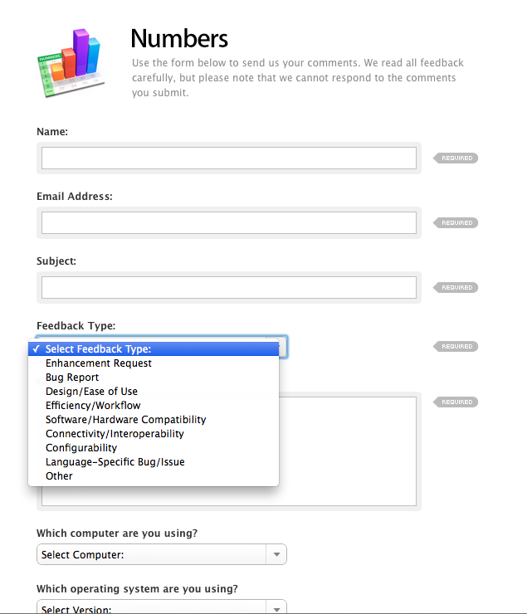
Consumer Feedback
Different level of feedback expected from consumers.
As well as information about any incident (or suggestion for improvement), the form asks some questions to understand how the customer uses the application, e.g. work, home or both.

Slide 25
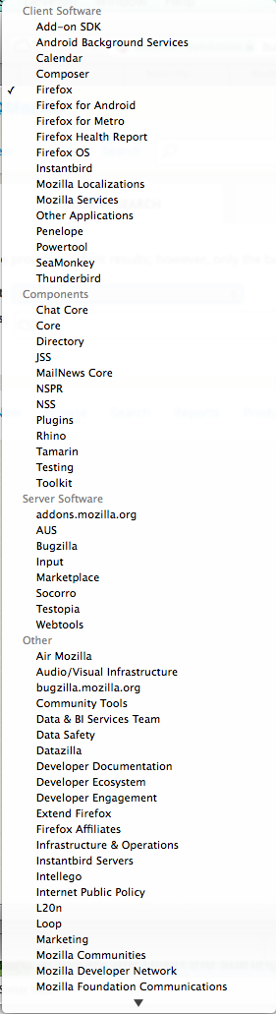
Bugzilla Bug Reporting Tool
Open Source tool that you can download and use
Used to manage bug reports for products including FireFox, Thunderbird, Bugzilla, and many more
Notes:
Screenshot shows a list of possible items managed by the tool at Bugzilla.

Slide 26
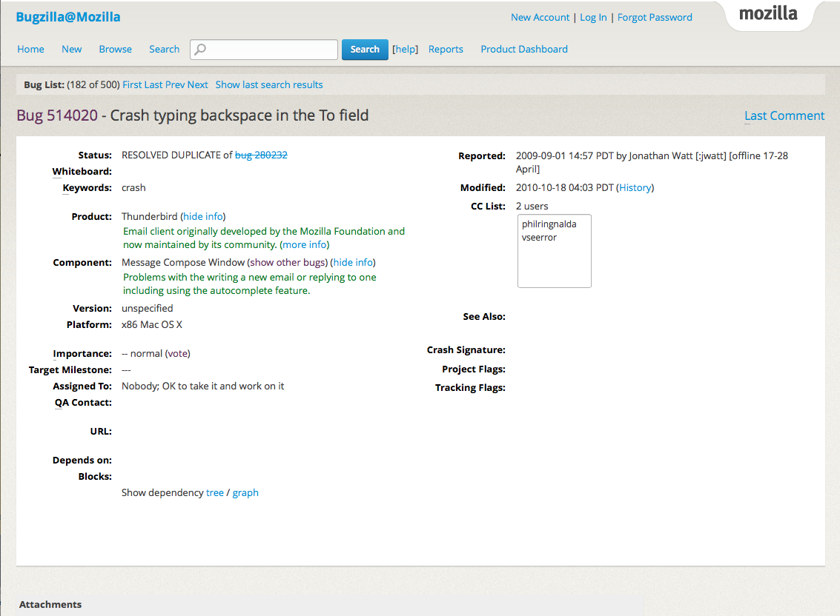
Notes:
This screen shows the top part of the bug report information. Quite a lot of this information is not filled in, but that might be typical in bug report. There needs to be some initial information and other information will be added as it becomes relevant. This bug is listed as Resolved and listed as a duplicate.

Slide 27
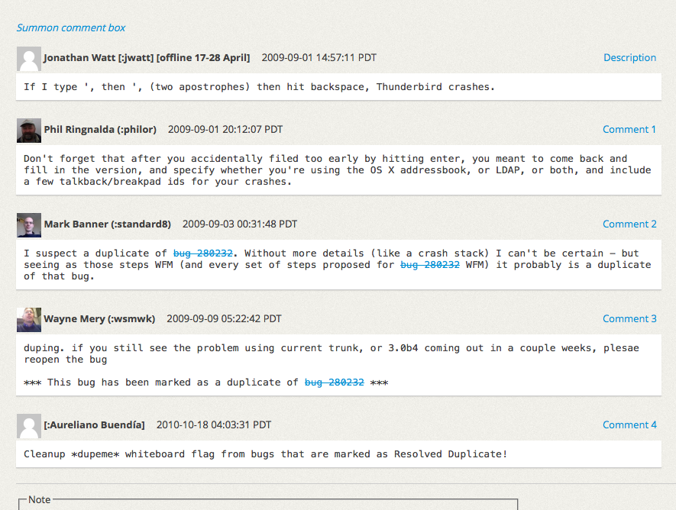
Notes:
This is the lower part of the same page. It provides some interaction between people who are trying to assess the relevance of this bug. The original reporter, jwatt, has a comment and then people from the team add other comments.

Slide 28
Microsoft’s Experience
Use of an internal tool to report bugs
Alan Page, in How Microsoft Tests Software, talks about the early days when an Excel Spreadsheet was used
Now running on custom software that stored on SQL Server database
A lot of possible fields that can be filled in
Different product teams choose which fields are to be used.
Core set of fields that need to be entered, e.g. Short description, longer description, product and severity of the bug.

Slide 29
Assessing a bug report
When a bug is reported, it is evaluated
You might see the term Triage – trying to decide how severe the bug is
Do we need more information?
Is this a duplicate of an existing bug?
Is enough known to fix a bug?
Do we need to investigate further?
Will this be fixed?
In this release?
In a future release?
Do you need advice on how to respond to a bug report – e.g. your management or legal input?
Notes:
Alan Page gives a good example of a bug that was found late in the product lifecycle. There had to be discussion about the significance of the bug and what would happen if they didn’t fix the bug before the release. That required the input of senior management and legal representatives. Sometimes, the bug can have a lot of implications for you and your customers.

Slide 30
Defect Management (1)
Example of status associated with a defect
New: When a bug is found/revealed for the first time, the software tester communicates it to his/her team leader in order to confirm if that is a valid bug. After getting confirmation from the test lead the software tester logs the bug and the status of “New” is assigned to the bug.
Assigned: after the bug is reported as “New” it comes to the development team. The development team verifies if the bug is valid. If the bug is valid, development leader assigns it to a developer to fix it and a status of “assigned” is assigned to it.
Open: Once the developer starts working on the bug, he/she changes the status of the bug to “Open” to indicate that he/she is working on it to find a solution.

Slide 31
Defect Management (2)
Fixed: Once the developer makes necessary changes in the code, he/she marks the bug as “Fixed” and passes it over to the development Lead in order to pass it to the testing team.
Pending re-test: After the bug is fixed, it is passed back to the testing team to get retested and the status of “Pending Retest” is assigned to it.
Re-test: The testing team leader changes the status of the bug, which is previously marked with “Pending Retest” to “Retest” and assigns it to a tester for retesting.
Closed: After the bug is assigned a status of Retest, it is again tested. If the problem is solved, the tester closes it and mark it with “closed” status.
Re-open
Rejected

Slide 32
Question about duplicate bug reports?
Your manager has said that he doesn’t want to see his team of testers creating bug reports for issues that have already been found.
Is that a good idea?
Answer Yes or No.

Slide 33
Test Teams
Have a look at a description of possible test teams on Bb.
Is it a good idea for developers to be responsible for testing the software?
Why or why not?
Think about the other options listed.

Slide 34
Summary
Software Methodologies and Risk
Quality Assurance and Quality Control
Test Metrics
Test Planning and Test Case Recording
Bug Reporting
Test teams

Slide 35
Any Questions?

