Slide 1
Design, Testing and Agile
Chapter 9

Slide 2
If it’s important, do it often
What is important when developing software?
Notes:
This idea comes from the eXtreme Programming method of developing software.

Slide 3
How does this relate to Testing?
If it is important… do it to the ‘extreme’!
Or, do it regularly as part of your work
Testing is one of 14 practices that eXtreme Programming (XP) uses
It is the combination of those practices that are important
Each practice is designed to work with the weaknesses of the other
If we only do some of these, are we are just pretending to be extreme?

Slide 4
Overview
Pair Programming
Test-Driven Development (TDD)
Reviewing Code and Discussing the Design
Keeping a maintainable Design

Slide 5
Pair Programming
Two people work together to develop new features.
Advantages?
Disadvantages?

Slide 6
Pair Programming Advantages
To increase code/design quality
Pairing allows for continual review
The reviewer is fully involved
Pair reviewing is less intimidating than formal reviews
Formal reviews still have their place…
Improved communication
Reduced risk
More team members are familiar with the code

Slide 7
Pair Programming Disadvantages
Risk of shared assumptions
Experience
Personalities
Expert, extrovert, novice, average, introvert
Workstation layout
Need for concentration
May not be a good idea to pair during exploration / spike work

Slide 8
Developer Roles
Driver –
Decides what to do and type
Listens to the navigator for advice
Makes sure the navigator understands what you’re doing
Navigator –
Asks questions to clarify
Suggests alternative approaches
Needs to understand fully what is being done
Prepared to take over if the driver gets stuck

Slide 9
The XP Day with Test-Driven Development
Stand-up
Meeting at 9am
Pair Up – Quick
Design
Write Test
Run
Test
Code
Refactor
Integrate (plus regression test) or throw
Leave at 5pm

Slide 10
Red
Green
Refactor

Slide 11
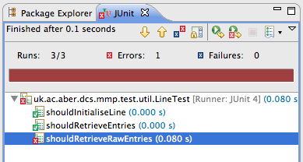
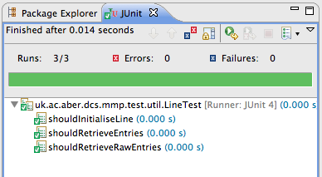
1
2
3
Refactor

Slide 12
Test-Driven Development (TDD)
Write tests before writing code implementation
Unit tests: written by programmer to define what it means for the code to work
Acceptance tests: written by customer to test that system behaves as required
Write minimum amount of code to pass the test
Use your tests as a safety net that allows change
Use tests as documentation

Slide 13
TDD Movie Example
Taken from Test Driven Development, David Astels, Prentice Hall.
XP Story. Movie List:
As a Manager, I want a way to create a list of movies and a way to add movies to it. Ordering of the list isn’t a concern.
One of the tasks derived from this story:
Task 1-1. Make a container for movies with a way to add to it. Doesn’t have to be ordered or sorted.

Slide 14
Developing the task: Make a Movie Container
The first test
Look for the simplest test possible
We need to keep a list of movies, so build a data structure for movies: this is the focus
Test 1: An empty list must have a size zero
Test 2: Adding a movie to empty list must result in a list with size of one
Test 3: Adding two movies to an empty list must result in a list with size of two
Test 4: If we add a movie to the list can we find if it is there? Also, if we ask for a movie not in the list do we get the correct negative response?

Slide 15
Developed the solution in class
We developed the solution in the class.
A copy of the solution will be provided on Blackboard.
Look at this. Do you think you could do something similar?

Slide 16
Any Questions?

