Slide 1
Elevator
R：陈怡珺
D：刘承奇
V：任怡静

Slide 2
Requirement
2 elevators
a building with 3 floors

Slide 3
Requirement
Elevator should take passenger if there is an ask
Elevators should not both response to the same request
Elevator should move to all floors requested by the passengers inside it.
Elevator’s door should be open after elevator stops
Elevator’s door should be closed while elevator is moving

Slide 4
Requirement ——UI inside elevator
Passenger can set request floor no.
Passenger can hold door open before it closed
Passenger can close door in advance
Passenger can know elevator’s moving direction
Passenger can know elevator’s position
Passenger can call staff if emergency occur

Slide 5
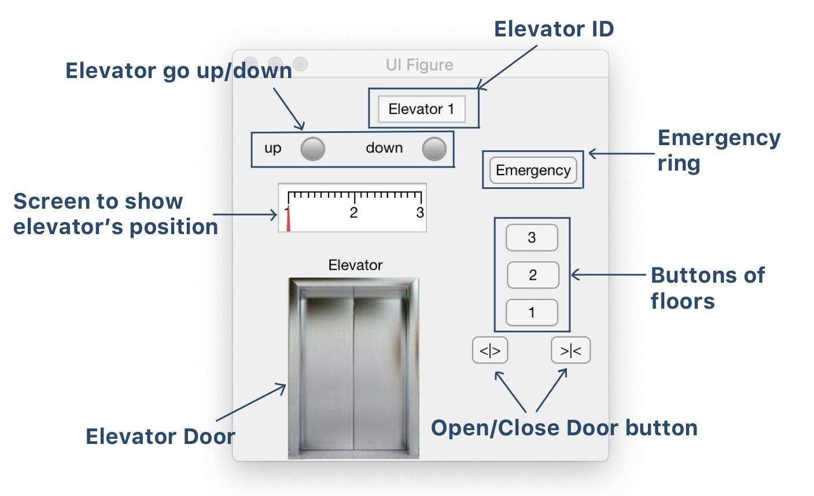
User Interface UI

Slide 6
Requirement ——UI on each floor
Passenger can ask for elevator
Passenger can ask for moving up/down
Passenger can know 2 elevators’ next moving direction
Passenger can know 2 elevators’ position

Slide 7
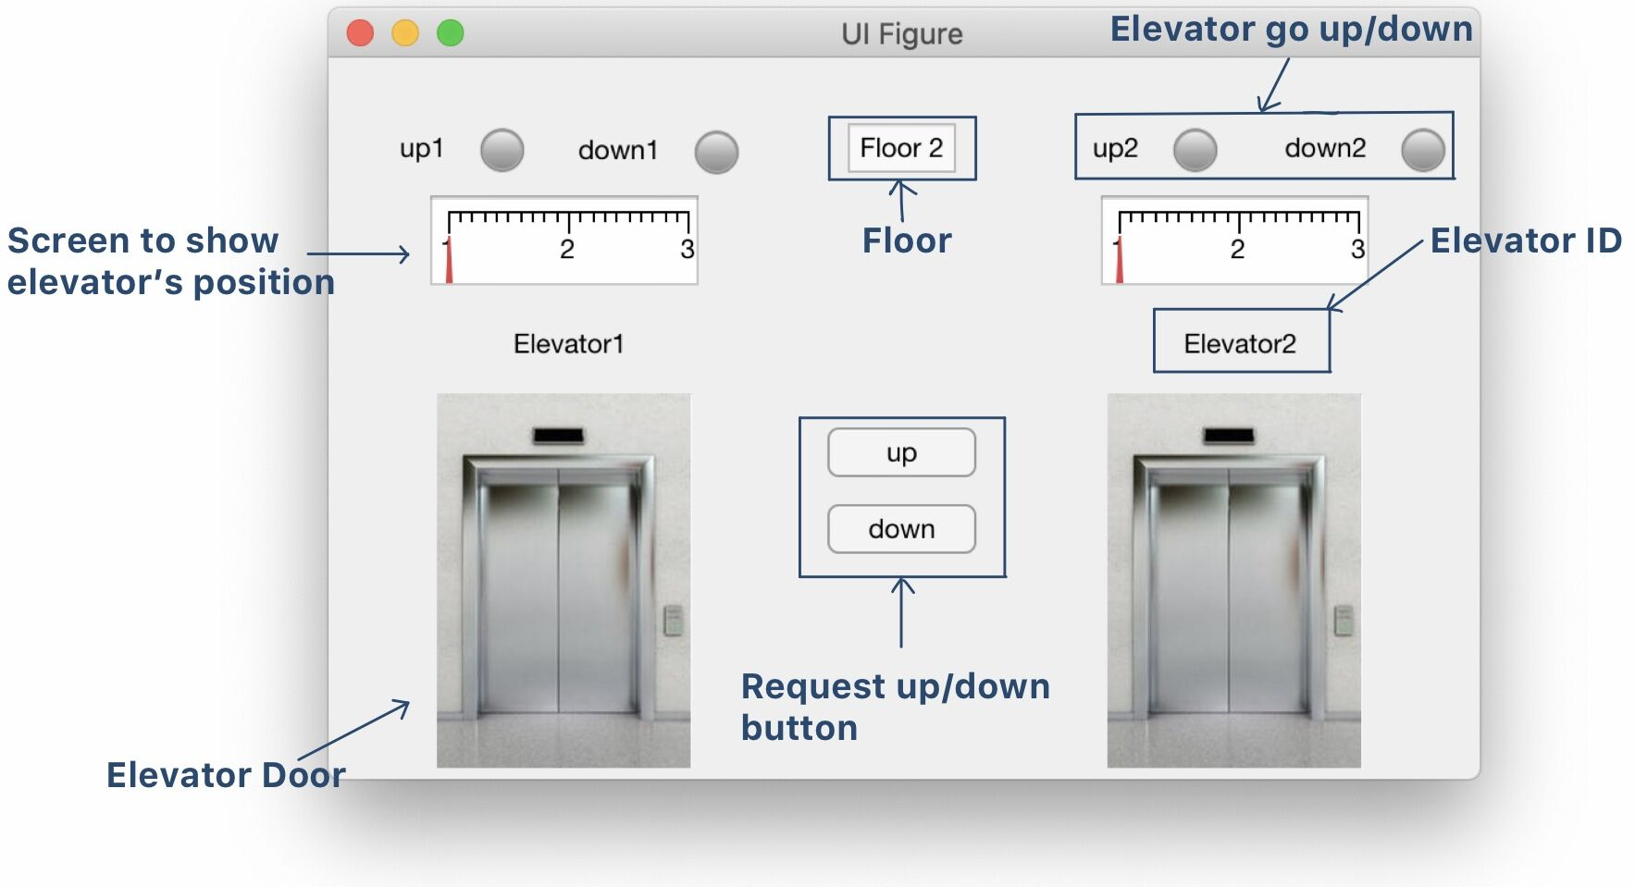
User Interface

Slide 8
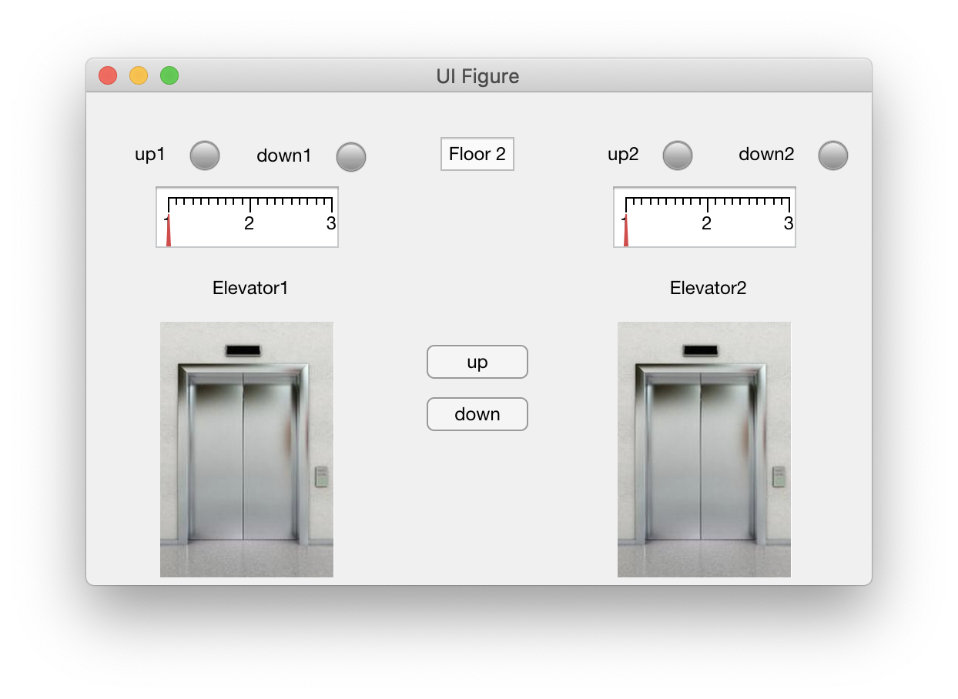
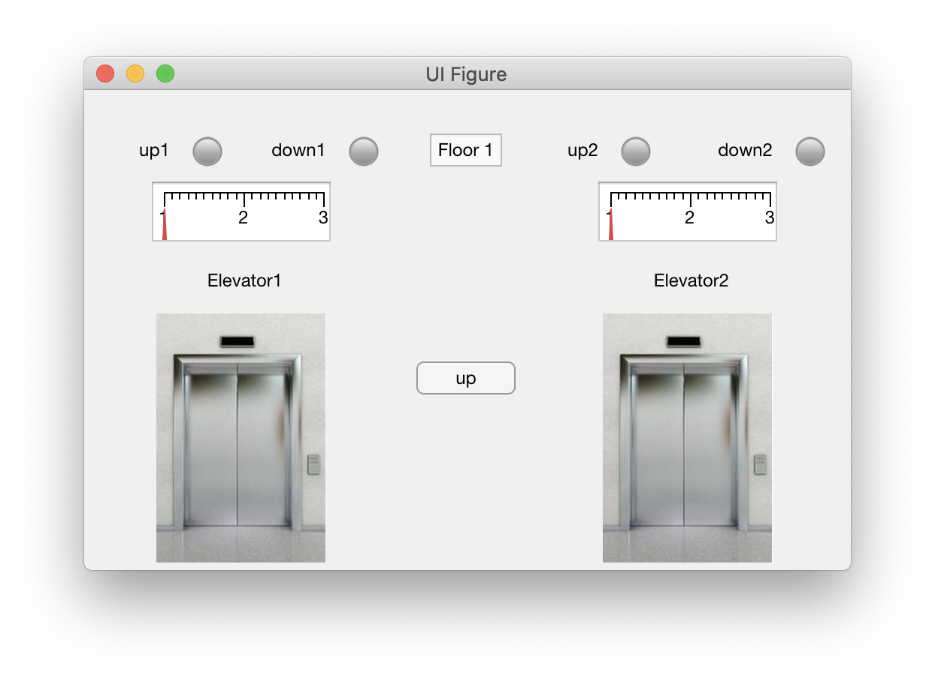
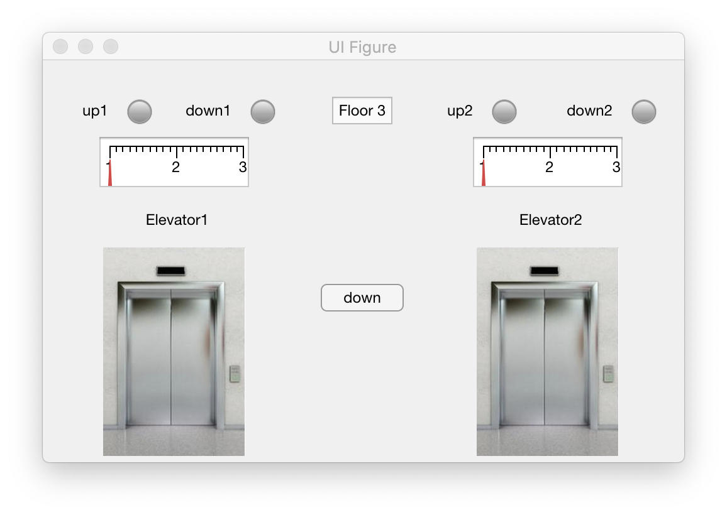
User Interface

Slide 9

Test Cases

Slide 10
Huarong Path
R: 刘承奇
D: 任怡静
V: 陈怡珺

Slide 11

Project Introduction
Huarong Path is a kind of Chinese folk puzzle game, based on the fictitious story in Romance of the Three Kingdoms.
In the game, players help Cao Cao move from the initial position to the bottom middle of the board by moving each piece, and escape from the exit.
Only one piece can be moved to one direction at a time.
It is not allowed to cross other pieces or cause overlapping of pieces.
Chess pieces are not allowed to go out of the chessboard.
The players should take as few steps as possible to win the game.

Slide 12
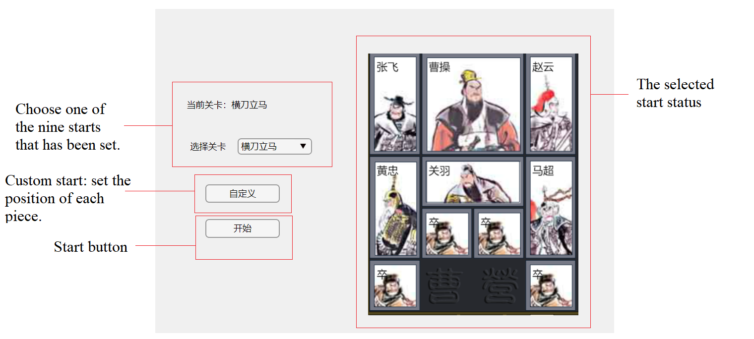
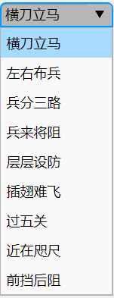
Game UI: Main Menu

Slide 13
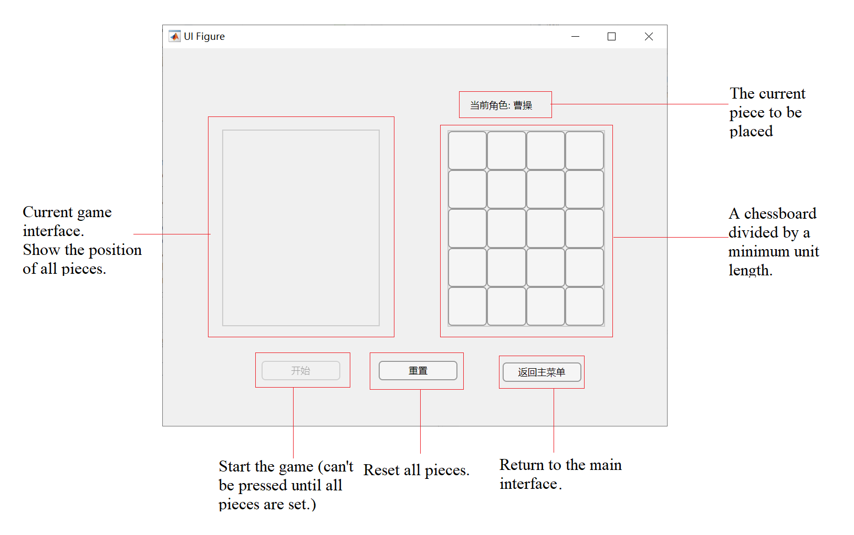
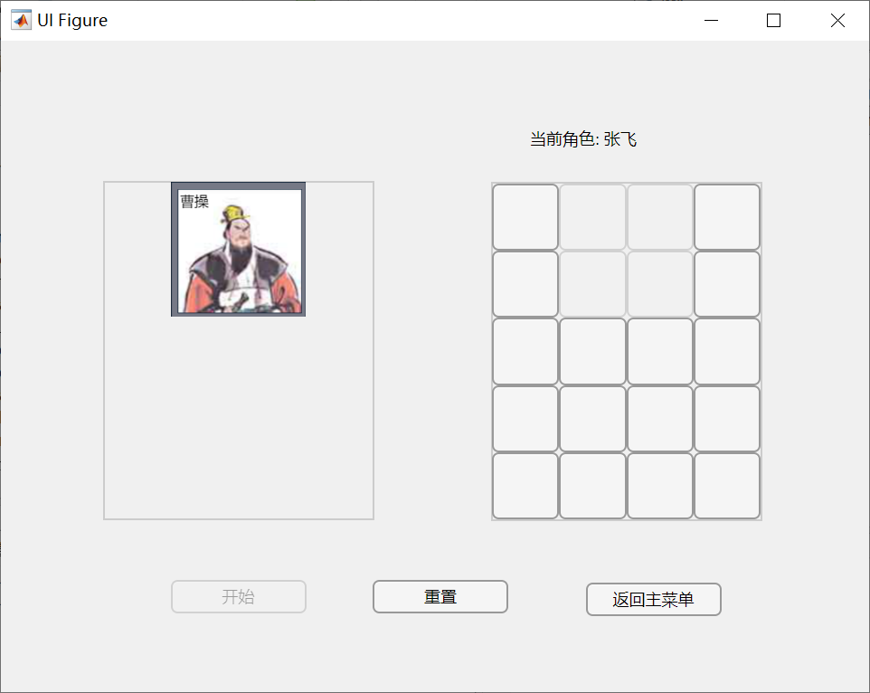
Game UI

Slide 14
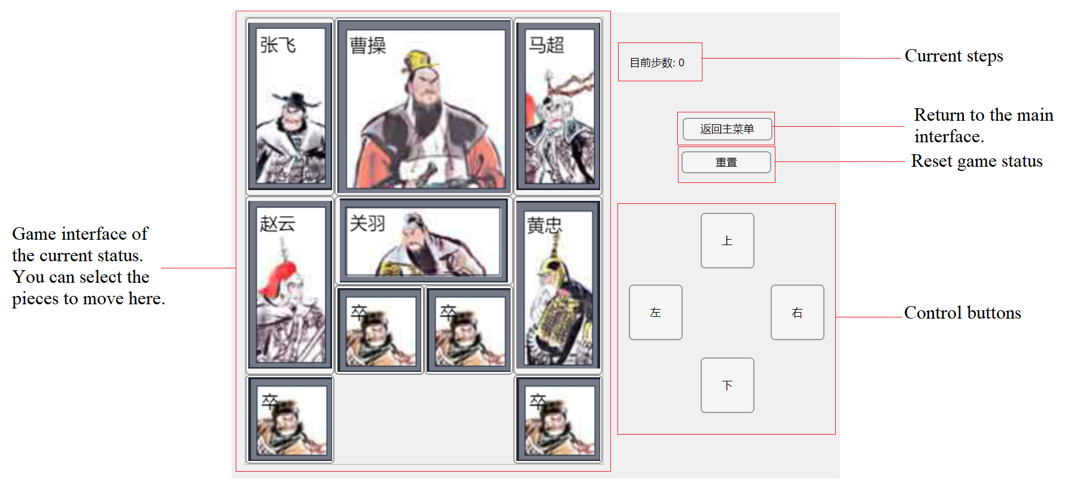
Game UI: Game interface

Slide 15
Test Cases

Slide 16
Drug Pump
R: 任怡静
D: 陈怡珺
V: 刘承奇

Slide 17

Basics
The max total amount per day is 3ml and the maximum injection amount per hour is 1ml. We hardwired it to the code to make sure that it cannot be violated.
The range of baseline injection is 0.01-0.1ml/min, and the bolus is 0.2-0.5ml/shot, we make sure that the value cannot go overflow or underflow

Slide 18
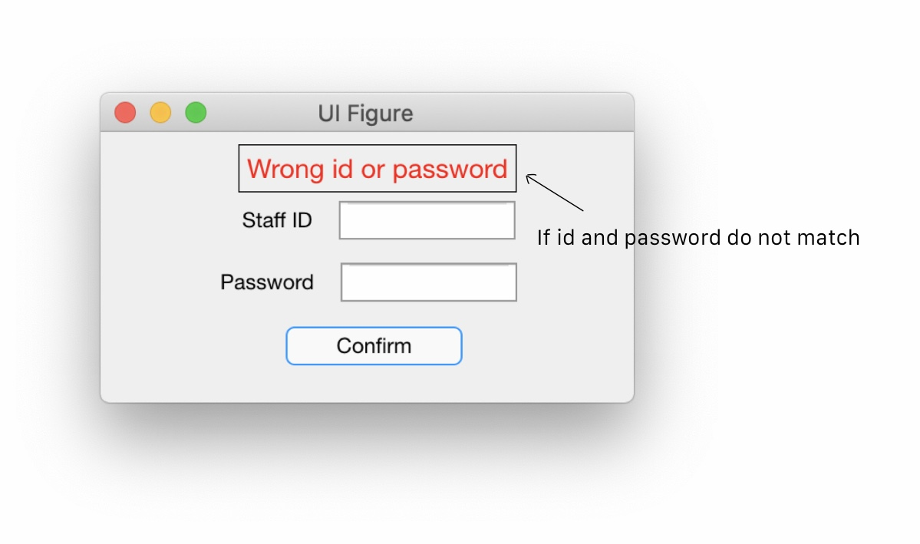
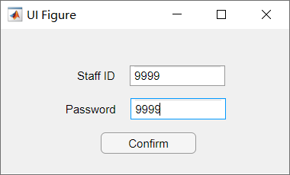
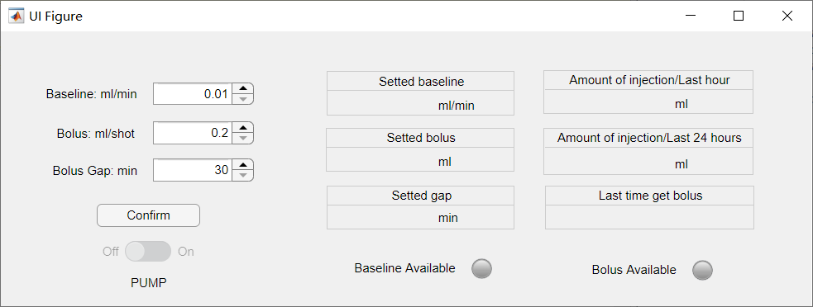
Interfaces: Start
The nurse have to input the right ID and password to enter the Setup interface
The nurse can change the dose of baseline/min, bolus/shot, and the Gaps between two bolus that is safe.
When finished, nurse will press confirm to unlock the On button.
The interface gives the real-time amount of injection for observation
There are light signals for easy understanding when baseline and bolus available.

Slide 19
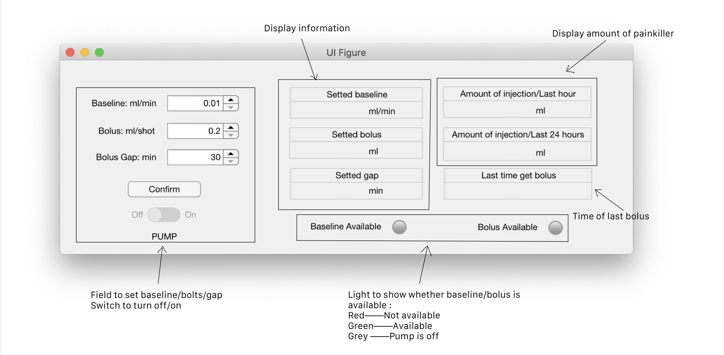
Interfaces: Processing
During process, when nurse want to change the value of the data, it will not change the data until the nurse press confirm button.
When data in the Setup interface is not consistent with the value in the pump system, a striking warning is on the screen until confirm is pressed or the value is consistent again.
The pump will only inject when all the day limits and hour limits are not violated, also it will reserve some drug capacity for bolus

Slide 20
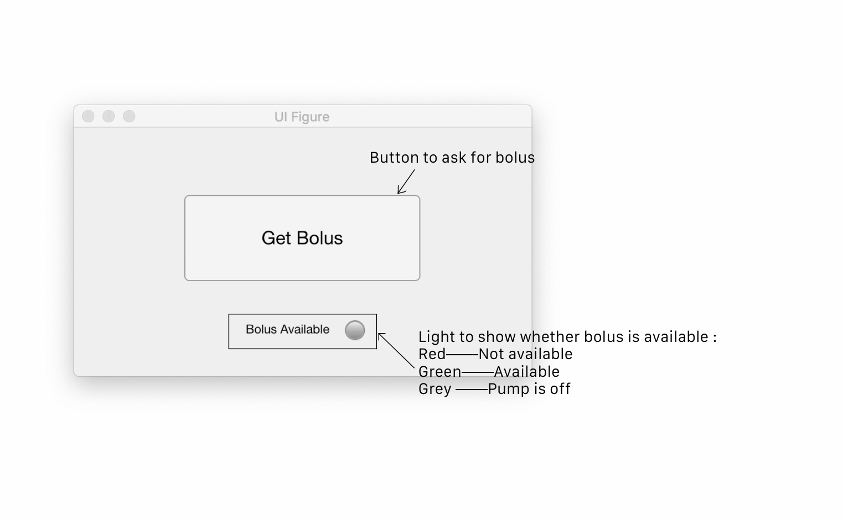
Interfaces: Patient Button
The patient can press the button when needed.
When pressed the bolus, the system will check for if the time interval in between is large enough compared to the value the nurse has set for him/her.
The patient can see when the bolus is available by watching the Bolus Available lightbulb is on

Slide 21
Test Cases

Slide 22
Thanks!
Provided by 陈怡珺 刘承奇 任怡静

