Slide 1
Portfolio Website Presentation

Slide 2
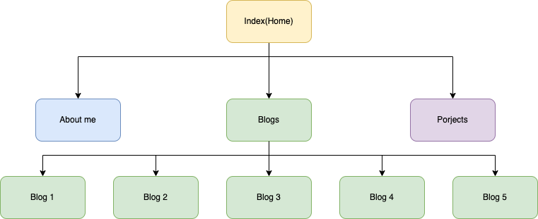
Sitemap

Slide 3
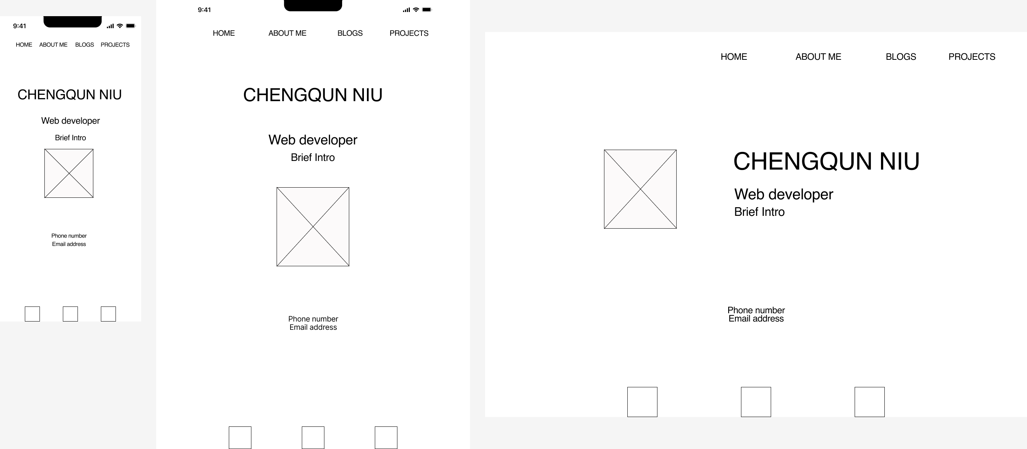
WireFrames-Index Page
-Index Page contain personal information, cute pic of mine and links to professional social accounts.
-nav bar and social acounts with display flex. Which is the same for each page.

Slide 4
Index Page ScreenShot
Flexbox on nav bar, which change the layout over 1200px
use clamp for header,title and text. Hence the size of text will change according to the resolution size. Clamp also used for the rest of pages
Under 1200px,imgage size will change according to the resolution size. Once reach 1200px, the size will be fixed.
flexbox on the content, image and text part.

Slide 5
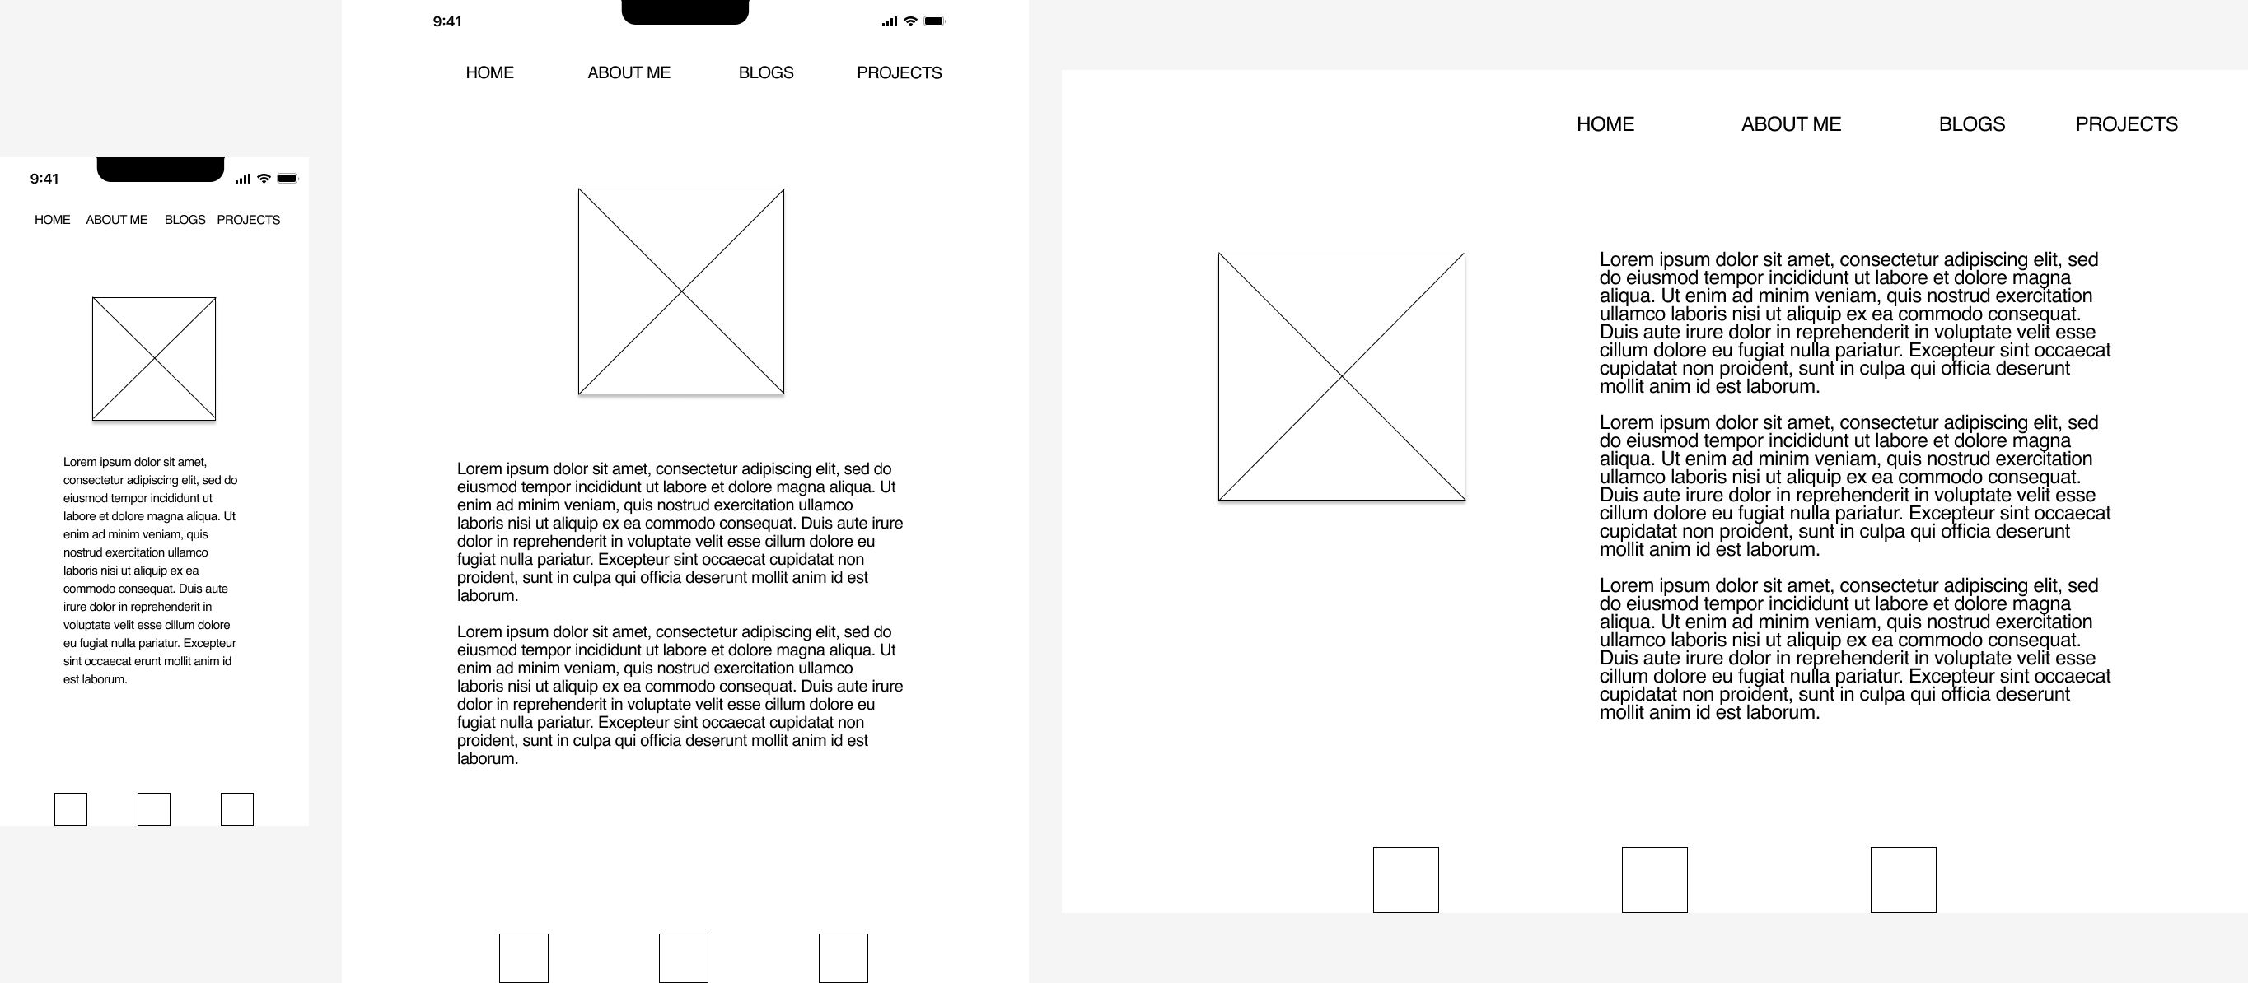
Wireframe-About me Page

Slide 6
About me Page
Background, work/study history, resume
flexbox and change layout on 1200px
underline the current page

Slide 7
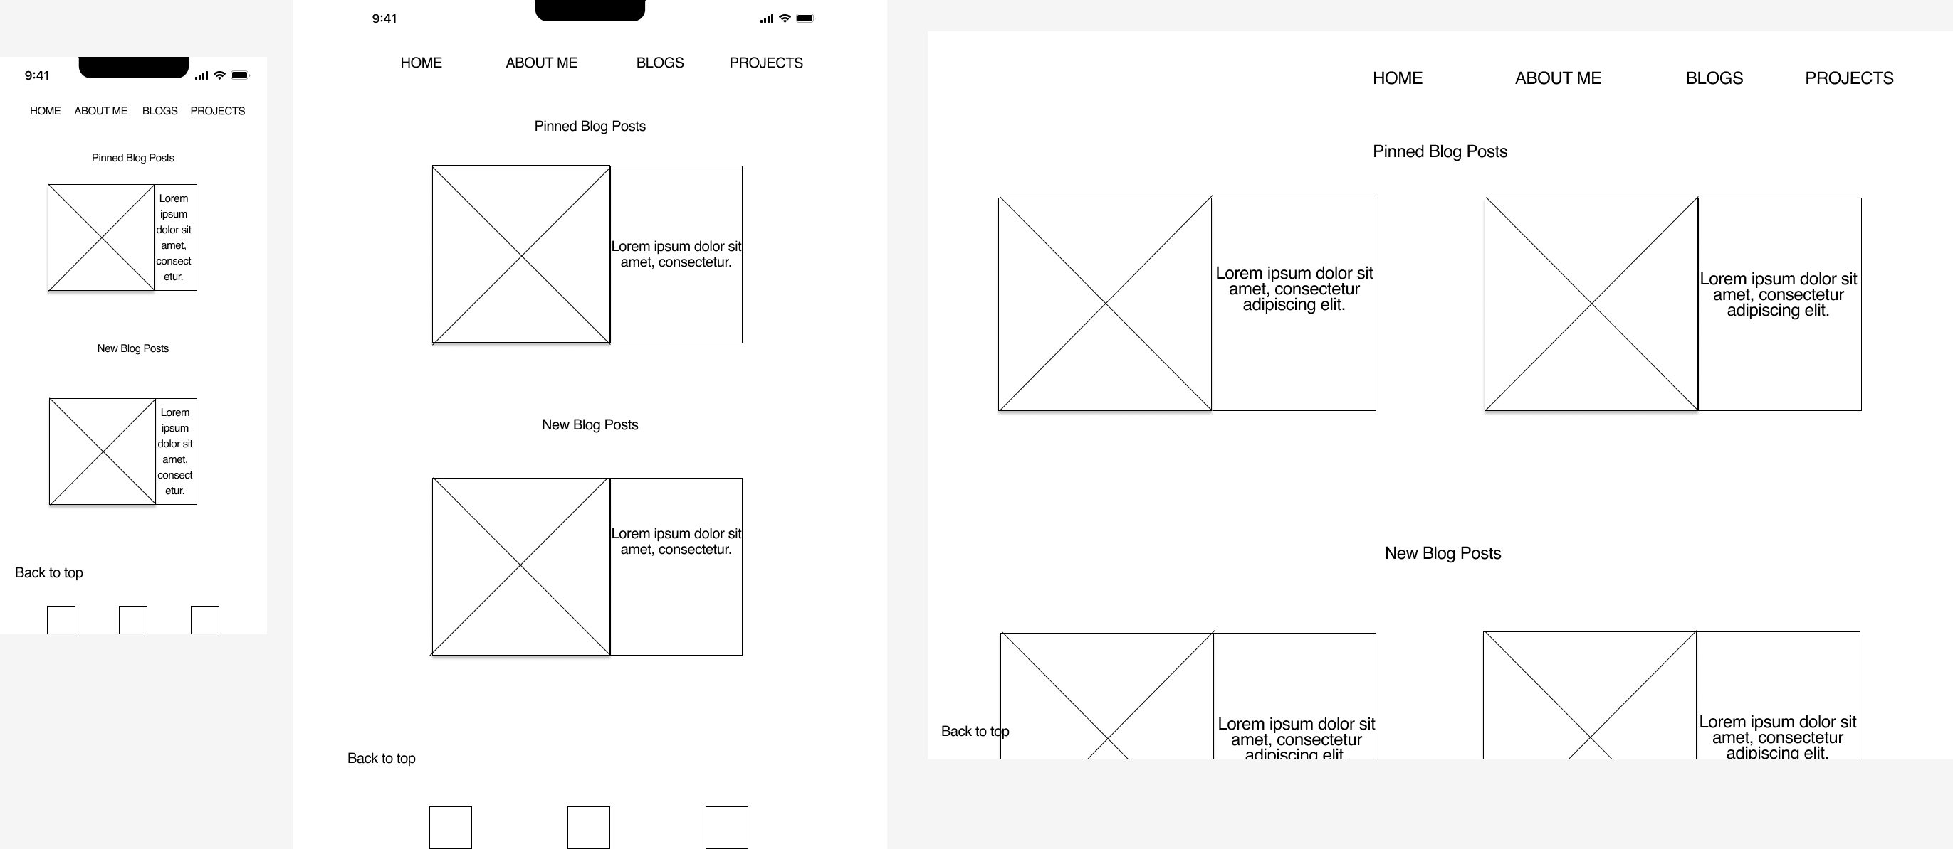
Wireframe-Blogs Page

Slide 8
Blogs Page
horizontal design and hide overlay text to save sapce for low resolution audience
as resolution become bigger, more text will be seen by audience. Once over 1200px, it will display two post at same line.
set background color for each post to make audience more easier to distinguish them
back to top button
post will enlarge when hover

Slide 9
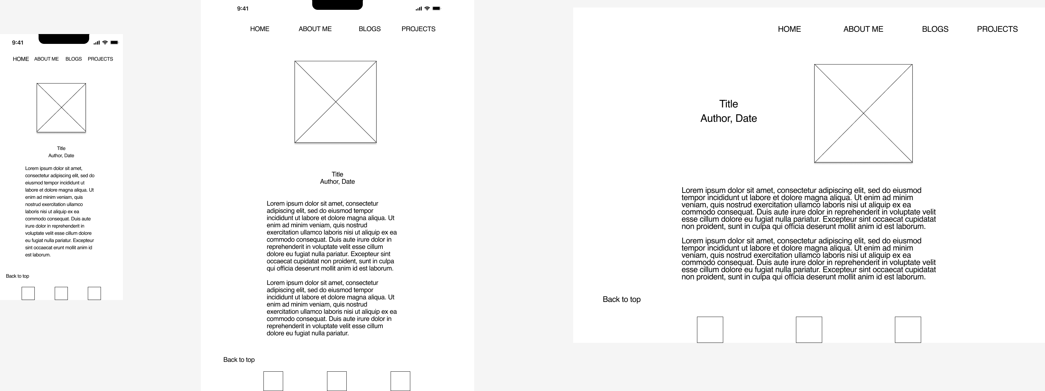
Wireframe-Single Blog Post Page

Slide 10
Single Blog Page
Flexbox on each blog post, change layout when over 1200px

Slide 11
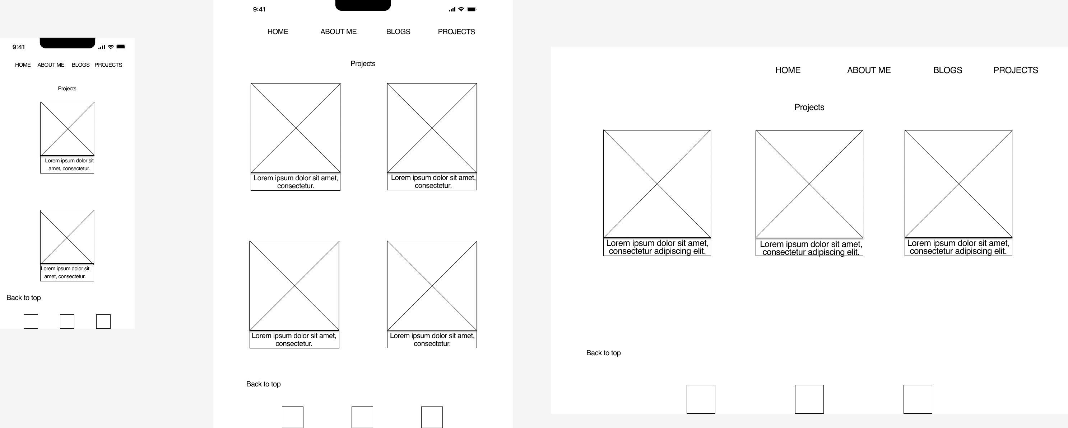
Wireframe-Projects Page

Slide 12
Projects Page
Flexbox on the page and also for the single project. Layout change with resolution changes
background color to easily distinguish each other
not like blog post, project has vertical design. Because normally the description will not be too long compared with posts

Slide 13
List of components
1. Nav bar on the top of each page. It is easy to find, change the layout with resolution. It will underline the current page that audience is viewing and enlarge when hovered over.
2.Footer at the bottom. The icon will enlarge when hovered over.
3.Flexbox on each page. Each page has flex container and each single component is set as flex container in order to be responsive for difference viewport. Each page will have different layout at different resolution.
4.

