Slide 1

Sticker store ordering system
Smoonypaws

Slide 2
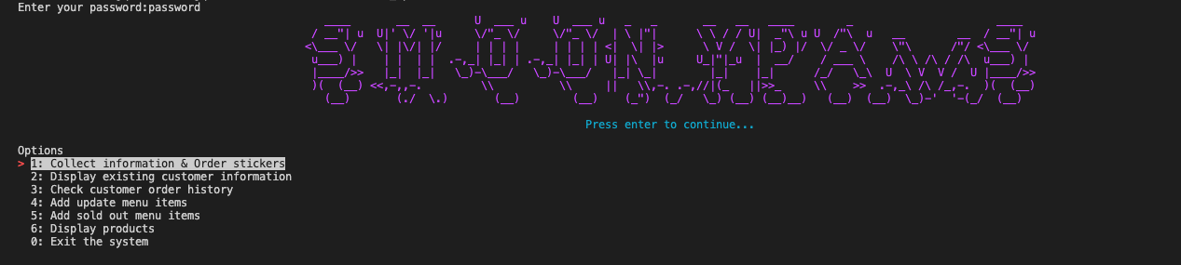
Walkthrough
Users have to enter the correct password to start the system (they could set up their password by execute a bash script)
Select one of these options to proceed

Slide 3

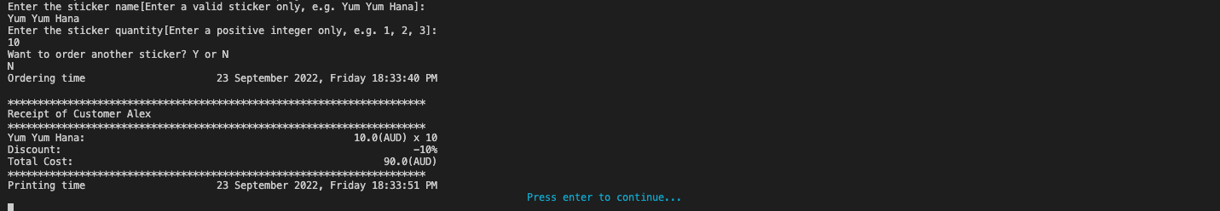
Collect customer information and order
Collect each customer's name
Ask users what customer wants to order and the quantity of the selected sticker. Quantity must be an positive integer and greater than 0.
Print receipt for the customer with time.

Slide 4
Allow customers to join rewards membership
Each customer will be automatically added to the customer list
The system will ask users whether the customer would like to become rewards customer

Slide 5
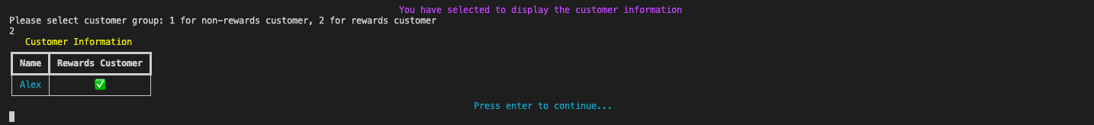
Displaying existing customers
Users could select number 1 or 2 to display either non-rewards customers or rewards customer.
If they enter something else instead of 1 or 2, they have chance to enter again.

Slide 6
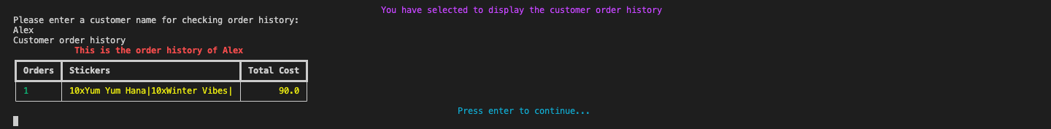
Displaying customer order history
Users could select a customer and display that customer's order history. Each order will be displayed on a single line.
If users enter a name that is not an existing customer, they have chance to enter again.
if that customer has no order history, a message will be displayed on the terminal.

Slide 7
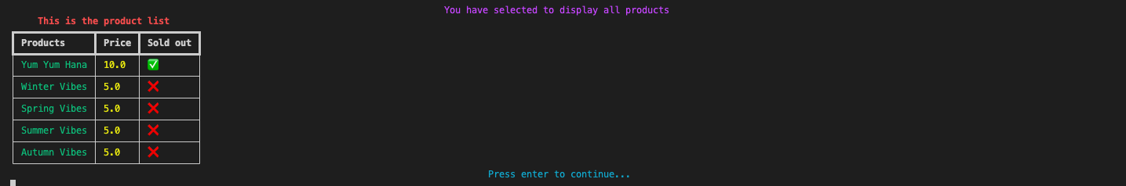
Display all products
Display all products, includes their name, price and whether they have been sold out.

Slide 8
Add and update menu
Users could add new items to the menu or update the price of existing menu items.
Users could also mark items as sold out.
If users enter invalid input, that input will be ignored.
If users use wrong format, like they only enters a string instead of key:value pair. They have chance to enter again.

Slide 9
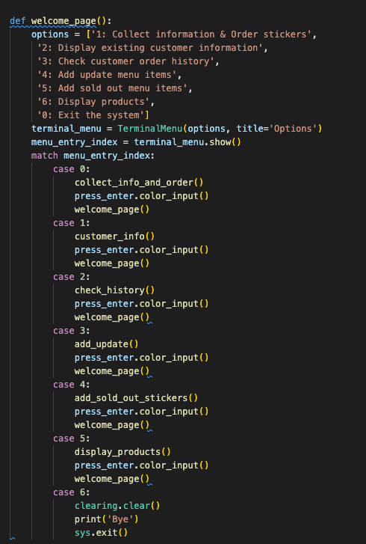
Option menu
Users could choose which function they would like to proceed

Slide 10
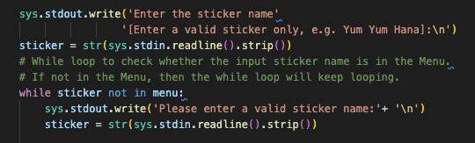
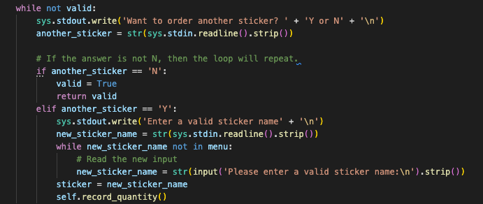
Loops
Use loops to check users input. If they enter an invalid input, the loop will repeat and ask them to enter again.

Slide 11
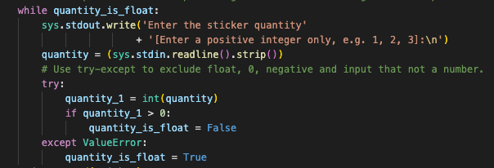
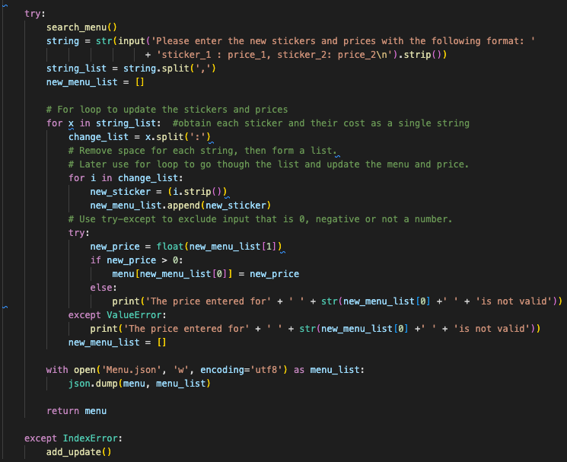
Error handling
ValueError to handle invalid input such as string.
IndexError use to handle input with wrong format. Like enter a string instead of key:value pair.

Slide 12

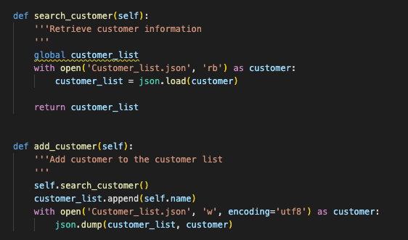

Use json file to store data
Use json file to store data.
System could trieve data from json files and update it.

Slide 13

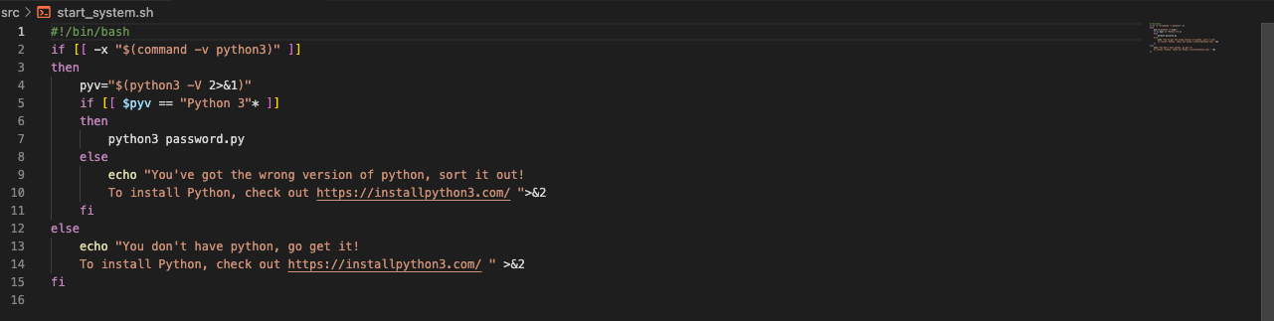
Command Line Arguments
Create five bash scripts to allow users to run the program from the terminal.

