Slide 1
分级查询
Notes:
Schedule: Timing Topic
30 minutes Lecture
20 minutes Practice
50 minutes Total

Slide 2
目标
通过本章学习，您将可以:
分级查询的概念
创建树形的报表
格式划分级数据
在树形结构中删除分支和节点
Notes:
Lesson Aim
In this lesson, you learn how to use hierarchical queries to create tree-structured reports.

Slide 3
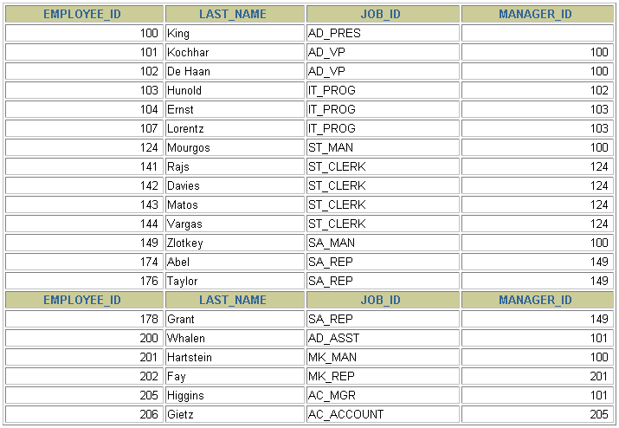
EMPLOYEES 表中的数据
Notes:
Sample Data from the EMPLOYEES Table
Using hierarchical queries, you can retrieve data based on a natural hierarchical relationship between rows in a table. A relational database does not store records in a hierarchical way. However, where a hierarchical relationship exists between the rows of a single table, a process called tree walking enables the hierarchy to be constructed. A hierarchical query is a method of reporting, in order, the branches of a tree.
Imagine a family tree with the eldest members of the family found close to the base or trunk of the tree and the youngest members representing branches of the tree. Branches can have their own branches, and so on.
A hierarchical query is possible when a relationship exists between rows in a table. For example, in the slide, you see that employees with the job IDs of AD_VP, ST_MAN, SA_MAN, and MK_MAN report directly to the president of the company. We know this because the MANAGER_ID column of these records contain the employee ID 100, which belongs to the president (AD_PRES).
Note: Hierarchical trees are used in various fields such as human genealogy (family trees), livestock (breeding purposes), corporate management (management hierarchies), manufacturing (product assembly), evolutionary research (species development), and scientific research.

Slide 4
树形结构
EMPLOYEE_ID = 100 (双亲)
King
MANAGER_ID = 100 (孩子)
Kochhar
De Hann
Mourgos
Hartstein
Zlotkey
Whalen
Higgins
Hunold
Rajs
Davies
Matos
Vargas
Fay
Abel
Taylor
Grant
Gietz
Ernst
Lorentz
Notes:
Natural Tree Structure
The EMPLOYEES table has a tree structure representing the management reporting line. The hierarchy can be created by looking at the relationship between equivalent values in the EMPLOYEE_ID and MANAGER_ID columns. This relationship can be exploited by joining the table to itself. The MANAGER_ID column contains the employee number of the employee’s manager.
The parent-child relationship of a tree structure enables you to control:
The direction in which the hierarchy is walked
The starting point inside the hierarchy
Note: The slide displays an inverted tree structure of the management hierarchy of the employees in the EMPLOYEES table.
Instructor Note
You can use the data shown in the previous slide to explain the tree structure shown in the slide.

Slide 5
分级查询
SELECT [LEVEL], column, expr...
FROM table
[WHERE condition(s)]
[START WITH condition(s)]
[CONNECT BY PRIOR condition(s)] ;
WHERE 条件:
expr comparison_operator expr
Notes:
Keywords and Clauses
Hierarchical queries can be identified by the presence of the CONNECT BY and START WITH clauses.
In the syntax:
SELECT Is the standard SELECT clause.
LEVEL For each row returned by a hierarchical query, the LEVEL pseudocolumn
returns 1 for a root row, 2 for a child of a root, and so on.
FROM table Specifies the table, view, or snapshot containing the columns. You can
select from only one table.
WHERE Restricts the rows returned by the query without affecting other rows of
the hierarchy.
condition Is a comparison with expressions.
START WITH Specifies the root rows of the hierarchy (where to start). This clause is
required for a true hierarchical query.
CONNECT BY Specifies the columns in which the relationship between parent and child
PRIOR rows exist. This clause is required for a hierarchical query.
The SELECT statement cannot contain a join or query from a view that contains a join.

Slide 6
遍历树
始 点
指定需要满足的条件
接受有效的条件
遍历 EMPLOYEES 表, 以姓名为 Kochhar的员工作为始点
START WITH column1 = value
...START WITH last_name = 'Kochhar'
Notes:
Walking the Tree
The row or rows to be used as the root of the tree are determined by the START WITH clause. The START WITH clause can be used in conjunction with any valid condition.
Examples
Using the EMPLOYEES table, start with King, the president of the company.
... START WITH manager_id IS NULL
Using the EMPLOYEES table, start with employee Kochhar. A START WITH condition can contain a subquery.
... START WITH employee_id = (SELECT employee_id
FROM employees
WHERE last_name = 'Kochhar')
If the START WITH clause is omitted, the tree walk is started with all of the rows in the table as root rows. If a WHERE clause is used, the walk is started with all the rows that satisfy the WHERE condition. This no longer reflects a true hierarchy.
Note: The clauses CONNECT BY PRIOR and START WITH are not ANSI SQL standard.
Instructor Note
You may wish to add that multiple hierarchical outputs are generated if more than one row satisfies the START WITH condition.

Slide 7
遍历树
CONNECT BY PRIOR column1 = column2
从顶到底遍历 EMPLOYEES 表
... CONNECT BY PRIOR employee_id = manager_id
方向
从顶到底
Column1 = Parent Key
Column2 = Child Key
从底到顶
Column1 = Child Key
Column2 = Parent Key
Notes:
Walking the Tree (continued)
The direction of the query, whether it is from parent to child or from child to parent, is determined by the CONNECT BY PRIOR column placement. The PRIOR operator refers to the parent row. To find the children of a parent row, the Oracle Server evaluates the PRIOR expression for the parent row and the other expressions for each row in the table. Rows for which the condition is true are the children of the parent. The Oracle Server always selects children by evaluating the CONNECT BY condition with respect to a current parent row.
Examples
Walk from the top down using the EMPLOYEES table. Define a hierarchical relationship in which the EMPLOYEE_ID value of the parent row is equal to the MANAGER_ID value of the child row.
... CONNECT BY PRIOR employee_id = manager_id
Walk from the bottom up using the EMPLOYEES table.
... CONNECT BY PRIOR manager_id = employee_id
The PRIOR operator does not necessarily need to be coded immediately following the CONNECT BY. Thus, the following CONNECT BY PRIOR clause gives the same result as the one in the preceding example.
... CONNECT BY employee_id = PRIOR manager_id
Note: The CONNECT BY clause cannot contain a subquery.

Slide 8

遍历树: 从底到顶
SELECT employee_id, last_name, job_id, manager_id
FROM employees
START WITH employee_id = 101
CONNECT BY PRIOR manager_id = employee_id ;
Notes:
Walking the Tree: From the Bottom Up
The example in the slide displays a list of managers starting with the employee whose employee ID is 101.
Example
In the following example, EMPLOYEE_ID values are evaluated for the parent row and MANAGER_ID, and SALARY values are evaluated for the child rows. The PRIOR operator applies only to the EMPLOYEE_ID value.
... CONNECT BY PRIOR employee_id = manager_id
AND salary > 15000;
To qualify as a child row, a row must have a MANAGER_ID value equal to the EMPLOYEE_ID value of the parent row and must have a SALARY value greater than $15,000.
Instructor Note
In the context of the first paragraph, you may wish to include here that the hierarchy will be established to the furthest extremity before the next parent row is evaluated.
In the context of the second paragraph, you may wish to include that additional conditions added to the CONNECT BY PRIOR clause potentially eliminated the whole of the branch, hence the EMPLOYEE_ID AND SALARY are evaluated for the parent row to determine if it is to be part of the output.

Slide 9
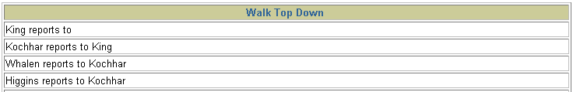
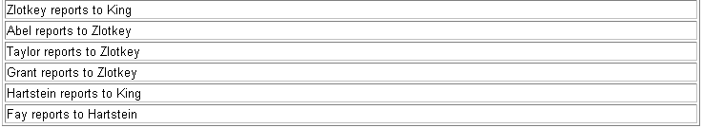
遍历树: 从顶到底
SELECT last_name||' reports to '||
PRIOR last_name "Walk Top Down"
FROM employees
START WITH last_name = 'King'
CONNECT BY PRIOR employee_id = manager_id ;
…
Notes:
Walking the Tree: From the Top Down
Walking from the top down, display the names of the employees and their manager. Use employee King as the starting point. Print only one column.

Slide 10
使用 LEVEL 伪列标记层次
层次1
根/双亲
King
层次2
双亲/孩子
Kochhar
De Hann
Mourgos
Hartstein
Zlotkey
层次3
双亲/孩子
/叶子
Whalen
Higgins
Hunold
Rajs
Davies
Matos
Vargas
Fay
Abel
Taylor
Grant
Gietz
Ernst
Lorentz
层次4
叶子
Notes:
Ranking Rows with the LEVEL Pseudocolumn
You can explicitly show the rank or level of a row in the hierarchy by using the LEVEL pseudocolumn. This will make your report more readable. The forks where one or more branches split away from a larger branch are called nodes, and the very end of a branch is called a leaf, or leaf node. The diagram in the slide shows the nodes of the inverted tree with their LEVEL values. For example, employee Higgens is a parent and a child, while employee Davies is a child and a leaf.
The LEVEL Pseudocolumn
Note: A root node is the highest node within an inverted tree. A child node is any nonroot node. A parent node is any node that has children. A leaf node is any node without children. The number of levels returned by a hierarchical query may be limited by available user memory.
In the slide, King is the root or parent (LEVEL = 1). Kochhar, De Hann, Mourgos, Zlotkey, Hartstein, Higgens, and Hunold are children and also parents (LEVEL = 2). Whalen, Rajs, Davies, Matos, Vargas, Gietz, Ernst, Lorentz, Abel, Taylor, Grant, and Fay are children and leaves.
(LEVEL = 3 and LEVEL = 4)

Slide 11
使用 LEVEL 和 LPAD格式化分层查询
COLUMN org_chart FORMAT A12
SELECT LPAD(last_name, LENGTH(last_name)+(LEVEL*2)-2,'_')
AS org_chart
FROM employees
START WITH last_name='King'
CONNECT BY PRIOR employee_id=manager_id
Notes:
Formatting Hierarchical Reports Using LEVEL
The nodes in a tree are assigned level numbers from the root. Use the LPAD function in conjunction with the pseudocolumn LEVEL to display a hierarchical report as an indented tree.
In the example on the slide:
LPAD(char1,n [,char2]) returns char1, left-padded to length n with the sequence of characters in char2. The argument n is the total length of the return value as it is displayed on your terminal screen.
LPAD(last_name, LENGTH(last_name)+(LEVEL*2)-2,'_')defines the display format.
char1 is the LAST_NAME , n the total length of the return value, is length of the LAST_NAME +(LEVEL*2)-2 ,and char2 is '_'.
In other words, this tells SQL to take the LAST_NAME and left-pad it with the '_' character till the length of the resultant string is equal to the value determined by LENGTH(last_name)+(LEVEL*2)-2.
For King, LEVEL = 1. Hence, (2 * 1) - 2 = 2 - 2 = 0. So King does not get padded with any '_' character and is displayed in column 1.
For Kochhar, LEVEL = 2. Hence, (2 * 2) - 2 = 4 - 2 = 2 . So Kochhar gets padded with 2 '_' characters and is displayed indented.
The rest of the records in the EMPLOYEES table are displayed similarly.

Slide 12
修剪树枝
使用 WHERE 子句删除节点
使用CONNECT BY 子句删除树枝
WHERE last_name != 'Higgins'
CONNECT BY PRIOR
employee_id = manager_id
AND last_name != 'Higgins'
Kochhar
Kochhar
Whalen
Higgins
Whalen
Higgins
Gietz
Gietz
Notes:
Pruning Branches
You can use the WHERE and CONNECT BY clauses to prune the tree; that is, to control which nodes or rows are displayed. The predicate you use acts as a Boolean condition.
Examples
Starting at the root, walk from the top down, and eliminate employee Higgins in the result, but process the child rows.
SELECT department_id, employee_id,last_name, job_id, salary
FROM employees
WHERE last_name != 'Higgins'
START WITH manager_id IS NULL
CONNECT BY PRIOR employee_id = manager_id;
Starting at the root, walk from the top down, and eliminate employee Higgins and all child rows.
SELECT department_id, employee_id,last_name, job_id, salary
FROM employees
START WITH manager_id IS NULL
CONNECT BY PRIOR employee_id = manager_id
AND last_name != 'Higgins';
Instructor Note
You may wish to add here that using a WHERE clause to restrict a node could result in the hierarchy not being reflected truly by the output.

Slide 13
总结
通过本章学习,您已经可以:
对具有层次关系的数据创建树形报表
指定遍历的始点和方向
删除节点和树枝
Notes:
Summary
You can use hierarchical queries to retrieve data based on a natural hierarchical relationship between rows in a table. The LEVEL pseudocolumn counts how far down a hierarchical tree you have traveled. You can specify the direction of the query using the CONNECT BY PRIOR clause. You can specify the starting point using the START WITH clause. You can use the WHERE and CONNECT BY clauses to prune the tree branches.

Slide 14
Hidden Slide
Notes:
Practice 19
1. Look at the following outputs. Are these outputs the result of a hierarchical query? Explain why or why not.
Exhibit 1:
Exhibit 2:
…

Slide 15
Hidden Slide
Notes:
Practice 19 (continued)
Exhibit 3:
Produce a report showing an organization chart for Mourgos’s department. Print last names, salaries, and department IDs.
3. Create a report that shows the hierarchy of the managers for the employee Lorentz. Display his immediate manager first.

Slide 16
Hidden Slide
Notes:
Practice 19 (continued)
Create an indented report showing the management hierarchy starting from the employee whose LAST_NAME is Kochhar. Print the employee’s last name, manager ID, and department ID. Give alias names to the columns as shown in the sample output.
If you have time, complete the following exercise:
5. Produce a company organization chart that shows the management hierarchy. Start with the person at the top level, exclude all people with a job ID of IT_PROG, and exclude De Haan and those employees who report to De Haan.

