Slide 1
JSON数据的解析
讲师：陈伟俊

Slide 2
JSON
JSON(JavaScript Object Notation) 是一种轻量级的数据交换格式，是用多个键值对表示数据的一种数据格式。
例如：{"ename":"tom","salary":2400} 表示一个员工姓名和工资
例如：一下就是一个数组集合
[
{"hiredate":"2010-05-07","empno":101,"ename":"tom","salary":2400},
{"hiredate":"2010-05-08","empno":102,"ename":"jack","salary":3700},
{"hiredate":"2010-05-09","empno":103,"ename":"rose","salary":4800}
]
需要注意的是，如果JSON数据中本身包含特殊字符，例如{}，[]，逗号，冒号等关键字，需要用\uXXXX的字符作为替代字符来转义

Slide 3
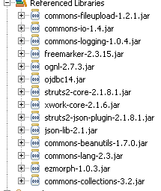
利用Struts2生成JSON需要扩展JAR包

Slide 4
Struts2返回JSON对象示例
JSONObject json = new JSONObject();
json.put("ename", "tom");
json.put("salary", 2400.0);
response.setContentType("text/html;charset=utf-8");
PrintWriter out = response.getWriter();
out.write(json.toString());

Slide 5
Android解析JSON示例
HttpClient client = getRequestObj();
String url = "http://192.168.1.100:7777/struts2_json/emp/queryById.action";
HttpGet httpGet = new HttpGet(url);
HttpResponse response = client.execute(httpGet);
JSONObject json = new JSONObject(EntityUtils
.toString(response.getEntity()));
System.out.println("empno=" + json.getInt("empno"));
System.out.println("ename=" + json.getString("ename"));
System.out.println("salary=" + json.getDouble("salary"));
System.out.println("hiredate=" + json.getString("hiredate"));

