Slide 1
Find Your Sister
PAO
App developed by: Chengshi Zhang, Tiancheng Liu, Yihao Hu, Zehua Zhao

Slide 2
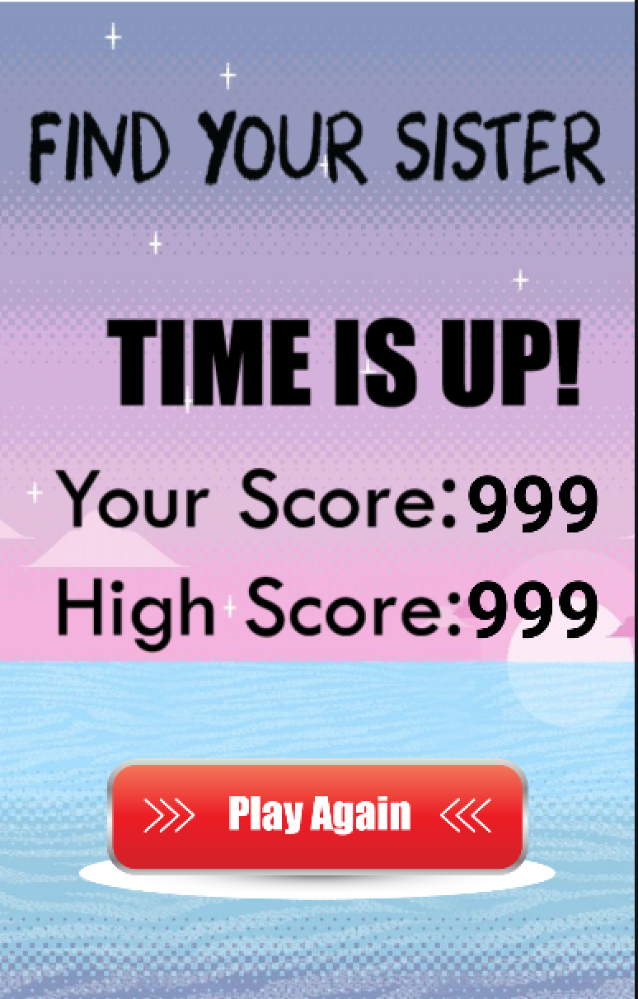
Overview
Find Your Sister is a fun and addictive game. It is simple, clean and intuitive. The user needs to find the celebrity whose name is given among twelve pictures of different celebrities.

Slide 3
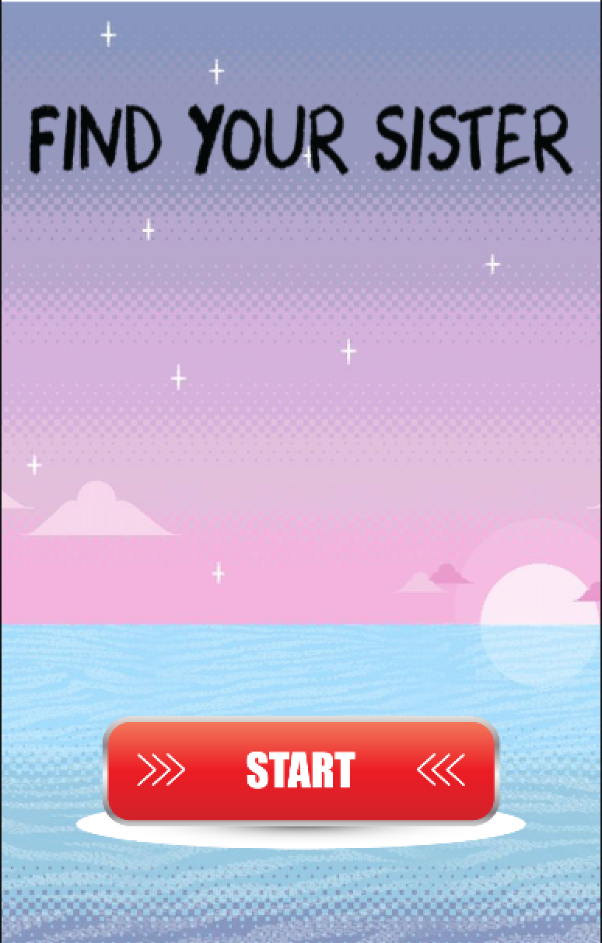
Start Screen
Game Title
Push button to start the game

Slide 4
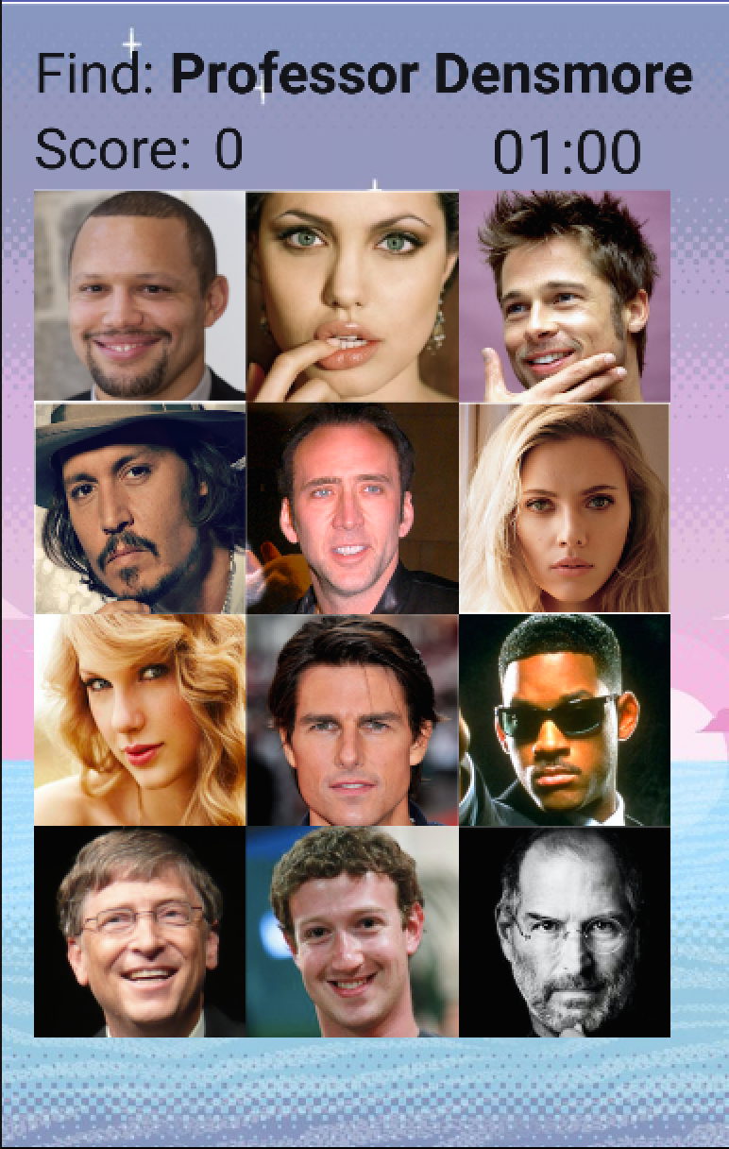
Main Game Screen
Name of the person that needs to be found
Every round takes only 1 minute, no extra time.
+1 if correct person found, -1 otherwise.
Click on the face to make selection. There might be duplicate correct face, click on one of them to get point.

Slide 5
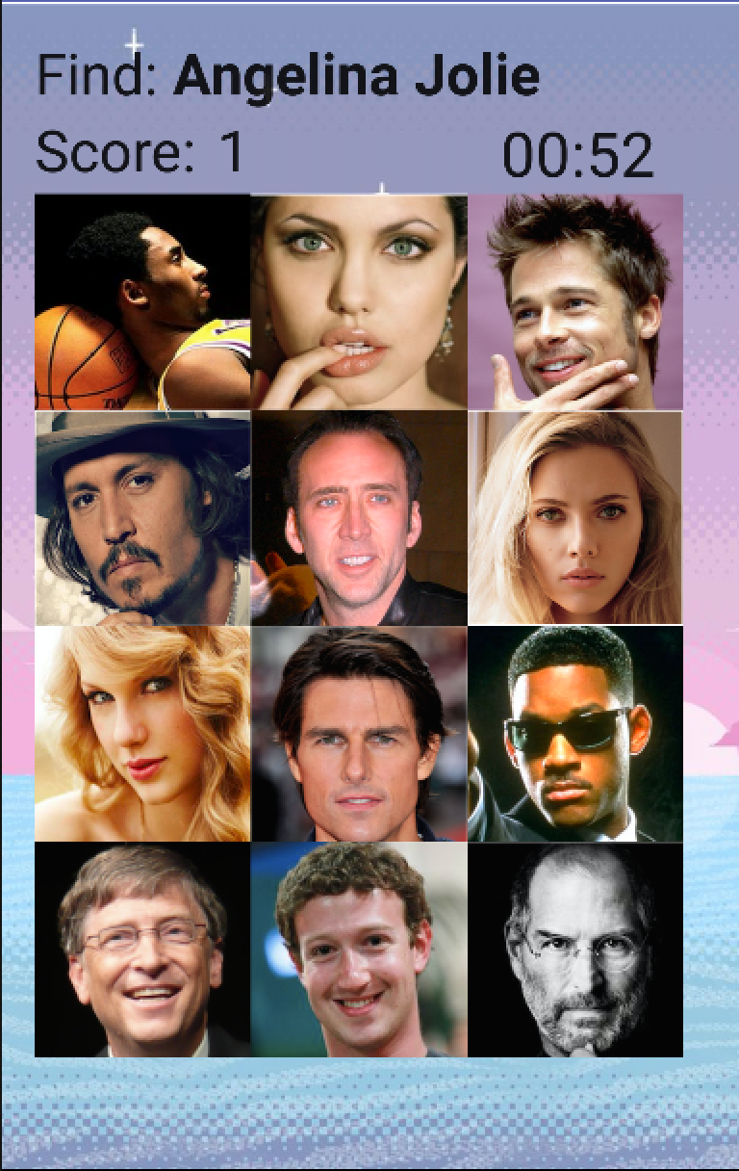
Gameplay
Name changes by random selection from the file when selection is made
Face changes randomly only when it has been clicked on

Slide 6
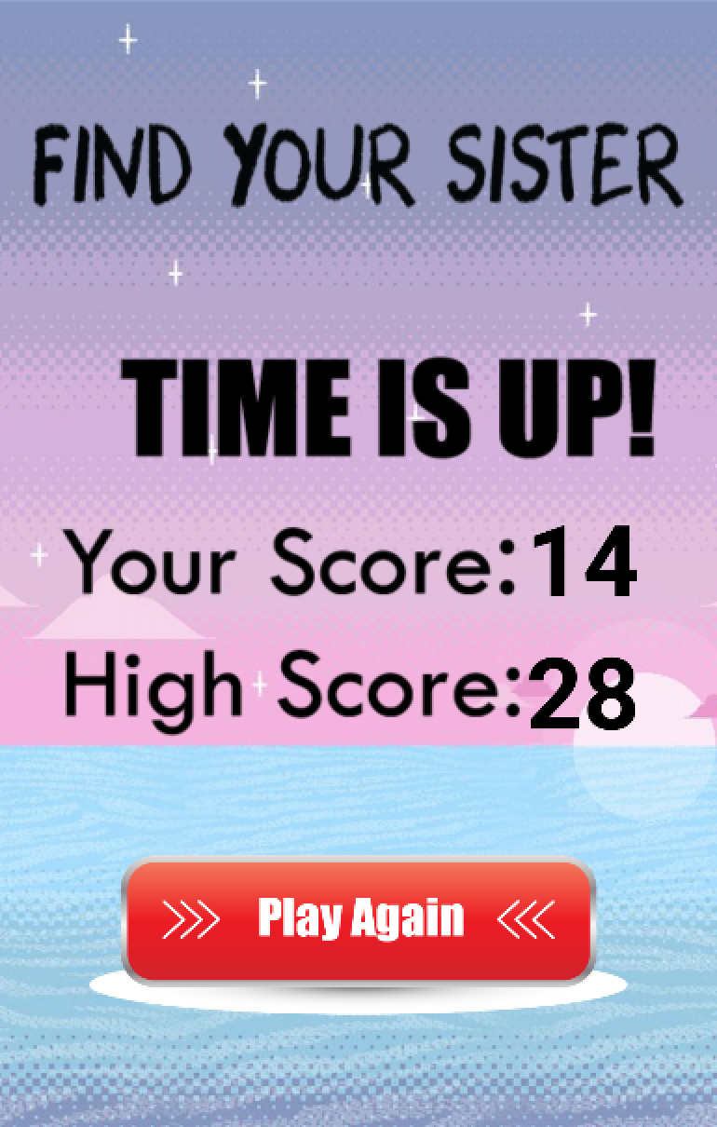
End Screen
Game end message
Score of this round
Highest score of history
Another chance to get highest score

Slide 7
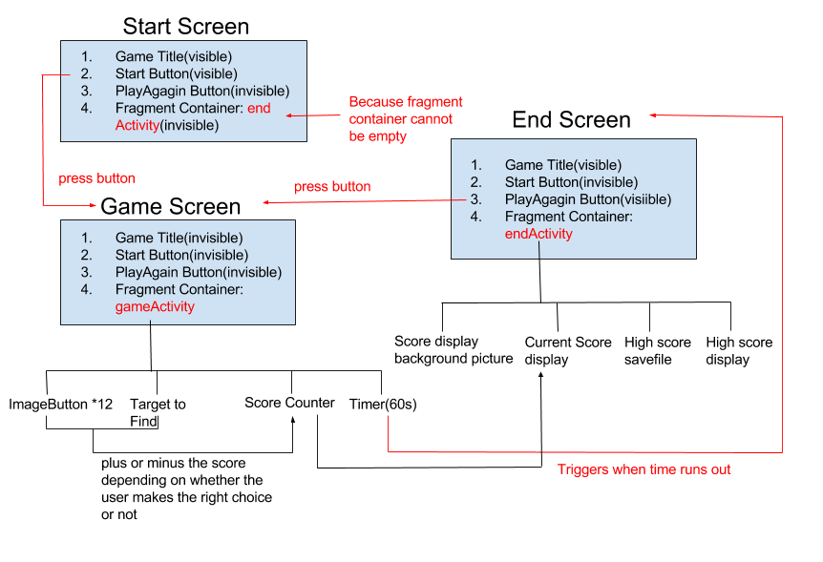

Slide 8
Thanks
and
Play NOW!

